Slide 1
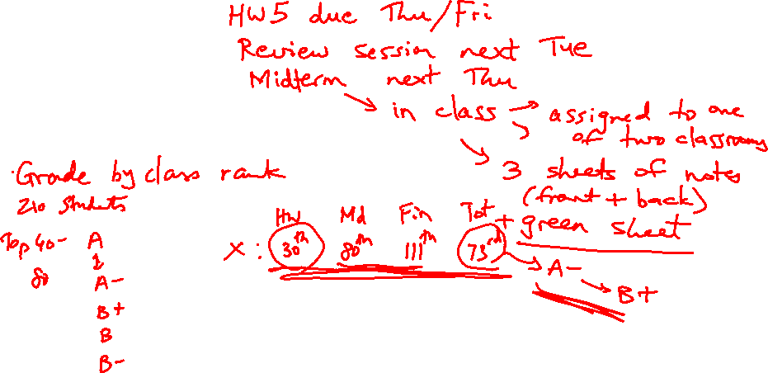
Lecture 13: Adders, Sequential Circuits
Today’s topics:
  Carry-lookahead adder
  Clocks, latches, sequential circuits

Slide 2
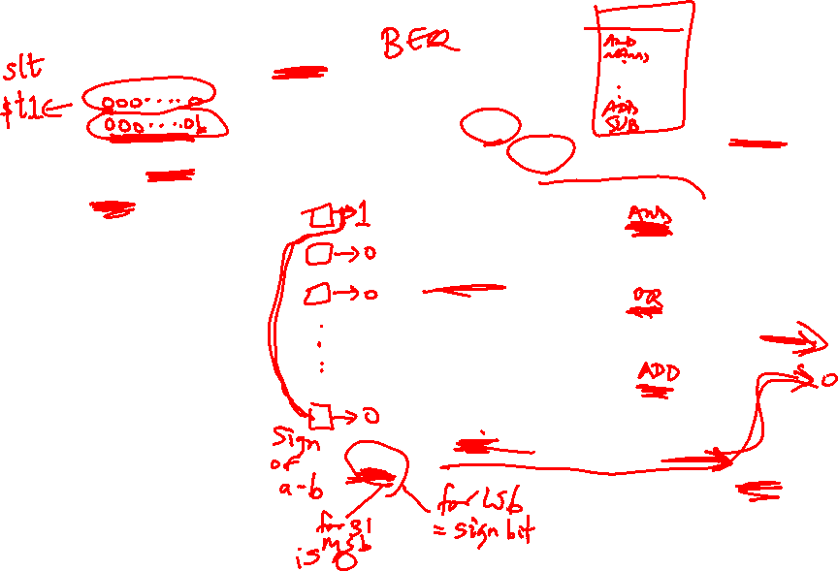
Incorporating slt
Perform a – b and check
the sign
New signal (Less) that
is zero for ALU boxes
1-31
The 31st box has a unit
to detect overflow and
sign – the sign bit
serves as the Less
signal for the 0th box
Source: H&P textbook

Slide 3
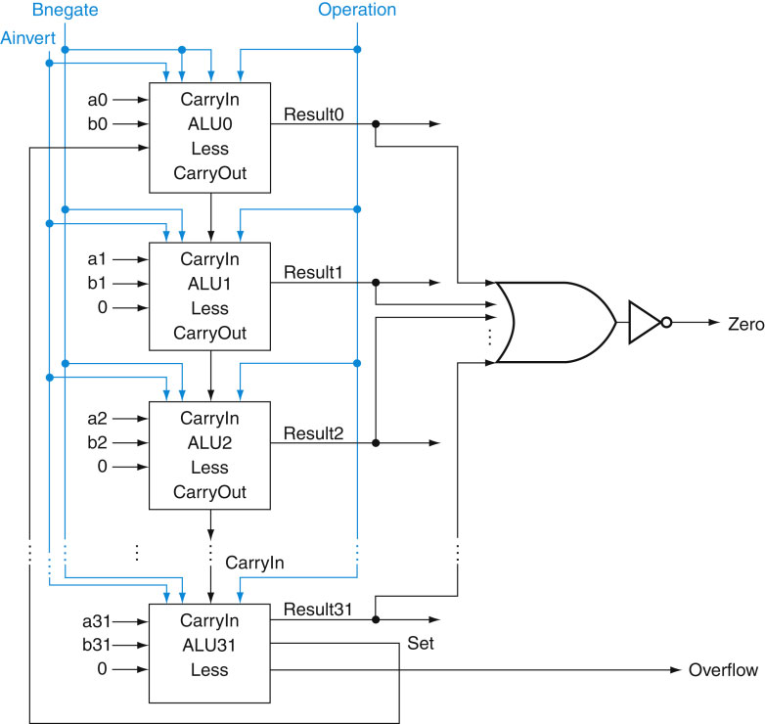
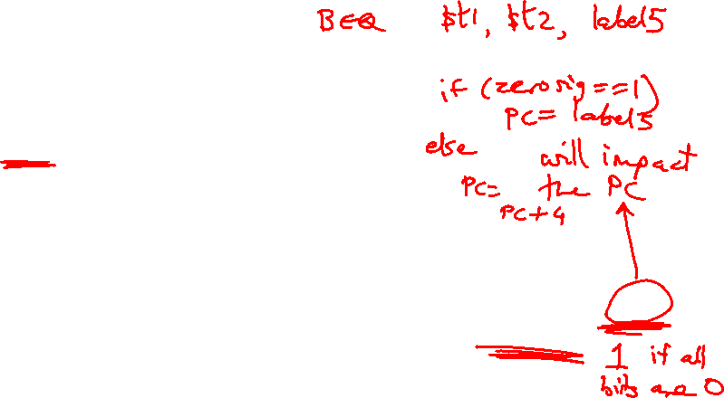
Incorporating beq
Perform a – b and
confirm that the
result is all zero’s
Source: H&P textbook

Slide 4

Control Lines
What are the values
of the control lines
and what operations
do they correspond to?
Source: H&P textbook

Slide 5
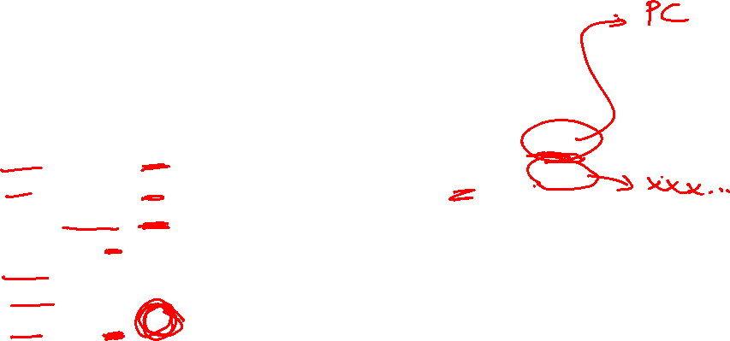
Control Lines
What are the values
of the control lines
and what operations
do they correspond to?
Ai Bn Op
AND 0 0 00
OR 0 0 01
Add 0 0 10
Sub 0 1 10
NOR 1 1 00
NAND 1 1 01
SLT 0 1 11
BEQ 0 1 10 (xx)
Source: H&P textbook

Slide 6
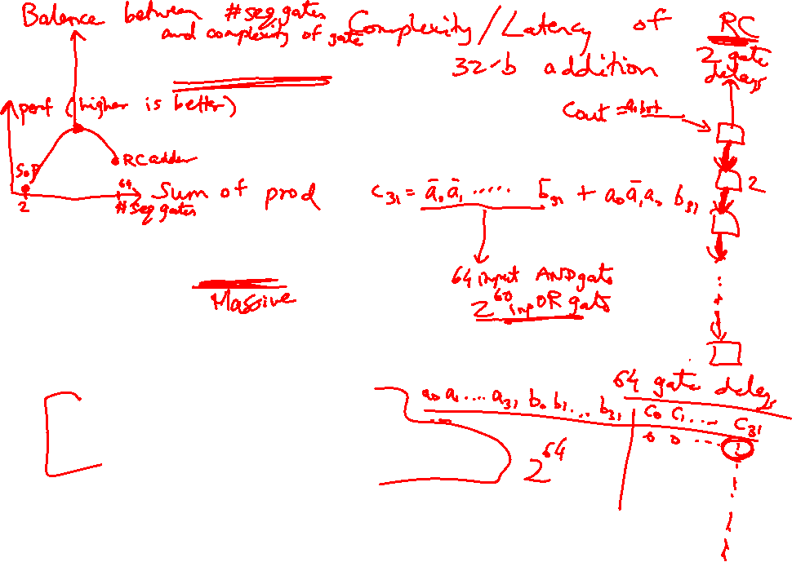
Speed of Ripple Carry
The carry propagates thru every 1-bit box: each 1-bit box sequentially
implements AND and OR – total delay is the time to go through 64 gates!
We’ve already seen that any logic equation can be expressed as the
sum of products – so it should be possible to compute the result by
going through only 2 gates!
Caveat: need many parallel gates and each gate may have a very
large number of inputs – it is difficult to efficiently build such large
gates, so we’ll find a compromise:
  moderate number of gates
  moderate number of inputs to each gate
  moderate number of sequential gates traversed

Slide 7
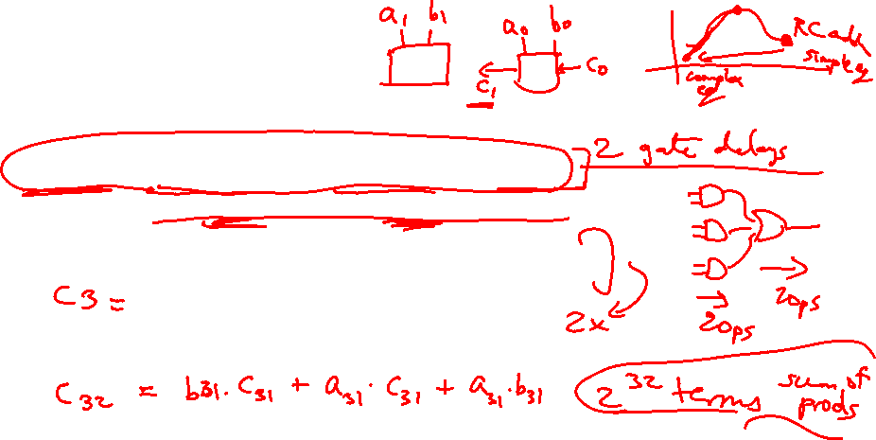
Computing CarryOut
CarryIn1 = b0.CarryIn0 + a0.CarryIn0 + a0.b0
CarryIn2 = b1.CarryIn1 + a1.CarryIn1 + a1.b1
= b1.b0.c0 + b1.a0.c0 + b1.a0.b0 +
a1.b0.c0 + a1.a0.c0 + a1.a0.b0 + a1.b1
…
CarryIn32 = a really large sum of really large products
Potentially fast implementation as the result is computed
by going thru just 2 levels of logic – unfortunately, each
gate is enormous and slow

Slide 8
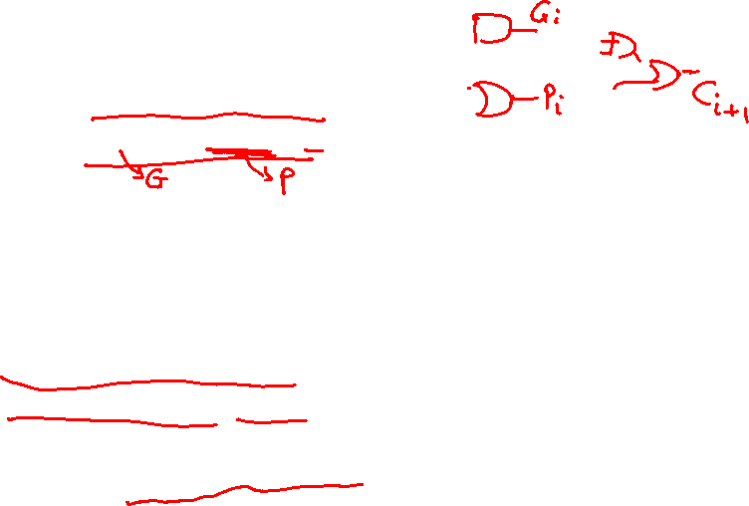
Generate and Propagate
Equation re-phrased:
Ci+1 = ai.bi + ai.Ci + bi.Ci
= (ai.bi) + (ai + bi).Ci
Stated verbally, the current pair of bits will generate a carry
if they are both 1 and the current pair of bits will propagate
a carry if either is 1
Generate signal = ai.bi
Propagate signal = ai + bi
Therefore, Ci+1 = Gi + Pi . Ci

Slide 9
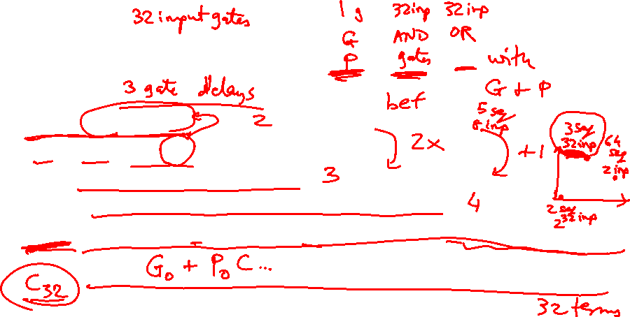
Generate and Propagate
c1 = g0 + p0.c0
c2 = g1 + p1.c1
= g1 + p1.g0 + p1.p0.c0
c3 = g2 + p2.g1 + p2.p1.g0 + p2.p1.p0.c0
c4 = g3 + p3.g2 + p3.p2.g1 + p3.p2.p1.g0 + p3.p2.p1.p0.c0
Either,
a carry was just generated, or
a carry was generated in the last step and was propagated, or
a carry was generated two steps back and was propagated by both
the next two stages, or
a carry was generated N steps back and was propagated by every
single one of the N next stages

Slide 10
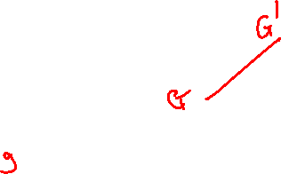
Divide and Conquer
The equations on the previous slide are still difficult to implement
as logic functions – for the 32nd bit, we must AND every single
propagate bit to determine what becomes of c0 (among other
things)
Hence, the bits are broken into groups (of 4) and each group
computes its group-generate and group-propagate
For example, to add 32 numbers, you can partition the task as
a tree
.
. . . .
. . . . . . . . . . . . . . . .

Slide 11
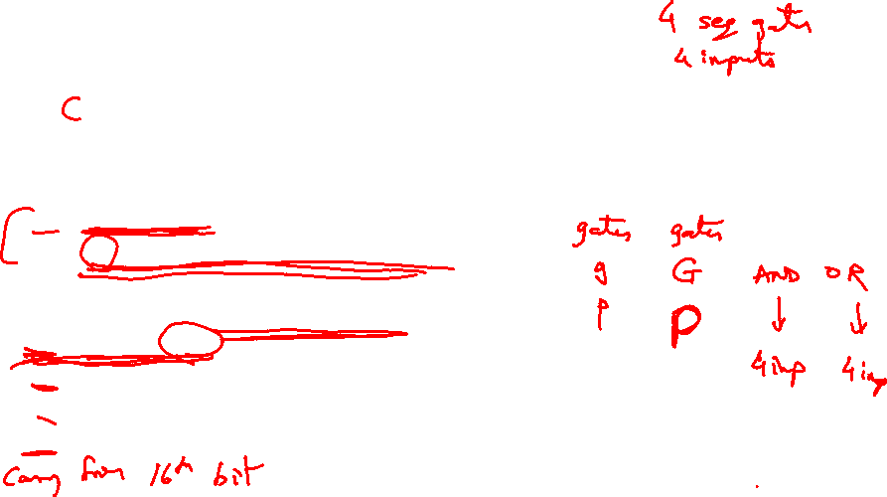
P and G for 4-bit Blocks
Compute P0 and G0 (super-propagate and super-generate) for the
first group of 4 bits (and similarly for other groups of 4 bits)
P0 = p0.p1.p2.p3
G0 = g3 + g2.p3 + g1.p2.p3 + g0.p1.p2.p3
Carry out of the first group of 4 bits is
C1 = G0 + P0.c0
C2 = G1 + P1.G0 + P1.P0.c0
C3 = G2 + (P2.G1) + (P2.P1.G0) + (P2.P1.P0.c0)
C4 = G3 + (P3.G2) + (P3.P2.G1) + (P3.P2.P1.G0) + (P3.P2.P1.P0.c0)
By having a tree of sub-computations, each AND, OR gate has few
inputs and logic signals have to travel through a modest set of
gates (equal to the height of the tree)

Slide 12

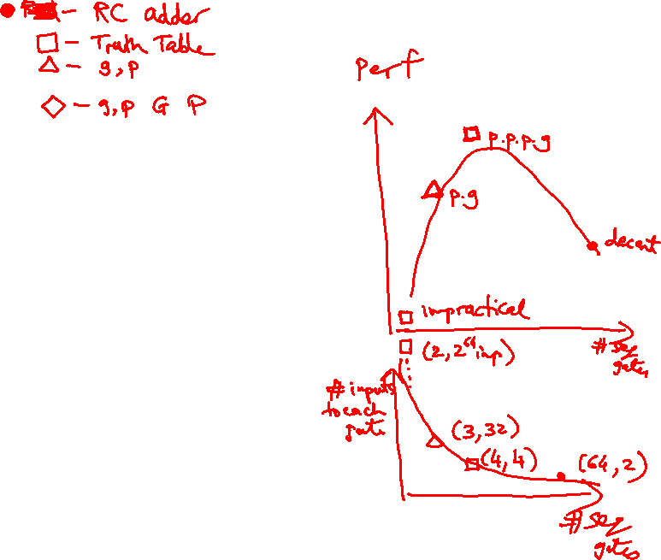
Example
Add a 0001 1010 0011 0011
b 1110 0101 1110 1011
g 0000 0000 0010 0011
p 1111 1111 1111 1011
P 1 1 1 0
G 0 0 1 0
C4 = 1

Slide 13
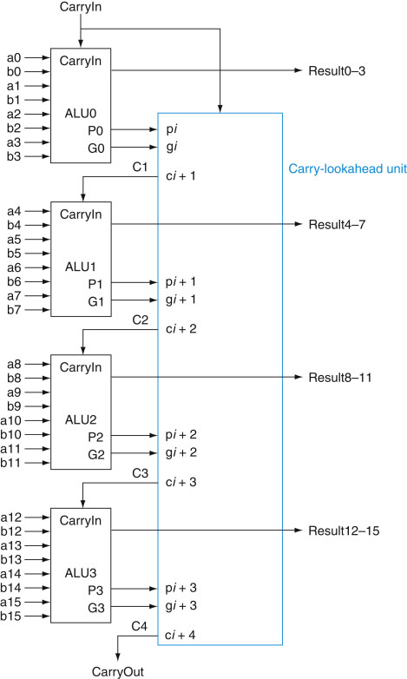
Carry Look-Ahead Adder
16-bit Ripple-carry
takes 32 steps
This design takes
how many steps?
4 sequential steps
Source: H&P textbook

Slide 14
Clocks
A microprocessor is composed of many different circuits
that are operating simultaneously – if each circuit X takes in
inputs at time TI_{X}, takes time TE_{X} to execute the logic,
and produces outputs at time TO_{X}, imagine the
complications in co-ordinating the tasks of every circuit
A major school of thought (used in most processors built
today): all circuits on the chip share a clock signal (a
square wave) that tells every circuit when to accept
inputs, how much time they have to execute the logic, and
when they must produce outputs

Slide 15
Clock Terminology
Rising clock edge
Cycle time
Falling clock edge
4 GHz = clock speed = 1 = 1 .
cycle time 250 ps

Slide 16
Sequential Circuits
Until now, circuits were combinational – when inputs change, the
outputs change after a while (time = logic delay thru circuit)
Combinational
Circuit
Combinational
Circuit
Inputs
Outputs
We want the clock to act like a start and stop signal – a “latch” is
a storage device that separates these circuits – it ensures that
the inputs to the circuit do not change during a clock cycle
Clock
Clock
Combinational
Circuit
Outputs
Combinational
Circuit
Inputs
Latch
Latch

Slide 17
Sequential Circuits
Sequential circuit: consists
of combinational circuit and
a storage element
At the start of the clock
cycle, the rising edge
causes the “state” storage
to store some input values
This state will not change for an entire cycle (until next rising edge)
The combinational circuit has some time to accept the value
of “state” and “inputs” and produce “outputs”
Some of the outputs (for example, the value of next “state”) may feed
back (but through the latch so they’re only seen in the next cycle)
Inputs
State
Clock
Inputs
Outputs
Combinational Cct

