Slide 1
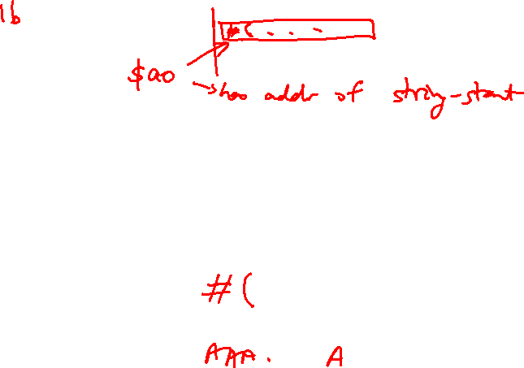

Lecture 12: Hardware for Arithmetic
Today’s topics:
  Logic for common operations
  Designing an ALU

Slide 2

Logic Blocks
A logic block has a number of binary inputs and produces
a number of binary outputs – the simplest logic block is
composed of a few transistors
A logic block is termed combinational if the output is only
a function of the inputs
A logic block is termed sequential if the block has some
internal memory (state) that also influences the output
A basic logic block is termed a gate (AND, OR, NOT, etc.)
We will only deal with combinational circuits today

Slide 3
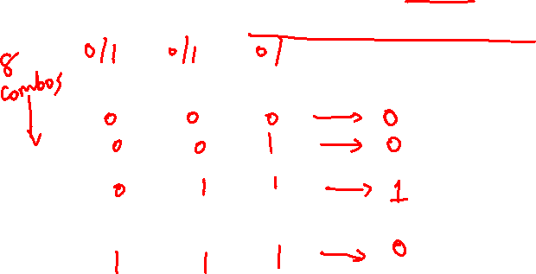
Truth Table
A truth table defines the outputs of a logic block for each
set of inputs
Consider a block with 3 inputs A, B, C and an output E
that is true only if exactly 2 inputs are true
A B C E

Slide 4

Truth Table
A truth table defines the outputs of a logic block for each
set of inputs
Consider a block with 3 inputs A, B, C and an output E
that is true only if exactly 2 inputs are true
A B C E
0 0 0 0
0 0 1 0
0 1 0 0
0 1 1 1
1 0 0 0
1 0 1 1
1 1 0 1
1 1 1 0
Can be compressed by only
representing cases that
have an output of 1

Slide 5
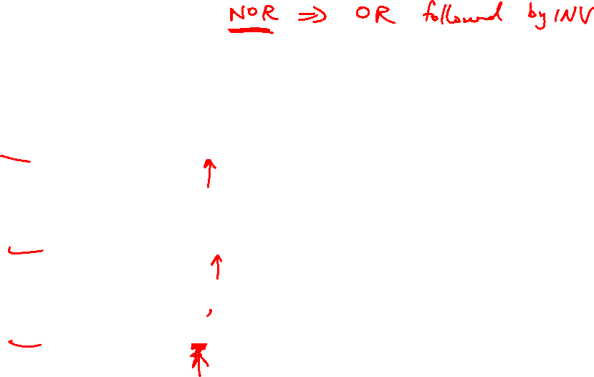
Boolean Algebra
Equations involving two values and three primary operators:
  OR : symbol + , X = A + B ➔ X is true if at least one of
  A or B is true
  AND : symbol . , X = A . B ➔ X is true if both A and B
  are true
  NOT : symbol , X = A ➔ X is the inverted value of A

Slide 6
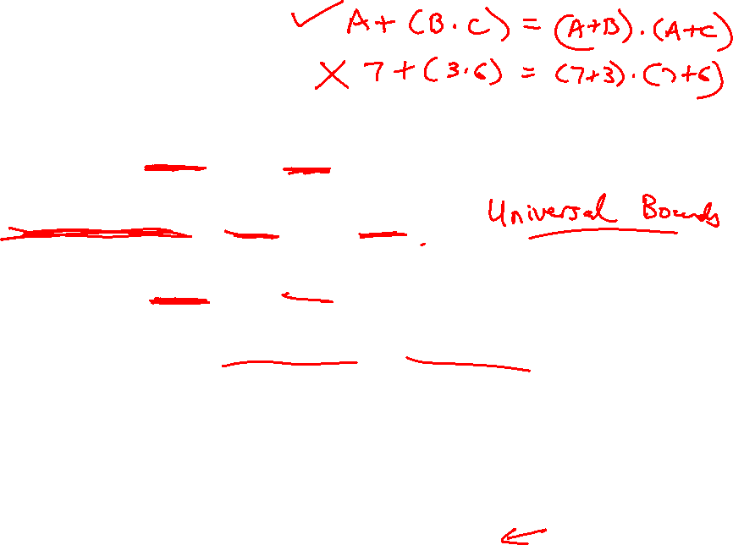
Boolean Algebra Rules
Identity law : A + 0 = A ; A . 1 = A
Zero and One laws : A + 1 = 1 ; A . 0 = 0
Inverse laws : A . A = 0 ; A + A = 1
Commutative laws : A + B = B + A ; A . B = B . A
Associative laws : A + (B + C) = (A + B) + C
A . (B . C) = (A . B) . C
Distributive laws : A . (B + C) = (A . B) + (A . C)
A + (B . C) = (A + B) . (A + C)

Slide 7
DeMorgan’s Laws
A + B = A . B
A . B = A + B
Confirm that these are indeed true

Slide 8


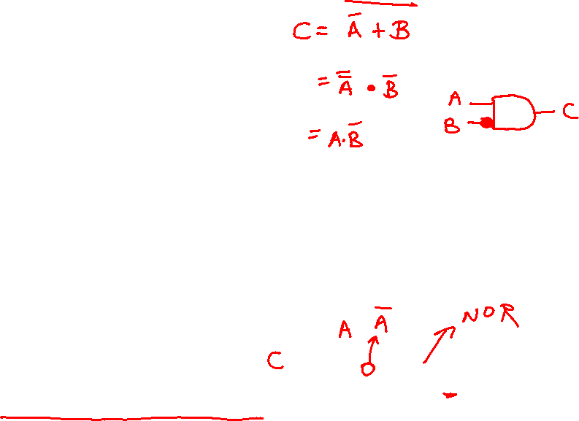
Pictorial Representations
AND OR NOT
Source: H&P textbook
What logic function is this?
Source: H&P textbook

Slide 9

Boolean Equation
Consider the logic block that has an output E that is true
only if exactly two of the three inputs A, B, C are true
Multiple correct equations:
Two must be true, but all three cannot be true:
E = ((A . B) + (B . C) + (A . C)) . (A . B . C)
Identify the three cases where it is true:
E = (A . B . C) + (A . C . B) + (C . B . A)

Slide 10
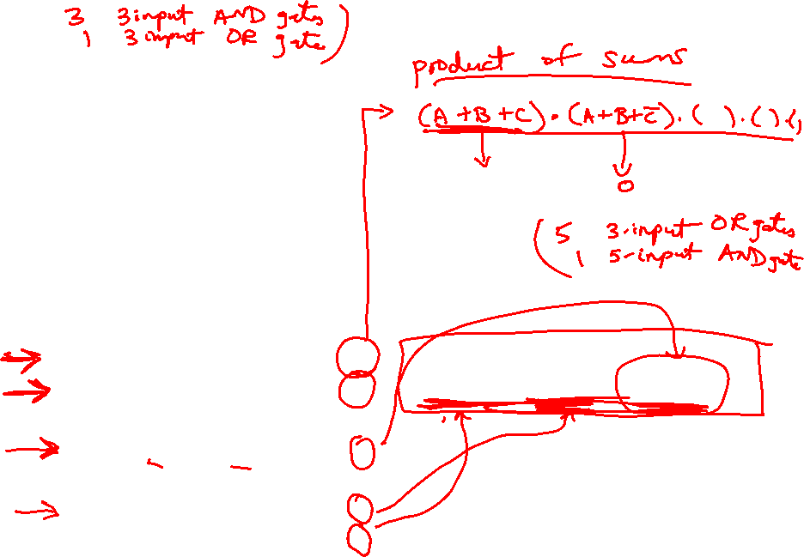
Sum of Products
Can represent any logic block with the AND, OR, NOT operators
  Draw the truth table
  For each true output, represent the corresponding inputs
  as a product
  The final equation is a sum of these products
A B C E
0 0 0 0
0 0 1 0
0 1 0 0
0 1 1 1
1 0 0 0
1 0 1 1
1 1 0 1
1 1 1 0
(A . B . C) + (A . C . B) + (C . B . A)
Can also use “product of sums”
Any equation can be implemented
with an array of ANDs, followed by
an array of ORs

Slide 11
NAND and NOR
NAND : NOT of AND : A nand B = A . B
NOR : NOT of OR : A nor B = A + B
NAND and NOR are universal gates, i.e., they can be
used to construct any complex logical function

Slide 12
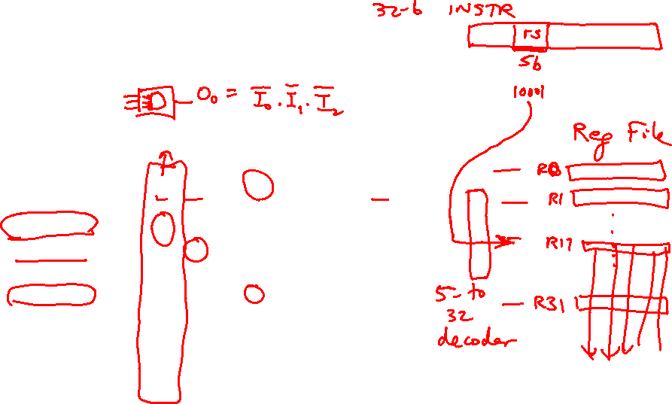
Common Logic Blocks – Decoder
Takes in N inputs and activates one of 2^{N} outputs
I₀ I₁ I₂ O₀ O₁ O₂ O₃ O₄ O₅ O₆ O₇
0 0 0 1 0 0 0 0 0 0 0
0 0 1 0 1 0 0 0 0 0 0
0 1 0 0 0 1 0 0 0 0 0
0 1 1 0 0 0 1 0 0 0 0
1 0 0 0 0 0 0 1 0 0 0
1 0 1 0 0 0 0 0 1 0 0
1 1 0 0 0 0 0 0 0 1 0
1 1 1 0 0 0 0 0 0 0 1
3-to-8
Decoder
I₀₋₂
O₀₋₇

Slide 13
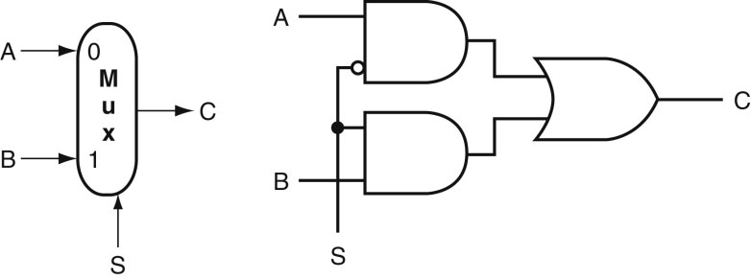
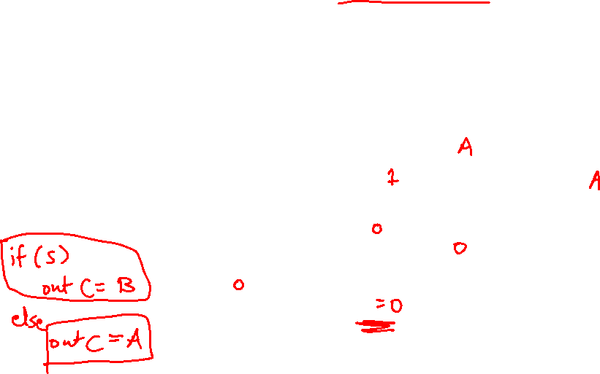
Common Logic Blocks – Multiplexor
Multiplexor or selector: one of N inputs is reflected on the
output depending on the value of the log₂N selector bits
2-input mux
Source: H&P textbook

Slide 14
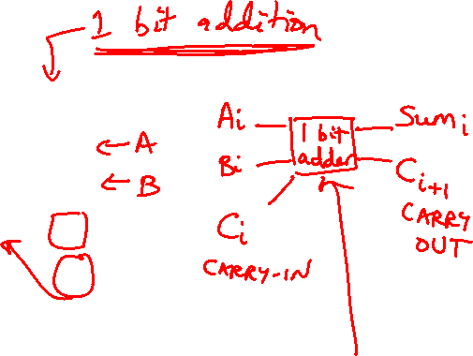
Adder Algorithm
1 0 0 1
0 1 0 1
Sum 1 1 1 0
Carry 0 0 0 1
Truth Table for the above operations:
A B Cin Sum Cout
0 0 0
0 0 1
0 1 0
0 1 1
1 0 0
1 0 1
1 1 0
1 1 1

Slide 15
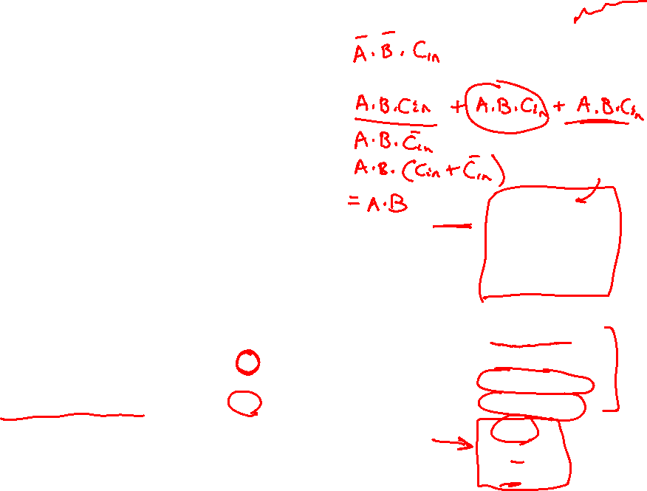
Adder Algorithm
1 0 0 1
0 1 0 1
Sum 1 1 1 0
Carry 0 0 0 1
Equations:
Sum = Cin . A . B +
B . Cin . A +
A . Cin . B +
A . B . Cin
Cout = A . B . Cin +
A . B . Cin +
A . Cin . B +
B . Cin . A
= A . B +
A . Cin +
B . Cin
Truth Table for the above operations:
A B Cin Sum Cout
0 0 0 0 0
0 0 1 1 0
0 1 0 1 0
0 1 1 0 1
1 0 0 1 0
1 0 1 0 1
1 1 0 0 1
1 1 1 1 1

Slide 16
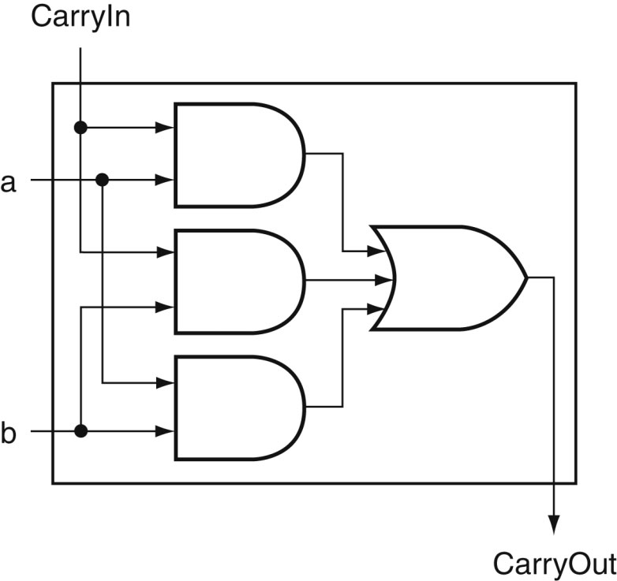

Carry Out Logic
Equations:
Sum = Cin . A . B +
B . Cin . A +
A . Cin . B +
A . B . Cin
Cout = A . B . Cin +
A . B . Cin +
A . Cin . B +
B . Cin . A
= A . B +
A . Cin +
B . Cin
Source: H&P textbook

Slide 17
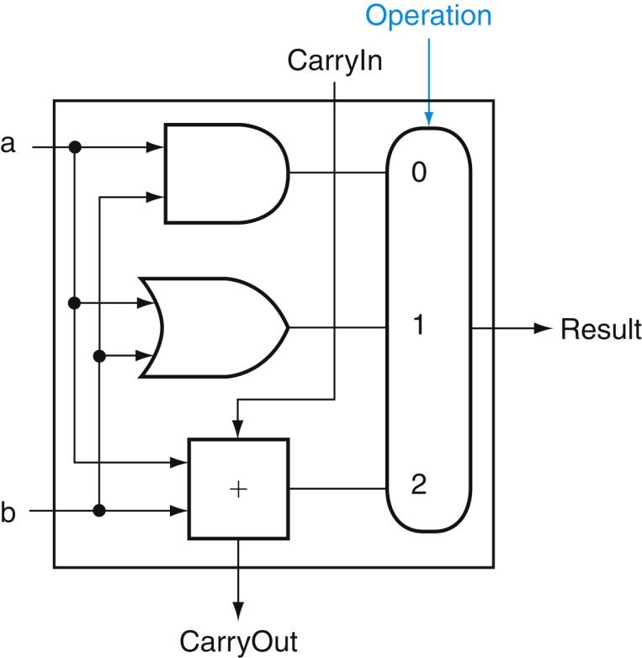
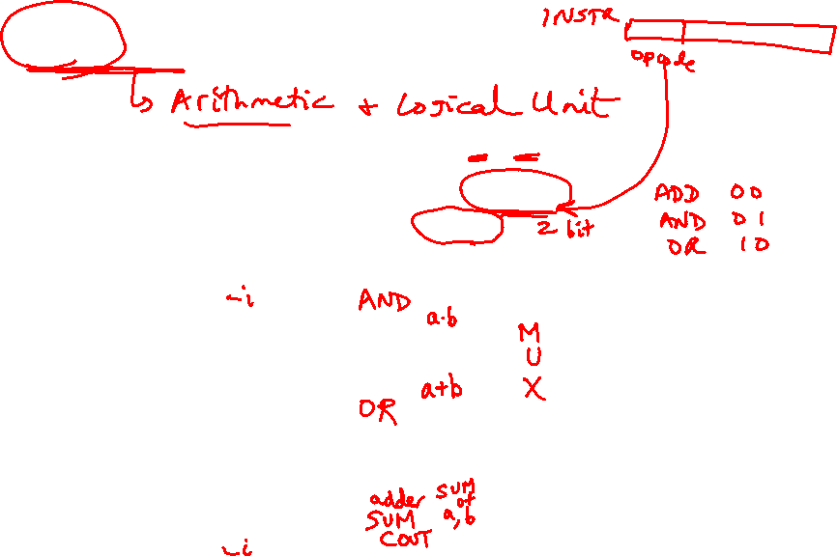
1-Bit ALU with Add, Or, And
Multiplexor selects between Add, Or, And operations
Source: H&P textbook

Slide 18
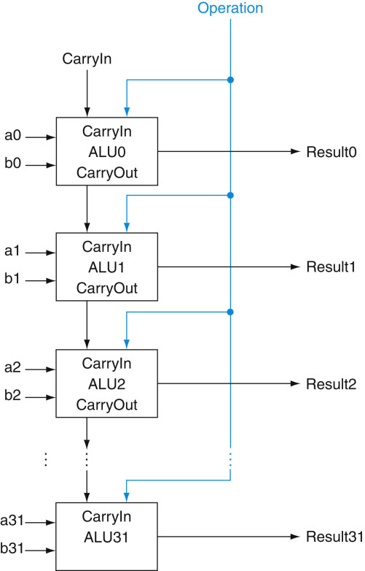
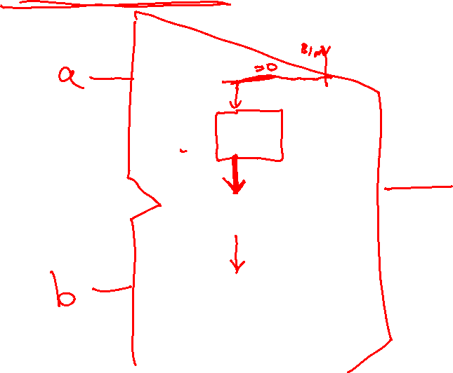
32-bit Ripple Carry Adder
1-bit ALUs are connected
“in series” with the
carry-out of 1 box
going into the carry-in
of the next box
Source: H&P textbook

Slide 19
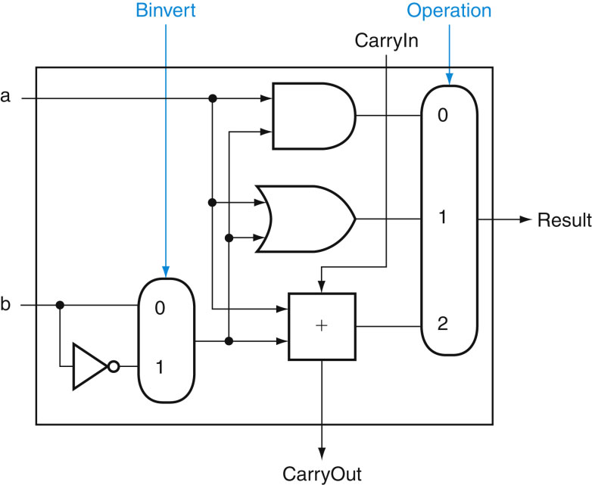
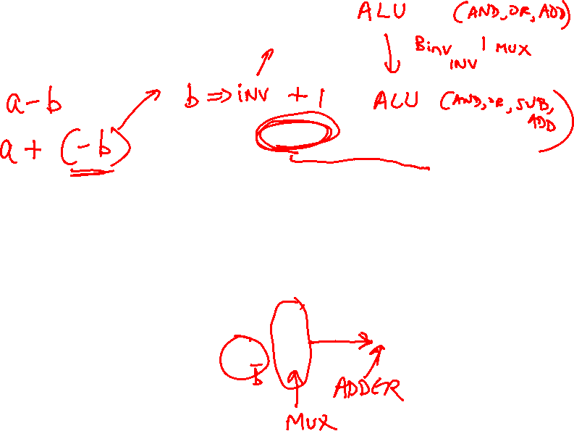
Incorporating Subtraction
Must invert bits of B and add a 1
  Include an inverter
  CarryIn for the first bit is 1
  The CarryIn signal (for the
  first bit) can be the same
  as the Binvert signal
Source: H&P textbook

Slide 20
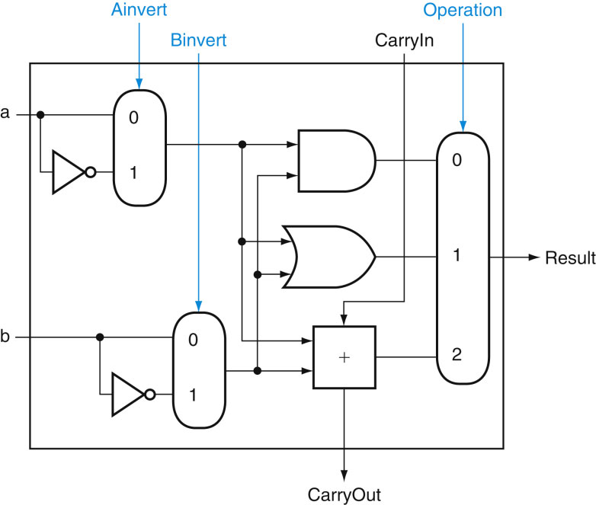
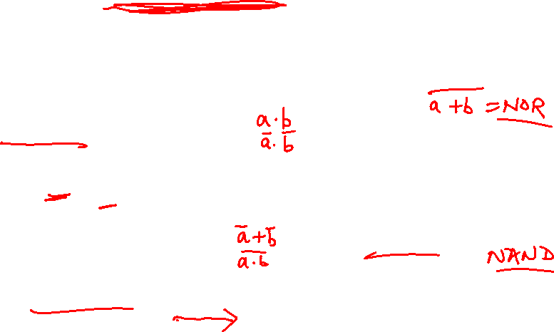
Incorporating NOR and NAND
Source: H&P textbook

Slide 21
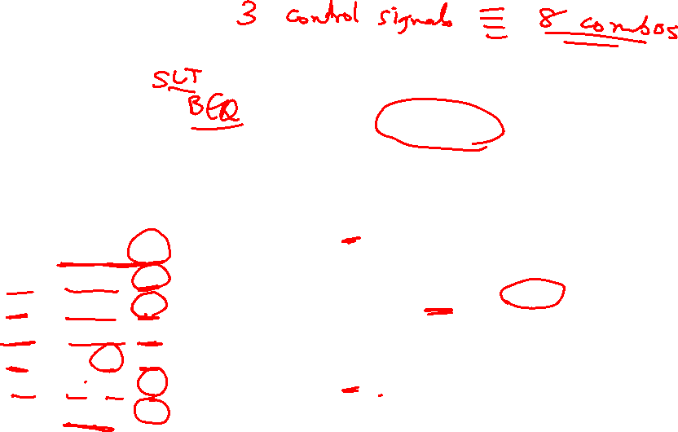
Control Lines
What are the values
of the control lines
and what operations
do they correspond to?
Ai Bn Op
AND 0 0 00
OR 0 0 01
Add 0 0 10
Sub 0 1 10
NAND 1 1 01
NOR 1 1 00
Source: H&P textbook

