Slide 1
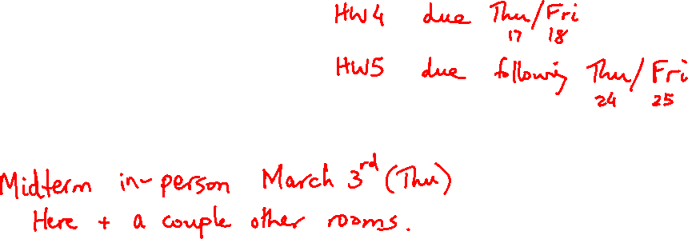
Lecture 11: Floating Point, Digital Design
Today’s topics:
  FP formats, arithmetic
  Intro to Boolean functions

Slide 2
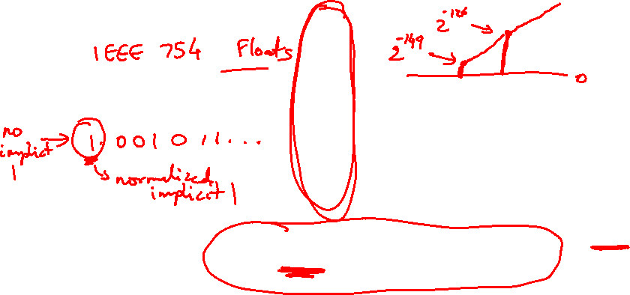
Value inf
Value NAN
Highest value ~2 x 2¹²⁷
2 special cases up top that use the
reserved exponent field of 255
0 255 00…0
0 255 xx….x
0 254 11….1
Value 1
0 127 00…0
Exponent field < 127, i.e., after
subtracting bias, they are negative
exponents, representing numbers < 1
Smallest Norm ~2 x 2⁻¹²⁶
Largest Denorm ~1 x 2⁻¹²⁶
Smallest Denorm ~2⁻¹⁴⁹
0 0..01 00…0
0 0..00 11…1
0 0..00 00…1
Special case with exponent field 0, used to
represent denorms, that help us gradually approach 0
Value 0
0 00..0 00…0
Same rules as above, but the sign bit is 1
Same magnitudes as above, but negative numbers

Slide 3

Example 2
Final representation: (-1)^{S} x (1 + Fraction) x 2^{(Exponent – Bias)}
Represent 36.90625_{ten} in single-precision format
36 / 2 = 18 rem 0
18 / 2 = 9 rem 0
9 / 2 = 4 rem 1
4 / 2 = 2 rem 0
2 / 2 = 1 rem 0
1 / 2 = 0 rem 1
0.90625 x 2 = 1.81250
0.8125 x 2 = 1.6250
0.625 x 2 = 1.250
0.25 x 2 = 0.50
0.5 x 2 = 1.00
0.0 x 2 = 0.0
36 is 100100
0.90625 is 0.1110100…0

Slide 4
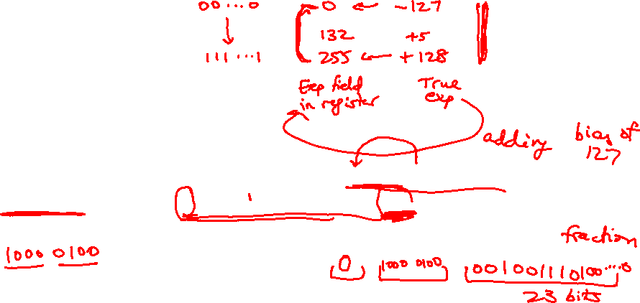
Example 2
Final representation: (-1)^{S} x (1 + Fraction) x 2^{(Exponent – Bias)}
We’ve calculated that 36.90625_{ten} = 100100.1110100…0 in binary
Normalized form = 1.001001110100…0 x 2⁵
(had to shift 5 places to get only one bit left of the point)
The sign bit is 0 (positive number)
The fraction field is 001001110100…0 (the 23 bits after the point)
The exponent field is 5 + 127 (have to add the bias) = 132,
which in binary is 10000100
The IEEE 754 format is 0 10000100 001001110100…..0
sign exponent 23 fraction bits

Slide 5
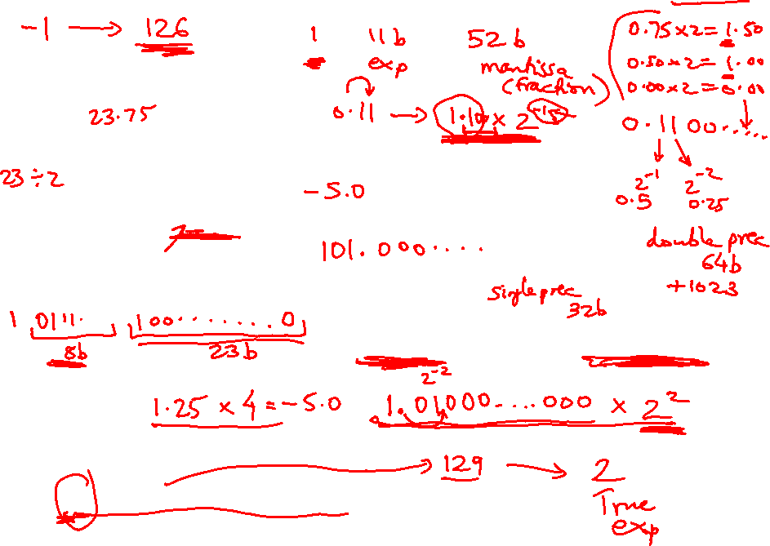
Examples
Final representation: (-1)^{S} x (1 + Fraction) x 2^{(Exponent – Bias)}
Represent -0.75_{ten} in single and double-precision formats
Single: (1 + 8 + 23)
Double: (1 + 11 + 52)
What decimal number is represented by the following
single-precision number?
1 1000 0001 01000…0000
Remember:
True exponent Exponent in register
+127
-127

Slide 6
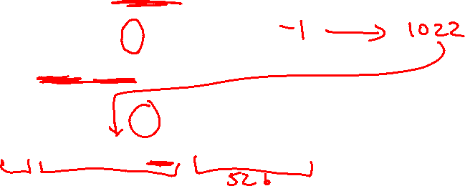
Examples
Final representation: (-1)^{S} x (1 + Fraction) x 2^{(Exponent – Bias)}
Represent -0.75_{ten} in single and double-precision formats
Single: (1 + 8 + 23)
1 0111 1110 1000…000
Double: (1 + 11 + 52)
1 0111 1111 110 1000…000
What decimal number is represented by the following
single-precision number?
1 1000 0001 01000…0000
-5.0

Slide 7
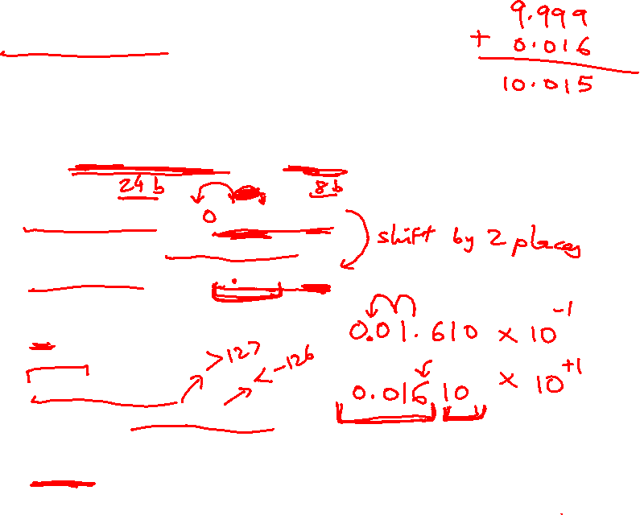
FP Addition
Consider the following decimal example (can maintain
only 4 decimal digits and 2 exponent digits)
9.999 x 10¹ + 1.610 x 10⁻¹
Convert to the larger exponent:
9.999 x 10¹ + 0.016 x 10¹
Add
10.015 x 10¹
Normalize
1.0015 x 10²
Check for overflow/underflow
Round
1.002 x 10²
Re-normalize

Slide 8

FP Addition
Consider the following decimal example (can maintain
only 4 decimal digits and 2 exponent digits)
9.999 x 10¹ + 1.610 x 10⁻¹
Convert to the larger exponent:
9.999 x 10¹ + 0.016 x 10¹
Add
10.015 x 10¹
Normalize
1.0015 x 10²
Check for overflow/underflow
Round
1.002 x 10²
Re-normalize
If we had more fraction bits,
these errors would be minimized

Slide 9
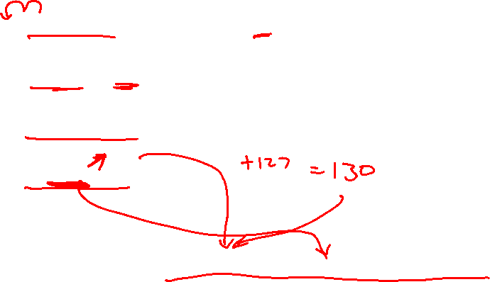
FP Addition – Binary Example
Consider the following binary example
1.010 x 2¹ + 1.100 x 2³
Convert to the larger exponent:
0.0101 x 2³ + 1.1000 x 2³
Add
1.1101 x 2³
Normalize
1.1101 x 2³
Check for overflow/underflow
Round
Re-normalize
IEEE 754 format: 0 10000010 11010000000000000000000

Slide 10
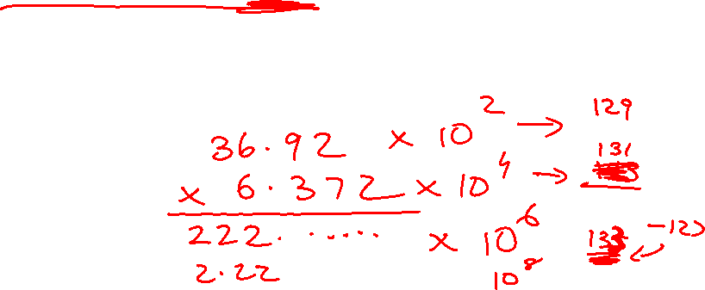
FP Multiplication
Similar steps:
  Compute exponent (careful!)
  Multiply significands (set the binary point correctly)
  Normalize
  Round (potentially re-normalize)
  Assign sign

Slide 11
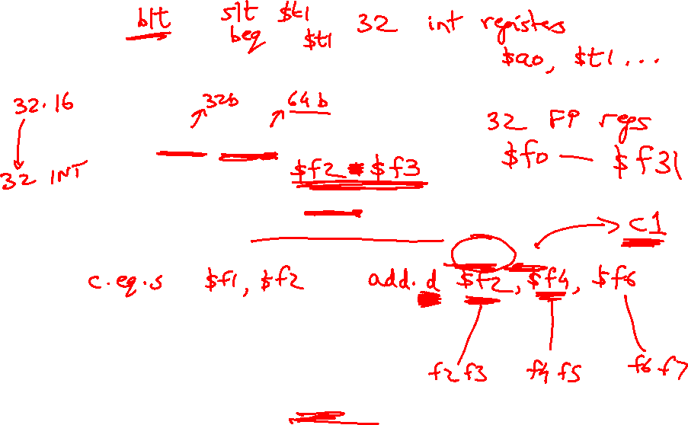
MIPS Instructions
The usual add.s, add.d, sub, mul, div
Comparison instructions: c.eq.s, c.neq.s, c.lt.s….
These comparisons set an internal bit in hardware that
is then inspected by branch instructions: bc1t, bc1f
Separate register file $f0 - $f31 : a double-precision
value is stored in (say) $f4-$f5 and is referred to by $f4
Load/store instructions (lwc1, swc1, ldc1) must still use
integer registers for address computation

Slide 12
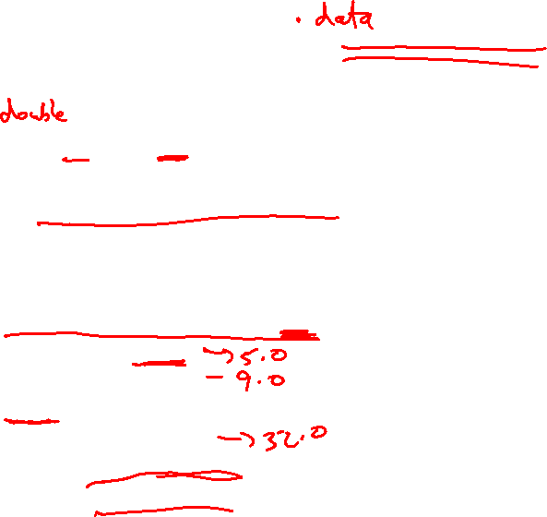
Code Example
float f2c (float fahr)
{
return ((5.0/9.0) * (fahr – 32.0));
}
(argument fahr is stored in $f12)
lwc1 $f16, const5
lwc1 $f18, const9
div.s $f16, $f16, $f18
lwc1 $f18, const32
sub.s $f18, $f12, $f18
mul.s $f0, $f16, $f18
jr $ra

Slide 13
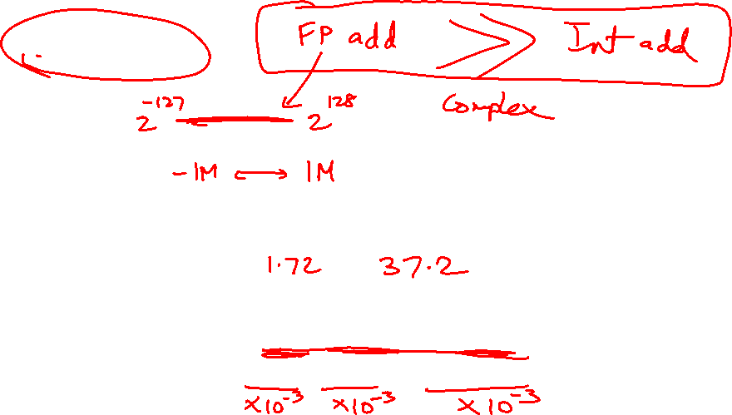
Fixed Point
FP operations are much slower than integer ops
Fixed point arithmetic uses integers, but assumes that
every number is multiplied by the same factor
Example: with a factor of 1/1000, the fixed-point
representations for 1.46, 1.7198, and 5624 are
respectively 1460, 1720, and 5624000
More programming effort and possibly lower precision
for higher performance

Slide 14
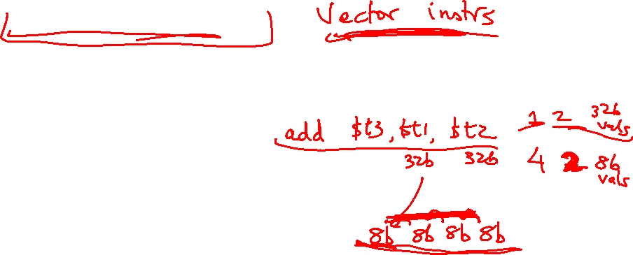
Subword Parallelism
ALUs are typically designed to perform 64-bit or 128-bit
arithmetic
Some data types are much smaller, e.g., bytes for pixel
RGB values, half-words for audio samples
Partitioning the carry-chains within the ALU can convert
the 64-bit adder into 4 16-bit adders or 8 8-bit adders
A single load can fetch multiple values, and a single
add instruction can perform multiple parallel additions,
referred to as subword parallelism

Slide 15
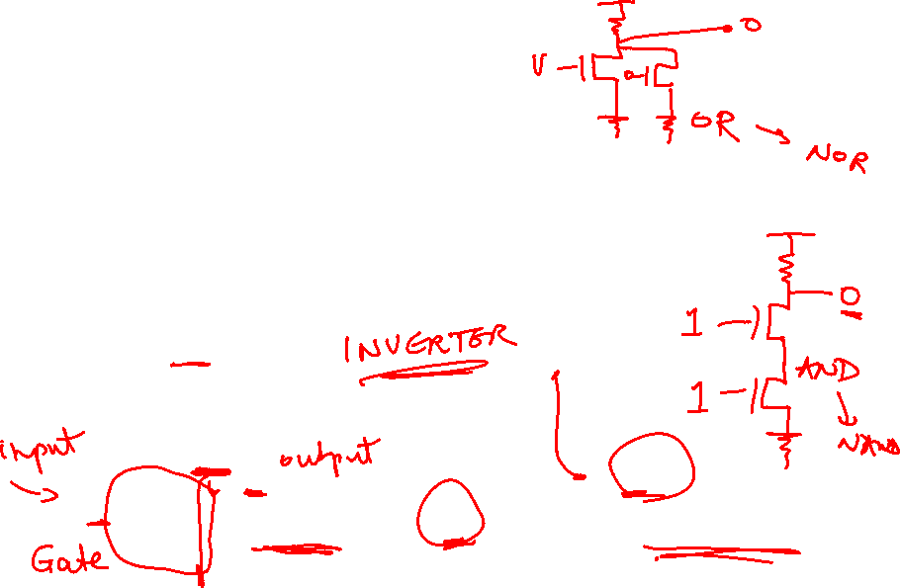
Digital Design Basics
Two voltage levels – high and low (1 and 0, true and false)
Hence, the use of binary arithmetic/logic in all computers
A transistor is a 3-terminal device that acts as a switch
V
V
0
V
V
Conducting
0
Non-conducting
0
0

Slide 16
Logic Blocks
A logic block has a number of binary inputs and produces
a number of binary outputs – the simplest logic block is
composed of a few transistors
A logic block is termed combinational if the output is only
a function of the inputs
A logic block is termed sequential if the block has some
internal memory (state) that also influences the output
A basic logic block is termed a gate (AND, OR, NOT, etc.)
We will only deal with combinational circuits today

Slide 17
Truth Table
A truth table defines the outputs of a logic block for each
set of inputs
Consider a block with 3 inputs A, B, C and an output E
that is true only if exactly 2 inputs are true
A B C E

Slide 18
Truth Table
A truth table defines the outputs of a logic block for each
set of inputs
Consider a block with 3 inputs A, B, C and an output E
that is true only if exactly 2 inputs are true
A B C E
0 0 0 0
0 0 1 0
0 1 0 0
0 1 1 1
1 0 0 0
1 0 1 1
1 1 0 1
1 1 1 0
Can be compressed by only
representing cases that
have an output of 1

Slide 19
Boolean Algebra
Equations involving two values and three primary operators:
  OR : symbol + , X = A + B ➔ X is true if at least one of
  A or B is true
  AND : symbol . , X = A . B ➔ X is true if both A and B
  are true
  NOT : symbol , X = A ➔ X is the inverted value of A

Slide 20
Boolean Algebra Rules
Identity law : A + 0 = A ; A . 1 = A
Zero and One laws : A + 1 = 1 ; A . 0 = 0
Inverse laws : A . A = 0 ; A + A = 1
Commutative laws : A + B = B + A ; A . B = B . A
Associative laws : A + (B + C) = (A + B) + C
A . (B . C) = (A . B) . C
Distributive laws : A . (B + C) = (A . B) + (A . C)
A + (B . C) = (A + B) . (A + C)

Slide 21
DeMorgan’s Laws
A + B = A . B
A . B = A + B
Confirm that these are indeed true

