Slide 1
Lecture 10: Division, Floating Point
Today’s topics:
Division
IEEE 754 representations

Slide 2
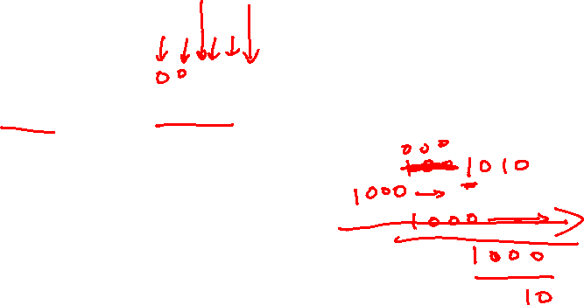
Division
1001_{ten} Quotient
Divisor 1000_{ten} | 1001010_{ten} Dividend
-1000
10
101
1010
-1000
10_{ten} Remainder
At every step,
shift divisor right and compare it with current dividend
if divisor is larger, shift 0 as the next bit of the quotient
if divisor is smaller, subtract to get new dividend and shift 1
as the next bit of the quotient

Slide 3
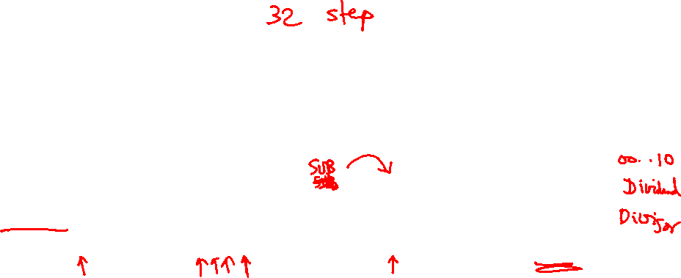
Division
1001_{ten} Quotient
Divisor 1000_{ten} | 1001010_{ten} Dividend
0001001010 0001001010 0000001010 0000001010
100000000000 → 0001000000→ 0000100000→0000001000
Quo: 0 000001 0000010 000001001
At every step,
shift divisor right and compare it with current dividend
if divisor is larger, shift 0 as the next bit of the quotient
if divisor is smaller, subtract to get new dividend and shift 1
as the next bit of the quotient

Slide 4
Divide Example
Divide 7_{ten} (0000 0111_{two}) by 2_{ten} (0010_{two})
Iter | Step | Quot | Divisor | Remainder
0 | Initial values
1
2
3
4
5

Slide 5
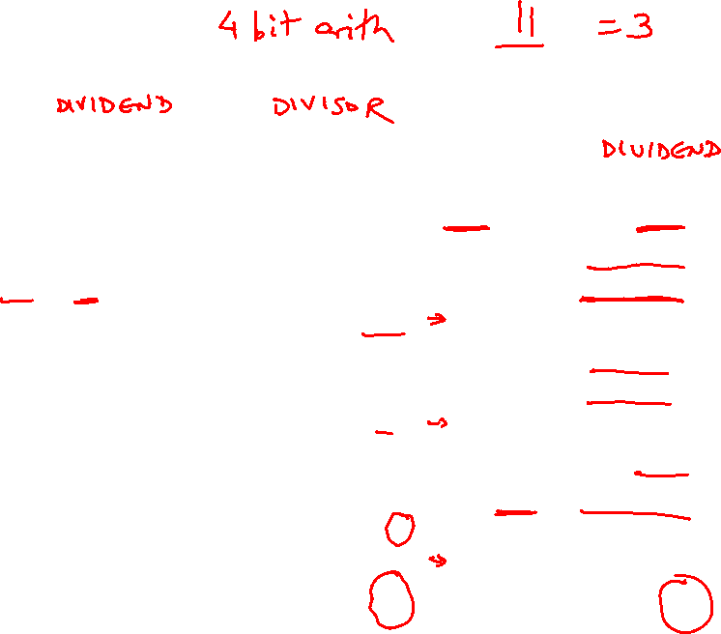
Divide Example
Divide 7_{ten} (0000 0111_{two}) by 2_{ten} (0010_{two})
Iter | Step | Quot | Divisor | Remainder
0 | Initial values | 0000 | 0010 0000 | 0000 0111
1 | Rem = Rem – Div Rem < 0 ➔ +Div, shift 0 into Q Shift Div right | 0000 0000 0000 | 0010 0000 0010 0000 0001 0000 | 1110 0111 0000 0111 0000 0111
2 | Same steps as 1 | 0000 0000 0000 | 0001 0000 0001 0000 0000 1000 | 1111 0111 0000 0111 0000 0111
3 | Same steps as 1 | 0000 | 0000 0100 | 0000 0111
4 | Rem = Rem – Div Rem >= 0 ➔ shift 1 into Q Shift Div right | 0000 0001 0001 | 0000 0100 0000 0100 0000 0010 | 0000 0011 0000 0011 0000 0011
5 | Same steps as 4 | 0011 | 0000 0001 | 0000 0001

Slide 6
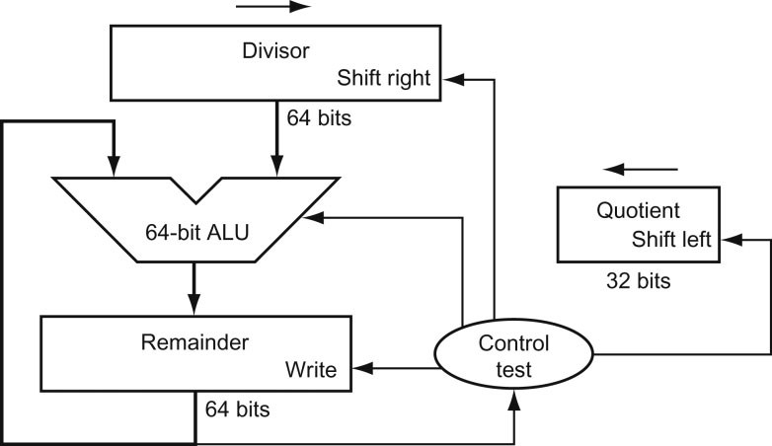
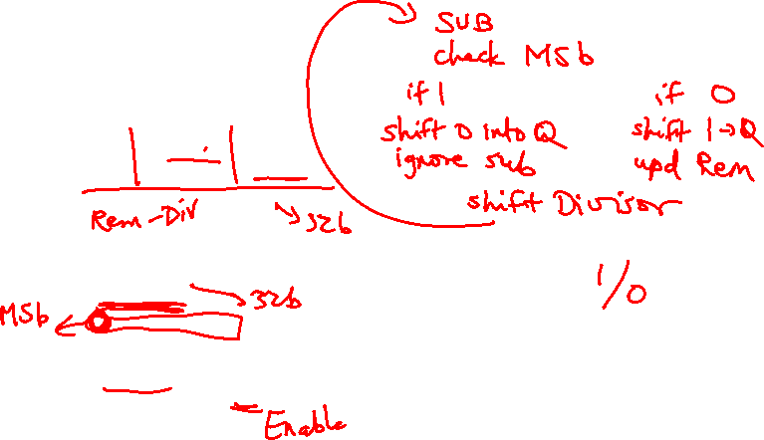
Hardware for Division
Source: H&P textbook
A comparison requires a subtract; the sign of the result is examined;
if the result is negative, the divisor must be added back
Similar to multiply, results are placed in Hi (remainder) and Lo (quotient)

Slide 7
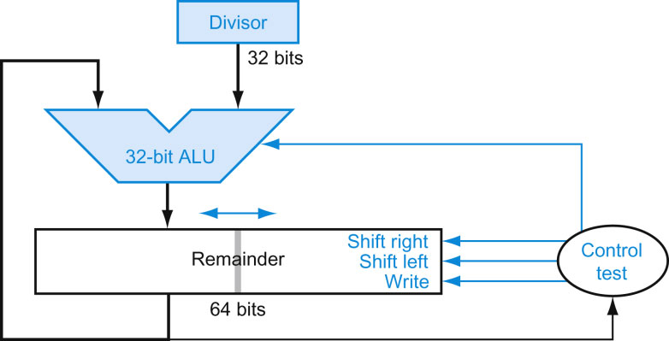
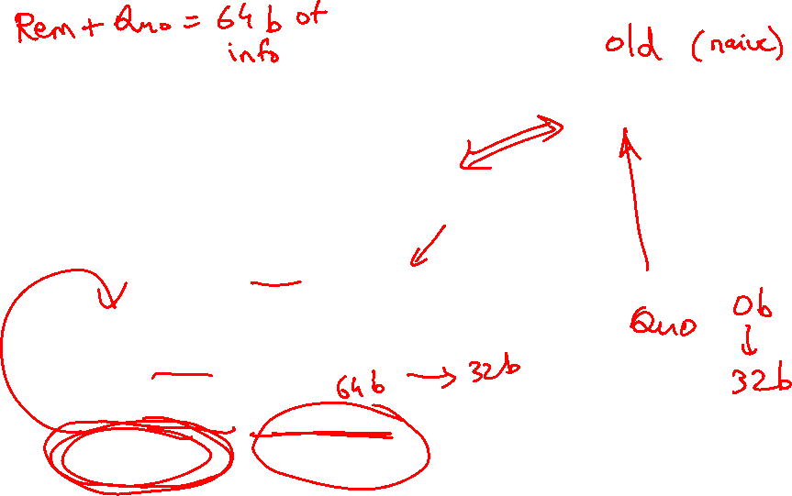
Efficient Division
Source: H&P textbook

Slide 8
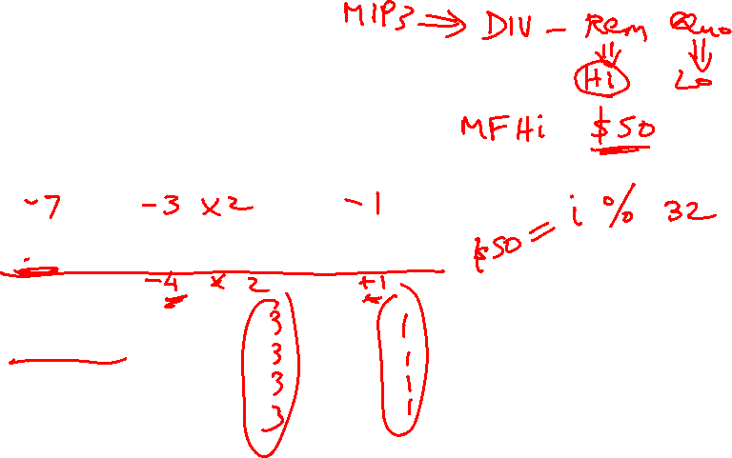
Divisions involving Negatives
Simplest solution: convert to positive and adjust sign later
Note that multiple solutions exist for the equation:
Dividend = Quotient x Divisor + Remainder
+7 div +2 Quo = Rem =
-7 div +2 Quo = Rem =
+7 div -2 Quo = Rem =
-7 div -2 Quo = Rem =

Slide 9
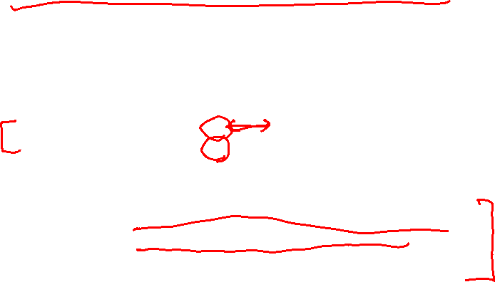
Divisions involving Negatives
Simplest solution: convert to positive and adjust sign later
Note that multiple solutions exist for the equation:
Dividend = Quotient x Divisor + Remainder
+7 div +2 Quo = +3 Rem = +1
-7 div +2 Quo = -3 Rem = -1
+7 div -2 Quo = -3 Rem = +1
-7 div -2 Quo = +3 Rem = -1
Convention: Dividend and remainder have the same sign
Quotient is negative if signs disagree
These rules fulfil the equation above

Slide 10
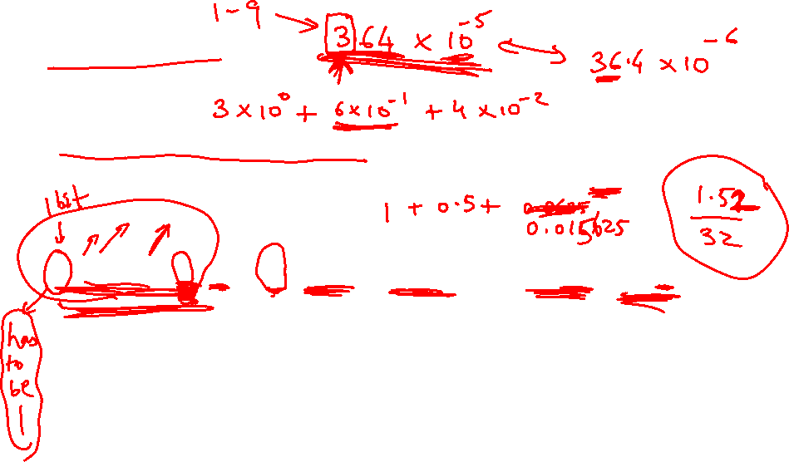
Floating Point
Normalized scientific notation: single non-zero digit to the
left of the decimal (binary) point – example: 3.5 x 10⁹
1.010001 x 2⁻⁵_{two} = (1 + 0 x 2⁻¹ + 1 x 2⁻² + … + 1 x 2⁻⁶) x 2⁻⁵_{ten}
A standard notation enables easy exchange of data between
machines and simplifies hardware algorithms – the
IEEE 754 standard defines how floating point numbers
are represented

Slide 11
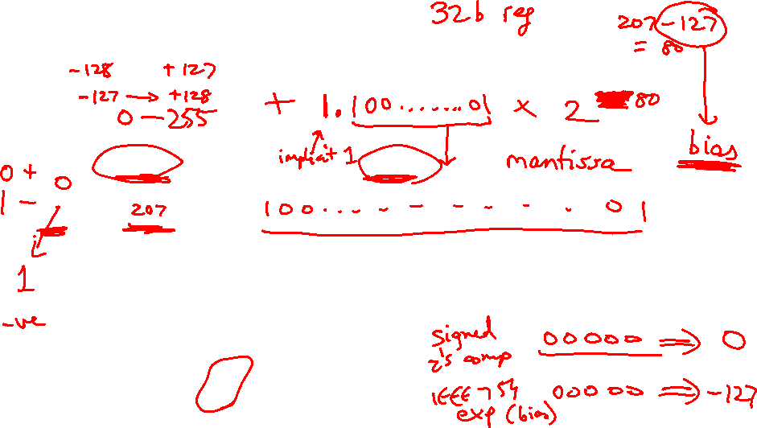
Sign and Magnitude Representation
Sign Exponent Fraction
1 bit 8 bits 23 bits
S
E
F
More exponent bits ➔ wider range of numbers (not necessarily more
numbers – recall there are infinite real numbers)
More fraction bits ➔ higher precision
Register value = (-1)^{S} x F x 2E
Since we are only representing normalized numbers, we are
guaranteed that the number is of the form 1.xxxx..
Hence, in IEEE 754 standard, the 1 is implicit
Register value = (-1)^{S} x (1 + F) x 2E

Slide 12
Sign and Magnitude Representation
Sign Exponent Fraction
1 bit 8 bits 23 bits
S
E
F
Largest number that can be represented: 2.0 x 2¹²⁸ = 2.0 x 10³⁸
(not really – see upcoming details)
Smallest number that can be represented: 1.0 x 2⁻¹²⁷ = 2.0 x 10⁻³⁸
(not really – see upcoming details)
Overflow: when representing a number larger than the max;
Underflow: when representing a number smaller than the min
Double precision format: occupies two 32-bit registers:
Largest: Smallest:
Sign Exponent Fraction
1 bit 11 bits 52 bits
S
E
F

Slide 13
Details
The number “0” has a special code so that the implicit 1 does not
get added: the code is all 0s
(it may seem that this takes up the representation for 1.0, but
given how the exponent is represented, that’s not the case)
(see discussion of denorms in the textbook)
The largest exponent value (with zero fraction) represents +/- infinity
The largest exponent value (with non-zero fraction) represents
NaN (not a number) – for the result of 0/0 or (infinity minus infinity)
Note that these choices impact the smallest and largest numbers
that can be represented

Slide 14
Exponent Representation
To simplify sort, sign was placed as the first bit
For a similar reason, the representation of the exponent is also
modified: in order to use integer compares, it would be preferable to
have the smallest exponent as 00…0 and the largest exponent as 11…1
This is the biased notation, where a bias is subtracted from the
exponent field to yield the true exponent
IEEE 754 single-precision uses a bias of 127 (since the exponent
must have values between -127 and 128)…double precision uses
a bias of 1023
Final representation: (-1)^{S} x (1 + Fraction) x 2^{(Exponent – Bias)}

Slide 15
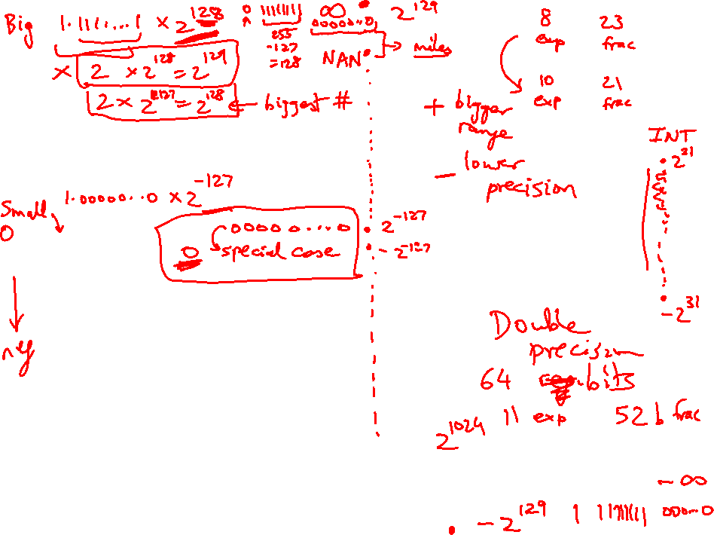

Slide 16
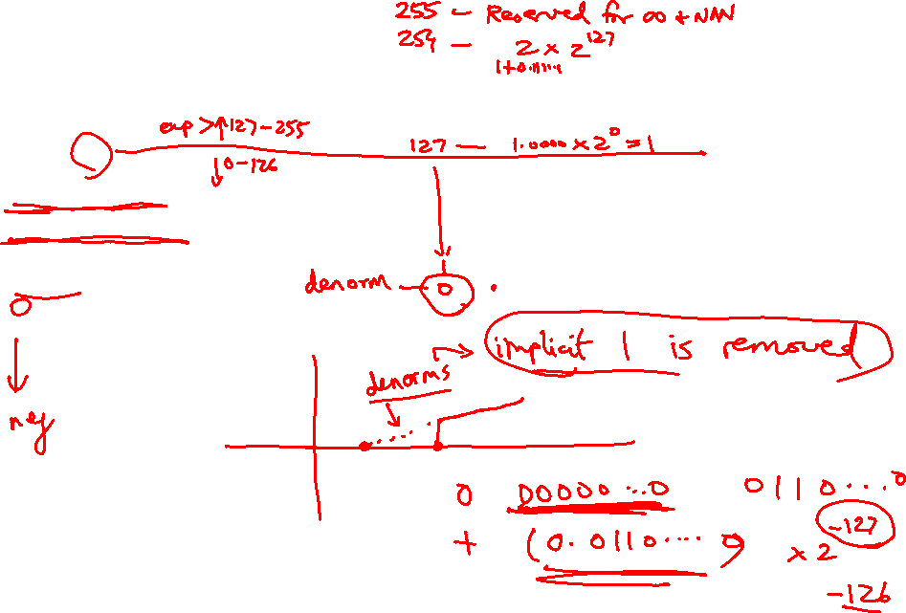
Value inf
Value NAN
Highest value ~2 x 2¹²⁷
0 255 00…0
0 255 xx….x
0 254 11….1
Value 1
0 127 00…0
Smallest Norm
Largest Denorm
Smallest Denorm
0 0..01 00…0
0 0..00 11…1
0 0..00 00…0
Value 0
0 00..0 00…0

Slide 17
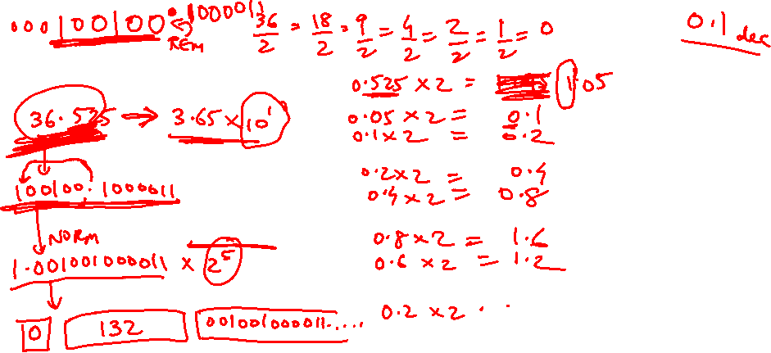
Examples
Final representation: (-1)^{S} x (1 + Fraction) x 2^{(Exponent – Bias)}
Represent -0.75_{ten} in single and double-precision formats
Single: (1 + 8 + 23)
Double: (1 + 11 + 52)
What decimal number is represented by the following
single-precision number?
1 1000 0001 01000…0000
Remember:
True exponent Exponent in register
+127
-127

Slide 18
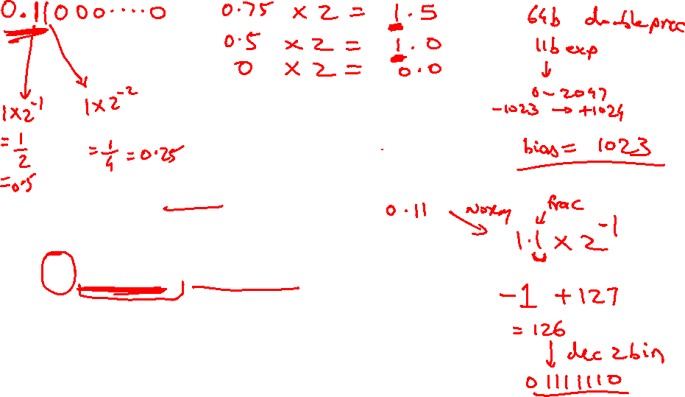
Examples
Final representation: (-1)^{S} x (1 + Fraction) x 2^{(Exponent – Bias)}
Represent -0.75_{ten} in single and double-precision formats
Single: (1 + 8 + 23)
1 0111 1110 1000…000
Double: (1 + 11 + 52)
1 0111 1111 110 1000…000
What decimal number is represented by the following
single-precision number?
1 1000 0001 01000…0000
-5.0

