Slide 1
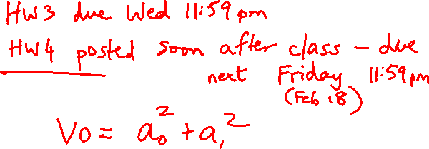
Lecture 9: Addition, Multiplication & Division
Today’s topics:
  Sign extension
  Addition
  Multiplication
  Division

Slide 2
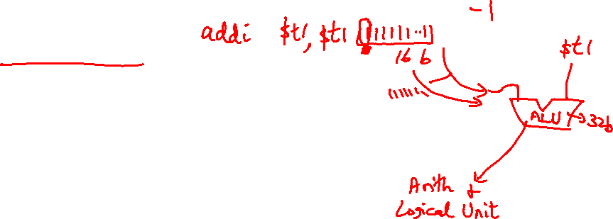
Sign Extension
Occasionally, 16-bit signed numbers must be converted
into 32-bit signed numbers – for example, when doing an
add with an immediate operand
The conversion is simple: take the most significant bit and
use it to fill up the additional bits on the left – known as
sign extension
So 2₁₀ goes from 0000 0000 0000 0010 to
0000 0000 0000 0000 0000 0000 0000 0010
and -2₁₀ goes from 1111 1111 1111 1110 to
1111 1111 1111 1111 1111 1111 1111 1110

Slide 3

Alternative Representations
The following two (intuitive) representations were discarded
because they required additional conversion steps before
arithmetic could be performed on the numbers
  sign-and-magnitude: the most significant bit represents
  +/- and the remaining bits express the magnitude
  one’s complement: -x is represented by inverting all
  the bits of x
  Both representations above suffer from two zeroes

Slide 4
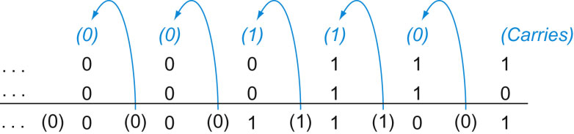
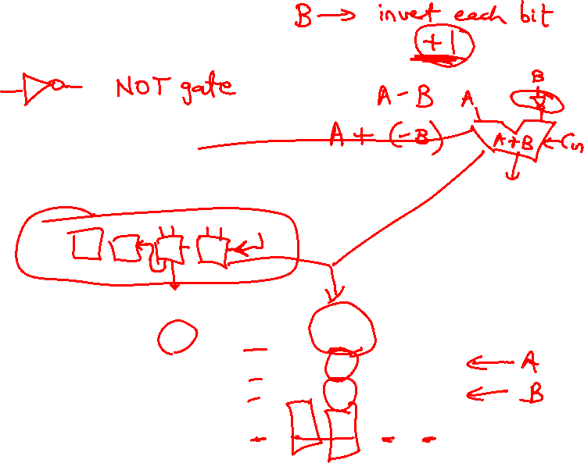
Addition and Subtraction
Addition is similar to decimal arithmetic
For subtraction, simply add the negative number – hence,
subtract A-B involves negating B’s bits, adding 1 and A
Source: H&P textbook

Slide 5
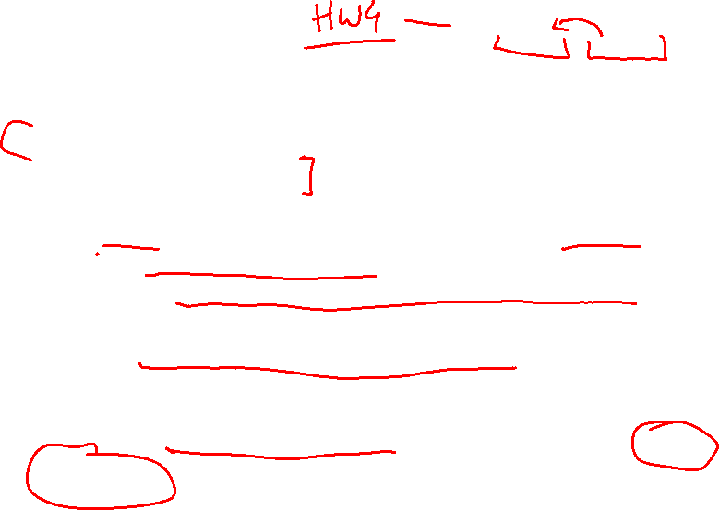
Overflows
For an unsigned number, overflow happens when the last carry (1)
cannot be accommodated
For a signed number, overflow happens when the most significant bit
is not the same as every bit to its left
  when the sum of two positive numbers is a negative result
  when the sum of two negative numbers is a positive result
  The sum of a positive and negative number will never overflow
MIPS allows addu and subu instructions that work with unsigned
integers and never flag an overflow – to detect the overflow, other
instructions will have to be executed

Slide 6
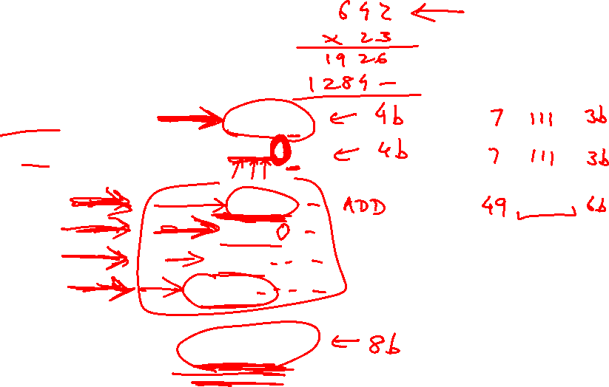
Multiplication Example
Multiplicand 1000_{ten}
Multiplier x 1001_{ten}
---------------
1000
0000
0000
1000
----------------
Product 1001000_{ten}
In every step
  multiplicand is shifted
  next bit of multiplier is examined (also a shifting step)
  if this bit is 1, shifted multiplicand is added to the product

Slide 7
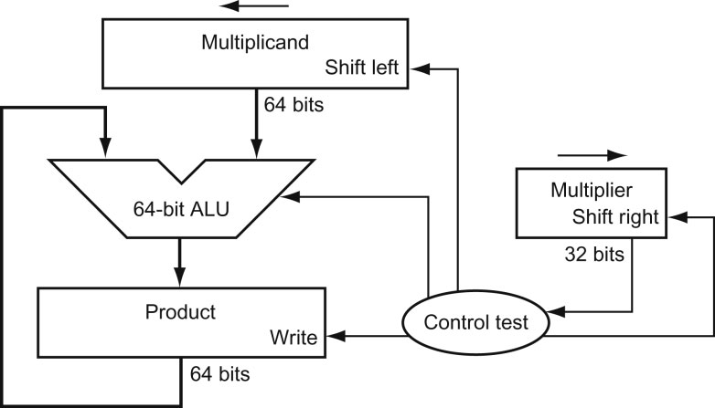
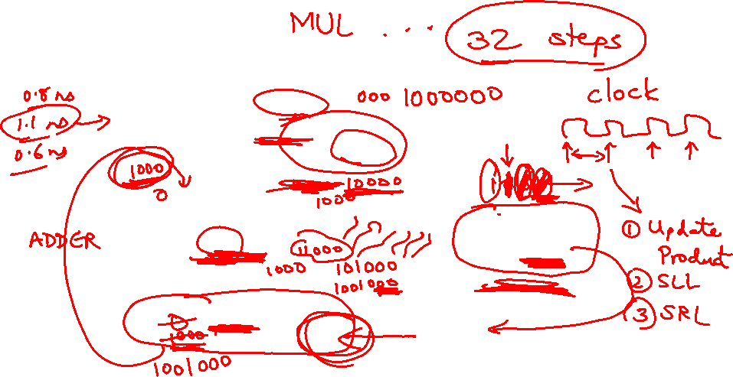
HW Algorithm 1
Source: H&P textbook
In every step
  multiplicand is shifted
  next bit of multiplier is examined (also a shifting step)
  if this bit is 1, shifted multiplicand is added to the product

Slide 8
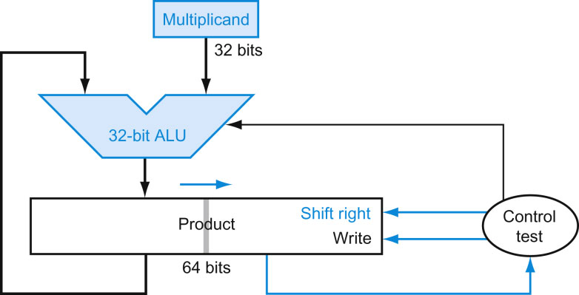
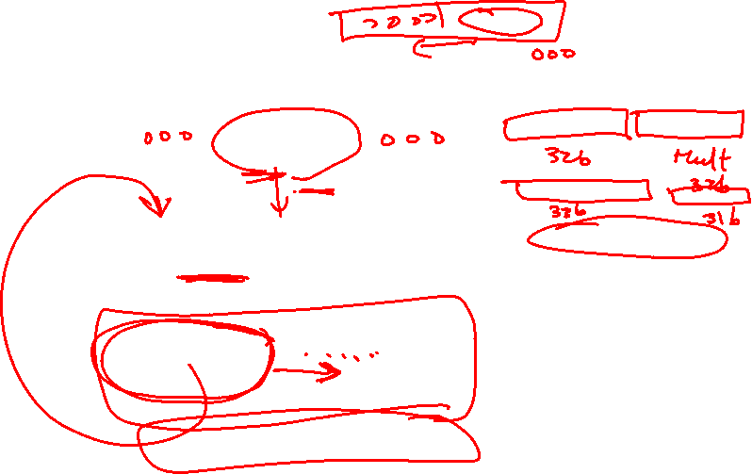
HW Algorithm 2
Source: H&P textbook
  32-bit ALU and multiplicand is untouched
  the sum keeps shifting right
  at every step, number of bits in product + multiplier = 64,
  hence, they share a single 64-bit register

Slide 9

Notes
The previous algorithm also works for signed numbers
(negative numbers in 2’s complement form)
We can also convert negative numbers to positive, multiply
the magnitudes, and convert to negative if signs disagree
The product of two 32-bit numbers can be a 64-bit number
-- hence, in MIPS, the product is saved in two 32-bit
registers

Slide 10
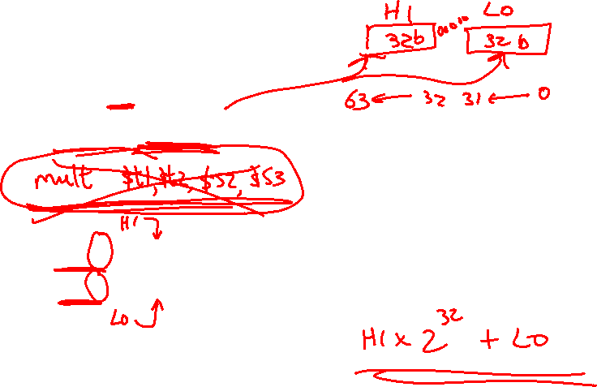
MIPS Instructions
mult $s2, $s3 computes the product and stores
it in two “internal” registers that
can be referred to as hi and lo
mfhi $s0 moves the value in hi into $s0
mflo $s1 moves the value in lo into $s1
Similarly for multu

Slide 11
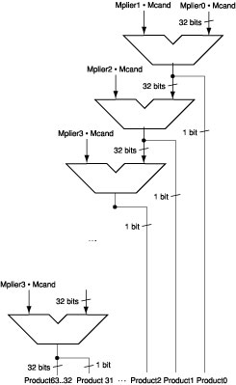
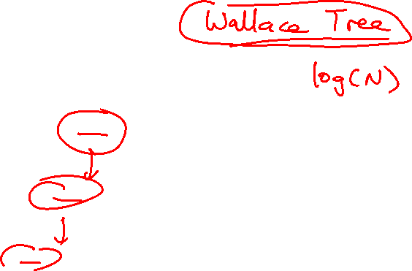
Fast Algorithm
The previous algorithm
requires a clock to ensure that
the earlier addition has
completed before shifting
This algorithm can quickly set
up most inputs – it then has to
wait for the result of each add
to propagate down – faster
because no clock is involved
-- Note: high transistor cost
Source: H&P textbook

Slide 12
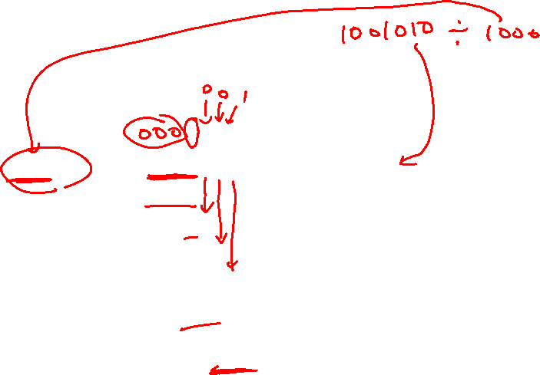
Division
1001_{ten} Quotient
Divisor 1000_{ten} | 1001010_{ten} Dividend
-1000
10
101
1010
-1000
10_{ten} Remainder
At every step,
  shift divisor right and compare it with current dividend
  if divisor is larger, shift 0 as the next bit of the quotient
  if divisor is smaller, subtract to get new dividend and shift 1
  as the next bit of the quotient

Slide 13
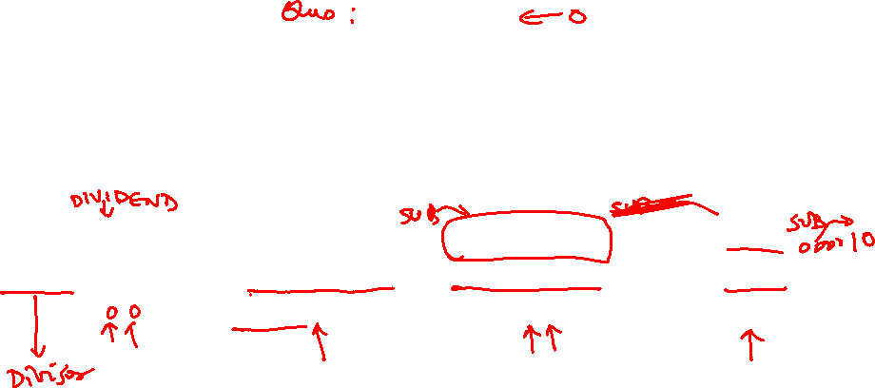
Division
1001_{ten} Quotient
Divisor 1000_{ten} | 1001010_{ten} Dividend
0001001010 0001001010 0000001010 0000001010
100000000000 → 0001000000→ 0000100000→0000001000
Quo: 0 000001 0000010 000001001
At every step,
  shift divisor right and compare it with current dividend
  if divisor is larger, shift 0 as the next bit of the quotient
  if divisor is smaller, subtract to get new dividend and shift 1
  as the next bit of the quotient

Slide 14
Divide Example
Divide 7_{ten} (0000 0111_{two}) by 2_{ten} (0010_{two})
Iter | Step | Quot | Divisor | Remainder
0 | Initial values
1
2
3
4
5

Slide 15
Divide Example
Divide 7_{ten} (0000 0111_{two}) by 2_{ten} (0010_{two})
Iter | Step | Quot | Divisor | Remainder
0 | Initial values | 0000 | 0010 0000 | 0000 0111
1 | Rem = Rem – Div Rem < 0 ➔ +Div, shift 0 into Q Shift Div right | 0000 0000 0000 | 0010 0000 0010 0000 0001 0000 | 1110 0111 0000 0111 0000 0111
2 | Same steps as 1 | 0000 0000 0000 | 0001 0000 0001 0000 0000 1000 | 1111 0111 0000 0111 0000 0111
3 | Same steps as 1 | 0000 | 0000 0100 | 0000 0111
4 | Rem = Rem – Div Rem >= 0 ➔ shift 1 into Q Shift Div right | 0000 0001 0001 | 0000 0100 0000 0100 0000 0010 | 0000 0011 0000 0011 0000 0011
5 | Same steps as 4 | 0011 | 0000 0001 | 0000 0001

