Slide 1
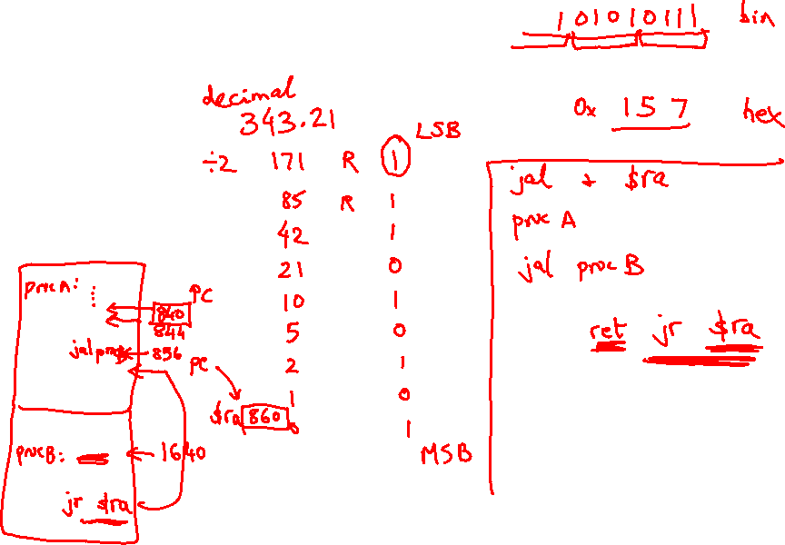
Lecture 6: Assembly Programs
Today’s topics:
  Procedures
  Examples

Slide 2
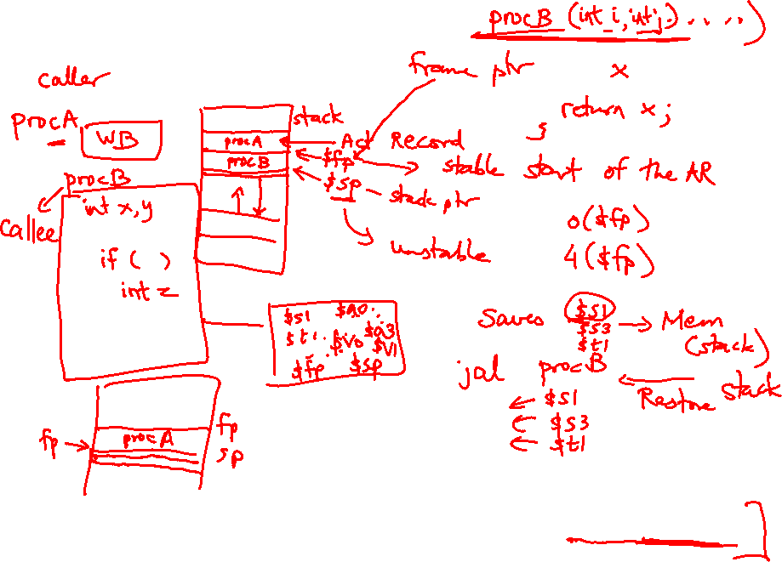
Procedures
Local variables, AR, $fp, $sp
Scratchpad and saves/restores
Arguments and returns
jal and $ra

Slide 3
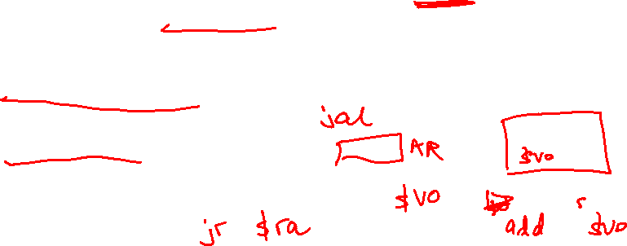
Procedures
Each procedure (function, subroutine) maintains a scratchpad of
register values – when another procedure is called (the callee), the
new procedure takes over the scratchpad – values may have to be
saved so we can safely return to the caller
  parameters (arguments) are placed where the callee can see them
  control is transferred to the callee
  acquire storage resources for callee
  execute the procedure
  place result value where caller can access it
  return control to caller

Slide 4
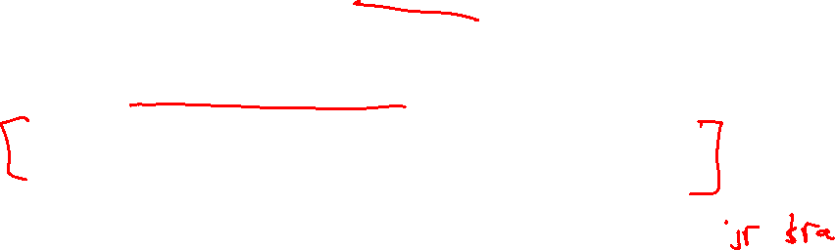
Jump-and-Link
A special register (storage not part of the register file) maintains the
address of the instruction currently being executed – this is the
program counter (PC)
The procedure call is executed by invoking the jump-and-link (jal)
instruction – the current PC (actually, PC+4) is saved in the register
$ra and we jump to the procedure’s address (the PC is accordingly
set to this address)
jal NewProcedureAddress
Since jal may over-write a relevant value in $ra, it must be saved
somewhere (in memory?) before invoking the jal instruction
How do we return control back to the caller after completing the
callee procedure?

Slide 5
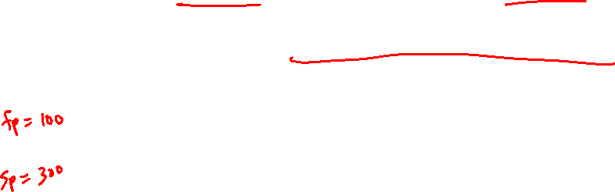
The Stack
The register scratchpad for a procedure seems volatile –
it seems to disappear every time we switch procedures –
a procedure’s values are therefore backed up in memory
on a stack
High address
Proc A’s values
Proc A
call Proc B
…
call Proc C
…
return
return
return
Proc B’s values
Proc C’s values
…
Stack grows
this way
Low address

Slide 6
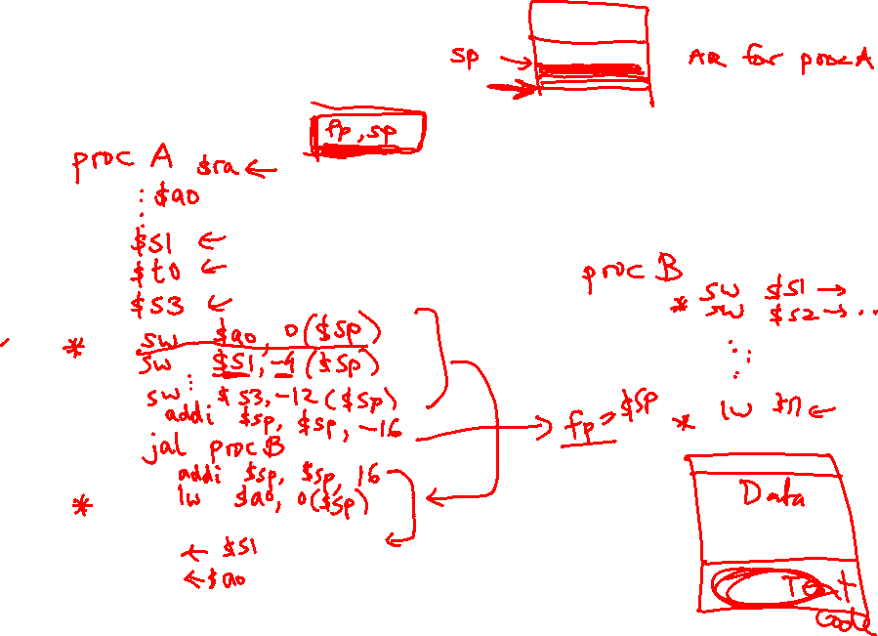
Saves and Restores

Slide 7
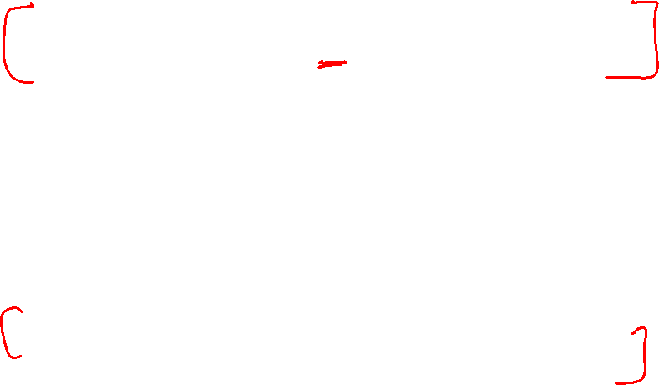
Storage Management on a Call/Return
A new procedure must create space for all its variables on the stack
Before/after executing the jal, the caller/callee must save relevant
values in $s0-$s7, $a0-$a3, $ra, $fp, temps into the stack space
Arguments are copied into $a0-$a3; the jal is executed
After the callee creates stack space, it updates the value of $sp
Once the callee finishes, it copies the return value into $v0, frees
up stack space, and $sp is incremented
On return, the caller/callee brings in stack values, ra, temps into registers
The responsibility for copies between stack and registers may fall
upon either the caller or the callee

Slide 8
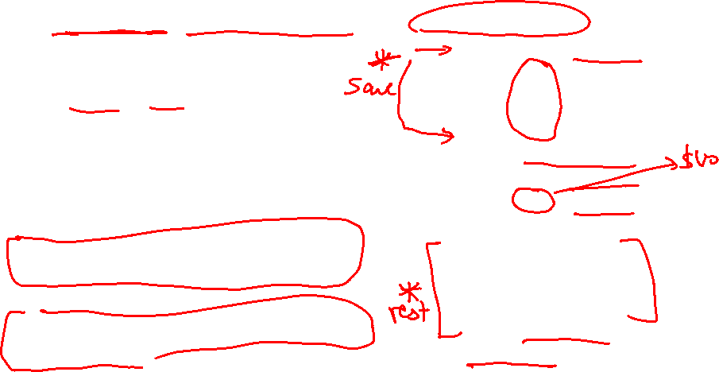
Example 1 (pg. 98)
int leaf_example (int g, int h, int i, int j)
{
int f ;
f = (g + h) – (i + j);
return f;
}
leaf_example:
addi $sp, $sp, -12
sw $t1, 8($sp)
sw $t0, 4($sp)
sw $s0, 0($sp)
add $t0, $a0, $a1
add $t1, $a2, $a3
sub $s0, $t0, $t1
add $v0, $s0, $zero
lw $s0, 0($sp)
lw $t0, 4($sp)
lw $t1, 8($sp)
addi $sp, $sp, 12
jr $ra
Notes:
In this example, the callee took care of
saving the registers it needs.
The caller took care of saving its $ra and
$a0-$a3.
Could have avoided using the stack altogether.

Slide 9

Saving Conventions
Caller saved: Temp registers $t0-$t9 (the callee won’t
bother saving these, so save them if you care), $ra (it’s
about to get over-written), $a0-$a3 (so you can put in
new arguments), $fp (if being used by the caller)
Callee saved: $s0-$s7 (these typically contain “valuable”
data)
Read the Notes on the class webpage on this topic

Slide 10
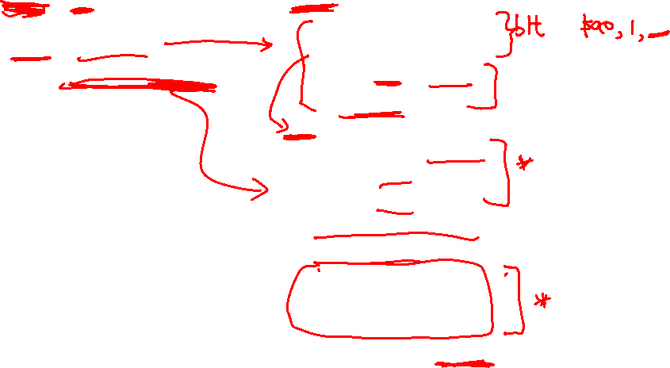
Example 2 (pg. 101)
int fact (int n)
{
if (n < 1) return (1);
else return (n * fact(n-1));
}
fact:
slti $t0, $a0, 1
beq $t0, $zero, L1
addi $v0, $zero, 1
jr $ra
L1:
addi $sp, $sp, -8
sw $ra, 4($sp)
sw $a0, 0($sp)
addi $a0, $a0, -1
jal fact
lw $a0, 0($sp)
lw $ra, 4($sp)
addi $sp, $sp, 8
mul $v0, $a0, $v0
jr $ra
Notes:
The caller saves $a0 and $ra
in its stack space.
Temp register $t0 is never saved.

Slide 11
Dealing with Characters
Instructions are also provided to deal with byte-sized
and half-word quantities: lb (load-byte), sb, lh, sh
These data types are most useful when dealing with
characters, pixel values, etc.
C employs ASCII formats to represent characters – each
character is represented with 8 bits and a string ends in
the null character (corresponding to the 8-bit number 0);
A is 65, a is 97

Slide 12
Example 3 (pg. 108)
Convert to assembly:
void strcpy (char x[], char y[])
{
int i;
i=0;
while ((x[i] = y[i]) != `\0’)
i += 1;
}
strcpy:
addi $sp, $sp, -4
sw $s0, 0($sp)
add $s0, $zero, $zero
L1: add $t1, $s0, $a1
lb $t2, 0($t1)
add $t3, $s0, $a0
sb $t2, 0($t3)
beq $t2, $zero, L2
addi $s0, $s0, 1
j L1
L2: lw $s0, 0($sp)
addi $sp, $sp, 4
jr $ra
Notes:
Temp registers not saved.

