Slide 1
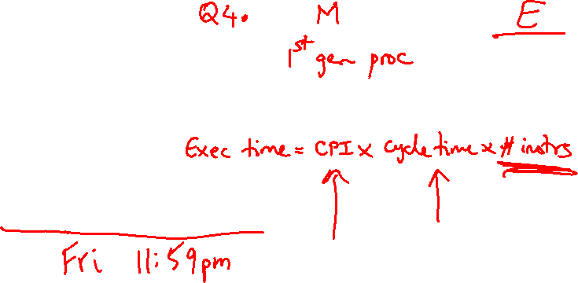
Lecture 4: MIPS Instruction Set
Today’s topics:
MIPS instructions
Code examples
HW 1 due today/tomorrow!

Slide 2

Instruction Set
Important design principles when defining the
instruction set architecture (ISA):
keep the hardware simple – the chip must only
implement basic primitives and run fast
keep the instructions regular – simplifies the
decoding/scheduling of instructions
We will later discuss RISC vs CISC

Slide 3

Example
C code a = b + c + d + e;
translates into the following assembly code:
add a, b, c add a, b, c
add a, a, d or add f, d, e
add a, a, e add a, a, f
Instructions are simple: fixed number of operands (unlike C)
A single line of C code is converted into multiple lines of
assembly code
Some sequences are better than others… the second
sequence needs one more (temporary) variable f

Slide 4

Subtract Example
C code f = (g + h) – (i + j);
Assembly code translation with only add and sub instructions:

Slide 5
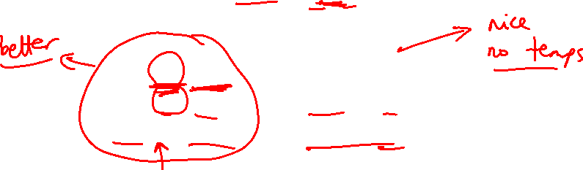
Subtract Example
C code f = (g + h) – (i + j);
translates into the following assembly code:
add t0, g, h add f, g, h
add t1, i, j or sub f, f, i
sub f, t0, t1 sub f, f, j
Each version may produce a different result because
floating-point operations are not necessarily
associative and commutative… more on this later

Slide 6
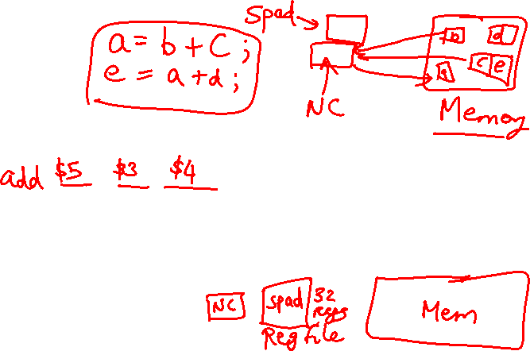
Operands
In C, each “variable” is a location in memory
In hardware, each memory access is expensive – if
variable a is accessed repeatedly, it helps to bring the
variable into an on-chip scratchpad and operate on the
scratchpad (registers)
To simplify the instructions, we require that each
instruction (add, sub) only operate on registers
Note: the number of operands (variables) in a C program is
very large; the number of operands in assembly is fixed…
there can be only so many scratchpad registers

Slide 7
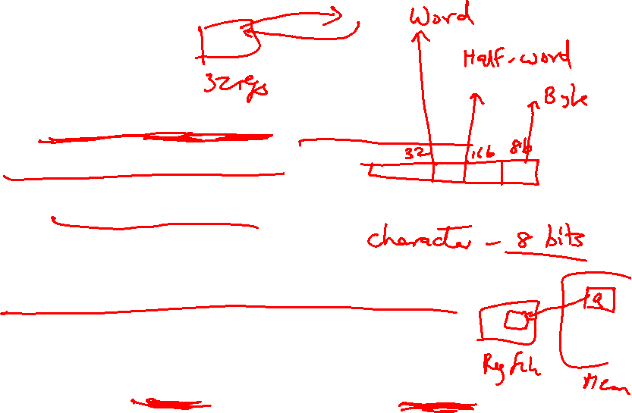
Registers
The MIPS ISA has 32 registers (x86 has 8 registers) –
Why not more? Why not less?
Each register is 32 bits wide (modern 64-bit architectures
have 64-bit wide registers)
A 32-bit entity (4 bytes) is referred to as a word
To make the code more readable, registers are
partitioned as $s0-$s7 (C/Java variables), $t0-$t9
(temporary variables)…

Slide 8
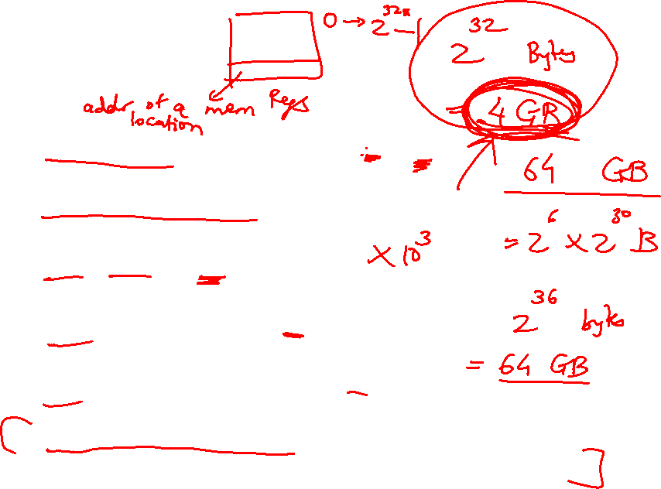
Binary Stuff
8 bits = 1 Byte, also written as 8b = 1B
1 word = 32 bits = 4B
1KB = 1024 B = 2¹⁰ B
1MB = 1024 x 1024 B = 2²⁰ B
1GB = 1024 x 1024 x 1024 B = 2³⁰ B
A 32-bit memory address refers to a number between
0 and 2³² – 1, i.e., it identifies a byte in a 4GB memory

Slide 9
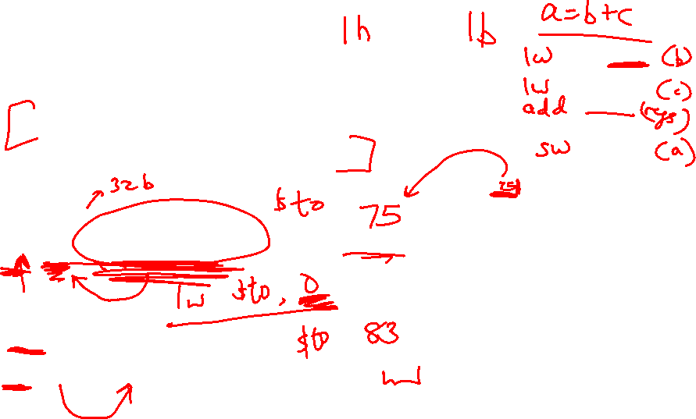
Memory Operands
Values must be fetched from memory before (add and sub)
instructions can operate on them
Load word
lw $t0, memory-address
Store word
sw $t0, memory-address
How is memory-address determined?
Memory
Register
Memory
Register

Slide 10
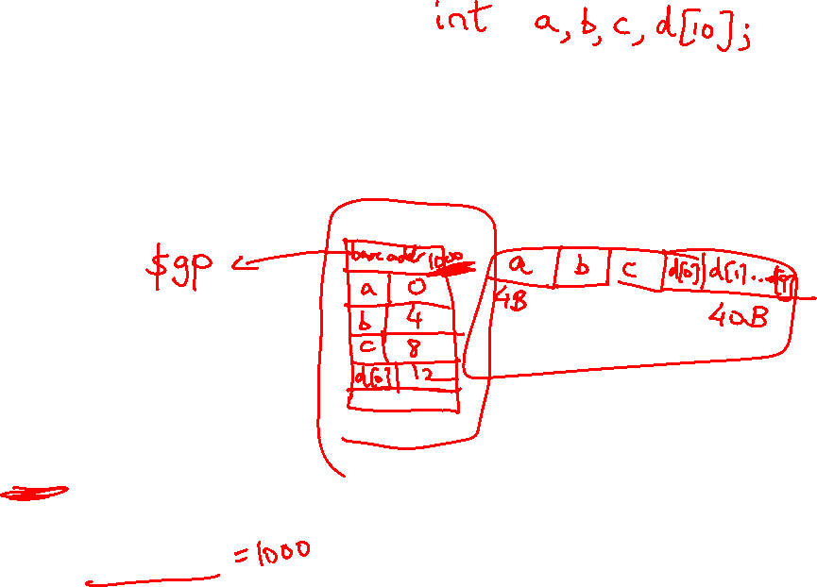
Memory Address
The compiler organizes data in memory… it knows the
location of every variable (saved in a table)… it can fill
in the appropriate mem-address for load-store instructions
int a, b, c, d[10]
…
Memory
Base address

Slide 11
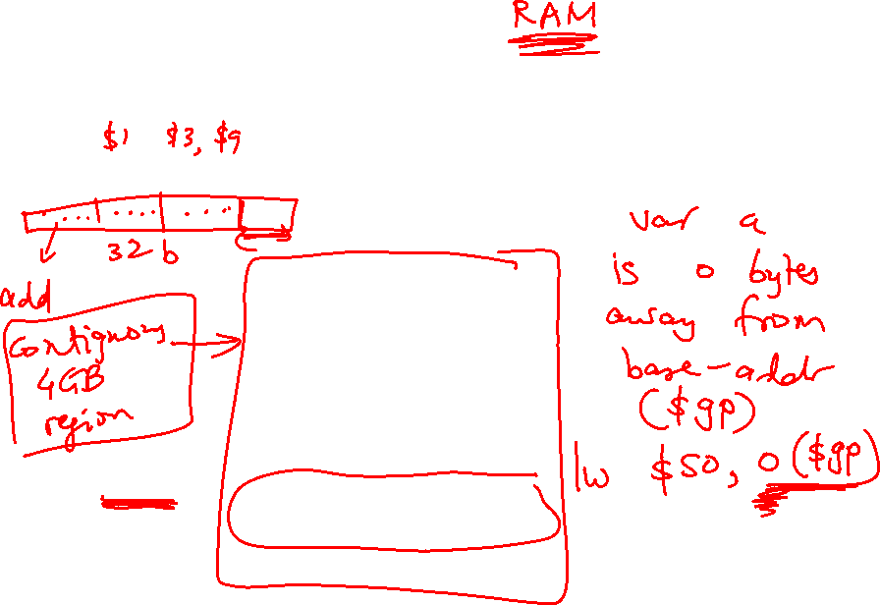
Memory Organization
$gp points to area in memory that saves global variables
Stack
Dynamic data (heap)
Static data (globals)
$gp
Text (instructions)

Slide 12
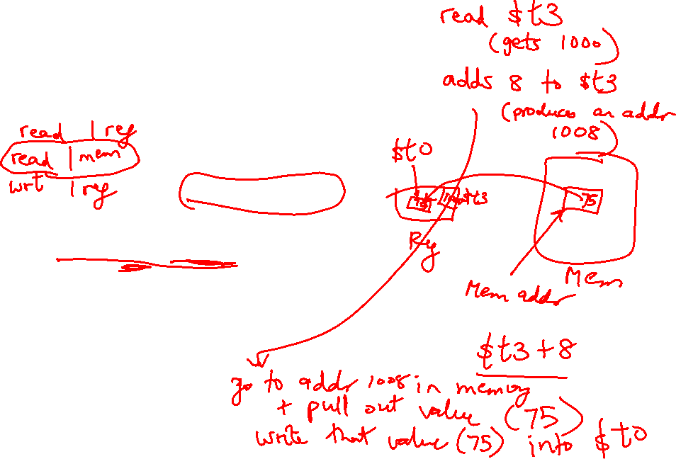
Memory Instruction Format
The format of a load instruction:
destination register
source address
lw $t0, 8($t3)
any register
a constant that is added to the register in parentheses

Slide 13
Memory Instruction Format
The format of a store instruction:
source register
destination address
sw $t0, 8($t3)
any register
a constant that is added to the register in parentheses

Slide 14
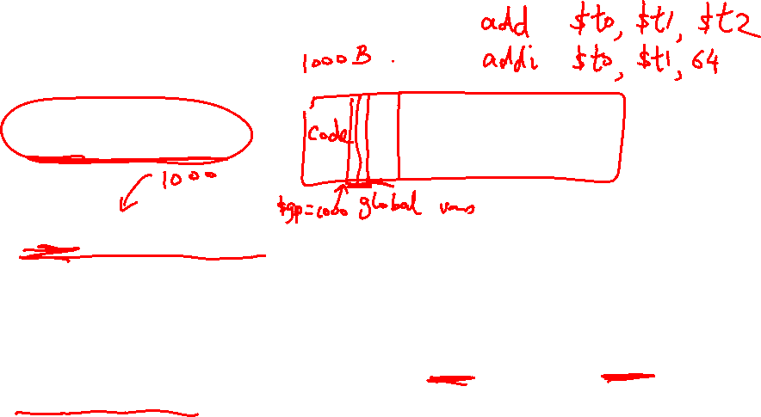
Example
int a, b, c, d[10];
addi $gp, $zero, 1000 # assume that data is stored at
# base address 1000; placed in $gp;
# $zero is a register that always
# equals zero
lw $s1, 0($gp) # brings value of a into register $s1
lw $s2, 4($gp) # brings value of b into register $s2
lw $s3, 8($gp) # brings value of c into register $s3
lw $s4, 12($gp) # brings value of d[0] into register $s4
lw $s5, 16($gp) # brings value of d[1] into register $s5

Slide 15
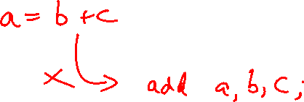
Example
Convert to assembly:
C code: d[3] = d[2] + a;

Slide 16
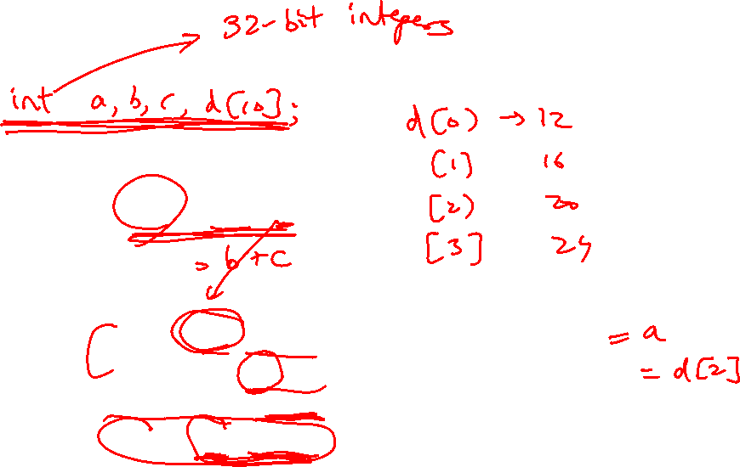
Example
Convert to assembly:
C code: d[3] = d[2] + a;
Assembly (same assumptions as previous example):
lw $s0, 0($gp) # a is brought into $s0
lw $s1, 20($gp) # d[2] is brought into $s1
add $s2, $s0, $s1 # the sum is in $s2
sw $s2, 24($gp) # $s2 is stored into d[3]
Assembly version of the code continues to expand!

Slide 17
Memory Organization
main {
foo ( )
foo {
M
The space allocated on stack by a procedure is termed the activation
record (includes saved values and data local to the procedure) – frame
pointer points to the start of the record and stack pointer points to the
end – variable addresses are specified relative to $fp as $sp may
change during the execution of the procedure
$gp points to area in memory that saves global variables
Dynamically allocated storage (with malloc()) is placed on the heap
inta,b
.
Stack
Dynamic data (heap)
malloc ( )
Static data (globals)
$ SP
Text (instructions)

