Slide 1
Lecture 3: Performance/Power, MIPS Instructions
Today’s topic:
  More performance/power equations, examples
  MIPS instructions intro
HW1 is due on Thursday
TA office hours have begun

Slide 2
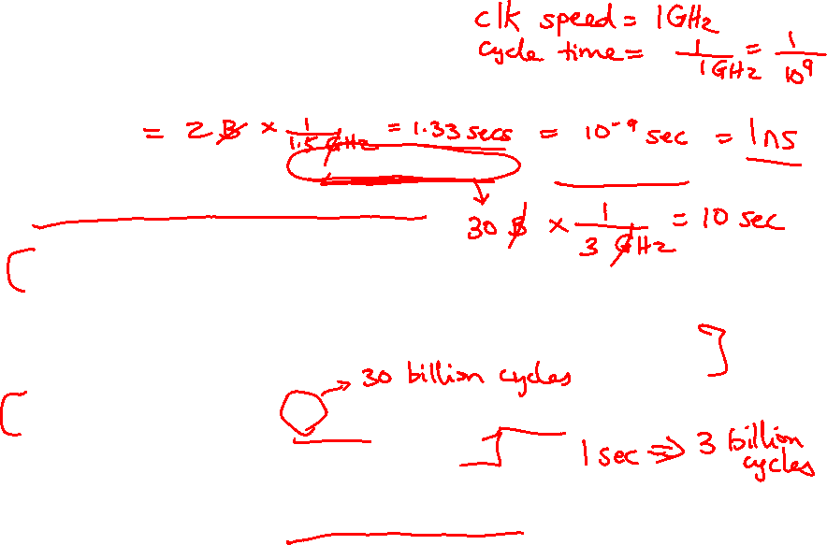
Performance Equation - I
CPU execution time = CPU clock cycles x Clock cycle time
Clock cycle time = 1 / Clock speed
If a processor has a frequency of 3 GHz, the clock ticks
3 billion times in a second – as we’ll soon see, with each
clock tick, one or more/less instructions may complete
If a program runs for 10 seconds on a 3 GHz processor,
how many clock cycles did it run for?
If a program runs for 2 billion clock cycles on a 1.5 GHz
processor, what is the execution time in seconds?

Slide 3
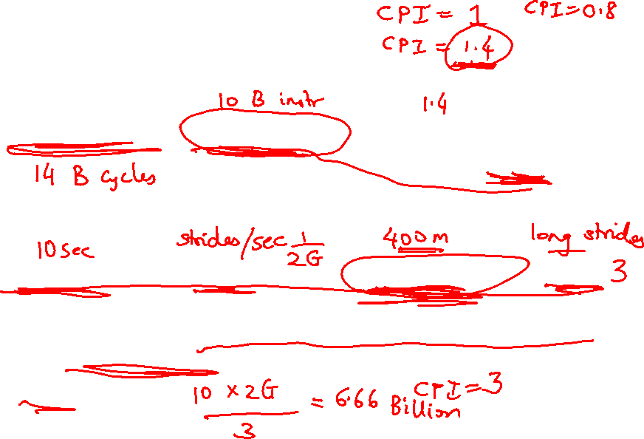
Performance Equation - II
CPU clock cycles = number of instrs x avg clock cycles
per instruction (CPI)
Substituting in previous equation,
Execution time = clock cycle time x number of instrs x avg CPI
If a 2 GHz processor graduates an instruction every third cycle,
how many instructions are there in a program that runs for
10 seconds?

Slide 4
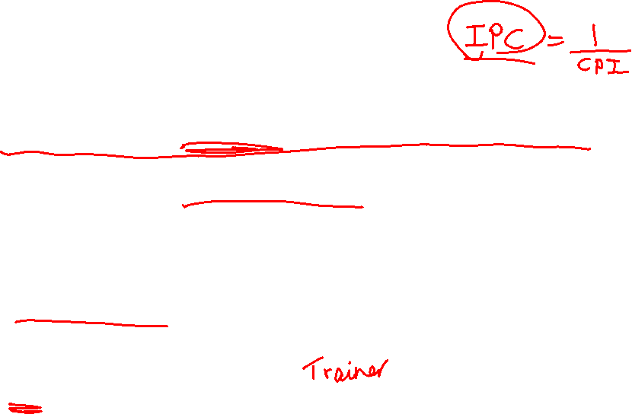
Factors Influencing Performance
Execution time = clock cycle time x number of instrs x avg CPI
Clock cycle time: manufacturing process (how fast is each
transistor), how much work gets done in each pipeline stage
(more on this later)
Number of instrs: the quality of the compiler and the
instruction set architecture
CPI: the nature of each instruction and the quality of the
architecture implementation

Slide 5
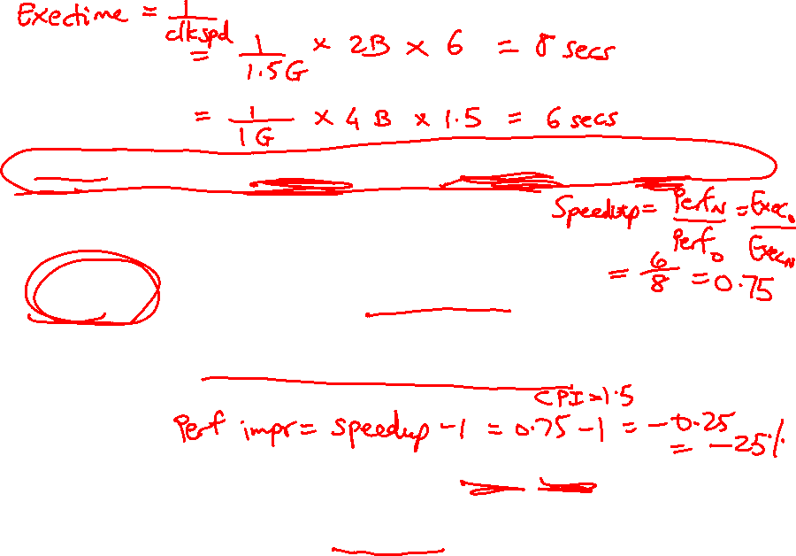
Example
Execution time = clock cycle time x number of instrs x avg CPI
Which of the following two systems is better?
A program is converted into 4 billion MIPS instructions by a
compiler ; the MIPS processor is implemented such that
each instruction completes in an average of 1.5 cycles and
the clock speed is 1 GHz
The same program is converted into 2 billion x86 instructions;
the x86 processor is implemented such that each instruction
completes in an average of 6 cycles and the clock speed is
1.5 GHz

Slide 6
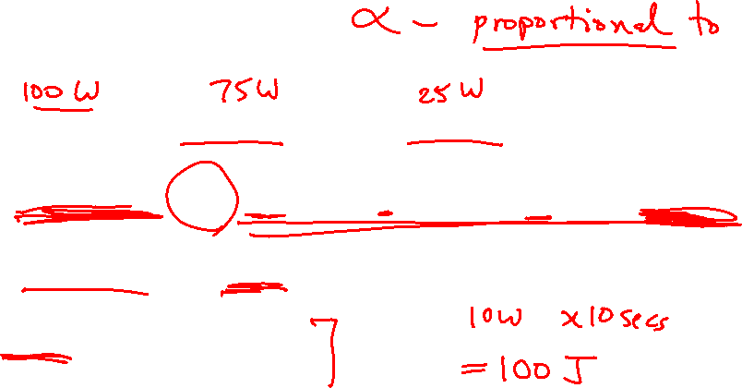
Power and Energy
Total power = dynamic power + leakage power
Dynamic power α activity x capacitance x voltage² x frequency
Leakage power α voltage
Energy = power x time
(joules) (watts) (sec)

Slide 7
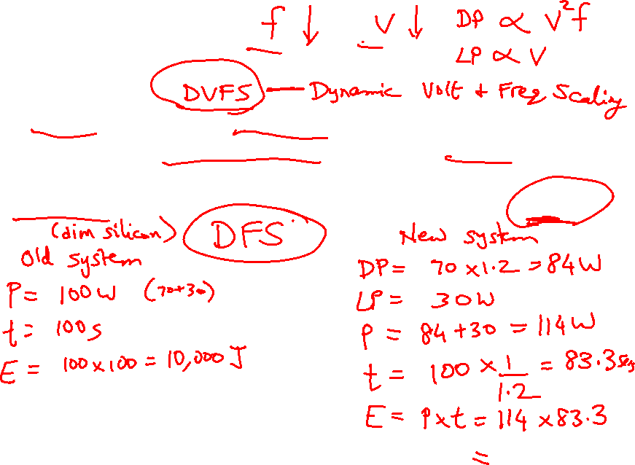
Example Problem
A 1 GHz processor takes 100 seconds to execute a program,
while consuming 70 W of dynamic power and 30 W of
leakage power. Does the program consume less energy in
Turbo boost mode when the frequency is increased to 1.2 GHz?

Slide 8
Example Problem
A 1 GHz processor takes 100 seconds to execute a program,
while consuming 70 W of dynamic power and 30 W of
leakage power. Does the program consume less energy in
Turbo boost mode when the frequency is increased to 1.2 GHz?
Normal mode energy = 100 W x 100 s = 10,000 J
Turbo mode energy = (70 x 1.2 + 30) x 100/1.2 = 9,500 J
Note:
Frequency only impacts dynamic power, not leakage power.
We assume that the program’s CPI is unchanged when
frequency is changed, i.e., exec time varies linearly
with cycle time.

Slide 9

Benchmark Suites
Each vendor announces a SPEC rating for their system
  a measure of execution time for a fixed collection of
  programs
  is a function of a specific CPU, memory system, IO
  system, operating system, compiler
  enables easy comparison of different systems
The key is coming up with a collection of relevant programs

Slide 10

SPEC CPU
SPEC: System Performance Evaluation Corporation, an industry
consortium that creates a collection of relevant programs
SPEC 2006 includes 12 integer and 17 floating-point applications
The SPEC rating specifies how much faster a system is, compared
to a baseline machine – a system with SPEC rating 600 is 1.5
times faster than a system with SPEC rating 400
Note that this rating incorporates the behavior of all 29
programs – this may not necessarily predict performance for
your favorite program!
Latest version: SPEC 2017

Slide 11
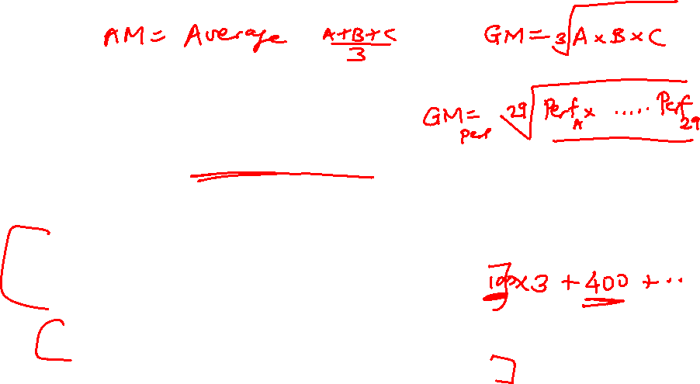
Deriving a Single Performance Number
How is the performance of 29 different apps compressed
into a single performance number?
SPEC uses geometric mean (GM) – the execution time
of each program is multiplied and the N^{th} root is derived
Another popular metric is arithmetic mean (AM) – the
average of each program’s execution time
Weighted arithmetic mean – the execution times of some
programs are weighted to balance priorities

Slide 12
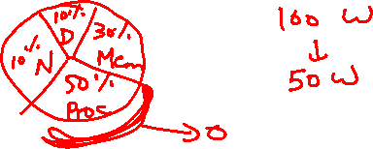
Amdahl’s Law
Architecture design is very bottleneck-driven – make the
common case fast, do not waste resources on a component
that has little impact on overall performance/power
Amdahl’s Law: performance improvements through an
enhancement is limited by the fraction of time the
enhancement comes into play
Example: a web server spends 40% of time in the CPU
and 60% of time doing I/O – a new processor that is ten
times faster results in a 36% reduction in execution time
(speedup of 1.56) – Amdahl’s Law states that maximum
execution time reduction is 40% (max speedup of 1.66)

Slide 13

Common Principles
Amdahl’s Law
Energy: performance improvements typically also result
in energy improvements – less leakage
90-10 rule: 10% of the program accounts for 90% of
execution time
Principle of locality: the same data/code will be used
again (temporal locality), nearby data/code will be
touched next (spatial locality)

Slide 14

Recap
Knowledge of hardware improves software quality:
compilers, OS, threaded programs, memory management
Important trends: growing transistors, move to multi-core
and accelerators, slowing rate of performance improvement,
power/thermal constraints, long memory/disk latencies
Reasoning about performance: clock speeds, CPI,
benchmark suites, performance and power equations
Next: assembly instructions

Slide 15
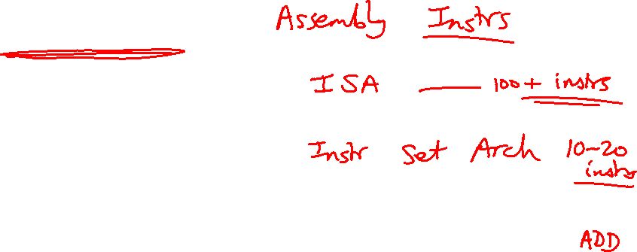
Instruction Set
Understanding the language of the hardware is key to understanding
the hardware/software interface
A program (in say, C) is compiled into an executable that is composed
of machine instructions – this executable must also run on future
machines – for example, each Intel processor reads in the same x86
instructions, but each processor handles instructions differently
Java programs are converted into portable bytecode that is converted
into machine instructions during execution (just-in-time compilation)
What are important design principles when defining the instruction
set architecture (ISA)?

Slide 16
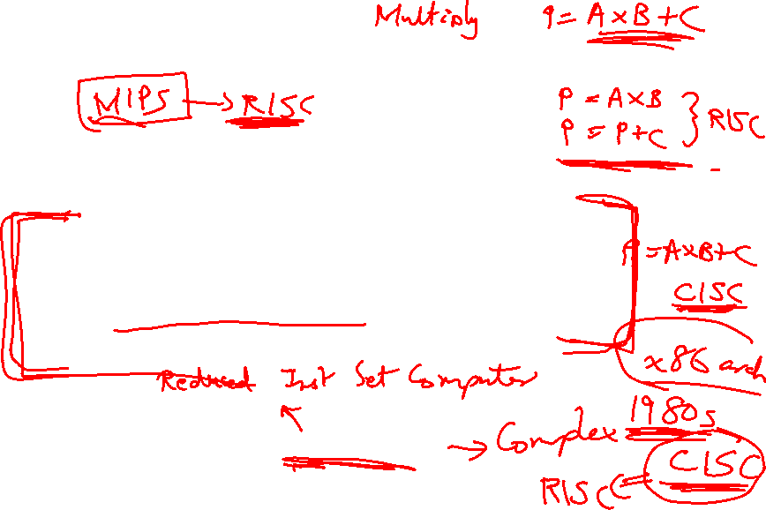
Instruction Set
Important design principles when defining the
instruction set architecture (ISA):
  keep the hardware simple – the chip must only
  implement basic primitives and run fast
  keep the instructions regular – simplifies the
  decoding/scheduling of instructions
  We will later discuss RISC vs CISC

Slide 17

A Basic MIPS Instruction
C code: a = b + c ;
Assembly code: (human-friendly machine instructions)
add a, b, c # a is the sum of b and c
Machine code: (hardware-friendly machine instructions)
00000010001100100100000000100000
Translate the following C code into assembly code:
a = b + c + d + e;

Slide 18
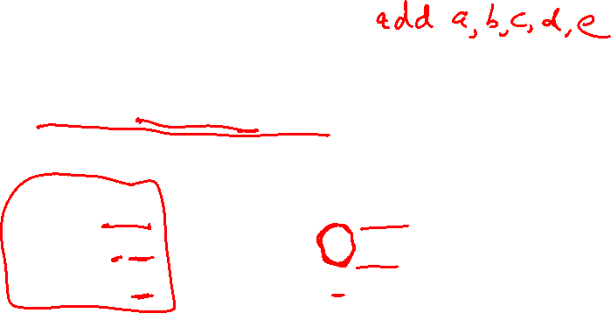
Example
C code a = b + c + d + e;
translates into the following assembly code:
add a, b, c add a, b, c
add a, a, d or add f, d, e
add a, a, e add a, a, f
Instructions are simple: fixed number of operands (unlike C)
A single line of C code is converted into multiple lines of
assembly code
Some sequences are better than others… the second
sequence needs one more (temporary) variable f

