Slide 1
Lecture 1: CS/ECE 3810 Introduction
Today’s topics:
  Why computer organization is important
  Logistics
  Modern trends

Slide 2



Why Computer Organization
Image credits: uber, extremetech, anandtech

Slide 3

Why Computer Organization
Image credits: gizmodo

Slide 4

Why Computer Organization
Embarrassing if you are a BS in CS/CE and can’t make sense of
the following terms: DRAM, pipelining, cache hierarchies, I/O,
virtual memory, …
Embarrassing if you are a BS in CS/CE and can’t decide which
processor to buy: 4.4 GHz Intel Core i9 or
4.7 GHz AMD Ryzen 9 (reason about performance/power)
Obvious first step for chip designers, compiler/OS writers
Will knowledge of the hardware help you write better and
more secure programs?

Slide 5

Must a Programmer Care About Hardware?
Must know how to reason about program performance
and energy and security
Memory management: if we understand how/where data
is placed, we can help ensure that relevant data is nearby
Thread management: if we understand how threads
interact, we can write smarter multi-threaded programs
→ Why do we care about multi-threaded programs?

Slide 6

Example
200x speedup for matrix vector multiplication
Data level parallelism: 3.8x
Loop unrolling and out-of-order execution: 2.3x
Cache blocking: 2.5x
Thread level parallelism: 14x
Further, can use accelerators to get an additional 100x.

Slide 7
Key Topics
Moore’s Law, power wall
Use of abstractions
Assembly language
Computer arithmetic
Pipelining
Using predictions
Memory hierarchies
Accelerators
Reliability and Security

Slide 8

Logistics
See class web-page
https://www.cs.utah.edu/~rajeev/cs3810
COVID reminders – follow university guidelines – lectures
also available on Zoom, but not recorded
TAs and office hours: TBA
Most communication on Canvas; email me directly to set
up office hours, or meet me right after class
Textbook: Computer Organization – HW/SW Interface,
Patterson and Hennessy, 5th or 6th edition

Slide 9
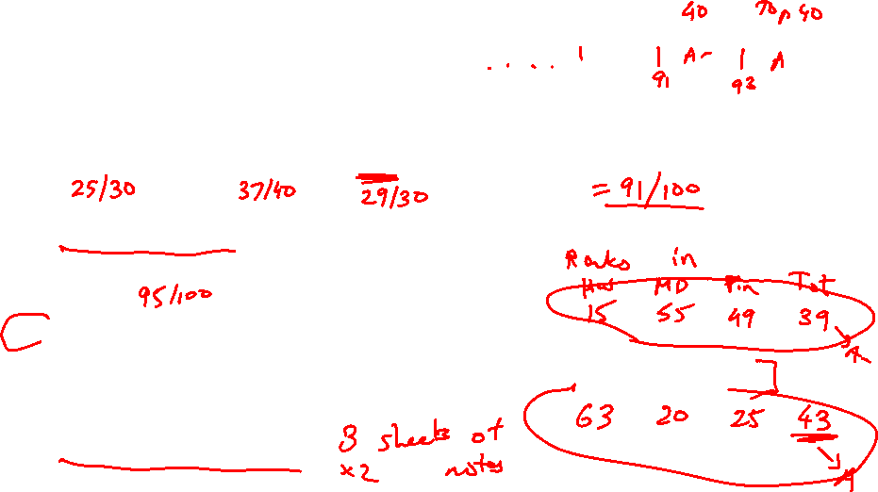
Course Organization
30% midterm, 40% final, 30% assignments
~10 assignments – you may skip two; assignments due
at the start of class (upload on Canvas)
Co-operation policy: you may discuss – you may not see
someone else’s written matter when writing your solution
Exams are open-notes
Print slides just before class
Screencast YouTube videos

Slide 10
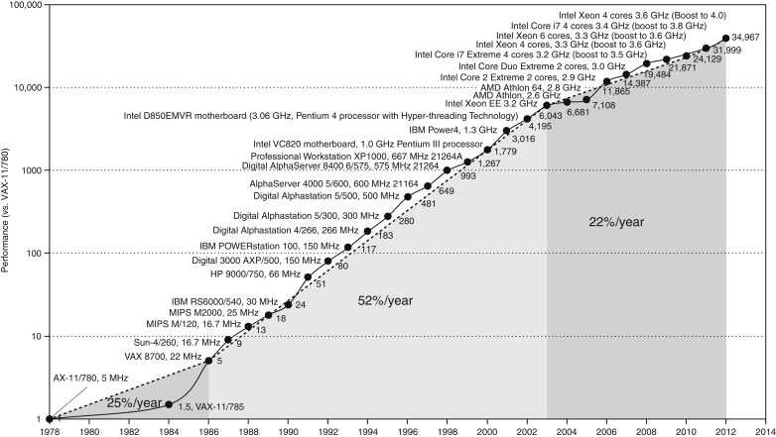
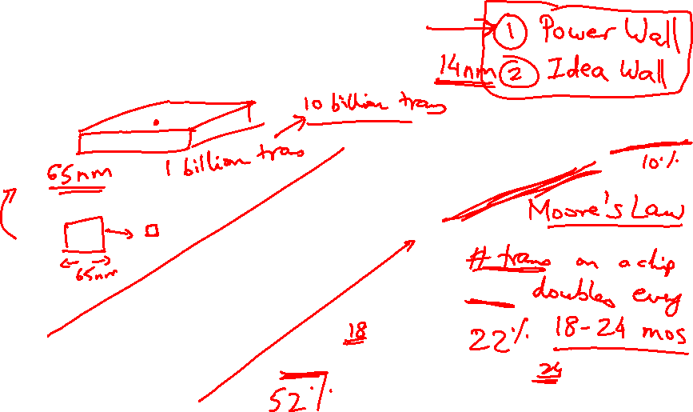
Microprocessor Performance
50% improvement every year!!
What contributes to this improvement?
Source: H&P Textbook

Slide 11
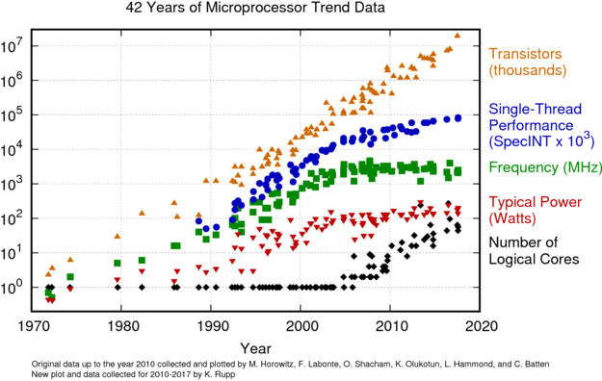
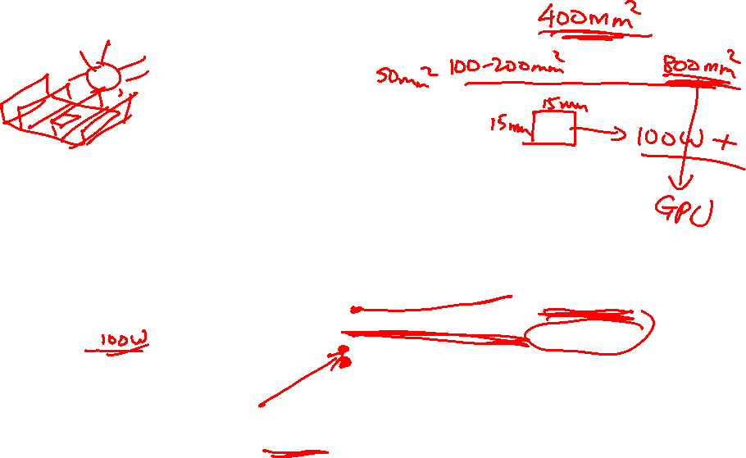
Microprocessor Performance
Source: karlrupp.net

Slide 12
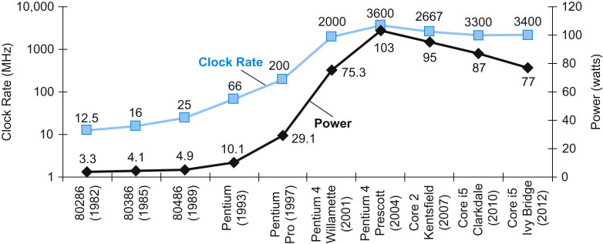
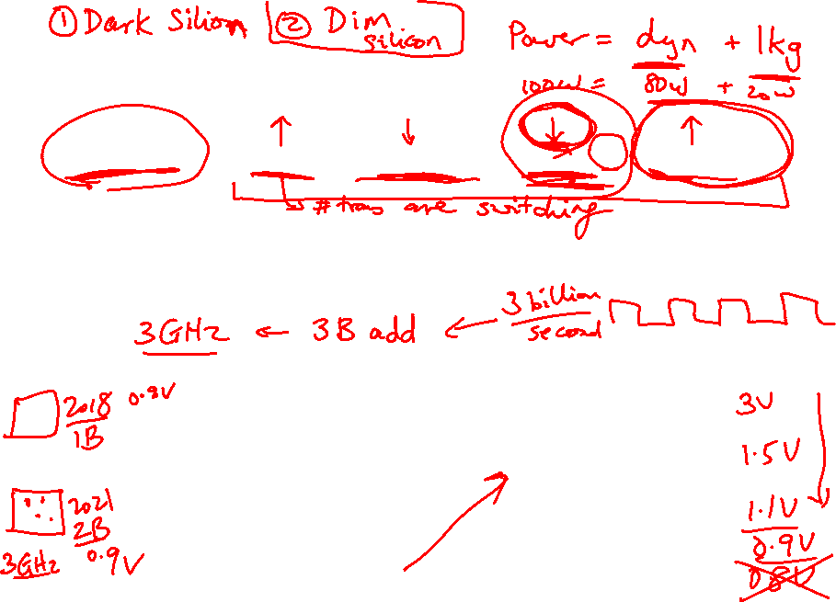
Power Consumption Trends
Dyn power α activity x capacitance x voltage² x frequency
Voltage and frequency are somewhat constant now,
while capacitance per transistor is decreasing and number
of transistors (activity) is increasing
Leakage power is also rising (function of #trans and voltage)
Source: H&P Textbook

Slide 13
Summary
Increasing frequency led to power wall in early 2000s
Frequency has stagnated since then
End of voltage (Dennard) scaling in early 2010s
Has led to dark silicon and dim silicon (occasional turbo)

Slide 14
Important Trends
Running out of ideas to improve single thread performance
Power wall makes it harder to add complex features
Power wall makes it harder to increase frequency
Additional performance provided by: more cores, occasional
spikes in frequency, accelerators

Slide 15
Important Trends
Historical contributions to performance:
  Better processes (faster devices) ~20%
  Better circuits/pipelines ~15%
  Better organization/architecture ~15%
In the future, bullet-2 will help little and bullet-1 will eventually
disappear!
Pentium P-Pro P-II P-III P-4 Itanium Montecito
Year 1993 95 97 99 2000 2002 2005
Transistors 3.1M 5.5M 7.5M 9.5M 42M 300M 1720M
Clock Speed 60M 200M 300M 500M 1500M 800M 1800M
Moore’s Law in action
At this point, adding transistors
to a core yields little benefit

Slide 16
What Does This Mean to a Programmer?
Today, one can expect only a 20% annual improvement;
the improvement is even lower if the program is not
multi-threaded
  A program needs many threads
  The threads need efficient synchronization and
  communication
  Data placement in the memory hierarchy is important
  Accelerators should be used when possible

Slide 17
Challenges for Hardware Designers
Find efficient ways to
  improve single-thread performance and energy
  improve data sharing
  boost programmer productivity
  manage the memory system
  build accelerators for important kernels
  provide security

Slide 18
Next Class
Topics: Trends, Performance, MIPS instruction set
architecture (Chapter 2)
Visit the class web-page
https://www.cs.utah.edu/~rajeev/cs3810

