Slide 1
Lecture 1: CS/ECE 3810 Introduction
Today’s topics:
Why computer organization is important
Logistics
Modern trends

Slide 2
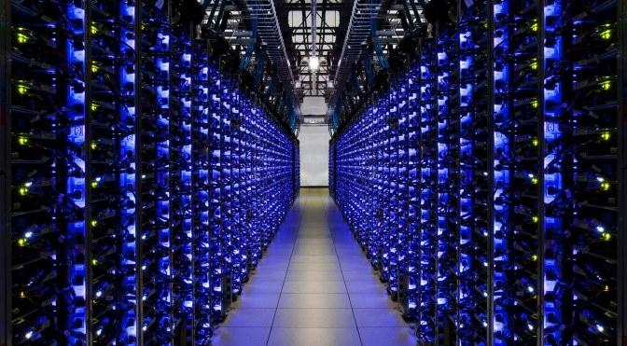
Why Computer Organization
Image credits: uber, extremetech, anandtech

Slide 3
Why Computer Organization
Image credits: gizmodo

Slide 4
Why Computer Organization
Embarrassing if you are a BS in CS/CE and can’t
make sense of the following terms: DRAM, pipelining,
cache hierarchies, I/O, virtual memory, …
Embarrassing if you are a BS in CS/CE and can’t decide
which processor to buy: 4.4 GHz Intel Core i9 or
4.7 GHz AMD Ryzen 9 (reason about performance/power)
Obvious first step for chip designers, compiler/OS writers
Will knowledge of the hardware help you write better
and more secure programs?

Slide 5
Must a Programmer Care About Hardware?
Must know how to reason about program performance
and energy and security
Memory management: if we understand how/where data
is placed, we can help ensure that relevant data is nearby
Thread management: if we understand how threads
interact, we can write smarter multi-threaded programs
→ Why do we care about multi-threaded programs?

Slide 6
Example
200x speedup for matrix vector multiplication
Data level parallelism: 3.8x
Loop unrolling and out-of-order execution: 2.3x
Cache blocking: 2.5x
Thread level parallelism: 14x
Further, can use accelerators to get an additional 100x.

Slide 7
Key Topics
Moore’s Law, power wall
Use of abstractions
Assembly language
Computer arithmetic
Pipelining
Using predictions
Memory hierarchies
Accelerators
Reliability and Security

Slide 8
Logistics
See class web-page
http://www.cs.utah.edu/~rajeev/cs3810
TAs and office hours: TBA
Most communication on Canvas; email me directly to set
up office hours, or meet me right after class
Textbook: Computer Organization – HW/SW Interface,
Patterson and Hennessy, 5th edition

Slide 9
Course Organization
30% midterm, 40% final, 30% assignments
~10 assignments – you may skip one; assignments due
at the start of class (upload on Canvas)
Co-operation policy: you may discuss – you may not see
someone else’s written matter when writing your solution
Exams are open-book and open-notes
Print slides just before class
Screencast YouTube videos

Slide 10
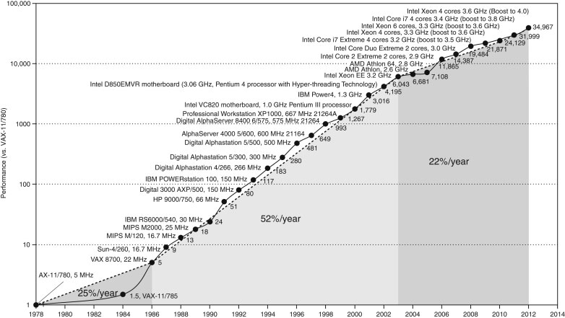
Microprocessor Performance
50% improvement every year!!
What contributes to this improvement?
Source: H&P Textbook

Slide 11
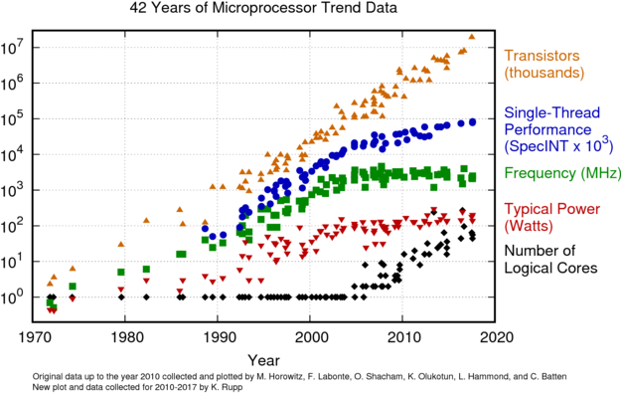
Microprocessor Performance
Source: karlrupp.net

Slide 12
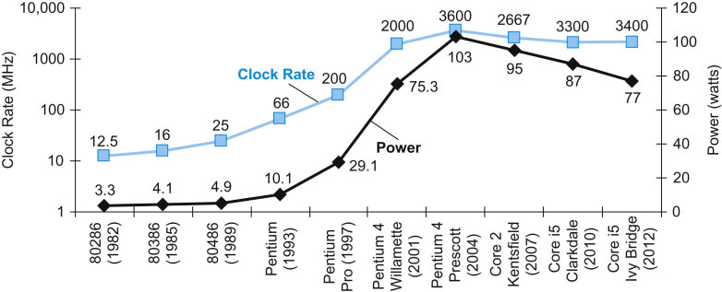
Power Consumption Trends
Dyn power α activity x capacitance x voltage² x frequency
Voltage and frequency are somewhat constant now,
while capacitance per transistor is decreasing and number
of transistors (activity) is increasing
Leakage power is also rising (function of #trans and voltage)
Source: H&P Textbook

Slide 13
Summary
Increasing frequency led to power wall in early 2000s
Frequency has stagnated since then
End of voltage (Dennard) scaling in early 2010s
Has led to dark silicon and dim silicon (occasional turbo)

Slide 14
Important Trends
Running out of ideas to improve single thread performance
Power wall makes it harder to add complex features
Power wall makes it harder to increase frequency
Additional performance provided by: more cores, occasional
spikes in frequency, accelerators

Slide 15
Important Trends
Historical contributions to performance:
Better processes (faster devices) ~20%
Better circuits/pipelines ~15%
Better organization/architecture ~15%
In the future, bullet-2 will help little and bullet-1 will
eventually disappear!
Pentium P-Pro P-II P-III P-4 Itanium Montecito
Year 1993 95 97 99 2000 2002 2005
Transistors 3.1M 5.5M 7.5M 9.5M 42M 300M 1720M
Clock Speed 60M 200M 300M 500M 1500M 800M 1800M
Moore’s Law in action
At this point, adding transistors
to a core yields little benefit

Slide 16
What Does This Mean to a Programmer?
Today, one can expect only a 20% annual improvement;
the improvement is even lower if the program is not
multi-threaded
A program needs many threads
The threads need efficient synchronization and
communication
Data placement in the memory hierarchy is important
Accelerators should be used when possible

Slide 17
Challenges for Hardware Designers
Find efficient ways to
improve single-thread performance and energy
improve data sharing
boost programmer productivity
manage the memory system
build accelerators for important kernels
provide security

Slide 18
The HW/SW Interface
Application software
a[i] = b[i] + c;
Compiler
lw $15, 0($2)
add $16, $15, $14
add $17, $15, $13
lw $18, 0($12)
lw $19, 0($17)
add $20, $18, $19
sw $20, 0($16)
Systems software
(OS, compiler)
Assembler
Hardware
000000101100000
110100000100010
…

Slide 19
Computer Components
Input/output devices
Secondary storage: non-volatile, slower, cheaper (HDD/SSD)
Primary storage: volatile, faster, costlier (RAM)
CPU/processor (datapath and control)

Slide 20
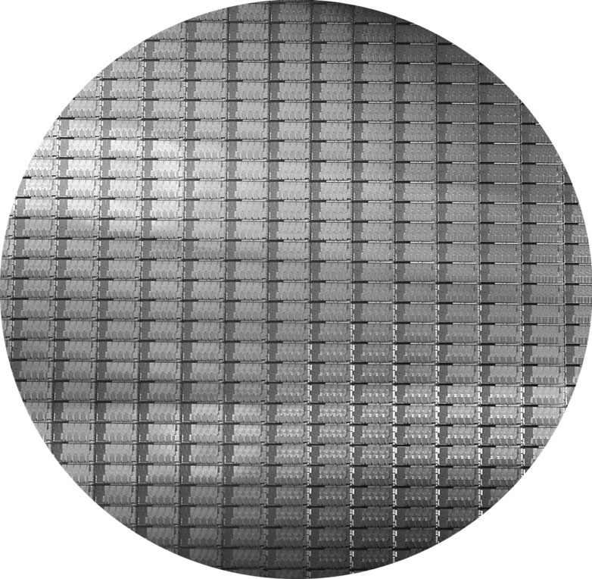
Wafers and Dies
Source: H&P Textbook

Slide 21
Manufacturing Process
Silicon wafers undergo many processing steps so that
different parts of the wafer behave as insulators,
conductors, and transistors (switches)
Multiple metal layers on the silicon enable connections
between transistors
The wafer is chopped into many dies – the size of the die
determines yield and cost

Slide 22
Processor Technology Trends
Shrinking of transistor sizes: 250nm (1997) →
130nm (2002) → 70nm (2008) → 35nm (2014) →
2019, start of transition from 14nm to 10nm
Transistor density increases by 35% per year and die size
increases by 10-20% per year… functionality improvements!
Transistor speed improves linearly with size (complex
equation involving voltages, resistances, capacitances)
Wire delays do not scale down at the same rate as
transistor delays

Slide 23
Memory and I/O Technology Trends
DRAM density increases by 40-60% per year, latency has
reduced by 33% in 10 years (the memory wall!), bandwidth
improves twice as fast as latency decreases
Disk density improves by 100% every year, latency
improvement similar to DRAM
Networks: primary focus on bandwidth; 10Mb → 100Mb
in 10 years; 100Mb → 1Gb in 5 years

Slide 24
Next Class
Topics: Performance, MIPS instruction set
architecture (Chapter 2)
Visit the class web-page
http://www.cs.utah.edu/~rajeev/cs3810

