Slide 1
Public-seed Pseudorandom Permutations
Pratik Soni
Stefano Tessaro
UC Santa Barbara
UC Santa Barbara
EUROCRYPT 2017
Notes:
Transcript:
Thank you for the introduction, Eike and thank you all for making it through yesterday’s
rump session and the early morning security checks!
Today, I will be talking about a new
definitional framework “Public-seed Pseudorandom Permutations” which is
joint work with Stefano Tessaro at UCSB.

Slide 2
Cryptographic schemes often built from generic building blocks
Typically: Block ciphers, hash/compression functions!
$$M_{1}$$
$$M_{2}$$
$$M_{ℓ}$$
$K⊕ipad$ || $M$
$$E_{K}$$
$$E_{K}$$
$$H$$
$$IV$$
$$H$$
$$K⊕opad$$
block cipher (e.g., AES)
hash function (e.g., SHA-3)
Is there a universal and simple building block
for efficient symmetric cryptography?
Notes:
Transcript:
The traditional approach to build cryptographic schemes, especially in symmetric cryptography,
is to base them on simpler building blocks. These are typically a block cipher like AES
or a hash function like SHA-3.
This design paradigm has been very successful in practice and hence applied cryptographers
have been recently asking the following question: whether there exists a simple building
block which suffices for all symmetric cryptography.

Slide 3
Recent trend: Start from seedless permutation
$$S_{0}$$
$$r$$
$$0$$
$$π$$
$$π$$
$$π$$
$$π$$
$$π$$
$$r$$
$$A$$
$$r$$
$$0$$
$$π$$
$$π$$
$$π$$
$$n −r$$
$$0$$
$$c$$
$$0$$
$$01$$
$$01$$
$$08$$
Sponge
paradigm
NORX
[AJN15]
Keccak
[BDPV08]
$$M_{0}$$
$$k$$
$$1$$
$$2$$
$$2$$
$$1$$
$$k$$
π
π
$$Z_{0}$$
$$v_{1}$$
$$2$$
$$2$$
$$1$$
$$0$$
$$M_{1}$$
$$k$$
…
$$v_{2}$$
π
π
$$π_{1}$$
$$1$$
$$0$$
$$1$$
$$k$$
$$Z_{1}$$
$$1$$
$$1$$
$$π_{2}$$
$$M_{i}$$
$$k$$
LP231
[RS08]
$$π_{3}$$
$$2$$
Farfalle
$$k$$
$$i$$
π
$$j$$
π
$$Z_{j}$$
[BDP+16]
$$w_{1}$$
Here: $π$ is an efficiently computable and invertible
one-to-one function
Notes:
Transcript:
There has been a recent trend of using a (seedless) permutation as the building block.
To cite a few examples, there are constructions of hash functions like Keccak,
a variant of which is the SHA-3 standard, and of authenticated encryption schemes,
PRFs, compression functions which use the permutation \pi as their core component where \pi
is an efficiently computable, efficiently invertible, one—one map.

Slide 4
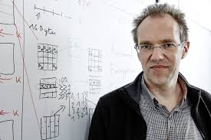
Permutations
Hashing
Garbling
MACs
KDFs
PRNGs
Authenticated
Encryption
“… it would be nice, now, if permutations
can be called
the Swiss Army Knife [of cryptography]”
— Joan Daemen, Passwords^12
Notes:
Permutations in recent times have seen many applications and therefore prominent cryptographers like,
John Daemen have gone on to call them as the Swiss Army Knives of cryptography.

Slide 5
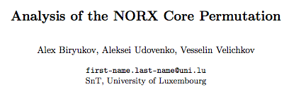
Typical instantiations
Ad-hoc construction
e.g., in $KECCAK$, $NORX$, …
Designed to withstand cryptanalysis
Fixed-key block ciphers
$$AES$$
e.g., $π :x→AES(0^{128},x)$
Faster, no re-keying costs!
$$0^{128}$$
Faster Hash functions [RS08], fast garbling [BHKR13]
Notes:
Transcript: There are 2 ways in which these permutations arise in practice:
First is via adhoc designs, constructed to withstand application-specific cryptanalysis. This approach is taken in constructions like Keccak and Norx.
Second is to use an already existing block cipher like AES and fix the key to say 0. This approach is used to build faster hash functions and fast garbling schemes.

Slide 6
Permutations assumptions
Permutations are great in practice,
but what about theory?
$$S_{0}$$
Goal: Standard-model reduction:
“If $π$ satisfies $X$ then $C[π]$ satisfies $Y.$”
$$0$$
$$π$$
$$π$$
$$π$$
$$0$$
e.g.,
$C=KECCAK$;
$Y=$ Anything non-trivial
$$X= ???$$
Observation: No standard-model proofs known for permutation-based constructions!
Common approach: Use random permutation (RP) model
$π$ is random + adversary given oracle access to $π$ and $π^{−1}$
Notes:
Permutations are great in practice but what about their theoretical foundations.
In theory, for a construction C using a permutation \pi, we would ideally like to prove a theorem like this:
If \pi satisfies some notion X, C[\pi] satisfies some security property Y.
So, the question is what notion X for the underlying permutation
suffices for proving something non-trivial like CR of Keccak?
There are no-standard models proofs for any permutation-based construction and
the only known approach is to use the RP model where the permutation \pi is
modelled as a random permutation and the adversary is given only oracle access
but to both \pi and \pi^-1.

Slide 7
But: random permutations do not exist [CGH98]
RP model proofs only yield security for generic attacks
Quite different state of affairs than for hash functions:
ideal model
standard model
Hash functions
random oracle
CRHF, OWFs, UOWHFs, CI, UCEs…
Permutations
RP
????
What cryptographic hardness can we expect from a permutation?
No one-wayness, no compression, no pseudorandomness …
Notes:
However, random permutations are ideal objects and they cannot be instantiated.
And, such ideal model proofs are only useful to give security guarantee against generic attacks
where we hope that the adversary doesn't exploit implementation specific vulnerabilities.
Note that this situation is in stark contrast to the case of hash functions where even
though RO model is popular we have an good understanding of plausible
standard model security assumptions that can be satisfied by good hash functions.
In contrast, for permutations, we don’t know of any such properties.
The question is therefore what kind of cryptographic hardness can we expect from a permutation:
Note that we cannot expect basic things like one-wayness, compression, pseudo-randomness
from permutations.

Slide 8
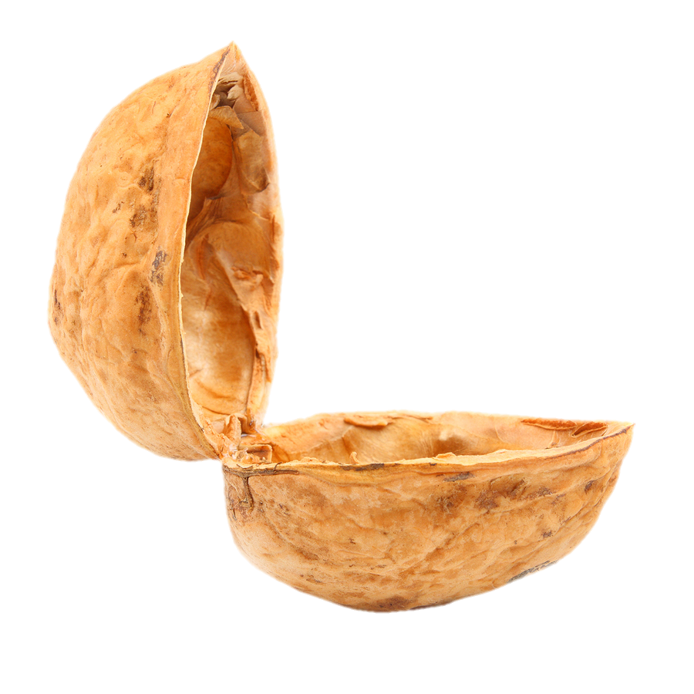
This work, in a nutshell
First plausible and useful standard-model security assumption for permutations.
“Public-seed Pseudorandom Permutations” (psPRPs)
inspired by the UCE framework [BHK13]
?
We address two main questions:
?
Are psPRPs
useful?
Can we get
psPRPs at all?
?
?
Yes!
Yes!
Notes:
So in this work, we propose the first plausible standard model security
assumptions on this useful building block permutations and show that it is very useful.
More concretely, we provide a definitional framework -- public-seed pseudorandom permutations,
psPRPs for short.
In addition we address the two fundamental questions
that any new framework should address:
1. Is the notion even feasible i.e. can we get psPRPs at all?
2. and if it so, are psPRPs even useful.
Our definitions are only a conceptual contribution as they can be easily adapted from the UCE
framework. However, we show that the notion is feasible and has interesting applications,
which is where our main technical contribution lies.
Before moving forward, I would like to give you a teaser of how we resolve these questions.

Slide 9
psPRPs have many applications
Deterministic & Hedged PKE
Immunizing
backdoored PRGs
[BHK13, BH15]
[DGG+15]
…
Feistel
Message-locked
Encryption (MLE)
$$psPRP$$
$$psPRP$$
$$UCE$$
[BHK13]
Hardcore functions (HC)
Sponges
KDM-secure
symmetric key Enc. (KDM)
[BHK13, BS16]
[MH14]
Point function
Obfuscation (PFOB)
CCA-secure Enc. (CCA)
Efficient garbling from fixed-key block-ciphers
Efficient garbling from fixed-key block-ciphers
Notes:
In this work, we show that psPRPs imply a lot of applications.
We recover some of these applications by constructing UCE hash functions which are known to
imply them from previous works. In particular, we construct UCEs from psPRPs
via existing practical constructions like the Sponge construction.
We also investigate applications that can be instantiated directly from psPRPs.
As one application we consider efficient-garbling from fixed-key BC.
And btw UCEs also imply psPRPs via the Feistel construction implying psPRPs exist.

Slide 10
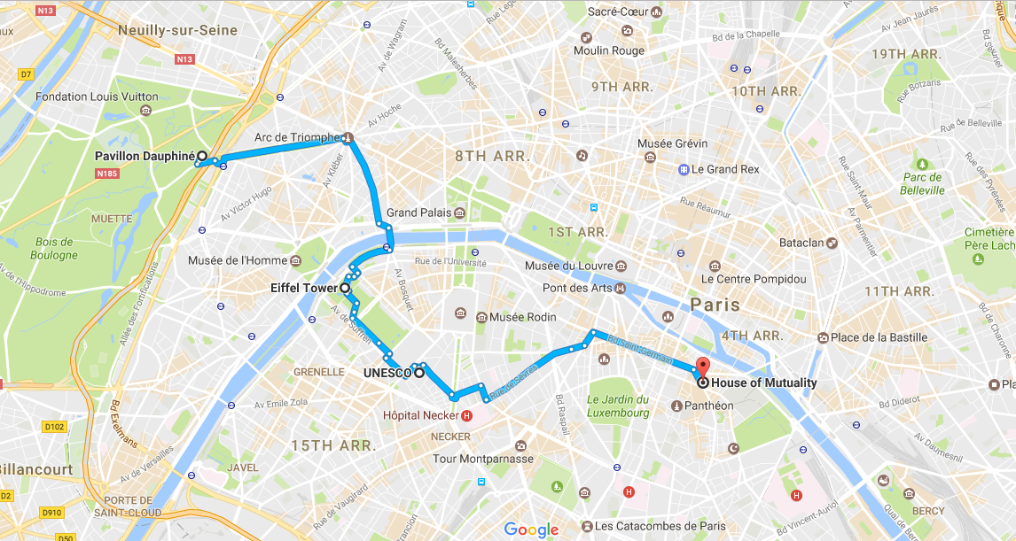
Roadmap
Definitions
Constructions & Applications
Conclusions
Co-related input hash
Functions (CIH)
Notes:
So, the plan of my talk is to define the psPRP security first then discuss the
constructions of psPRPs and its applications. Then I will conclude with some open questions.

Slide 11
We consider seeded permutations
$$π :{\left\{0,1\right\}}^{n}→{\left\{0,1\right\}}^{n}$$
$$P=(Gen,π, π^{−1})$$
Efficient (poly-time) algorithms
$$Gen$$
$$π_{s}$$
$$π_{s}^{−1}$$
$$1^{λ}$$
$$s$$
$$x$$
$$π_{s}\left(x\right)$$
$$y$$
$$π_{s}^{−1}\left(y\right)$$
Seed
generation
Forward evaluation
Backward evaluation
(1) $π_{s} :{\left\{0,1\right\}}^{n}→{\left\{0,1\right\}}^{n}$
(2) $∀x :π_{s}^{−1}\left(π_{s}\left(x\right)\right)=x$
Notes:
First observation is that, as in the complexity theoretic treatment of hash functions,
we need to extend permutations with a seed to define non-trivial security notions.
So now, our basic object is a seeded permutation P which is a tuple of
three efficient algorithms Gen, pi,pi^-1 where
Gen takes the security parameter 1^\lambda and outputs a random seed
\pi is the forward evaluation algorithm that takes in x and s and outputs y
\pi^-1 is the backward eval algorithm.
Throughout this talk, for notational convenience,
we will address to \pi with seed s as \pi_s instead.

Slide 12
Traditional security notion if seed is secret: Pseudorandom Permutation
$$s←Gen(1^{λ})$$
$$ρ←Perms(n)$$
$π_{s}$ / $π_{s}^{−1}$
$$ρ/ρ^{−1}$$
$$≈$$
5
$$D$$
$$0/1$$
Stage 1:
Oracle access
Secret seed
Stage 2:
Learns seed
No oracle access
Limited information flow
Notes:
When the seed is secret, the traditional security notion for seeded permutations is that of a pseudorandom permutation,
where an efficient distinguisher D cannot distinguish if it has been given access to
the permutation P under a random seed (as in the left world) or a random permutation \rho and its inverse (on the right).
But here the seed is kept secret!
and if we give the seed to D, then clearly the notion of PRP breaks down completely.
Now informally, to define security when the seed is public, which is what we care about.
we tear the distinguisher into two stages:
The first stage adversary plays the PRP game with the secret seed
and the second stage adversary gets the seed but has no access to the oracle,
and we allow some limited information flow between the stages.
This paradigm for defining security was first used in the UCE framework.

Slide 13
UCE security
$$h_{s}$$
$$s←Gen(1^{λ})$$
$$f$$
$$s←Gen(1^{λ})$$
$$f←Funcs(m,n)$$
$$≈$$
$$S$$
source
$$s$$
$$L$$
$$D$$
$$H=(Gen, h)$$
$$0/1$$
distinguisher
Bellare
Hoang
Keelveedhi
Notes:
UCE is a two-stage security notion for seeded hash functions.
The first stage adversary called the source is given oracle access to either
the hash function under a random seed s or a truly random function.
After making multiple queries to the oracle, S passes some leakage to
the second stage adversary called the distinguisher which in addition
learns the seed s and outputs a bit.
UCE expects that these two worlds be indistinguishable in the eyes of (S,D).

Slide 14
psPRP security
$$π_{s}/π_{s}^{−1}$$
$$s←Gen(1^{λ})$$
$$ρ/ρ^{−1}$$
$$ρ←Perms(n)$$
$$S$$
Makes forward and backward queries!
$$P=(Gen, π,π^{−1})$$
$$s$$
$$L$$
$$D$$
$$0/1$$
$P$ is $psPRP$-secure if $∀$ PPT $\left(S,D\right)$, left and right are indistinguishable.
Notes:
To define the psPRP security, we are going to adopt the same paradigm
except that S is given oracle access to a seeded permutation instead of the
seeded hash function, hence we need to handle both forward and inverse queries.
Respectively, S has access to a random permutation and its inverse instead of the random function on the right.
Then the second stage proceeds as before where D gets the leakage and seed and outputs a bit.
We say P is psPRP-secure if for all efficient S and D, the left and the right worlds are indistinguishable.

Slide 15
$P$ is $psPRP$-secure if $∀$ PPT $\left(S,D\right)$, …
$$π_{s}/π_{s}^{−1}$$
$$s←Gen(1^{λ})$$
$$ρ/ρ^{−1}$$
$$ρ←Perms(n)$$
$$≈$$
$$y$$
$$y$$
$$(+,0^{n})$$
$$(+,0^{n})$$
$$S$$
$$s$$
$$L=y$$
Outputs 1 iff
$$y=π_{s}\left(0^{n}\right)$$
$$D$$
$$1$$
with prob. 1
$$1$$
with prob. $1/2^{n}$
$psPRP$-security is impossible against all sources!
Notes:
Unfortunately, we cannot achieve psPRP security against all sources and distinguishers.
Because there exists this source which makes a forward query, denoted by the plus sign,
on a fixed input 0^n and outputs the response y as it’s leakage.
Then D receiving y and s outputs 1 iff y is the image of 0^n under \pi_s.
In the left case, D always outputs 1. In the right case, the response y is uniformly distributed and
is independent of the seed. So, D outputs 1 with prob. 1/2^n,
Therefore, (S,D) distinguish the above worlds and
hence we cannot expect psPRP security against all sources.
highlight the arrows

Slide 16
Sources need to be restricted
$$P=(Gen,π, π^{−1})$$
all sources
$$π_{s}/π_{s}^{−1}$$
$$s←Gen(1^{λ})$$
$$ρ/ρ^{−1}$$
$$ρ←Perms(n)$$
$$𝒮$$
$$S$$
$$s$$
$$L$$
$$D$$
$$0/1$$
$P$ is $psPRP[𝒮]$-secure if$∀ S∈𝒮$ and $∀$PPT $D$, left and right are indistinguishable.
Notes:
Therefore to obtain meaningful security notions, we need to restrict the set of sources.
The seeded permutation P is psPRP[S]-secure, for a class S of sources,
if now for all sources only in the class calligraphic S and all efficient D,
the left and right worlds are indistinguishable.
Note in particular that a different source class is going to give rise to a different security notion.
Therefore, psPRP is a family of notions.

Slide 17
This talk – unpredictable and reset-secure sources
all sources
reset-secure
$$𝒮^{srs}$$
$$𝒮^{sup}$$
unpredictable
Both restrictions model that $D$ cannot predict the queries made by the sources!
$${𝒮^{sup}⊆𝒮}^{srs}$$
⟹
$psPRP\left[𝒮^{srs}\right]$ is a stronger
assumption than $psPRP\left[𝒮^{sup}\right]$
Notes:
In particular we introduce two very important classes of sources namely
unpredictable and reset-secure sources. These restrictions also exist in the UCE framework.
Both these restrictions model, in different ways, the fact that $D$ cannot predict the
queries made by the sources.
Note that this ability of D to predict that sources queried on 0^n
is what made the previous attack work.
Moreover, sup is a subset of srs and hence psPRP for reset-sources
is a stronger assumption!

Slide 18
Source restrictions – unpredictability
$$(σ, x_{i})$$
$$ρ←Perms(n)$$
$$σ∈ \{+,−\}$$
$$S$$
$$ρ/ρ^{−1}$$
$$y_{i}$$
$$Q←Q∪\{\left(σ, x_{i}\right), (\overline{σ}, y_{i})\}$$
$$L$$
It should be hard for $A$ to predict any of $S$’s queries or its inverse
$$A$$
$$Q′$$
$${Pr⁡[ Q}^{′ }∩ Q≠φ]=negl(λ)$$
$𝒮^{sup}:$ $A$ is computationally unbounded
$$⊆$$
$psPRP[𝒮^{cup}]$ impossible if iO exists [BFM14]
$𝒮^{cup}:$ $A$ is PPT
Notes:
Let me define unpredictability first.
We say that S having oracle access to a random permutation \rho and \rho^-1
is unpredictable if a predictor A receiving some leakage from S and having access
to the random permutation \rho and \rho^-1 cannot predict any
of S’s queries or its inverse. This is captured by this game!
Here, A can either be computationally unbounded or bounded which gives two different notions:
statistically and computationally unpredictable sources respectively
where the statistical case is the stronger restriction.
Furthermore, we can adapt a technique due to Bruzka, Farshim and Mittlebach
and show that psPRP security corresponding to the computational notion
cannot be achieved if iO exists. Hence, we focus only on psPRP for statistical unpredictability.

Slide 19
Source restrictions – reset-security
$$S$$
$$ρ/ρ^{−1}$$
$$S$$
$$ρ/ρ^{−1}$$
$$ρ←Perms(n)$$
$$≈$$
$$ρ←Perms(n)$$
$$L$$
$$L$$
$$R$$
$$ρ/ρ^{−1}$$
$$R$$
$$ρ_{1}/ρ_{1}^{−1}$$
$$ρ_{1}←Perms(n)$$
$$0/1$$
$$0/1$$
$𝒮^{srs}:$ $R$ is computationally unbounded
$$⊆$$
$𝒮^{crs}:$ $R$ is PPT
$${𝒮^{cup}⊆𝒮}^{crs}$$
Notes:
Reset-security is an indistinguishability based notion where
S queries rho\rho^-1, outputs a leakage L to the reset adversary which gets access
to the same oracle \rho\rho^-1 in the left world. However in the right world,
S and R interact with independent permutations.
We say that source S is reset-secure if the two world are indistinguishable in the eyes of R.
As before, there are two notion, statistical and computational. The computational
notion doesn't make sense if iO exists and hence we only focus on the psPRP for statistical reset-sources.

Slide 20
Recap
$$psPRP[𝒮^{srs}]$$
$$UCE[𝒮^{srs}]$$
$$psPRP[𝒮^{srs}]$$
$$psPRP[𝒮^{sup}]$$
$$UCE[𝒮^{sup}]$$
$$psPRP[𝒮^{sup}]$$
Central assumption in UCE theory
Notes:
So, so far we have seen two new security assumptions for permutations called
psPRP for reset sources and unpredictable sources where reset-secure is
strictly the stronger assumption.
Our psPRP assumptions are mirror images of the UCE notions
against reset-secure and unpredictable sources, which are
analogously defined.
Infact, these were the central assumptions in the UCE theory and a lot of applications follow from them.
A natural question,therefore, is to investigate if psPRPs, mirror images of UCEs, also play such a central role.
We show that, infact, they do as we will see next.

Slide 21
Roadmap
Definitions
Constructions & Applications
Conclusions
Co-related input hash
Functions (CIH)

Slide 22
Next
?
Can we get
psPRPs at all?
?
Are psPRPs
useful?
?
?
Constructions from UCEs
Constructions of UCEs
Direct applications Garbling from fixed-key block ciphers
Heuristic
Instantiations
Common denominator:
A new, restricted notion of indifferentiability!
CP-sequential indifferentiability
Co-related input hash
Functions (CIH)
Notes:
So now we come back to the two fundamental questions
Can we get psPRPs at all and are psPRPs even useful which is where our
main technical contribution lies.
To address the first question, we provide both standard model constructions of psPRPs
From UCEs and practical instantiations, which we prove secure in ideal models.
For the other question, first we provide constructions of UCEs which
allow us to recover all applications of the UCE framework and as a direct application of our notions,
we are going to study garbling based on fixed-key BC.
In particular, we will first focus on these discussing these two because these reductions
between psPRPs and UCE have a common technical denominator which is a
new and restricted notion of indifferentiability -- CP-seq indiff.

Slide 23
CP-sequential indifferentiability
Indifferentiability[MRH04]
$$f←Funcs(∗,n)$$
$$A$$
$$C$$
$$A$$
$$RO$$
$$A_{1}$$
$$A_{1}$$
$$f$$
$$st$$
$$≈$$
$$st$$
?
$$A_{2}$$
$$RP$$
$$A_{2}$$
$$Sim$$
$$ρ{/ρ}^{−1}$$
$$ρ←Perms(n)$$
$$0/1$$
$$0/1$$
$C\left[RP\right]∼_{cpi} RO⇔∃$ PPT $Sim$ $∀$ PPT $(A_{1}, A_{2})$:
left and right are indistinguishable.
Remarks:
1. Full indifferentiability ⟹ CP-seq indiff.
2. Reverse ordering: seq. indifferentiability [MPS12]
Notes:
A special case of the traditional notion of indifferentiability considers a construction C
that uses RP as its primitive, where RP implements a random permutation \rho,\rho^-1.
We want C[RP] to behave like a RO and we want this in a setting where we
have A that can query the construction C and the primitive RP. However, this doesn’t make sense
as there is no RP on the right hand side. Hence indiff requires that there exist a Sim. implementing
RP, that makes these two worlds indistinguishable. This is the classical notion of indiff.
We restrict the notion even further by asking the adversary to make all of
its queries to the construction before making its queries to the primitive RP.
We say C is CP-seq indiff from RO if these worlds are indistinguishable.
It is easy to see that full indiff implies CP-seq indiff.
Furthermore, if adversary is restricted to make all its primitive queries
before its construction queries that is the reverse ordering, then this notion is called seq. indiff notion
which is incomparable to CP-seq indiff.
CP-seq indiff is an indistinguishability based two-stage security notion that asks for indistinguishability between permutation based construction C and the RO.
In the left world, the first stage dis A_1 queries the construction C. In the second stage, A_2 receives some state information and access the Primitive \rho. We refer to this system as RP for notational convenience.
In the right world, A_1 queries the random oracle RO and in the second stage A_2 queries a Sim which needs to simulate the primitive \rho and has access to RO.
We say that C[RP] is CP-seq-indiff from RO, if there exists an efficient Sim such that A_2 cannot distinguish the left and the right world. Note here, that all queries to the construction C have to be made
before the first query to the primtiive \rho.
Hence, the name CP-seq.indiff.
If we remove these restriction on the ordering of queries then we recover the full indiff notion by Maurer Renner and Holenstein. Infact, full indiff implies CP-seq indiff. The reverse ordering of queries has also been studied and is known in the literature as seq. indiff. which is incomparable to CP-seq. indiff.
Next we discuss our main reduction theorem which transforms a psPRPs into a UCE via CP-seq. indiff constructions.
<And many more places: remove clicks them from C to rho>
<remove green freehand drawing>

Slide 24
From psPRPs to UCEs
Theorem:
$$C\left[RP\right]∼_{cpi} RO$$
+
⟹
$$C[P]$$
$UCE[𝒮^{srs}$]-secure.
$P$ $psPRP[𝒮^{srs}$]-secure
$$C$$
Similar result proved in [BHK14], but:
Need full indifferentiability
Only stated for UCE domain extension
$$ρ{/ρ}^{−1}$$
$$RP$$
$$π_{s}/π_{s}^{−1}$$
Corollary: Every perm-based indiff. hash-function transforms a psPRP into a UCE!
Notes:
So, let's first look at how to construct UCEs from psPRPs using CP-seq indiff.
Given a permutation based construction C which is CP-seq indiff from RO
then on instantiating the RP in C with a psPRP-reset-secure permutation P, we get the construction C[P]
which is a UCE for reset-secure sources.
A similar result was proved in a follow-up paper
by the UCE author but they required full indifferentiability for
this theorem to go through and their theorem was in the
context of domain extension of FIL UCE to VIL UCE.
As an immediate corollary we get that a permutation-based
indifferentiable hash-function now transforms a psPRP into a UCE.
And this is good because, we know there are a lot of such hash functions.
And one such example is the sponge construction.

Slide 25
From psPRPs to UCEs – Sponges
$$M∈\{0,1\}^{∗}$$
$$M_{1}$$
$$M_{2}$$
$$M_{l}$$
$$S_{0}$$
$$r$$
$$0$$
$$y∈\{0,1\}^{r}$$
$$r$$
$$ρ$$
$$ρ$$
$$ρ$$
$$n −r$$
$$0$$
$$π_{s}$$
$$π_{s}$$
$$π_{s}$$
Theorem [BDVP08]: $Sponge[RP]$ $∼_{cpi}RO$.
Corollary: $P$ $psPRP\left[𝒮^{srs}\right]$-secure ⟹ $Sponge[P]$ $UCE\left[𝒮^{srs}\right]$-secure.
Validates the Sponge paradigm for UCE applications!
Notes:
This is the sponge construction which is the basis of the SHA3 standard.
A result by Bertoni et. al. establishes the indifferentiability of the sponge construction.
Moreover as an immediate corollary of their theorem, we can see that Sponge is also CP-seq. indiff from RO.
Therefore, if we instantiate the random permutation \rho with
a psPRP for reset-sources, we have that Sponge[P] is UCE for reset-secure.
This now validates the sponge-paradigm for UCE applications, which is a great result.

Slide 26
From psPRPs to UCEs – Chop
CP-sequentially indiff. constructions that are not fully indiff.?
truncates $n$-bits to $r$-bits
$$x∈\{0,1\}^{n}$$
$$ρ$$
$$y∈\{0,1\}^{r}$$
$$n$$
$$π_{s}$$
$$n$$
$$r$$
Theorem: $Chop[RP]$ $∼_{cpi} RF$ when $n−r∈ω(\log{λ)}$.
$Chop\left[RP\right]$ is not indifferentiable
$$psPRP\left[𝒮^{sup}\right]$$
$$UCE\left[𝒮^{sup}\right]$$
Corollary: $P$ $psPRP\left[𝒮^{srs}\right]$-secure ⟹ $Chop[P]$ $UCE[𝒮^{srs}]$-secure.
From $Chop\left[P\right]$ to VIL UCE: Domain extension techniques [BHK14]
Notes:
However, since we rely only on CP-seq. indiff. for transforming psPRPs into UCEs,
we ask if there exist simpler constructions for this task
that probably are not fully indifferentiable?
In the paper, we propose one such construction: the Chop construction,
which takes an n-bit string as input and takes the image under the permutation
and truncates the output to r-bits. This chop construction is not fully indifferentiable
but we prove that the Chop construction is CP-seq, indiff from a RF (which implements a function
sampled randomly from the set of n-bit to r-bits functions) and hence suffices
to obtain UCE for reset-source if RP is instantiated with a psPRP for reset-sources.
Infact there is more to this construction:
we show in the paper that it has a special property that allows us to obtain
UCE for unpred sources from a psPRP for unpred sources,
which is the weaker assumption. Sure, we get something weaker in terms of UCE too but it is sufficient for many applications.
Furthermore, Chop is an FIL function and to get VIL function,
one can use domain-extension techniques from previous work.

Slide 27
psPRPs from UCEs
Theorem:
$$C\left[RO\right]∼_{cpi} RP$$
+
⟹
$C\left[H\right]$ $psPRP[𝒮^{srs}$]-secure.
$H$ $UCE[𝒮^{srs}$]-secure
$$A_{1}$$
$$A_{1}$$
$$RP$$
$$C$$
$$≈$$
$$st$$
$$st$$
$$A_{2}$$
$$RO$$
$$A_{2}$$
$$Sim$$
$$b′$$
$$b′$$
Corollary: Every hash-function-based indiff. permutation transforms a UCE into a psPRP.
Notes:
Next, we address the question of constructing psPRPs from UCEs.
We note a similar reduction applies here as well.
That is given a RO-based construction C which is CP-seq indiff from a RP and H being a UCE for reset-sources
then on instantiating RO with H in C, we get a psPRP for reset-sources.
As an immediate corollary we get that a hash-function based
indifferentiable permutation now transforms a UCE into a psPRP.
One such construction is the Feistel construction.

Slide 28
From UCEs to psPRPs – Feistel
$$X_{0}$$
$$X_{1}$$
$$f_{1}$$
$$f_{2}$$
$$X_{2}$$
$$n$$
$$n$$
$$n$$
$$X∈\{0,1\}^{2n}$$
$$f_{3}$$
$$X_{3}$$
$$Y∈\{0,1\}^{2n}$$
$$n$$
$$n$$
$$n$$
$$f_{4}$$
$$X_{4}$$
$$ψ_{5}[f]$$
$$X_{5}$$
$$f_{5}$$
$$X_{5}$$
[DS16]
[DSKT16]
[HKT11]
[CPS08]
???
$$X_{6}$$
impossible
#rounds for indifferentiability
psPRPs exist in the standard model
if UCEs exist!!!
Notes:
There has been a long line of work addressing the indiff of Feistel.
The state of the art is that 8-rounds are sufficient for achieving full indifferentiability
and at least 6-round are required.
Therefore, an 8-round Feistel is sufficient to transforms a reset-secure UCE
into a reset-secure psPRP.
And this is good news because psPRPs exist in the standard model if UCEs exist.

Slide 29
Can we reduce the round-complexity of Feistel
for UCE to psPRP transformation?
This work!!!
[DS16]
[DSKT16]
[HKT11]
#rounds for CP-sequential indifferentiability
Theorem: 5-round Feistel ($ψ_{5}[f]$) $∼_{cpi}$ $RP$.
Corollary: $H$ $UCE\left[𝒮^{srs}\right]$-secure ⟹ $ψ_{5}[H]$ $psPRP[𝒮^{srs}]$-secure.
Notes:
But since, we rely only on CP-seq. indiff. We ask if a lower round number suffices for UCE to psPRP transformation?
We show that 5 is sufficient because CP-seq indiff is achieved already at 5-rounds.
Hence, as a corollary we have that 5-round Feistel transforms a
UCE for reset-sources into a psPRP for reset-sources!

Slide 30
5-round proof is technically involved
$$X_{0}$$
$$X_{1}$$
$$f_{1}$$
Our 5-round Sim:
detect
detect
$$f_{2}$$
$$X_{2}$$
Relies on chain completion techniques
$$f_{3}$$
$$X_{3}$$
Heavily exploits query ordering
$$f_{4}$$
$$X_{4}$$
forceVal
forceVal
$$X_{5}$$
Very different chain-completion strategy from previous works, no recursion needed
Set
uniform
Set
uniform
$$f_{5}$$
$$X_{5}$$
$$X_{6}$$
Open: Do 4-rounds suffice?
This work!!!
[DS16]
[DSKT16]
[HKT11]
???
[LR88]
impossible
#rounds of Feistel for psPRP-security
Notes:
The Feistel result is the most technically involved result of the paper.
However, I won’t be able to go in further details but I invite you to look into the paper.
For people working on indiff. of Feistel, our Sim relies on the chain completion techniques
in previous work but we have to develop new completion techniques to get
away with a low round number and in the process we heavily exploit the fact
that distinguisher cannot make any construction queries after making a primitive query.
Moreover, an interesting open question is if 4-rounds suffices for psPRP-security.
We know that 4-rounds are necessary due to LubyRackoff’s result.

Slide 31
Heuristic Instantiations
From Block-ciphers e.g. AES
$$π:$$
$$E$$
$$P=$$
$$(Gen,π, π^{−1})$$
$psPRP\left[𝒮^{srs}\right]$-secure
Ideal-Cipher model
$$Gen:$$
$$s←\{0,1\}^{k}$$
From Permutations e.g. the Keccak permutation
$$π:$$
$$P=$$
$$(Gen,π, π^{−1})$$
$$π$$
$psPRP\left[𝒮^{sup}\right]$-secure
RP model
$$Gen:$$
$$s←\{0,1\}^{k}$$
Notes:
So far we have seen how to instantiate psPRPs via Feistel.
But this is probably not how we are going to come up with candidates for psPRPs in practice.
In practice, for example, we would like to use a block-cipher. A natural way
natural way to obtain psPRPs from BC is using the key of the BC as the seed of the permutation.
We validate this construction to be a psPRP in the IC model.
Another primitive that we start from are these practical constructions of permutations
like the Keccak permutation. Unfortunately, they don’t have a seed.
We show that the natural way to seed such permutations i.e. via the
EM cipher is a another good way to get a psPRP but in the RP model.
Note that we can validate these constructions only in ideal models due to the lack of standard model
assumptions on BC and \pi.

Slide 32
Fast Garbling from psPRPs
$x_{a}^{0}$, $x_{a}^{1}$
And
$x_{g}^{0}$, $x_{g}^{1}$
Fast garbling from [BHKR13]
$$x_{b}^{0},x_{b}^{1}$$
Only calls fixed-key block cipher $x→E(0^{k},x)$
Garbled And
$E\left(0^{n},K_{10}\right)⊕K_{10}⊕x_{g}^{0}$
$E\left(0^{n},K_{01}\right)⊕K_{01}⊕x_{g}^{0}$
$E\left(0^{n},K_{11}\right)⊕K_{11}⊕x_{g}^{1}$
$E\left(0^{n},K_{00}\right)⊕K_{00}⊕x_{g}^{0}$
Very fast – no key-schedule
Proof in RP model
This work: Replace $E\left(0^{k},x\right)$by $π_{s}$for a random seed generated upon garbling.
Theorem: Secure garbling when $π_{s}$ is $psPRP[𝒮^{sup}]$.
Notes:
For an immediate application of psPRPs, we study the important problem of efficient garbling which has applications as far as MPC.
More concretely, we focus on the permutation based construction by
Bellare, Hoang, Keelveedhi and Rogaway 13.
Their schemes are very fast as they make calls only a fixed-key BC
but unfortunately they prove them secure in RP model.
We show that if instead of using a fixed-key AES, one uses a psPRP by picking a seed at random
for every garbling, we get a garbling scheme which is secure in the standard model
and is almost as efficient as BHKR.
This shows that psPRPs are
useful beyond just recovering the applications of UCEs.

Slide 33
Roadmap
Definitions
Constructions & Applications
Conclusions
Co-related input hash
Functions (CIH)

Slide 34
Conclusion
psPRPs
First standard model assumptions on permutations
Constructions
Applications
psPRPs
Notes:
In conclusion, in this work we introduce psPRPs a definitional framework that
proposes the first standard model assumptions on permutations. On the technical front,
we show that psPRPs are feasible notion and that they imply
a lot of applications.

Slide 35
Many open questions…
?
psPRPs:
?
More applications: psPRP-based PRNGs, authenticated encryption?
?
?
More efficient constructions: Round complexity of Feistel for psPRPs?
Public-seed Pseudorandomness - general paradigm:
Applications of public-seed Ideal Ciphers?
Beyond psPRPs:
Simpler assumptions on permutations?
Is SHA-3 a CRHF under any non-trivial assumption?
Thank you!
Notes:
However, there are many open questions:
investigating if psPRPs can enable
PRNGs or authenticated encyption schemes in the standard model.
A more concrete question is to resolve the round complexity of Feistel for constructing
psPRPs. We showed that 5 is sufficient.
In the paper we show that psPRPs and UCEs follow from a general paradigm of public seed pseudorandomness,
which allows to extend any ideal primtives with a seed and hence define
standard model assumptions for them. Another primtiive would be a public-seed ideal cipher.
Exploring applications of this primitive is another direction.
psPRP is a strong notion so the obvious question is of defining simpler
assumptions on permutations that say suffice to prove CR of SHA3.
Thank you!

