Slide 1
Naor-Reingold Goes Public:
The Complexity of Known-key Security
Pratik Soni
UC Santa Barbara
Stefano Tessaro
UC Santa Barbara
EUROCRYPT 2018
Tel-Aviv, Israel
Notes:
Thank you for the introduction Christian.
Thank you everyone for staying for the last session of the conference.
This talk is about the relatively unexplored foundations of block ciphers in the known-key setting and is joint work with Stefano Tessaro.
Feedback:
A general comment is that you are saying too much and going round and round.
Also, there is way too much math so either do things graphically or go slow in the delivery while showing math!
You are asking too many questions in the delivery.... Just say things directly

Slide 2
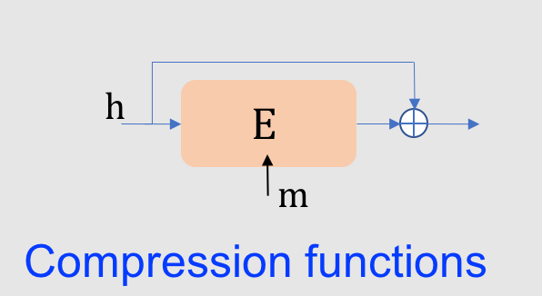
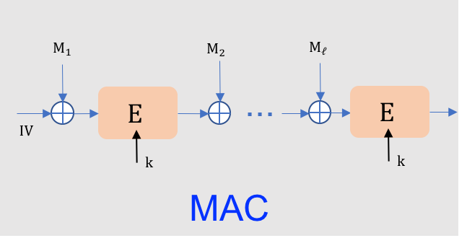
Block ciphers are crypto’s workhorses!
$E$ : family of efficiently computable, invertible permutations
$$u∈{\left\{0,1\right\}}^{n}$$
$$E$$
$$v∈{\left\{0,1\right\}}^{n}$$
$$E^{−1}$$
$$u∈{\left\{0,1\right\}}^{n}$$
$$k$$
$$k$$
$$M_{1}$$
$$M_{2}$$
$$M_{ℓ}$$
$$E$$
...
$$E$$
$$IV$$
$$k$$
$$C_{l−1}$$
$$k$$
$$C_{l}$$
$$C_{1}$$
Encryption
. . .
PRNGs, PRFs, AE, Garbling,...
Notes:
A block cipher E is a family of efficiently computable, efficiently invertible permutations over a finite block-length.
They are used ubiquitously within encryption schemes, message authentication codes, compression and hash functions, prfs and garbling schemes to name a few...
TODO:
[Clean up the figures]

Slide 3
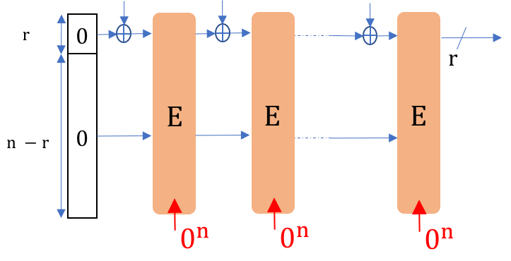
“Good” block cipher?
Unpredictability
Key-recovery security
. . .
. . .
Secret-key
setting
Related-key security
Pseudorandomness
Adversary doesn’t know k!
But, E is also used in apps where Adv. knows $k$
$$h$$
$$E$$
Known-key
Setting
$$m$$
For every $k$,
$E_{k}$ is random
Compression function
Permutation-based crypto
E behaves like an ideal cipher
Notes:
the question is what is a secure block-cipher?
Often, security needs to hold with respect to a secret key and this setting is well understood.
But, there are many applications where the key is not kept secret, for example the design of compression functions. Also many constructions like the sponge paradigm, which underlies SHA-3, are based on permutations which can be thought of as a special case of a block cipher where the key is fixed to a specific value and hence known to the adversary.
We refer to this setting as the known-key setting where
security proofs are given in the ideal cipher model.
[assuming E is an ideal cipher]
[in the ideal cipher model.]
TODO:
Clean up figures
So, it is extremely essential to assess properties a block cipher is expected to satisfy when used in such applications. Previous attempts to formalize this have largely been considered in a setting where a randomly chosen key is kept secret from the adversary and then you ask E to be unpredictable, pseudorandom or related-key secure.
This is in sharp contrast to how block ciphers are used in practice, where adversary not only get to learn the key but worse it can even influence the choice of the key as in DM compression function.
Another extreme example is the permutation-based sponge paradigm which has inspired the design of the SHA-3 standard. Here, one can instantiate the underlying permutations with a block cipher by fixing its key to say zero, resulting in a setting where E is used with a fixed publicly known key. In this setting, which we call as the known-key setting formalizing properties that good block ciphers should satisfy has been challenging... for instance all the secret-key notion do not apply.
General approach in applications is then to assume that E is an ideal cipher -- which is a block cipher that is a independent random permutation on each key.
Feedback:
Check the border around the figures

Slide 4
“Good” block cipher in known-key setting?
E behaves like an ideal cipher
Indifferentiability
[MRH04]
Too strong for apps
Expensive to achieve
Loose concrete security
Complicated proofs
Ideal-model property
This work:
Weaker yet
useful notions
Possibly better efficiency & security
Potentially
standard model
Correlation Intractable
Ciphers
[KR07, MPS12]
Public-seed Pseudorandom
Permutations
[ST17]
Notes:
The property that guarantees that a construction behaves like an ideal cipher is that of indifferentiability.
Although popular, indifferentiability has its limitations. For example, often it is too strong for specific applications, underlying bounds are weak, its expensive to achieve and more importantly
it only makes sense in ideal models.
In this work we instead seek for notions that are weaker but sufficient for a wide range of applications,
potentially standard model,
which possibly provide better security and
hopefully for which we have efficient constructions.
The only two notions
that have been studied in the known-key setting are
Correlation intractable ciphers and public-seed pseudorandom permutations.

Slide 5
Correlation Intractable Ciphers [KR07, MPS12]
Infeasible to find input-output pairs satisfying “sparse” relations
even when key is known!
e.g., $\left(u,v\right)∈ R$
if $u=v$
Evasive relations
Collision-resistant hash,
Fiat Shamir instantiation...
e.g., $E_{k}(u)=u$
psPRPs & CI Ciphers are good design goals...
... but can we build them?
Efficiently?
Public-seed Pseudorandom Permutations (psPRPs) [ST17]
Indistinguishable from a random permutation
even when key is made public later!
Garbling, UCE, Point func obfuscation,
CCA enc, Immunizing backdoored PRNGs...
Notes:
Very informally, Correlation intractable ciphers are block ciphers
for which for a known, randomly chosen key it is infeasible to find input-output pairs that
satisfy some sparse relations, for example the fixed-point relation.
We refer to such relations as evasive which I will define later.
and public-seed pseudorandom permutations or psPRPs for short are block ciphers which remain indistinguishable from a random permutation in some specific sense even when the key is made public.
Variants of both these ciphers imply interesting applications making them good design goals.
Yet the complexity of building such ciphers is not well understood which is the focus of our work.

Slide 6
Our goal: Block cipher constructions
$$H$$
$$E$$
Non-invertible function
Block cipher
This work:
2 calls are sufficient!
psPRPs
(5 calls [ST17])
CI ciphers
(6 calls [MPS12])
Focus is on complexity: # calls to $H$
(theoretically) well understood in the secret-key setting
[LR88, Ohn88, Kor89, ZMI89, Pat90, Pie90, Pat91, SP91, Pat92, SP92 , Mau92,
Luc96, NR97, Vau98, Pat98, PRS99, RR00, Pat01, MP03, Pat03, Pat04, HR10]
Notes:
More precisely we are interested in block cipher constructions that rely on a non-invertible function H as the core cryptographic primitive.
Also, we are interested in complexity, that is the number of calls that E makes to H. This is well studied in the secret-key setting. In the known-key setting we are aware of only two isolated results requiring 5-calls to construct psPRP and 6-calls to construct a Correlation intractable cipher.
Here, we give constructions for both that make only 2-calls.

Slide 7
Naor-Reingold (NR) construction [NR97]
$$x_{1}$$
$$x_{2}$$
$$P_{k_{1}}$$
$$P_{k_{2}}^{−1}$$
$$u∈{\left\{0,1\right\}}^{2n}$$
$$H_{k^{′}}(0||⋅)$$
$$H_{k^{′}}(1||⋅)$$
$$v∈{\left\{0,1\right\}}^{2n}$$
$$x_{0}$$
$$x_{3}$$
$$NR[P,H]$$
$P_{k}$: $2n$-bit permutation
$H_{k}$: $(n+1)$-bit to $n$-bit function
Notes:
In particular we are going to follow the NR construction
which is a two-round feistel network sandwiched between two permutations.
The feistel round functions are obtained by keying a function H and prepending 0 and 1 to the two calls to H on x1 and x2 respectively and the permutations are sampled from a family P.
Feedback:
Say: two-round feistel which takes as input 2n-bit string x0 || x1 and outputs x2 || x3.
Not mentioning u and v here?
Previous delivery:
Our starting point is the construction due to Naor and Reingold in 1997 which we will refer to as the NR construction.
It takes a 2n-bit input u, computes the image (x0,x1) of u under the permutation P with key k1.
Then calls H on key k and input x1, xoring the result with x_0 to generate x2.
Then it makes its second call to H_k on x_2 to generate x3. Finally, the output v is the image of (x3,x2) under P^-1 with another key k2.
An easy way to think of the construction is that its a two-round feistel sandwiched between two permutations.

Slide 8
Naor-Reingold (NR) construction [NR97]
Thm [NR97]:
+
$H=$ PRF
$NR=$ PRP
$P=$ pairwise ind.
non-cryptographic
property
This work: NR retains meaningful security
in known-key setting!*
(*For appropriate $P$ and $H$)
Notes:
NR showed that when P is a family of pairwise independent permutations and H is a PRF
then the construction is a pseudorandom permutation.
Pairwise independence is a cheap, combinatorial
requirement which can be satisfied unconditionally. So, NR requires only 2-calls to a
cryptographically hard primitive! and is the most efficient known approach to build a block
cipher in the secret-key setting.
We show that NR construction retains meaningful security even in the known-key setting,
under appropriate assumptions on P and H.
Feedback:
Should we have secret-key setting written here?
Most optimal known approach?

Slide 9
Our contributions: NR goes public
Theorem 1:
+
public-seed
PRP
$P=$ pairwise ind.
$$H=$$
UCE
$$NR=$$
Equivalently, public-seed PRFs
Universal Computational Extractors
[BHK13]
non-cryptographic
property
Theorem 2:
public
random
function
CI for
evasive
relations
+
$$H=$$
???
$P=$ $α$-wise ind.
$$H=$$
$$NR=$$
$P=$ $???$
($α$ = sufficiently large)
Notes:
First, we show that NR is a public-seed PRP when H is a
Universal Computational Extractor or UCE for short.
Analogous to psPRPs, UCEs are hash functions that are
indistinguishable from a random function even when the
key is made public later. So, they are just public-seed PRFs.
Next, we show that NR is CI for so called evasive relations when
H is a public random function and P satisfies some strong but combinatorial properties
that I will explain later. Although it is not clear that CI for block ciphers is impossible in the standard model, following previous work we prove CI under ideal assumptions on round functions. And getting standard model results is an interesting open question.
[satisfies stronger but still a non-cryptographic
property that of being a \alpha-wise independent permutation for a sufficiently large \alpha.]
(So these are just public-seed PRFs. Is this important?)
(Under some appropriate stronger combinatorial assumption that it is CI for a large class of relations that I will explain later)
[remove k^2-wise or k-ary that involves k input/output pairs or just state k-ary relations]
Questions:
What k = O(1)
What are the bounds?
Why k^2?
Why almost?
[Is the first line necessary?]
Aux info:
Unlike the case of hash functions, it is not clear if CI for block ciphers is impossible in the standard model and infact recent positive results
for CI of fixed-input length hash functions gives hope that we can achieve the same for block ciphers.
Interestingly, we are not aware of any attacks for the NR construction for super-constant arity relations
and attacks or a proof for the super-arity case is an interesting direction.
Unlike the case of hash functions, it is not clear that CI of block ciphers is impossible in the standard model and for lacking of knowing better we follow previous work and consider ideal model assumptions.

Slide 10
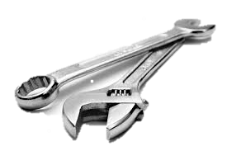
Our techniques: NR goes public
Theorem 1:
+
public-seed
PRP
$P=$ pairwise ind.
$$H=$$
UCE
$$NR=$$
Borrow techniques from
black-box separations [IR89, BMG09]
Theorem 2:
public
random
function
CI for
evasive
relations
+
$$H=$$
$$NR=$$
$P=$ $α$-wise ind.
($α$ = sufficiently large)
New framework:
unconditional CI Amplification
Notes:
The techniques used to prove the first theorem are very different than in the secret-key setting.
In particular, we had to resort to techniques from black-box separations of which
we believe ours is the first constructive application.
Our second theorem relies on a new framework that amplifies CI unconditionally.
TODO?
The flow seems abrupt as its talks about thm1 then thm2 and then techniques for thm1 and thm2.

Slide 11
Coming up next...
NR is correlation intractable
NR is public-seed
pseudorandom permutation
Conclusion
Notes:
In the rest of the talk, I want walk you through the two results starting with CI first.

Slide 12
Correlation Intractable (CI) ciphers [KR07, MPS12]
For relation $R$:
A wins if $$\left(u,v\right)∈ R ∧ v=E_{k}^{H}\left(u\right)$$
A wins if $$\left(u,v\right)∈ R ∧ v=E_{k}\left(u\right)$$
$$H$$
random
$$k$$
Challenger
Adversary A
$$(u, v)$$
$E$ is CI for $R$
if $∀$ PPT A, Pr[A wins] = negl.
$$\left(0,E_{k}\left(0\right)\right)∈R$$
$$\left(E_{k}^{−1}(0),0\right)∈R$$
$\left(u,v\right)∈R$ if $u=0$
$∀ R$?
$\left(u,v\right)∈R$ if $v=0$
Notes:
Time : 1m 40s
Intuitively I already said what is correlation intractability. More formally, it is defined w.r.t.\ a relation R and is captured by the following game where an adversary A receives a randomly chosen block cipher key k and wins if it finds a pair (u,v) in the relation R such that v is the output of the block cipher under key k and input u.
E is CI for this relation, if the winning Pr of a probabilistic poly time A is negl. As we consider CI in ideal models, we allow E to depend on H which is modelled as a public random function and A is given oracle access to H.
One needs to be careful here, as CI is not achievable for all relations. For example relation that contains all tuples of the form (0,v) is trivial to satisfy as adversary can simply evaluate the cipher on 0.
But, because block-ciphers are also efficiently invertible the relation that contains tuples of the form (u,0)
are also easy and this is unlike the case of hash functions where such a relation is infact considered a good target for CI.
Feedback:
Directly saying CI for R is abrupt? CI is usually defined w.r.t. relation R as is modelled by the following game
Does saying there are obvious relations that are easy gives feeling that CI for such relations is easy?
E is missing here...
Mention: that the key is known
For what relations can we expect CI is a subtle issue.
[Skip this:CI block ciphers are inspired by the notion of CI hash functions
introduced by Canetti, Goldreich and Halevi.]

Slide 13
Evasive relations
hard to satisfy for a random permutation
Interesting evasive relations:
$$\left(u,v\right)∈R$$
$R$ is evasive if $Pr\left[\left(u,v\right)∈R\right]=negl.$
if $u=v$ (fixed-point relation)
$$ρ←Perms(n)$$
if $u⊕v=c$
$$ρ/ρ^{−1}$$
if $v^{2}=u^{3}+au+b$
$$…$$
$$\left(u,v=ρ(u)\right)$$
PPT
“$∀ u$, the fraction of $v$ s.t. $\left(u,v\right)∈R$ is negl.
and vice versa!”
Notes:
Here, we restrict our focus on relations
that we call evasive
which more formally are relations
that are hard for an efficient adversary A
to satisfy given access to a random permutation
and its inverse.
Interesting examples are fixed-point relation which consists of all tuples where u equals v or
more generally a relation that requires the xor of u and v to be a fixed constant c. Another example is the relation that contains all points on a elliptic curve and so on...
Combinatorially, this means that for any u, the fraction of v’s such that (u,v) is in the relation is negl and vice-versa.
[Byheart this to the word]
More formally, R is evasive if no PPT adversary having access to a random permutation \rho and its inverse can find a tuple (u,v) in R such that v = \rho(u).
Feedback:
Here already you can introduce the fixing notation you used while defining green blob.
Fix u and show a red box for v and similarly the other way around.

Slide 14
$k$-ary evasive relations
involve $k$ input/output pairs
$$\left\{\left(u_{1},v_{1}\right), \left(u_{2}, v_{2}\right),…, \left(u_{k},v_{k}\right)\right\}∈R$$
Applications of CI for k-ary evasive relations:
$$k=1$$
(Unary)
Fiat Shamir transform
instantiation
$$k=2$$
(Binary)
Collision resistant
compression function
Notes:
We looked at relations that involve only one input/output pair. Ofcourse this can be generalized to k-ary relations which involve k input/output pairs.
CI for k-ary evasive relations has important applications:
CI for unary evasive relations (k=1) implies one can securely instantiate the Fiat-Shamir transform,
for binary relations it implies that certain block-cipher based compression functions are collision resistant and so on...
Now... Looked at one input pair, generalized to k-ary evasive relations.
Relations for which CI implies block-cipher based compression functions is collision resistance.
These relations involve only one input-output pair. But one can also
think of useful relations involving more than one pair.
For example the binary relation which expects the xor of two distinct u1,u2 to be equal to the xor of v1,v2.
[Infact satisfying this relation has been common target of cryptanalytic attacks in the known key setting.]
Or there are more complicated relations, CI against which imply that certain compression functions are CR.
Ideally we would like k = arbitrary but many constructions just make a small number of calls to the underlying block cipher so a constant k suffices.
(Fiat Shamir, CR-hash functions of compression functions or Davis Meyer?, cite the paper)
== relations involves k input/output pair has many applications

Slide 15
# calls to $H$ for CI?
[DS15]
8-rnd Feistel
$k$ = arbitrary
Indifferentiability
8 calls
[MPS12]
6-rnd Feistel
$k$ = arbitrary
Sequential
Indifferentiability
6 calls
[MPS12]
5-rnd Feistel
$$k≥4$$
5 calls
[This work]
NR
$k$ = O(1)
Unconditional
CI Amplification
2 calls
sufficient for
most applications
Notes:
There has been some work on building correlation intractable ciphers.
Indifferentiability is well-known known to imply CI and
hence by a recent result 8-rnd Feistel (making 8-calls to H)
is correlation intractable for arbitrary arity evasive relations.
Infact, for correlation intractability a weaker variant called
sequential indifferentiability suffices, which is satisfied by
the 6-rnd Feistel, reducing the required number of
calls for CI to 6.
On the negative side, 5-rnd Feistel construction is not CI for 4-ary relations.
As we saw before,
here we reduce the number of calls to just 2
by showing NR is CI and
CI we achieve is for only constant arity evasive
relations which is sufficient for most applications.
As mentioned before our result follows from a new framework -- unconditional CI amplification
In this work, we reduce the number of calls to just 2 by showing
that NR is CI for any constant ary relation. Our result is follows from a new framework
called unconditional CI amplification.
Here you can show 2-calls first and then say the previous works!
This is an advantage over previous work
AS I mentioned before this relies on a general technique – unconditional CI amplification!

Slide 16
Main technique: unconditional CI Amplification
Step 1
Evasive rels
Thm:
$E′$ is CI for
$E$ is CI for
$$R$$
$$R_{π,σ}$$
Pf:
$$R_{π,σ}∈$$
$$∀ R∈$$
(w.h.p.)
Step 2
$π,σ$: limited-independence perms
, description part of E’s key
$$\left(u,v\right)∈R$$
$$π$$
$$E_{k^{′}}^{′}$$
$$σ^{−1}$$
$$π(u)$$
$$σ(v)$$
$$u$$
$$v$$
$$R_{π,σ}=\left\{ \left(π\left(u\right), σ\left(v\right)\right) :\left(u,v\right)∈R\right\}$$
Suffices
to show:
$R_{π,σ}$ is hard for $E_{k}$
$R$ is evasive
Notes:
Let me now describe the framework.
We are given a blockcipher E’ which is CI for a subset of
evasive relations shown by the green oval,
we want construct a blockcipher E which is CI for all evasive relations.
Consider an E that pre-processes
the input and post processes the output of E' with a permutations \pi and \sigma^-1
respectively where \pi,\sigma are ltd independence perm
whose description is known to the adv.
If it is easy to find an input/output pair (u,v) of E that is in some relation R then the tuple (\pi(u), \sigma(v)) which is an input/output pair of E' is in the derived relation R_\pi,\sigma.... obtained by
applying pi and sigma to all u and v in R.
So, if we can show for every evasive relation R,
with overwhelming probability over the choice of \pi and \sigma the derived relation
R_\pi,\sigma is hard for the inner block
cipher then R is hard for E, implying CI of E.
This left-hand side implication is really just a combinatorial
argument and the challenge is that this must hold
even when \pi and \sigma are just limited-independence
permutations and their complete description is given to the adversary as part of block cipher E's key.
There are two steps involved when applying this framework.
Step 1: Determine the set of relation hard for a given E' and Step 2 is to prove the left implication.
Feedback:
E is missing
second and third para can be optimised
R hard for E' and E' is CI for R are used in place of each other, is this confusing?

Slide 17
NR is correlation intractable
$$x_{1}$$
$$x_{2}$$
$$π$$
$$E_{k^{′}}^{′}$$
$$σ^{−1}$$
$$π$$
$$σ^{−1}$$
$$u$$
$$H(0||⋅)$$
$$H(1||⋅)$$
$$v$$
$$x_{0}$$
$$x_{3}$$
Theorem 2 Simplified:
Theorem 2:
($k=$ O(1))
public
random
function
CI for
unary evasive
relations
CI for
$k$-ary evasive
relations
$$π$$
+
$=$ $k^{2}$-wise ind.
$$H=$$
$$NR=$$
$$σ$$
Proof:
Step 1:
For $E’$= 2-rnd Feistel, = ?
Concentration bounds for randomness
with limited-independence [SSS93, BR94]
Step 2:
$R$ unary evasive
$$R_{π,σ}∈$$
(w.h.p.)
$R_{π,σ}$ is hard for $E_{k}$
$R$ is evasive
Notes:
Instantiating E' with a 2-rnd feistel and
sampling \pi,\sigma from a family of
k^2-wise independent permutations, we obtain the result we saw earlier:
NR is CI for k-ary evasive relations.
A crucial step in proving the theorem involves giving a
hard concentration bound for bounding the sum of random variables with limited independence.
For simplicity, lets just look at unary relations
and let \pi and \sigma be permutations with sufficient independence.
The proof involves two steps... so lets begin with the first step.
Feedback:
One confusing point is that we drop the key k'.

Slide 18
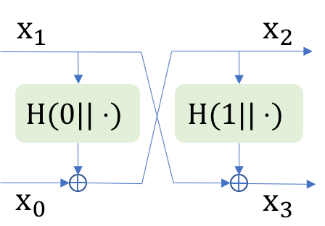
Step 1:
For $E’$= 2-rnd Feistel, = ?
$$=$$
$$x_{1}^{∗}$$
$$x_{2}^{∗}$$
$$H$$
$$y_{2}^{∗}$$
$$y_{1}^{∗}$$
$$y_{1}^{∗}$$
$$y_{2}^{∗}$$
$$\$\$$$
$$1||x_{2}^{∗}$$
$$0||x_{1}^{∗}$$
$$x_{0}^{∗}$$
$$x_{3}^{∗}$$
?
?
$$=$$
$$=$$
$$x_{2}^{∗}⊕y_{1}^{∗}$$
$$x_{1}^{∗}⊕y_{2}^{∗}$$
$$x_{2}^{∗}⊕\$\$$$
$$\left(x_{0}^{∗} \right\| x_{1}^{∗}, { x}_{2}^{∗} ‖ x_{3}^{∗})$$
$R′∈$ if $\operatorname{Pr}\left[\left(x_{0}^{∗} \left\|{ x}_{1}^{∗}, x_{2}^{∗} \right\|{ x}_{3}^{∗}\right)∈R′\right]=negl.$
$x_{3}$-sparsity:
$x_{0}$-sparsity:
$$\left(x_{0} \left\| x_{1}, { x}_{2} \right\|{ x}_{3}\right)∈R^{′}$$
$$∈$$
$n$-bit
strings
$n$-bit
strings
If $x_{0}=x_{3}$
If $x_{1}=x_{2}$
$$<δ⋅2^{n}$$
$$<δ⋅2^{n}$$
$$δ=negl.$$
$$\operatorname{Pr}\left[x_{0}^{∗}=x_{3}^{∗}\right]=1/2^{n}$$
Notes:
Recall that we consider an adversary A
that makes queries to H and tries to output a tuple
(x0*||x1*, x2*||x3^*) which is an input/output pair of 2-rnd feistel. We are interested in R' that are hard for 2-rnd feistel, equivalently relations for which Pr[the output of A belongs to R'] is negl.
To give you an intuition about hard relations, lets
lets first consider a relation R' that is easy.
It contains all pairs (x0||x1, x2||x3) for which x1 = x2.
Attacker can always satisfy this relation
by doing the following. It picks it fav x1*, chooses x2* equal to x1* and now just needs to complete
the remainder input half x0* and output half x3^*appropriately.
It first makes two queries to H, on 0x1* to get back y1* and then second query to get back y2* and now computes x0* as x2* xor y1* and similarly x3*, resulting in a tuple that satisfies the relation.
However, this doesn’t mean all relations are easy.
Lets look at a similar relation which instead
requires x0 = x3. Here, its not clear how A would proceed,
an example strategy is to begin by fixing
x3*, x2^*, fixing x1* and hope the corresponding x0*
which is defined as the xor of x2^* and the result
of querying H on 0x1^* equals x3*.
But as the result of H is random,
the pr that A hits x0^* = x3^* is small.
Infact one can show with not too much that R' is indeed hard for 2-rnd feistel.
More generally:
a relation R' is hard for 2-rnd feistel
if for any fixing of x1,x2,x3 the set of x0’s that put the tuple x0,x1,x2,x3 in R' is only a negl fraction of all n-bit strings.
And the same holds for x3's for any fixing x0,x1,x2.
We refer to these conditions as x0 and x3 sparsity respectively.
Feedback:
Need to compress
hard for 2-rnd feistel with a public random round function?
In the later example, you want to show y2^* as well.
Cut the first para and paste it at the end of second para? Otherwise R' in green appears to be abrupt.

Slide 19
Step 2:
$R$ unary evasive
$$R_{π,σ}∈$$
$$x_{1}$$
$$x_{2}$$
$$π$$
$$E′$$
$$σ^{−1}$$
$$π$$
$$σ^{−1}$$
$$u$$
$$H(0||⋅)$$
$$H(1||⋅)$$
$$v$$
$$=σ^{−1}(x_{3}||x_{2})$$
$$x_{0}$$
$$x_{3}$$
$$R_{π,σ}=\left\{ \left(π\left(u\right), σ\left(v\right)\right) :\left(u,v\right)∈R\right\}$$
To show:
$x_{0}$-sparsity
$2n$-bit
strings
$$π^{−1}(⋅||x_{1})$$
$$\left(x_{0} \left\| x_{1}, { x}_{2} \right\|{ x}_{3}\right)∈R_{π,σ}$$
with prob.
$<δ$
$$<δ⋅2^{n}$$
?
(in expectation)
$$R_{v}=\{u :\left(u,v\right)∈R\}$$
$n$-bit strings
$$<δ⋅2^{2n}$$
Notes:
1m 23s
To conclude the proof, we need to show that R \pi,\sigma satisfies x0 and x3 sparsity.
Lets focus on x0-sparsity and the other case is symmetrical.
Fixing x2,x3 also fixes via \sigma^-1 the value v.
Since R is evasive, the number of u's s.t. (u,fixed v) \in R at most \delta 2^2n for some negligible delta, Let this set be R_v shown by the inner rectangular box.
Now, we need to count the number of x0's such that \pi^-1(x0||x1) falls in R_v, and recall that
for R_{\pi,\sigma} to be x_0-sparse
this number needs to be a negligible
fraction of the n-bit strings.
the probability that this is true for any particular x0 is at most delta. Therefore, the expected number of x_0's is indeed delta * 2^n. Limited independence of \pi via a concentration bound shows that the number is not much less. Handling k-ary case is much harder and I invite you to look at the paper for more details.
----
Since for every x_0 in the red box the image of x0||x1 under pi^-1 falls in the set Rv,
it is equivalent to count the number of x0's whose pre-images fall in Rv.
As pi is random the probability for a fixed x0 to be such is at most \delta/2
and hence the expected number of such x0's is at most \delta/2 \cdot 2^n
which following a concentration bound will show that the size of the red box is at most
dekta 2^n except with exponentially small probability, thereby completing the proof
The proof of k-ary relations is similar in spirit but much more complicated and I invite you to look at the paper for more details.
Aux:
Need to compress and rephrase
Now, for a fixed x0, the probability that \pi^-1(x0||x1) is in R_v is at most \delta, since \pi is random therefore the expected number of x0 for which \pi^() is at most \delta 2^n, hence the size of the red box is at most \delta (but only in expectation!)
Need to show both x0 and x3 sparsity together?
x_0 in the red box iff \pi^-1(x0||x1) is in R_v.

Slide 20
Coming up next...
NR is correlation intractable
NR is public-seed
pseudorandom permutation
Conclusion
Notes:
Alright! If you have dozed off for a bit then this is a good time to wake up as in the next few minutes, I will, very briefly, give you the result on psPRPs.

Slide 21
Public-seed Pseudorandom Permutation (psPRP) [ST17]
(PRP)
$$k→K$$
$$ρ←Perms(n)$$
$E_{k}$ / $E_{k}^{−1}$
$$≈$$
$$ρ/ρ^{−1}$$
$$D$$
source
$$∈𝓢$$
$$S$$
$$k$$
$$0/1$$
distinguisher
leakage
restrict to avoid
trivial impossibilities
$$L$$
$E$ is a psPRP$[𝓢]$
if $∀$ $S∈𝒮$ and $∀$ PPT $D, E_{k}\text{/}E_{k}^{−1}≈ρ\text{/}ρ^{−1}$
Notes:
Most of us are familiar with the notion of pseudorandom permutation which requires
that no efficient distinguisher D can distinguish if it has been given oracle access to E
and its inverse under a randomly chosen key/seed as in the left world
or a random permutation \rho and its inverse as in the right world.
A naive extension to the known-key setting would be to ask pseudorandomness to hold even when D is given k, which is clearly impossible. So, to define meaningful notion of pseudorandomness in the known-key setting, the adversary is broken into two stages: Stage 1 adversary called the source S plays the PRP game and
Stage 2 adversary called the distinguisher D learns the key but has no oracle access
and some information flow is allowed from S to D in form of a leakage L. To avoid naïve attacks the leakge needs to be restricted which is obtained by considering sources from specific a source class.
Then block cipher E is a psPRP for that class if for every S in the class and every PPT D
the left world and right worlds are indistinguishable.
Infact one recovers the UCE notion for hash function after removing inversion queries and replacing the cipher with a hash function.
Feedback:
Need to define UCE
k random instead of sampling

Slide 22
$𝓢^{up}$ = Unpredictable Sources
$$(σ, x_{i})$$
$$ρ←Perms(n)$$
$$σ∈\{+,−\}$$
$$S$$
$$ρ/ρ^{−1}$$
$$Q←Q∪\{\left(σ, x_{i}\right), (\overline{σ}, y_{i})\}$$
$$y_{i}$$
$$L$$
$$Q_{B}$$
Hard to predict $S$’s queries
or its inverse
predictor $B$
(unbounded)
$S$ is unpredictable
if $∀ B$, $\operatorname{Pr}\left[Q_{B}∩Q≠ϕ\right]=negl.$
Notes:
An example of the source class is unpredictable sources.
we say that a source making queries to a random permutation and its inverse is unpredictable if given leakage if it is hard for any predictor to predict S's queries or its inverse given the leakage.
This is modelled by the following game which I am not going to go in details.
Here add probability that it is hard to predict queries which is captured by the following game which I wont be going into too many details
Feedback
\sigma is not defined.

Slide 23
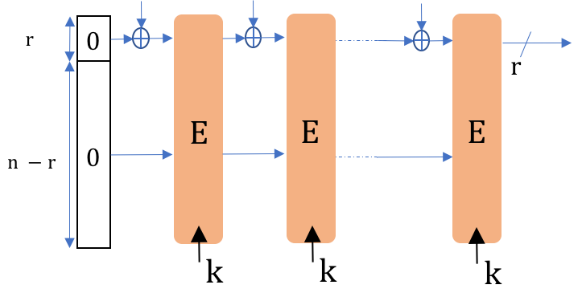
$E$ is psPRP$[𝒮^{rs}]$
$E$ is psPRP$[𝒮^{up}]$
Sufficient for lot of applications:
Instantiating Sponges
SHA-3[$E$]$=$ UCE[$𝒮^{rs}$] [ST17]
Efficient Garbling
reset-secure
Ga[$E$] $=$ prvind-secure [ST17]
$$𝒮^{rs}$$
[BHKR13]
$$𝒮^{up}$$
unpred.
Constructions
Sponge[$E$]
?
all (PPT) sources
5-rnd Feistel
[ST17]
Notes:
for which the corresponding notion is psPRP for unpred sources.
Another example of source class is that of reset-secure sources which I wont be defining in the talk. They are a superset of unpredictable resulting in the stronger notion of psPRP[S^rs].
Such restricted psPRPs already imply interesting applications.
For example, instantiating the underlying permutations of the sponge function
with a psPRP for reset sources results in Sponge being a UCE for reset sources.
This validates the design of SHA-3 for UCE applications.
Another example is the permutation based garbling scheme
which is efficient but was shown secure in the random permutation model.
Instantiating permutations with a psPRP for unpred sources gives a proof in the standard model.
Although applications are well studied, we lack efficient constructions for psPRPs.
The only known result is that 5-rnd Feistel is a psPRP for reset sources.
Feedback:
which avoids rekeying costs by instantiating permutations with
a fixed-key cipher, but prove security in the random permutation
model. We showed that instantiating permutations instead with psPRPs
for unpredictable sources inherits most of the efficiency guarantees
and also get a proof in the standard model.
Keep the Sponge figure till the end?

Slide 24
Our results: NR is a psPRP
Theorem 1a:
+
$H=$ UCE[$𝒮^{up}$]
$NR=$ psPRP[$𝒮^{up}$]
$P=$ pairwise ind.
Theorem 1b:
+
$H=$ UCE[$𝒮^{rs}$]
$NR=$ psPRP[$𝒮^{rs}$]
$P=$ pairwise ind.
Notes:
We show that NR is a psPRP for both for unpredictable sources and reset-secure sources
when the underlying H is a UCE for unpred sources and reset-secure sources respectively.
And P is a family of pairwise independence permutations which is the same condition which was sufficient for proving security of NR in secret-key setting.
Let me give you a high level view of main steps involved in proving these theorems starting with unpred result.
Feedback:
Say something about the power or beauty of the NR construction.

Slide 25
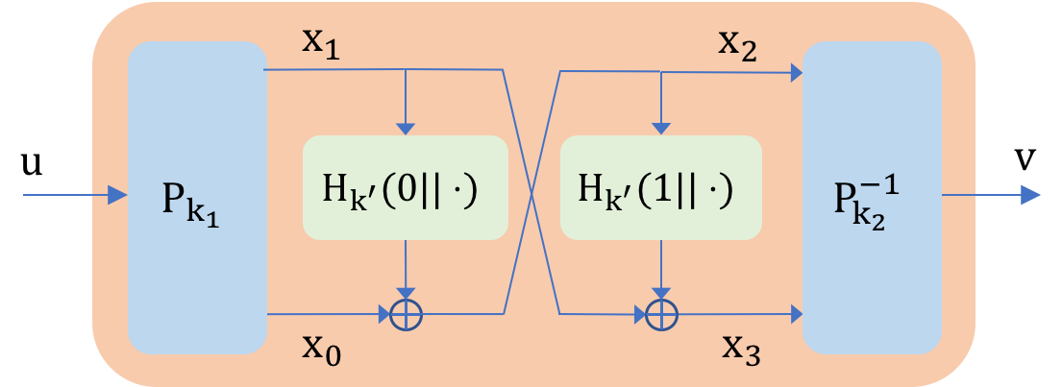
NR is a psPRP[$𝒮^{up}$] – Proof sketch
$H$ = UCE[$𝒮^{up}$]
Indistinguishability of NR
random $k′$
$$f←Funcs(n+1,n)$$
Only if $\overline{S}$ is unpredictable!
$$H_{k^{′}}$$
$$f$$
Lemma:
$$≈$$
$$≈$$
random
$S$ unpredictable
$\overline{S}$ unpredictable
$$k=(k_{1},k_{2},k′)$$
random $k_{1},k_{2}$
$$\overline{S}$$
random $k_{1},k_{2}$
$$\overline{S}$$
$$ρ←Perms(2n)$$
$$k_{1}$$
$$k_{2}$$
$$k_{1}$$
$$k_{2}$$
$${NR}_{k}/NR_{k}^{−1}$$
$${NR}_{k}/NR_{k}^{−1}$$
$$ρ/ρ^{−1}$$
$$k$$
$$(k_{1},k_{2},k^{′})$$
$$\left(k_{1},k_{2},k^{′}\right)$$
$$\left(k_{1},{k_{2},k}^{′} \right)$$
$$k′$$
$k′$
$$k$$
$$S$$
$$D$$
$$S$$
$$D$$
$$S$$
$$D$$
$$L$$
$$L$$
$$L$$
Notes:
To show that NR is a psPRP for unpred sources we need to show the left world
where a unpredictable source S and a distinguisher D are accessing the NR
under a random key k is indistinguishable from the right world where S instead
accesses a random permutation \rho and its inverse.
Recall that NR is a two round feistel with a keyed round functions
sandwiched between two keyed permutations. Equivalently, NR can be viewed
as a construction that makes oracle calls to the keyed function H.
This allows us to introduce an
intermediate world which is identical to the the left world except that H is replaced by a n+1 to n bit random function f.
Now, the indistinguishabiity of the two right world follows from the indistinguishability of the NR construction with a random round function from a random permutation. Note that here indistinguishability of NR is required to hold even when the adversary gets access to permutation keys k1, k2 at the end of the game which is slightly stronger than the classical indistinguishability proof due to NR.
The indistinguishability of the two left worlds, consider this source \bar{S} which perfectly simulates the NR construction for the source S in the left world. Now,
indistinguishability follows from the UCE security of H
for this newly constructed source \bar{S}. However, this is only true if the new \bar{S} is unpredictable!
Therefore, showing that \barS is unpred whenever S is unpre is the main and final step of the proof which is generally the challenging part is such proofs.
Feedback: Remove K_NR, K_H and K_P
Mention S is unpred on the slides

Slide 26
NR is a psPRP[$𝒮^{rs}$] – Proof sketch
$H$ = UCE[$𝒮^{rs}$]
Indistinguishability of NR
random $k′$
$$f←Funcs(n+1,n)$$
Only if $\overline{S}$ is reset-secure!
$$H_{k^{′}}$$
$$f$$
Lemma:
$$≈$$
$$≈$$
$S$ reset-secure
$\overline{S}$ reset-secure
random $k_{1},k_{2}$
$$\overline{S}$$
$$k_{1},k_{2}←K_{P}$$
$$\overline{S}$$
$$ρ←Perms(2n)$$
Requires techniques from [IR89, BMG09]
$$k_{1}$$
$$k_{2}$$
$$k_{1}$$
$$k_{2}$$
$${NR}_{k}/NR_{k}^{−1}$$
$${NR}_{k}/NR_{k}^{−1}$$
$$ρ/ρ^{−1}$$
$$(k_{1},k_{2},k^{′})$$
$$\left(k_{1},k_{2},k^{′}\right)$$
$$k′$$
$k′$
$$k$$
$$S$$
$$D$$
$$S$$
$$D$$
$$S$$
$$D$$
$$L$$
$$L$$
$$L$$
Notes:
The proof of reset-security is identical except that we need to show \barS is instead reset-secure whenever S is. Establishing this requires IR-style proofs techniques, please look at the paper for more details.

Slide 27
Coming up next...
NR is correlation intractable
NR is public-seed
pseudorandom permutation
Conclusion

Slide 28
Naor-Reingold goes Public!
Theorem 1:
$𝒮∈\{𝒮^{up}$, $𝒮^{rs}\}$
+
$H=$ UCE[$𝒮$]
$NR=$ psPRP[$𝒮$]
$P=$ pairwise ind.
Theorem 2:
($k=$ O(1))
public
random
function
CI for
$k$-ary evasive
relations
$P=$ $k^{2}$-wise ind.
+
$$H=$$
$$NR=$$
Paper on eprint:
https://eprint.iacr.org/2018/137
Notes:
To conclude, in this work we considered the useful security notions of block ciphers in the known-key setting namely psPRPs and CI-ciphers and gave constructions of such ciphers from the NR paradigm requiring only 2-calls to non-invertible function.
The full version is on eprint and I am happy to take any questions now!

