Slide 1
Efficient Processing of Top-k Queries in Uncertain Databases
Ke Yi, AT&T Labs
Feifei Li, Boston University
Divesh Srivastava, AT&T Labs
George Kollios, Boston University

Slide 2
Top-k Queries
Extremely useful in information retrieval
  top-k sellers, popular movies, etc.
  google
tuple | score
t1 t2 t3 t4 t5 | 65 30 100 80 87
tuple | score
t3 t5 t4 t1 t2 | 100 87 80 65 30
Threshold Alg
[FLN’01]
RankSQL
[LCIS’05]
top-2 = {t3, t5}

Slide 3
Top-k Queries on Uncertain Data
tuple | score
t3 t5 t4 t1 t2 | 100 87 80 65 30
tuple | score
t3 t5 t4 t1 t2 | 100 87 80 65 30
confidence
0.2 0.8 0.9 0.5 0.6
confidence
0.2 0.8 0.9 0.5 0.6
top-k answer depends on
the interplay between
score and confidence
(sensor reading, reliability)
(page rank, how well match query)

Slide 4
Top-k Definition: U-Topk [SIC’07]
The k tuples with the maximum probability
of being the top-k
tuple | score
t3 t5 t4 t1 t2 | 100 87 80 65 30
confidence
0.2 0.8 0.9 0.5 0.6
{t3, t5}:
0.2*0.8 = 0.16
{t3, t4}:
0.2*(1-0.8)*0.9 = 0.036
{t5, t4}:
(1-0.2)*0.8*0.9 = 0.576
...
Potential problem: top-k could be very different from top-(k+1)

Slide 5
Top-k Definition: U-kRanks [SIC’07]
The i-th tuple is the one with the maximum
probability of being at rank i, i=1,...,k
tuple | score | confidence
t3 t5 t4 t1 t2 | 100 87 80 65 30 | 0.2 0.8 0.9 0.5 0.6
Rank 1:
t3: 0.2
t5: (1-0.2)*0.8 = 0.64
t4: (1-0.2)*(1-0.8)*0.9 = 0.144
...
Rank 2:
t3: 0
t5: 0.2*0.8 = 0.16
t4: 0.9*(0.2*(1-0.8)+(1-0.2)*0.8)
= 0.612
Potential problem: duplicated tuples in top-k

Slide 6
Uncertain Data Models
An uncertain data model represents a probability distribution of database instances (possible worlds)
Basic model: mutual independence among all tuples
Complete models: able to represent any distribution of possible worlds
  Atomic independent random Boolean variables
  Each tuple corresponds to a Boolean formula, appears iff the formula evaluates to true [DS’04]
  Exponential complexity

Slide 7
Uncertain Data Model: x-relations [Trio]
Each x-tuple represents a discrete probability distribution of tuples
x-tuples are mutually independent, and disjoint
single-alternative
multi-alternative
U-Top2: {t1,t2}
U-2Ranks: (t1, t3)

Slide 8
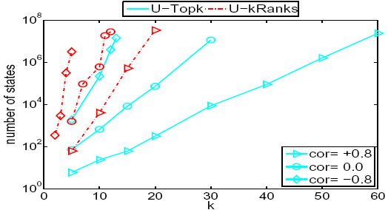
Soliman et al.’s Algorithms [SIC’07]
Scan depth is optimal
Running time is NOT!
t1 t2 t3 t4 t5 t6 t7 t8 ...
0.3 0.7 0.4 0.2 0.1 1 0.1 0.8 ...
t1, t2
query: U-Top2
0.21
t1
t1, ¬t2
0.3
f
0.09
¬t1, t2, t3
1
¬t1, t2
0.28
¬t1
0.7
0.49
¬t1, ¬t2
¬t1, t2, ¬t3
0.21
0.21

Slide 9
Why Scan by Score?
score | prob.
N N-1 N-2 ... 2 1 | 1/N 1/N 1/N ... 1/N 1
contrived
score | prob.
N N-1 N-2 ... 2 1 | 0.4 0.5 0.5 ... 0.5 0.5
not-so-contrived
Makes the alg
easier!
(1-1/N)^{N-1} ≈1/e
scan by prob. is much better
scan by score is much better
Theorem: For any function f on score and prob., there exits an uncertain db such that if we scan by the order of f, we need to scan Ω(N) tuples.

Slide 10
New Algorithm: U-Topk
t1 t2 t3 t4 t5 t6 t7 t8 ...
0.2 0.8 0.7 0.2 0.1 1 0.1 0.8 ...
{t2, t5} being top-2 ⬄
t2, t5 appearing and t1, t3, t4 not appearing
Consider the i-th tuple ti:
Question: Among t1, ..., ti, which k tuples have the maximum prob. of appearing while the rest not appearing?
Answer: The k tuples with the largest prob.
Just need to answer the question for all i

Slide 11
New Algorithm: U-Topk
t1 t2 t3 t4 t5 t6 t7 t8 ...
0.2 0.8 0.4 0.2 0.1 1 0.1 0.8 ...
top-k prob. tuples
{t1,t2}
{t2,t3}
{t2,t6}
prob. others don’t appear
1
0.8
0.64
0.576
0.346
top-k prob.
0.16
0.448
0.276
upper bound
0.64
0.48 0.384
Running time: O(n log k)
Space: O(k)
To achieve optimal scan depth, compute upper bound on future possible results:

Slide 12
Handling Multi-Alternatives
t1 t2 t3 t4 t5 t6 t7 t8 ...
0.8 0.6 0.1 0.7 0.2 1 0.2 0.8 ...
Consider the i-th tuple ti:
Question: Among t1, ..., ti, which k tuples have the maximum prob. of appearing while the rest not appearing?
Answer: The k tuples with the largest prob.
i=5, k=2:
Pr[{t1,t4}] = p(t1)p(t4)(1-p(t2)-p(t5)) = 0.112
Pr[{t1,t2}] = p(t1)p(t2)(1-p(t4)) = 0.144

Slide 13
Handling Multi-Alternatives
t1 t2 t3 t4 t5 t6 t7 t8 ...
0.8 0.6 0.1 0.7 0.2 1 0.2 0.8 ...
Answer: The k tuples with the largest p(t)/q_{i}(t), where q_{i}(t) is the prob. that none of t’s alternatives before ti appears.
i=5, k=2:
Pr[{t1,t4}] = p(t1)p(t4)(1-p(t2)-p(t5))
Pr[{t1,t2}] = p(t1)p(t2)(1-p(t4)) = 0.144
p(t1) p(t4)
= (1-p(t1)-p(t3))(1-p(t2)-p(t5))(1-p(t4))
(1-p(t1)-p(t3)) (1-p(t4))
p(t1) p(t2)
= (1-p(t1)-p(t3))(1-p(t2)-p(t5))(1-p(t4))
(1-p(t1)-p(t3)) (1-p(t2)-p(t5))

Slide 14

Handling Multi-Alternatives
t1 t2 t3 t4 t5 t6 t7 t8 ...
0.8 0.6 0.1 0.7 0.2 1 0.2 0.8 ...
Answer: The k tuples with the largest p(t)/q_{i}(t), where q_{i}(t) is the prob. that none of t’s alternatives before ti appears.
Algorithm (basically the same as the single-alternative case)
- As i goes from k to n, keep a table of all p(t) and q(t) values;
- Maintain the k tuples with the largest p(t)/q(t) ratios;
- Maintain the upper bound on future results:
(single-alternative case: )
Running time: O(n log k)
Space: O(n)

Slide 15
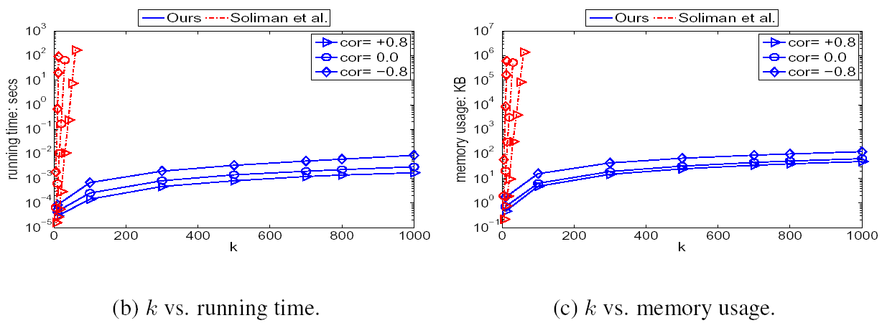
U-Topk: Experiments

Slide 16
U-kRanks
The i-th tuple is the one with the maximum
probability of being at rank i, i=1,...,k
tuple | score | confidence
t3 t5 t4 t1 t2 | 100 87 80 65 30 | 0.2 0.8 0.9 0.5 0.6
Rank 1:
t3: 0.2
t5: (1-0.2)*0.8 = 0.64
t4: (1-0.2)*(1-0.8)*0.9 = 0.144
...
Rank 2:
t3: 0
t5: 0.2*0.8 = 0.16
t4: 0.9*(0.2*(1-0.8)+(1-0.2)*0.8)
= 0.612
...

Slide 17
U-kRanks: Dynamic Programming
t1 t2 t3 t4 t5 t6 t7 t8 ...
0.2 0.8 0.7 0.2 0.1 1 0.1 0.8 ...
t5 appears at rank 3 iff
2 tuples in {t1, ..., t4} appear
r_{i,j}: prob. exactly j tuples in {t1, ..., ti} appear
r_{i,j} = p(ti)*r_{i-1,j-1} + (1-p(ti))*r_{i-1,j}
Running time: O(nk)
Space: O(k)

Slide 18
Handling Multi-Alternatives
t1 t2 t3 t4 t5 t6 t7 t8 ...
0.8 0.6 0.1 0.7 0.2 1 0.2 0.8 ...
0.9
0.8
r_{i,j}: prob. exactly j tuples in {t1, ..., ti} appear
Trick 1: merging tuples

Slide 19
Handling Multi-Alternatives
t1 t2 t3 t4 t5 t6 t7 t8 ...
0.8 0.6 0.1 0.7 0.2 1 0.2 0.8 ...
0.9
0.8
r_{i,j}: prob. exactly j tuples in {t1, ..., ti} appear
Trick 1: merging tuples
Trick 2: dropping tuples
prob. t7 appears at rank j = p(t7)*r_{6,j-1}
Running time: O(n²k)
Space: O(n)

Slide 20
U-kRanks: Experiments

Slide 21
Future Directions
Dynamic updates?
  A linear-size structure, O(k log²n) update time, not practical
Distributed monitoring?
Assumed an underlying ranking engine that produces tuples in score order, how about other information integration scenarios?
  Top-k of join results of probabilistic tuples
  Spatial db: top-k probable nearest neighbors

