Slide 1
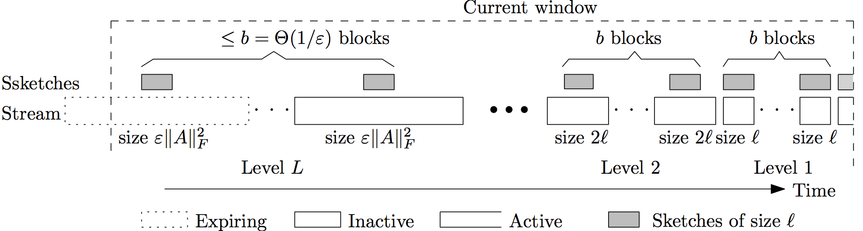
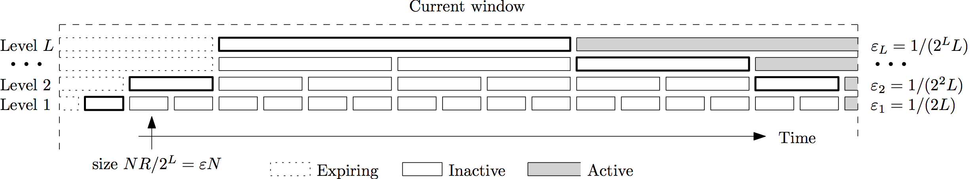
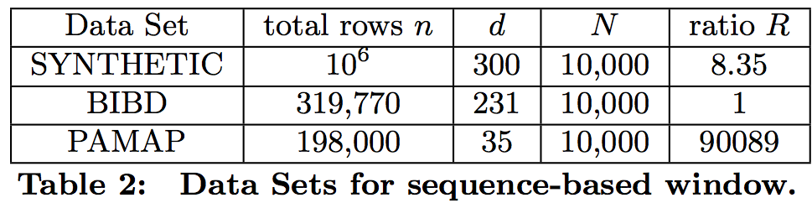
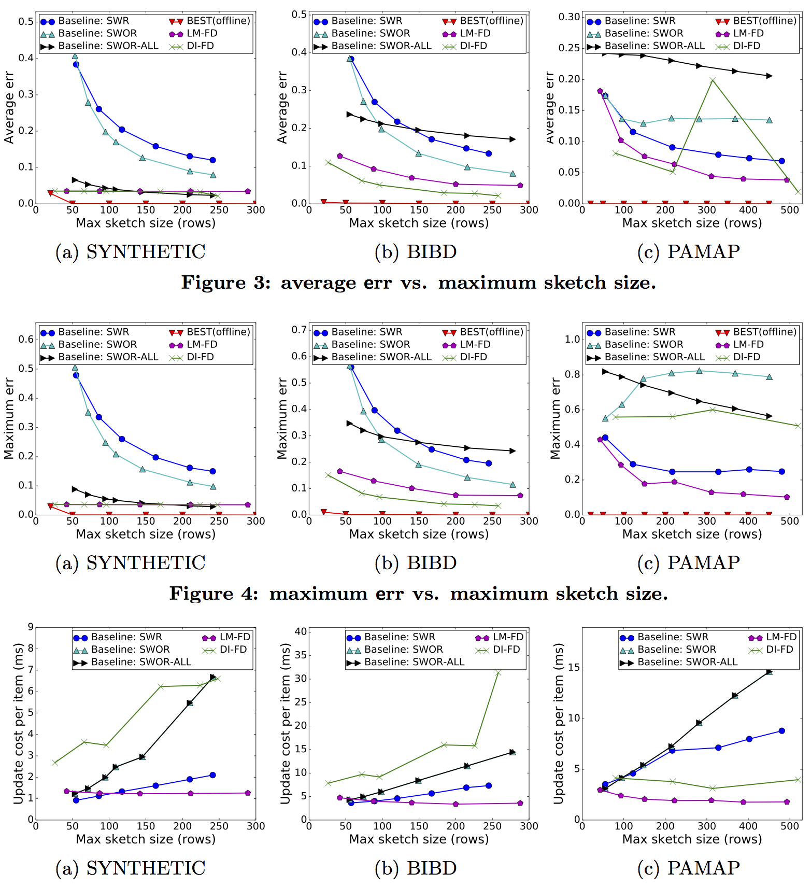
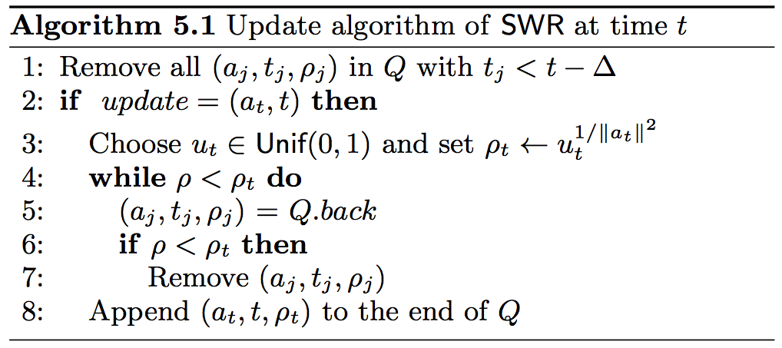
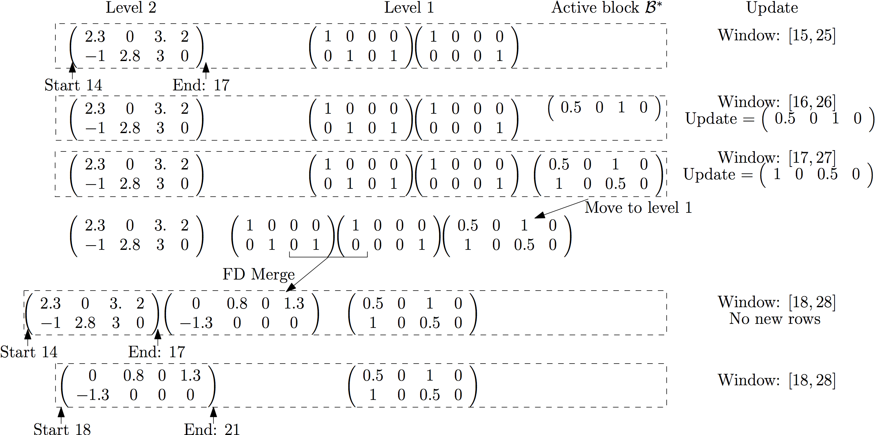
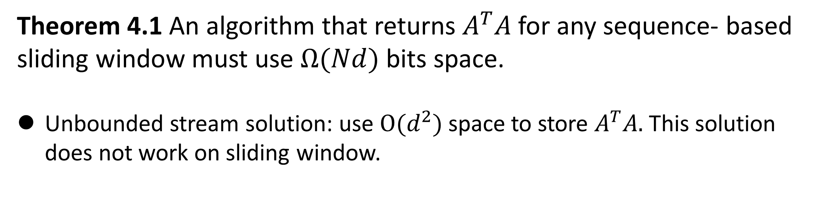
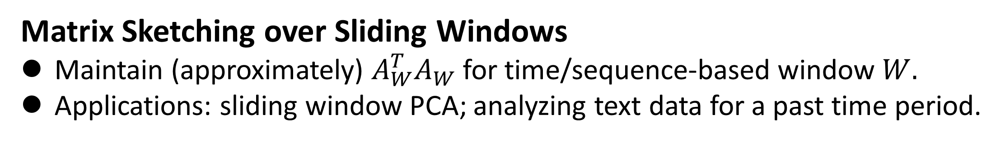
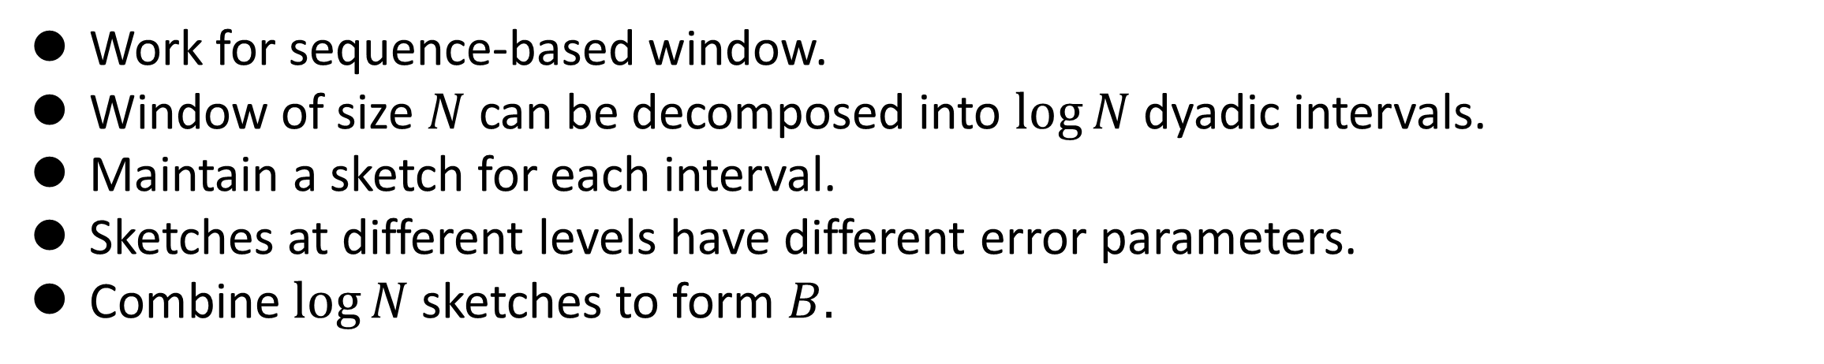
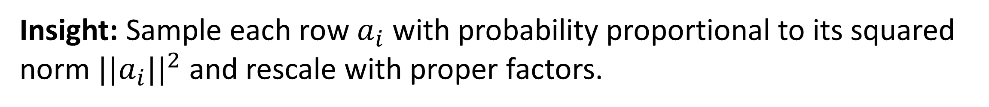
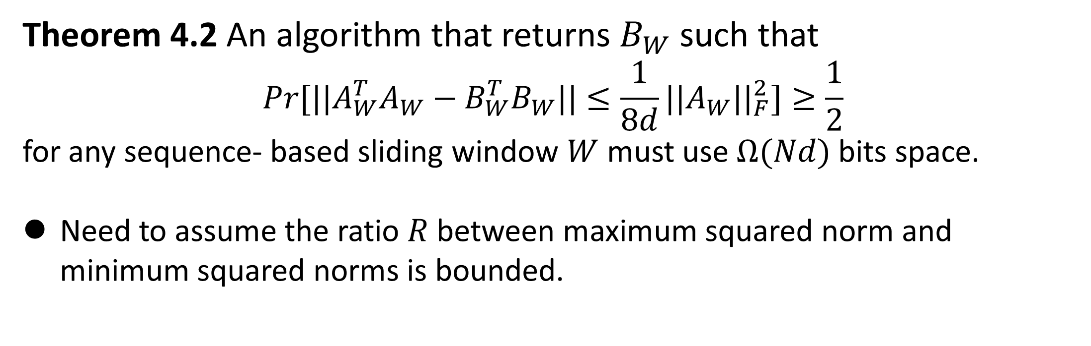
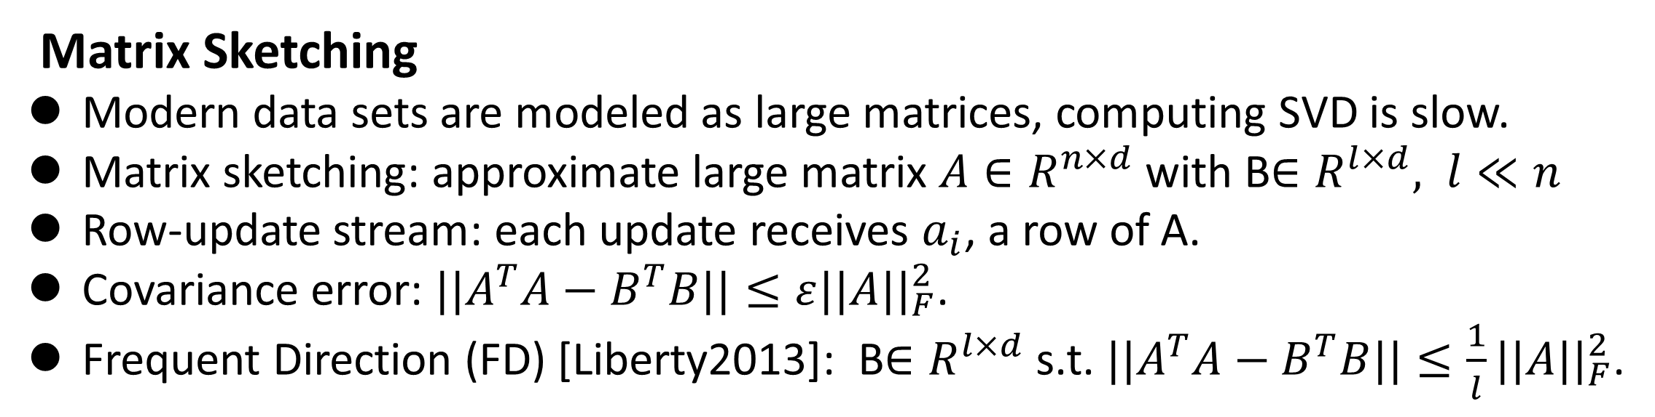
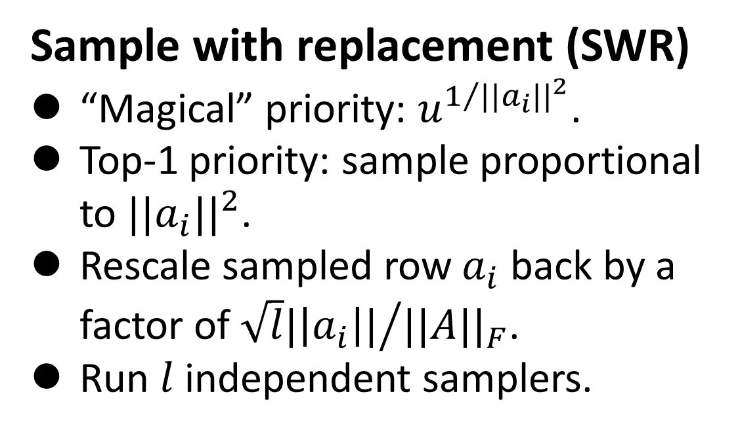
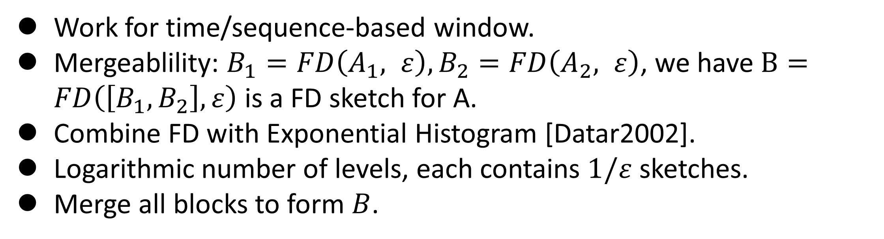
Matrix Sketching over Sliding Windows
Zhewei Wei¹, Xuancheng Liu¹, Feifei Li², Shuo Shang¹, Xiaoyong Du¹, Ji-Rong Wen¹
¹ School of Information, Renmin University of China
² School of Computing, The University of Utah
Contact: zhewei@ruc.edu.cn
Motivation and Problem Statement
Illustration:
Matrix Sketching
Modern data sets are modeled as large matrices, computing SVD is slow.
Matrix sketching: approximate large matrix $A∈R^{n×d}$ with B$∈R^{l×d}, l≪n$
Row-update stream: each update receives $a_{i}$, a row of A.
Covariance error: $||A^{T}A−B^{T}B||≤ε||A{||}_{F}^{2}$.
Frequent Direction (FD) [Liberty2013]: B$∈R^{l×d}$ s.t. $||A^{T}A−B^{T}B||≤\frac{1}{l}||A{||}_{F}^{2}$.
Dyadic Interval: DI-FD algorithm
Sliding Window Summaries:
Model time-sensitive data.
Sequence-based: past N items; Time-based: items in a past time period.
Matrix Sketching over Sliding Windows
Maintain (approximately) $A_{W}^{T}A_{W}$ for time/sequence-based window $W.$
Applications: sliding window PCA; analyzing text data for a past time period.
Lower bounds: Challenges and Assumptions
Work for sequence-based window.
Window of size $N$ can be decomposed into $log⁡N$dyadic intervals.
Maintain a sketch for each interval.
Sketches at different levels have different error parameters.
Combine $log⁡N$ sketches to form $B.$
Theorem 4.1 An algorithm that returns $A^{T}A$for any sequence- based sliding window must use $Ω(Nd)$bits space.
Unbounded stream solution: use $O(d^{2})$space to store $A^{T}A.$ This solution does not work on sliding window.
Experiments and Conclusion
Theorem 4.2 An algorithm that returns $B_{W}$ such that
$$Pr[||A_{W}^{T}A_{W}−B_{W}^{T}B_{W}||≤\frac{1}{8d}||A_{W}{||}_{F}^{2}]≥\frac{1}{2}$$
for any sequence- based sliding window $W$ must use $Ω(Nd)$bits space.
Need to assume the ratio $R$ between maximum squared norm and minimum squared norms is bounded.
Datasets:
Sampling-based algorithm
Observations
FD vs. Sampling: DI-FD and LM-FD provide better space-error tradeoffs.
DI-FD vs. LM-FD: depends on the ratio R between maximum squared norm and minimum squared norms in the data set.
SWOR vs. SWR: depends on data set.
Baseline: Sampling-based algorithm
Insight: Sample each row $a_{i}$ with probability proportional to its squared norm ${||a}_{i}{||}^{2}$ and rescale with proper factors.
Sample with replacement (SWR)
“Magical” priority: $u^{1/{{||a}_{i}{||}^{2}}}$.
Top-1 priority: sample proportional to ${||a}_{i}{||}^{2}$.
Rescale sampled row $a_{i}$ back by a factor of ${\sqrt{l}|\left|a_{i}\right||}/{||A{||}_{F}}$.
Run $l$ independent samplers.
Logarithmic Method: LM-FD algorithm
Work for time/sequence-based window.
Mergeablility: $B_{1}=FD\left(A_{1}, ε\right),B_{2}=FD\left(A_{2}, ε\right)$, we have $B=FD\left(\left[B_{1},B_{2}\right], ε\right)$ is a FD sketch for A.
Combine FD with Exponential Histogram [Datar2002].
Logarithmic number of levels, each contains $1/ε$ sketches.
Merge all blocks to form $B$.
Example:
Conclusions
Sampling: interpretable, bad space usage. Slow update.
DI-FD: best space usage for normalized, sequence-based windows. Slow update.
LM-FD: space-efficient, work for time/sequence-based windows, insensitive to R. Fast update.

