Slide 1
How can Computational Geometry help Mobile Networks:
Geometry in Wireless Sensor Networks
Jie Gao
Stony Brook University
CG Week 2012
Algorithms in the Field Workshop

Slide 2
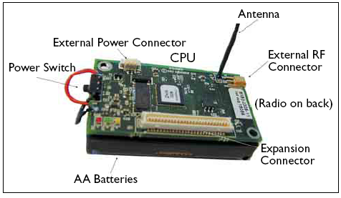
A generic sensor node
CPU.
On-board flash memory or external memory
Sensors: thermometer, camera, motion, light sensor, etc.
Wireless radio.
Battery.

Slide 3
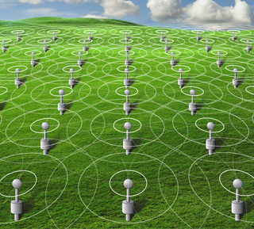
Sensor Networks

Slide 4
Applications
Initially: Scientific Monitoring
  High-resolution data collection and monitoring.
  Deploy sensors in a remote region, collect data to a base station.
Examples
  Habitat monitoring of animal behaviors
  Environment monitoring (redwoods, golden gate bridge, tunnels, etc)

Slide 5
Applications
Later: Cyber Physical Systems (CPS), Internet of Things (IoT)
  Real-time data acquisition.
  Situation understanding.
  Event response and control.
Examples:
  Health monitoring
  Smart buildings; green buildings
  SmartGrid
Sensing
Environment
Control

Slide 6
Applications
Emerging: Participatory Sensing
  Sensors on cellular phones (GPS, microphone, cameras…)
  “Crowdsourcing”
  Devices are available, charged & maintained.
Applications
  Social activities (foursquare)
  Traffic monitoring (waze)

Slide 7
Where is the geometry?
Sensor locations
  Points in the plane
  Points on a terrain
  Points in 3D
  Mobile sensors

Slide 8
Where is the geometry?
Sensor communication models
  Short-range communication (for reducing energy consumption/interference)
  E.g. Unit disk graph model (UDG)

Slide 9
Where is the geometry?
Sensing models
  Isotropic: point, disk.
  Non-isotropic: camera, laser.

Slide 10
Where is the geometry?
Sensor data
  Spatial & temporal correlation in most physical phenomena

Slide 11
Model is important
Captures important properties
Simple enough s.t. interesting results can be proved.
Multiple interesting models & solutions.

Slide 12
Two case study
Network localization
Geometric routing

Slide 13
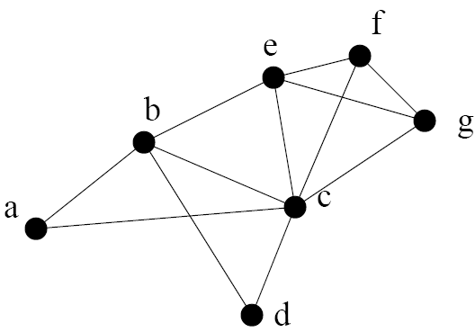
Network Localization
Given a network of sensors, find their (absolute or relative) positions.
Input:
  Network connectivity.
  (optional) noisy edge length.
  (optional) noisy angles.

Slide 14

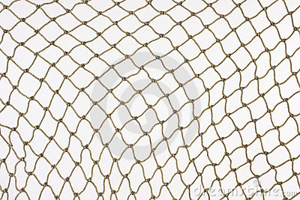
Unit disk graph realization
Given a graph, can you realize it as a unit disk graph in R²?
?

Slide 15
Unit disk graph realization
Given a graph, can you realize it as a unit disk graph in R²?
NP-complete [Breu, Kirkpatrick’98]
NP-hard to approx. within √1.5 [Kuhn, Moscibroda, Wattenhofer’04]
NP-complete w. edge lengths [Aspnes, Goldenberg, Yang’04; Bâdoiu, Demaine, Hajiaghayi, Indyk’04]
NP-complete w. angles [Bruck, Gao, Jiang’05]
NP-complete w. noisy edge length & angles [Basu, Gao, Mitchell, Sabhnani’06]

Slide 16
Unit disk graph realization
Approximation?
Known: O(log^{2.5} n log log n) on ratio of longest edge/ shortest non-edge [Kuhn, Moscibroda, Wattenhofer’04]
Open question: O(1)-approximation?
Given a combinatorial UDG, embed all neighbors to be within distance 1, and all non-neighbors at least α apart, for a constant α.

Slide 17
Why is UDG realization so hard?
Intuitively,
Formally, all proofs use reduction from 3-SAT.
C
B
A
Not convex!
Packing disjoint disks rep. independent set!
AC, BC is an edge ➔ |AC| ≤ 1; |BC| ≤ 1
AB is not an edge ➔ |AB| >1

Slide 18
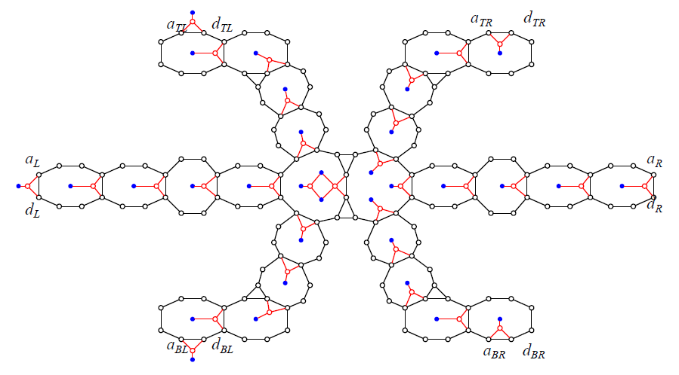
Truth setting gadget
cage
Independent set
Unit disk graph recognition is NP-hard, Breu & Kirkpatrick, 1998.

Slide 19
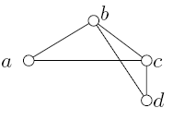


2nd challenge: flip ambiguity
Given two triangles with fixed edge length, one can flip one triangle relative to the other.
Incorrect global flip.

Slide 20
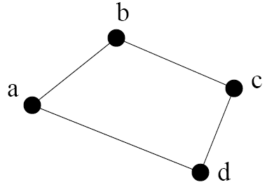
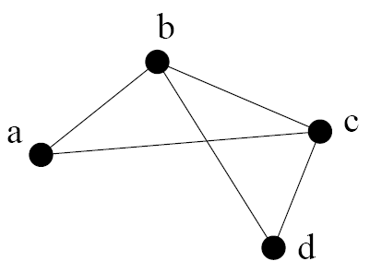
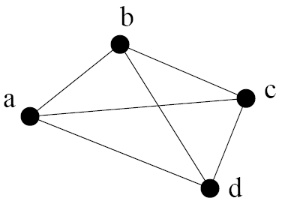
Rigidity and global rigidity
Rigidity: no continuous deformation
Global rigidity: unique embedding in R²
Not rigid
Rigid, not globally rigid
Globally rigid

Slide 21
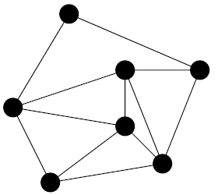
2D rigidity is well understood!
A graph is rigid in 2D if and only if it contains a Laman graph on its vertices.
A Laman graph has n vertices, 2n-3 edges and any subset of k vertices spans at most 2k-3 edges.

Slide 22
Global rigidity
A graph is globally rigid in 2D iff it is 3-connected and redundantly rigid (rigid upon the removal of an edge).
Rigid, not globally rigid
Globally rigid
[Berg, Jordan 2003] [Hendrickson 1992]

Slide 23
Recognizing rigidity is easy
Pebble game: test whether a graph is generically rigid in time O(nm), n=|V|, m=|E|.
Testing global rigidity?
  Test redundant rigidity
  Test 3-connectivity.
D. J. Jacobs and B. Hendrickson, An Algorithm for two dimensional rigidity percolation: The pebble game. J. Comput. Phys., 137:346-365, 1997.

Slide 24
But finding an embedding is hard!
Given a graph with edge lengths specified, finding a valid graph realization in R^{d} for a fixed dimension d is NP-complete.
Rank constraint is non-convex.
1st idea: embed in R^{n} and project down to R² – multi-dimensional scaling.
2nd idea: poly time algorithm for special families of graphs.
What about dense graphs?

Slide 25
A detour
Look at a different model of the network.

Slide 26
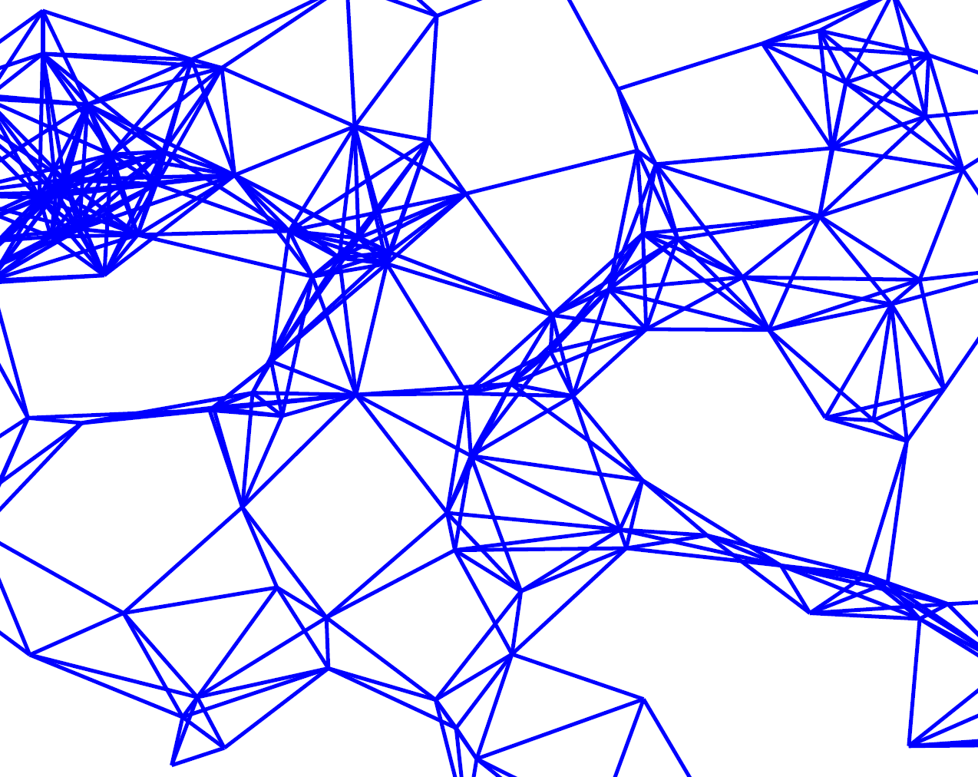
Local view

Slide 27
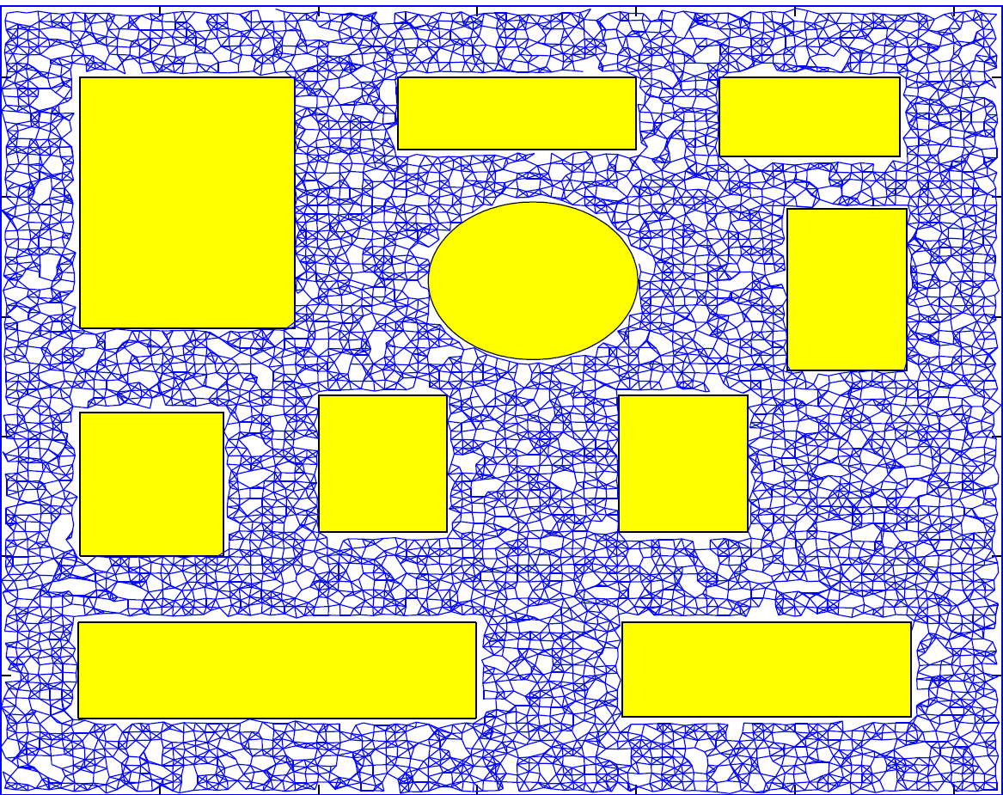
Global view
obstacles

Slide 28
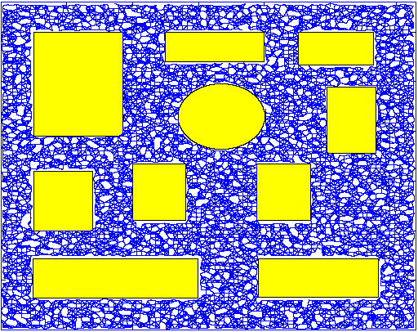
Large-scale sensor field
large-scale, dense deployment.
  Sufficient sensor coverage.
w/ holes/obstacles.
Prominent feature: shape of the network.

Slide 29
Graph abstraction of sensor networks
The “graph” view of a sensor network depends very much on the network connectivity, which is not stable: links come and go, nodes fail…
Dynamic graph problems, in general, are difficult problems.

Slide 30
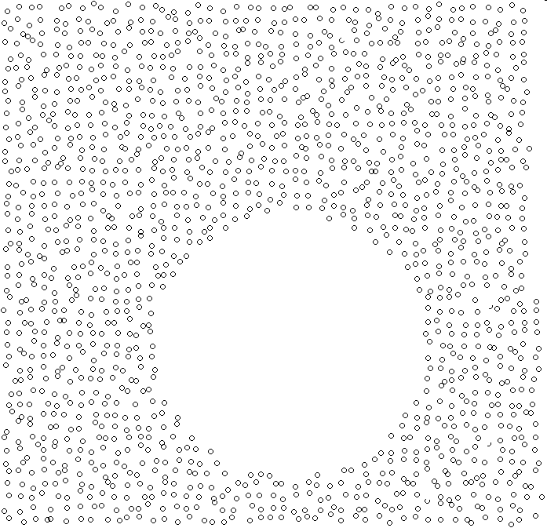
Geometric View of Sensor Networks
The global geometry/ topology is stable
We know how to handle shapes
obstacle

Slide 31
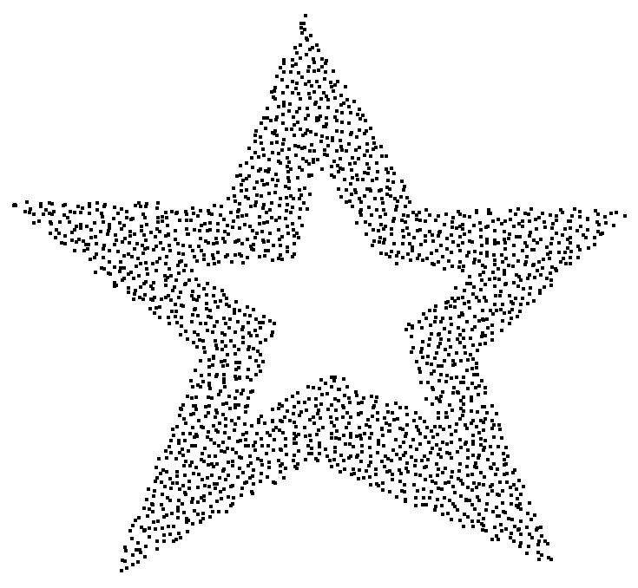
Network Localization
Surface reconstruction?
Large, dense sensor field with complex geometry.
Nearby nodes are able to communicate.
Use connectivity information only.
Recover the relative positioning.

Slide 32
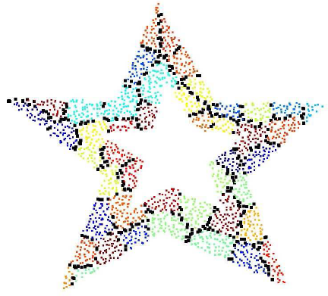
The algorithm
Select landmarks on the boundary.
Landmark Voronoi diagram:
Nodes identify closest landmark under network distance
Combinatorial Delaunay complex:
Neighboring landmarks connected by an edge
[Lederer, Wang, Gao, 2008].

Slide 33
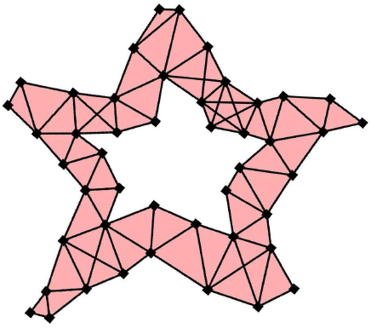
The algorithm, cont
Embed the combinatorial Delaunay complex
  Edge length = network hop count
  Glue adjacent triangles side by side.

Slide 34
No flip ambiguity for Delaunay triangles
Recall: we want to embed as a simplicial complex.
  Intersection of two simplices is empty or is a common face.
good
bad

Slide 35
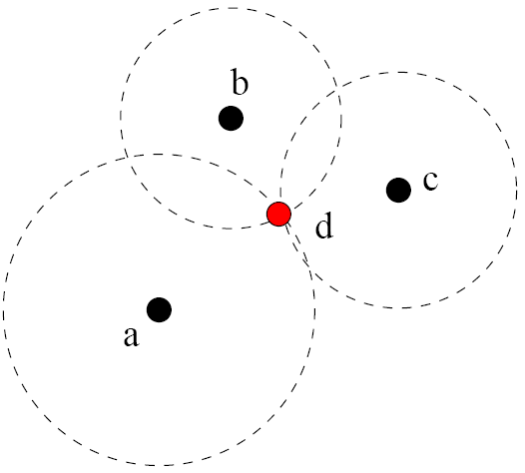
Algorithm, cont
Embed the rest of the nodes.
  Each node embeds itself with hop-count distances to nearby 3 landmarks.

Slide 36
Are we done?
How to select landmarks?
Make sure the Delaunay complex is rigid.

Slide 37
Landmark selection condition
If the Voronoi diagram (Voronoi edges and vertices) is connected in R, then the Delaunay graph is rigid.
Sampling criterion:
Each boundary point p
has a landmark
within LFS(p).

Slide 38
Two case study
Network localization
Geometric routing

Slide 39
Greedy Routing in Sensor Networks
Assign coordinates to nodes
Message moves to neighbor closest to destination
Simple, compact, scalable

Slide 40
Greedy routing may get stuck
Can get stuck
Find a different embedding so that greedy routing does not get stuck!
Lake

Slide 41
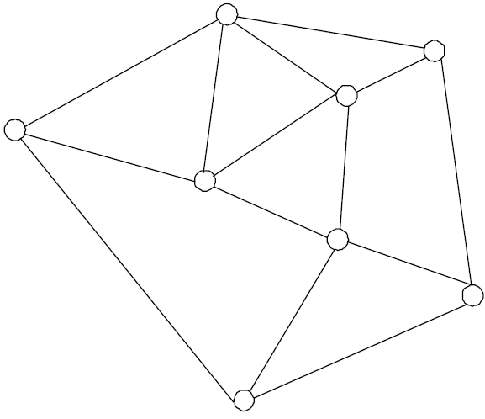
Greedy embedding
Given a graph G, find an embedding of the vertices in R^{d}, s.t. for each pair of nodes s, t, there is a neighbor of s closer to t than s itself.
Q: how to compute?
t
C. H. Papadimitriou and D. Ratajczak. On a conjecture related to geometric routing. Theor. Comput. Sci., 344(1):3–14, 2005.
s

Slide 42
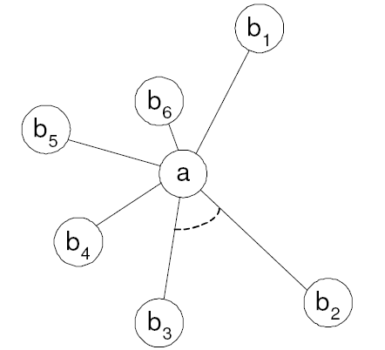
Greedy embedding does not always exist
A star with ≥ 6 leaves does not have a greedy embedding in R²
≤π/3
Source
Destination
Not the longest distance in Δab₂b₃

Slide 43
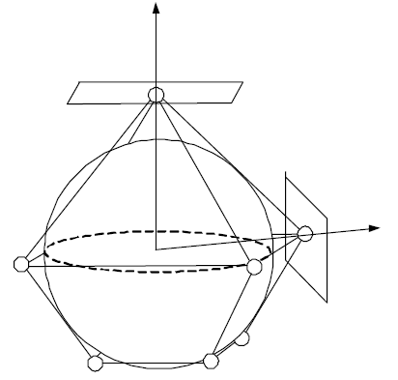
Conjecture [Papadimitriou, Ratajczak]
Any planar 3-connected graph has a greedy embedding R².
Any 3-connected planar graph is the edge graph of a 3D convex polytope, with edges tangent to a sphere. [Steinitz 1922].

Slide 44
Polyhedral routing
Theorem: Greedy routing with the distance function d(u, v) = - e(u)⋅e(v) guarantees delivery.
Distance is a linear function ➔ single global minimum.
For destination v, d(u, v) is minimum if u=v.
No stuck point due to convexity.

Slide 45
Progress on the conjecture
Dhandapani proved that any triangulation admits a greedy embedding (SODA’08).
Leighton and Moitra proved the conjecture (FOCS’08).
Independently, Angelini et al. also proved it (Graph Drawing’08).

Slide 46
Leighton and Moitra’s Proof
All 3-connected planar graphs contain a spanning Christmas Cactus graph.
All Christmas Cactus graphs admit a greedy embedding in the plane.

Slide 47
A Christmas Cactus

Slide 48
Christmas cactus graph
A cactus graph is connected, each edge is in at most one simple cycle.
A Christmas Cactus graph is a cactus graph for which the removal of any node disconnects it into at most 2 pieces.
“Tree of cycles”

Slide 49
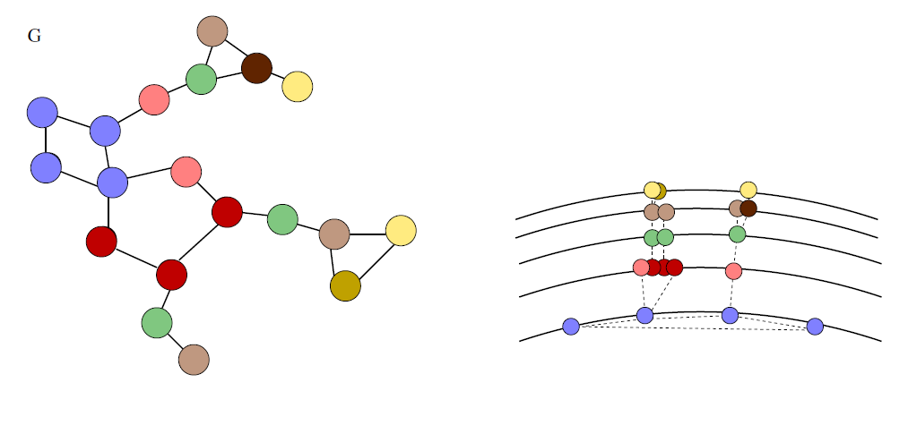
How does the embedding look like?
Leighton and Moitra
Requires high resolution!
Ω(n log n) bit size coordinates! [Eppstein, Goodrich’08]

Slide 50
Succinct greedy drawing
Goal: o(n log n) bit size coordinates.
But this is in general impossible. [Battista, Frati, Angelini, 2009].
Notice: no need to store exact coordinates, only need comparison.
Goldrich and Strash show compressed representation of “Christmas cactus embedding” using O(log n) size storage.

Slide 51
Greedy drawing
Very nice theory
In practice: links go up and down.
Maintaining the greedy drawing is non-trivial.
Switch to the geometric view.

Slide 52
Greedy routing get stuck at “holes”
Can get stuck
Lake
y
x
z

Slide 53
Deform the holes to be circular
Greedy routing does not get stuck at circular holes. [Sarkar, Yin, Gao, Luo, Gu, 2009]
➔
Conformal map!

Slide 54
Conformal map for greedy routing
Curvature flow (Ricci flow) is a natural distributed algorithm.
Deform a complex shape to a simple one, making it easy to explore the space of paths.
  Multi-path routing
  Recover from link failure
  Find routes of different homotopy types

Slide 55

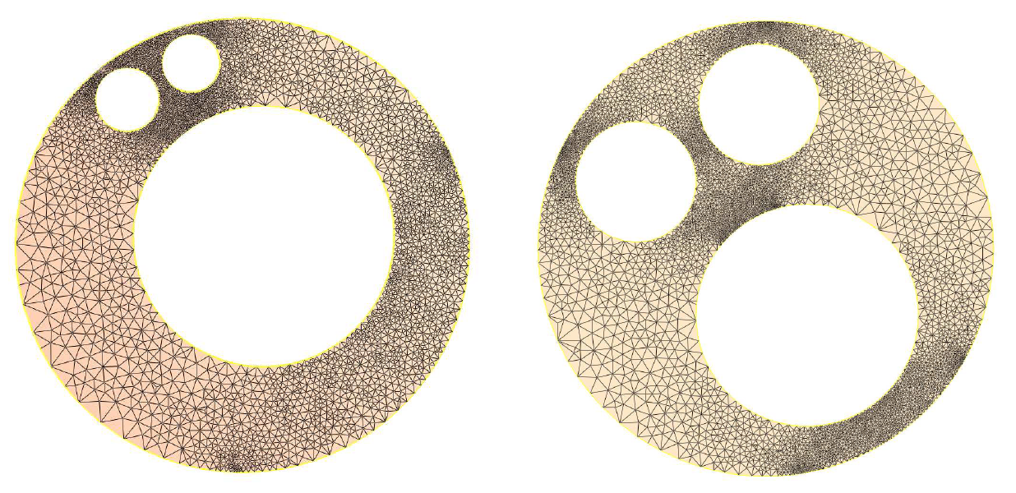
Möbius Transform
Möbius transform
  Conformal: maps circles to circles
➔
a, b, c, d are 4 complex numbers, ad ≠ bc

Slide 56
Recover from link failure
Apply a Möbius transformation & route in an alternative embedding. [Jiang, Ban, Goswami, Zeng, Gao, Gu, 2011]

Slide 57
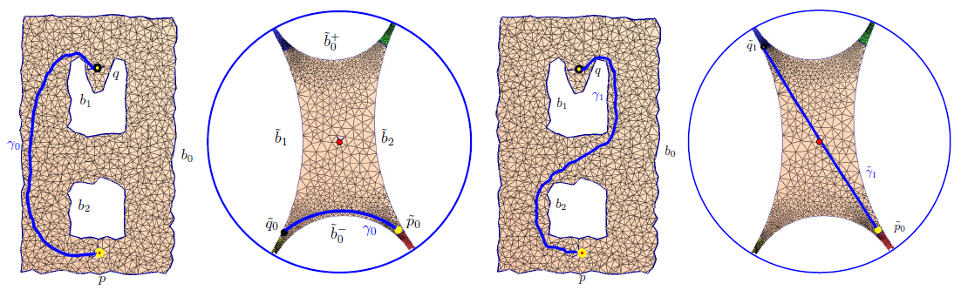
Embed into hyperbolic plane
Greedy routing on the universal covering space finds paths of different homotopy types. [Zeng, Sarkar, Luo, Gu, Gao, 2010]

Slide 58
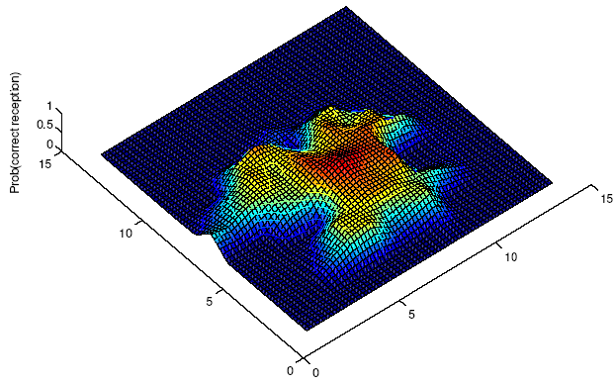
Conclusion
Many nice geometric problems
Modeling the problem is important
“All models are wrong, but some are useful.” [George E. P. Box]
Unit disk graph model
In reality,

Slide 59
Questions and Comments
http://www.cs.sunysb.edu/~jgao
jgao@cs.sunysb.edu
Jie Gao and Leo Guibas, Geometric Algorithms for Sensor Networks, Philosophical Transactions of the Royal Society A, 2012.

