Slide 1
Computing the Center of Uncertain Points on Tree Networks
Haitao Wang
Jingru Zhang
Utah State University

Slide 2

An uncertain point on a tree T
An uncertain point $P_{i}$ has at most m possible locations on T, and each location has a probability
0.2
0.1
0.4
0.3
0.1

Slide 3











An uncertain point
The expected distance from $P_{i}$ to a point x is
$$Ed\left(P_{i},x\right)=w_{i}∙\sum_{j=1}^{m}{f_{ij}∙d(x,p_{ij})}$$
$$f_{i3}$$
$$p_{i3}$$
$$f_{i2}$$
x
$$f_{i5}$$
$$f_{i1}$$
$$p_{i2}$$
$$p_{i5}$$
$$p_{i1}$$
$$f_{i4}$$
$$p_{i4}$$

Slide 4





Problem definition
Input: a tree T
a set $P$ of n uncertain points each with m locations on T
Output: the center $x^{∗}$ to minimize $\max_{1≤i≤n}{Ed(P_{i},x)}$
T
$P_{1}$ ------
$$x^{∗}$$
$P_{2}$ ------
$P_{3}$ ------

Slide 5
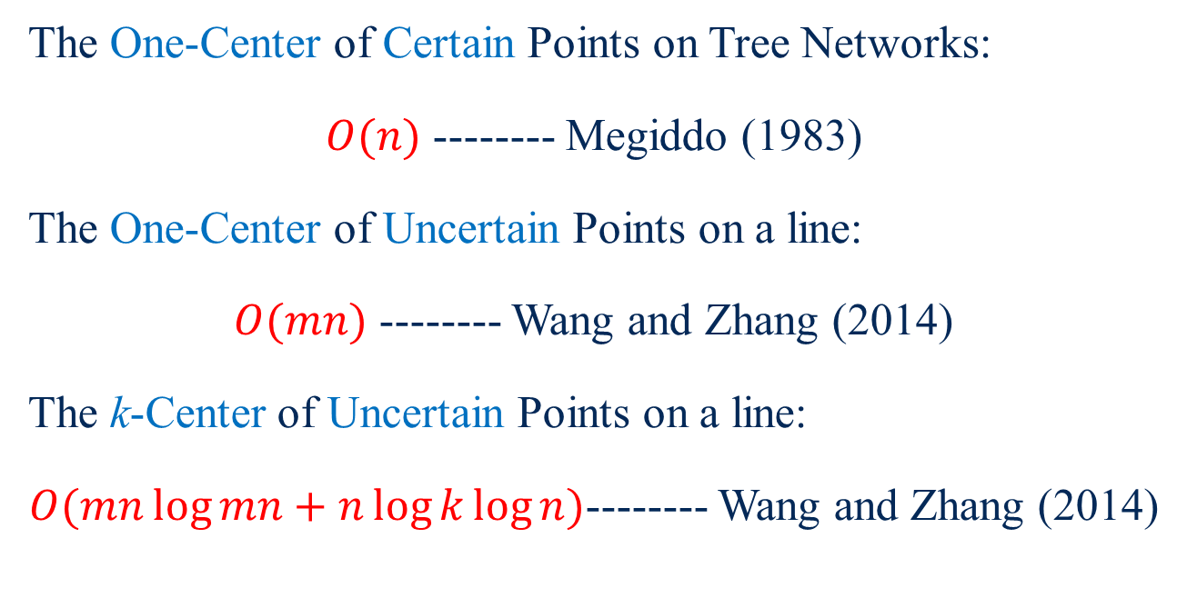
Related works
The One-Center of Certain Points on Tree Networks:
$O(n)$ -------- Megiddo (1983)
The One-Center of Uncertain Points on a line:
$O(mn)$ -------- Wang and Zhang (2014)
The k-Center of Uncertain Points on a line:
$O(mn\log{mn}+n\log{k}\log{n})$-------- Wang and Zhang (2014)

Slide 6
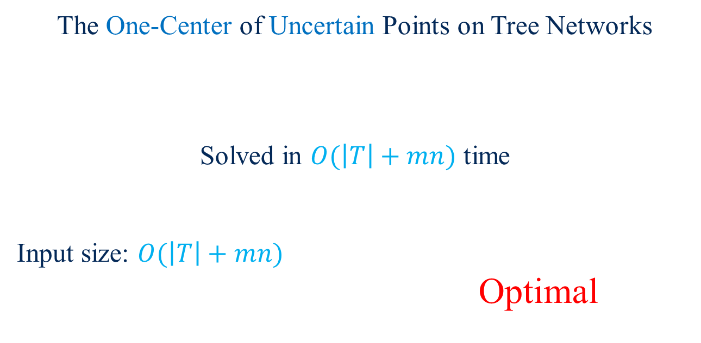
Our result
The One-Center of Uncertain Points on Tree Networks
Solved in $O(\left|T\right|+mn)$ time
Input size: $O(\left|T\right|+mn)$
Optimal

Slide 7





The vertex-constrained version
Input: a tree $T$ and a set $P$ of n uncertain points on $T$
each $p_{ij}$ is at a vertex of $T$ and each vertex holds a location $p_{ij}$
Output: the center $x^{∗}$ to minimize $\max_{1≤i≤n}{Ed(P_{i},x)}$
T
$P_{1}$ ------
$$x^{∗}$$
$P_{2}$ ------
$P_{3}$ ------

Slide 8

Problem reduction
Our problem
The vertex-constrained version
$O(\left|T\right|+mn)$ time

Slide 9


The problem
The vertex-constrained version:
Find the center $x^{∗}$ of a set $P$ of n uncertain points on $T$
$P_{i}$ ------ $m$ possible locations (each being at a vertex of $T$)
$|T|=O(mn)$
$$x^{∗}$$

Slide 10



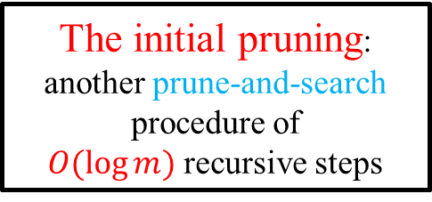

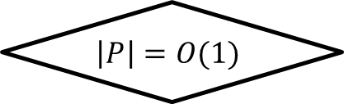
The prune-and-search framework
Our result:
Finding $x^{∗}$ of n uncertain points of $P$ on T in $O(|T|)$ time
Each round: Prune $\frac{1}{8}n$ uncertain points of $P$
The initial pruning:
another prune-and-search procedure of
$O(\log{m})$ recursive steps
N
$$\left|P\right|=O(1)$$
Y
Prune $\frac{1}{8}n$ uncertain points
Compute $x^{∗}$ in $O(m)$ time

Slide 11




An observation
Given any point x on T, we can determine whether x is $x^{∗}$, and if not, determine which subtree of x contains $x^{∗}$ in $O(|T|)$ time.
$$T_{2}(x)$$
$$T_{1}(x)$$
$$x$$

Slide 12








The initial pruning
$T_{1}(c)$ contains $x^{∗}$ and $\left|T_{1}\left(c\right)\right|<\frac{\left|T\right|}{2}+1$
$$T_{5}(c)$$
$$T_{1}(c)$$
$$x^{∗}$$
$$T_{2}(c)$$
$$c$$
$$T_{4}(c)$$
c --- the centroid of T
$$T_{3}(c)$$

Slide 13
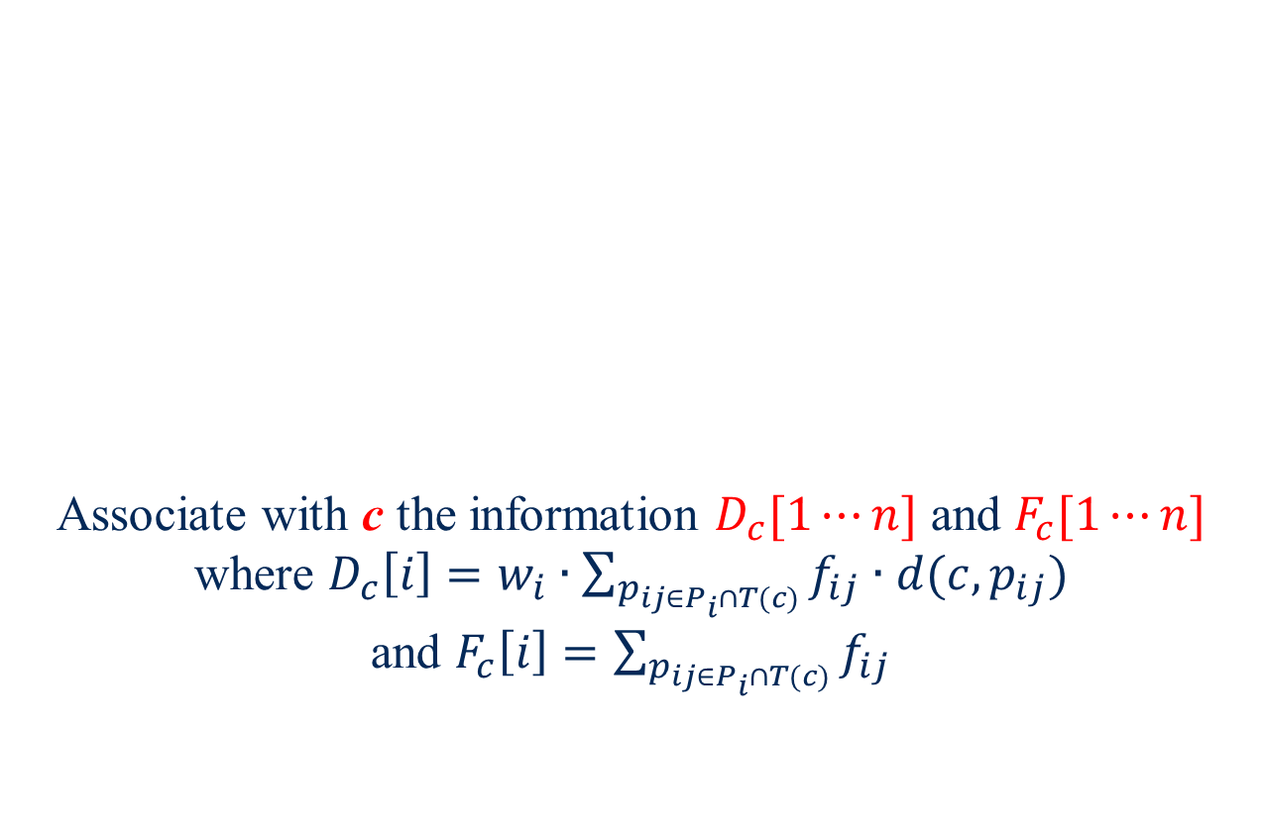





Pruning $T\backslash T_{1}(c)$
$$T\left(c\right)=\left(T\backslash T_{1}\left(c\right)\right)∪\{c\}$$
Associate with c the information $D_{c}[1⋯n]$ and $F_{c}[1⋯n]$
where $D_{c}\left[i\right]=w_{i}∙\sum_{p_{ij∈P_{i}∩T(c)}}{f_{ij}∙d(c,p_{ij})}$
and $F_{c}\left[i\right]=\sum_{p_{ij∈P_{i}∩T(c)}}{f_{ij}}$
$$T(c)$$
$$c$$
$$T_{1}(c)$$

Slide 14





Pruning $T\backslash T_{1}(c)$
c -------- connector
$$D_{c}[1⋯n]$$
$$c$$
$$F_{c}[1⋯n]$$
$$T_{1}(c)$$

Slide 15



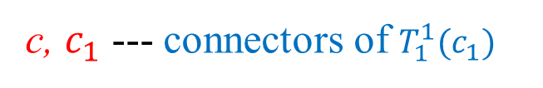







Finding $x^{∗}$ on $T_{1}\left(c\right)$
centroid
$$T_{1}(c)$$
$$D_{c_{1}}[1⋯n]$$
$$c_{1}$$
$$T_{1}^{2}(c_{1})$$
$$F_{c_{1}}[1⋯n]$$
$$c$$
$$T_{1}^{1}(c_{1})$$
$$x^{∗}$$
Find $x^{∗}$ on $T_{1}^{1}(c_{1})$ and $\left|T_{1}^{1}\left(c_{1}\right)\right|<\frac{\left|T\right|}{4}+1$
c, $c_{1}$ --- connectors of $T_{1}^{1}(c_{1})$

Slide 16



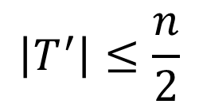
The initial pruning
$O(\log{m})$ recursive steps ----- $O(\left|T\right|+n)$ time
A subtree $T^{′}$ of T contains $x^{∗}$ and $C$ connectors
$$T^{′}$$
$$\left|T^{′}\right|≤\frac{n}{2}$$
$$C=O(\log{m})$$

Slide 17

An observation
$$\left|T^{′}\right|≤\frac{n}{2}$$
At most $\frac{n}{2}$ uncertain points having locations in $T^{′}$
$P^{′}$

Slide 18






Pruning uncertain points - $C=1$
For any two uncertain points $P_{i},P_{j} ∈P^{′}$ with $Ed\left(c, P_{i}\right)>Ed\left(c, P_{j}\right)$, $Ed\left(x, P_{i}\right)≥Ed\left(x, P_{j}\right)$ if and only if $d\left(c,x\right)≤t_{ij}$
If $d\left(x^{∗},c \right)<t_{ij}$, prune $P_{j}$; otherwise, prune $P_{i}$.
$$T^{′}$$
$$c$$
$$\left(P_{i},P_{j}\right)$$
t-value: $t_{ij}$

Slide 19








Determining $d\left(x^{∗},c \right)≤t_{ij}$
$$d\left(x,c \right)>t_{ij}$$
Several disjoint subtrees $\left\{{T_{1}}^{′},⋯{T_{h}}^{′}\right\}$ of $T^{′}$
If $x^{∗}∉{T_{k}}^{′}$ for any $1≤k≤h$, $d\left(x^{∗},c \right)≤t_{ij}$
Call it “the Center-Detecting Problem”
$${T_{3}^{}}^{′}$$
$${T_{4}^{}}^{′}$$
$$c$$
$${T_{5}^{}}^{′}$$
$${T_{2}^{}}^{′}$$
$${T_{1}^{}}^{′}$$

Slide 20









The center-detecting problem
Input: $T_{1}$, $T_{2}$, ∙∙∙, $T_{h}$ are disjoint subtrees of T
Goal: to determine whether $x^{∗}$ lies in one of $T_{1}$, $T_{2}$, ∙∙∙, $T_{h}$
We solve the problem in $O(T)$ time
$$T_{2}$$
$$T_{4}$$
$$T_{5}$$
$$T$$
$$T_{1}$$
$$T_{7}$$
$$T_{3}$$
$$T_{6}$$

Slide 21
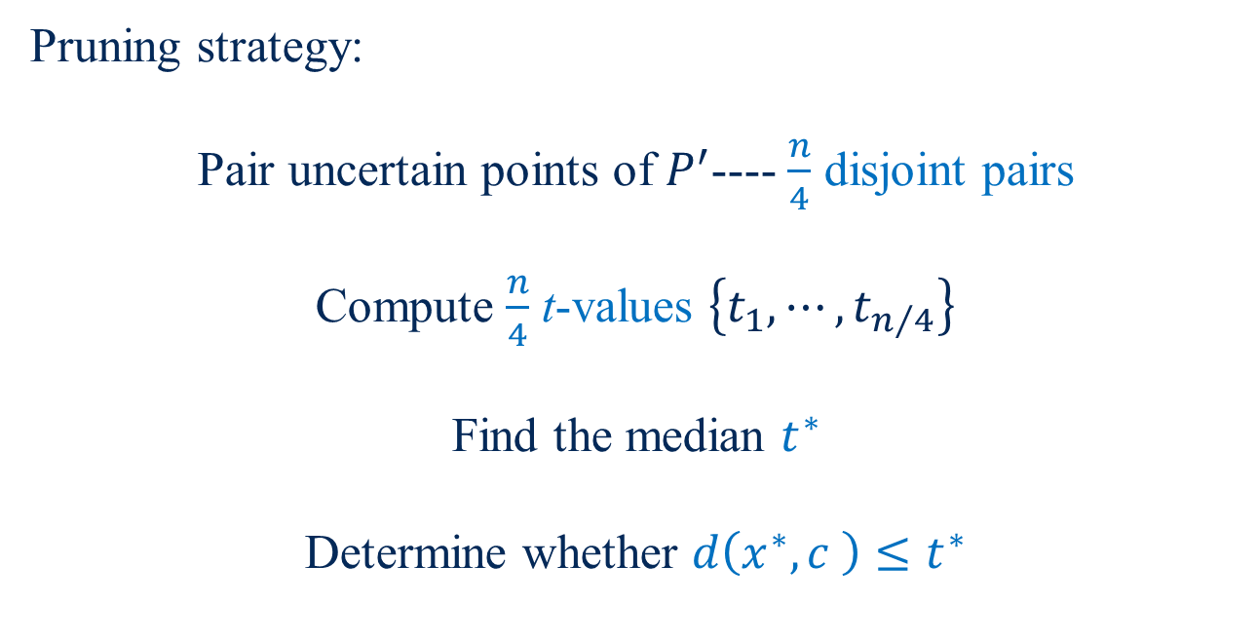
Pruning uncertain points - $C=1$
Pruning strategy:
Pair uncertain points of $P^{′}$---- $\frac{n}{4}$ disjoint pairs
Compute $\frac{n}{4}$ t-values $\left\{t_{1}, ⋯, t_{n/4}\right\}$
Find the median $t^{∗}$
Determine whether $d\left(x^{∗},c \right)≤t^{∗}$

Slide 22









Determining whether $d\left(x^{∗},c \right)≤t^{∗}$
$d\left(x,c \right)>t^{∗}$ disjoint subtrees $\left\{{T_{1}}^{′},⋯{T_{h}}^{′}\right\}$
$$T^{′}$$
$$T_{3}^{′}$$
$$T_{4}^{′}$$
$$c$$
$$T_{5}^{′}$$
$$T_{2}^{′}$$
$$T_{1}^{′}$$

Slide 23

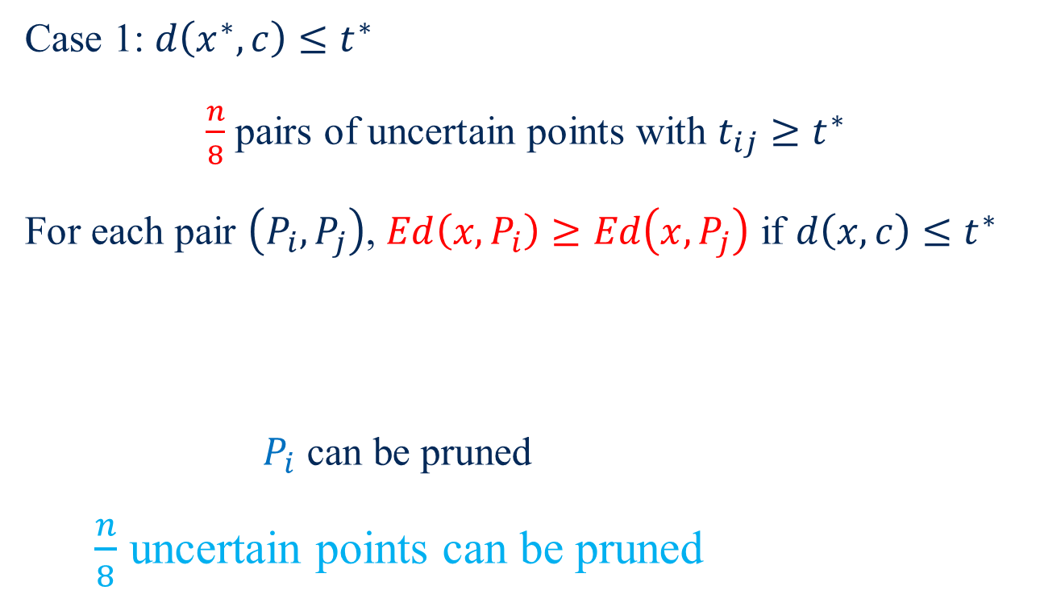







Pruning uncertain points - $C=1$
Case 1: $d\left(x^{∗},c\right)≤t^{∗}$
$\frac{n}{8}$ pairs of uncertain points with $t_{ij}≥t^{∗}$
For each pair $\left(P_{i}, P_{j}\right)$, $Ed\left(x, P_{i}\right)≥Ed\left(x, P_{j}\right)$ if $d\left(x,c\right)≤t^{∗}$
$P_{i}$ can be pruned
$\frac{n}{8}$ uncertain points can be pruned
$$T_{3}^{′}$$
$$T_{4}^{′}$$
$$c$$
$$T_{5}^{′}$$
$$T_{2}^{′}$$
$$T_{1}^{′}$$
$$T^{′}$$

Slide 24

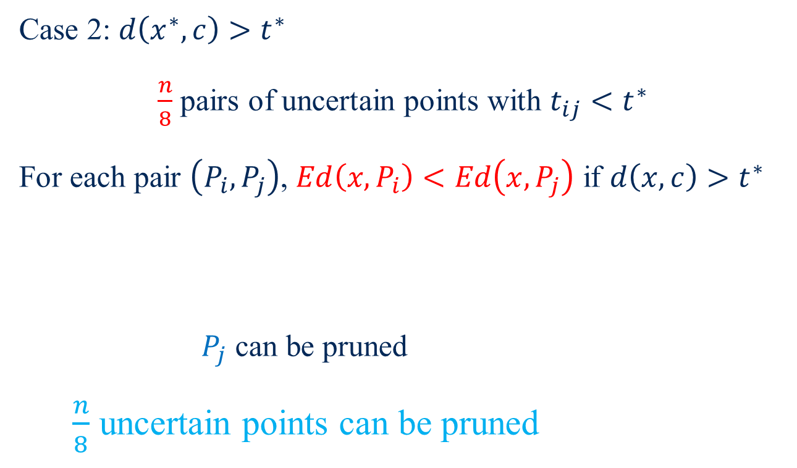

Pruning uncertain points - $C=1$
Case 2: $d\left(x^{∗},c\right)>t^{∗}$
$\frac{n}{8}$ pairs of uncertain points with $t_{ij}<t^{∗}$
For each pair $\left(P_{i}, P_{j}\right)$, $Ed\left(x, P_{i}\right)<Ed\left(x, P_{j}\right)$ if $d\left(x,c\right)>t^{∗}$
$P_{j}$ can be pruned
$\frac{n}{8}$ uncertain points can be pruned
$$T_{3}^{′}$$
$$T_{4}^{′}$$
$$c$$
$$T_{5}^{′}$$
$$T_{2}^{′}$$
$$T_{1}^{′}$$
$$T^{′}$$

Slide 25







Pruning uncertain points - $C=1$
For each location $p_{ij}$ of an unpruned $P_{i}$ on $T/T^{′}$, create a vertex and connect it with $c$ by an edge of length $d(p_{ij},c)$
A tree $T^{+}$ contains $\frac{7}{8}n$ uncertain points and $\frac{7}{8}mn$ vertices
$$T/T^{′}$$
$$T^{′}$$
$$p_{ij}$$
$$p_{ij}$$
$$c$$
$$c$$

Slide 26

Pruning uncertain points - $C=1$
Finding the center of n uncertain points on T
Finding the center of $\frac{7}{8}n$ uncertain points on $T^{+}$

Slide 27

The initial pruning
$O(\log{m})$ recursive steps ----- $O(\left|T\right|+n)$ time
A subtree $T^{′}$ of T contains $x^{∗}$ and $C$ connectors
$$T^{′}$$
$$\left|T^{′}\right|≤\frac{n}{2}$$
$$C=O(\log{m})$$

Slide 28






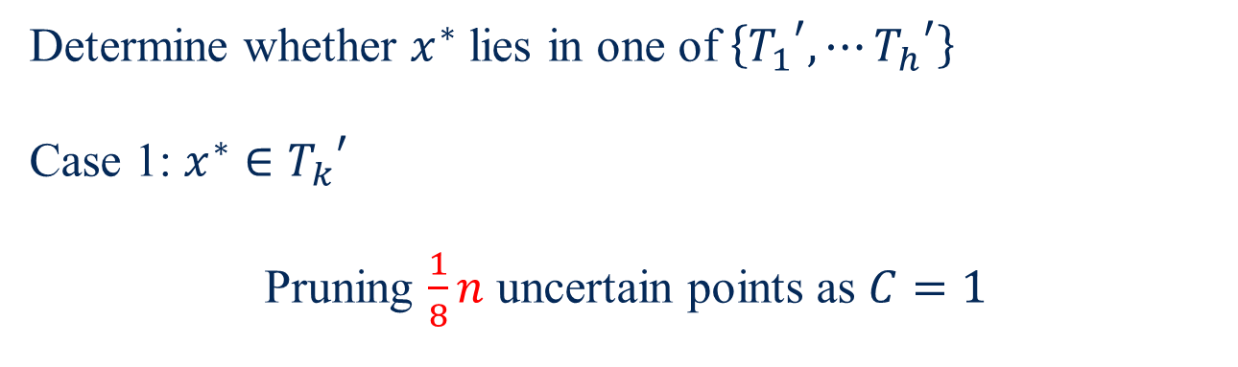




Pruning uncertain points - $C=2$
$$T^{′}$$
$$T_{3}^{′}$$
$$T_{4}^{′}$$
$$T_{5}^{′}$$
$$c_{1}$$
$$c_{2}$$
$$T_{2}^{′}$$
$$x^{∗}$$
$$T_{1}^{′}$$
Determine whether $x^{∗}$ lies in one of $\left\{{T_{1}}^{′},⋯{T_{h}}^{′}\right\}$
Case 1: $x^{∗}∈{T_{k}}^{′}$
Pruning $\frac{1}{8}n$ uncertain points as $C=1$

Slide 29












Pruning uncertain points - $C=2$
Case 2: $x^{∗}∈π(c_{1},c_{2})$
For any two uncertain points $P_{i}, P_{j}∈P^{′}$ and a point $x∈π(c_{1},c_{2})$, the $t$-value $t_{ij}$ exists such that $Ed\left(x,P_{i}\right)≥Ed\left(x,P_{j}\right)$ if and only if $d(c_{1},x)≤t_{ij}$.
$$T_{3}^{′}$$
$$T_{4}^{′}$$
$$T_{5}^{′}$$
$$\left(P_{i}, P_{j}\right)$$
$$c_{1}$$
$$c_{2}$$
$t$-value: $t_{ij}$
x
$$T_{2}^{′}$$
$$T_{1}^{′}$$
$$Ed\left(x,P_{i}\right)≥Ed\left(x,P_{j}\right)$$

Slide 30
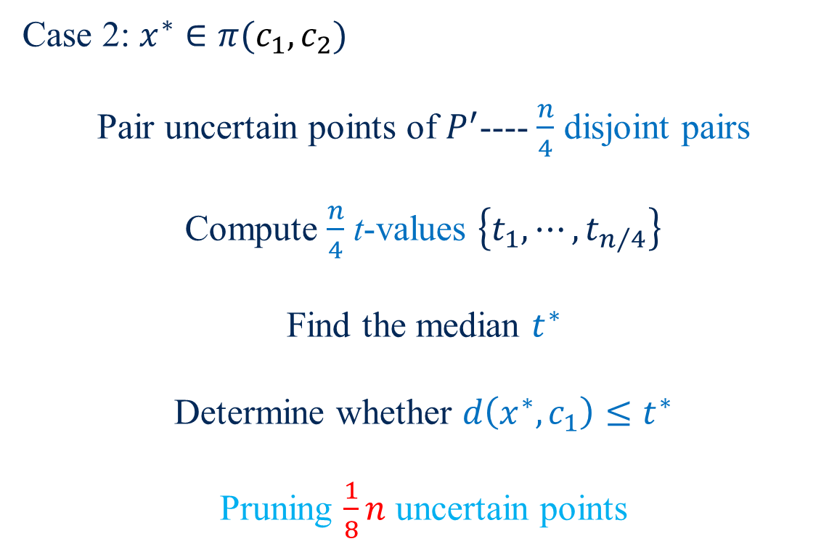

Pruning uncertain points - $C=2$
Case 2: $x^{∗}∈π(c_{1},c_{2})$
Pair uncertain points of $P^{′}$---- $\frac{n}{4}$ disjoint pairs
Compute $\frac{n}{4}$ t-values $\left\{t_{1}, ⋯, t_{n/4}\right\}$
Find the median $t^{∗}$
Determine whether $d\left(x^{∗},c_{1}\right)≤t^{∗}$
Pruning $\frac{1}{8}n$ uncertain points

Slide 31







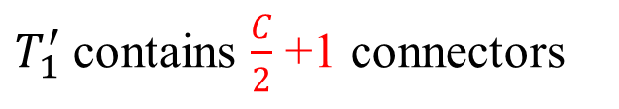
Pruning uncertain points - $C>2$
Centroid of connectors
$$x^{∗}$$
$$T_{2}^{′}$$
$$T^{′}$$
$$T_{1}^{′}$$
$$T_{3}^{′}$$
$$T_{4}^{′}$$
$T_{1}^{′}$ contains $\frac{C}{2}$ +1 connectors

Slide 32






Pruning uncertain points - $C>2$
$O(\log{\log{m}})$ recursive steps
$$T^{′}$$
$O\left(n\log{m}\right)$ time
C$=1$
C$=2$

Slide 33
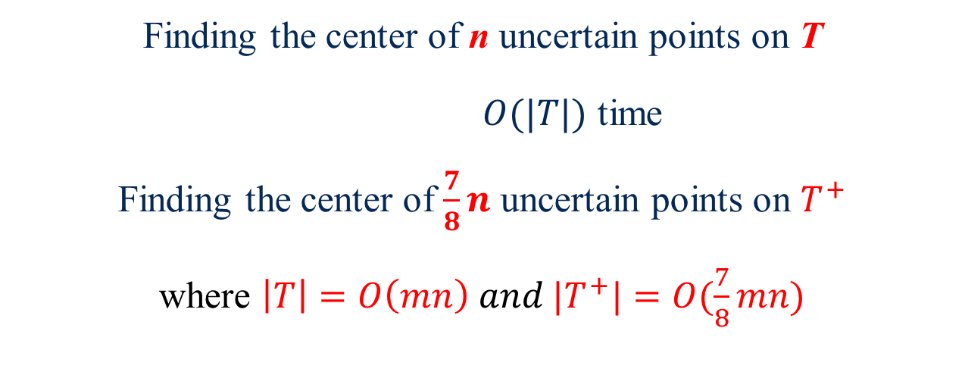
After each round
Finding the center of n uncertain points on T
$O(|T|)$ time
Finding the center of $\frac{7}{8}n$ uncertain points on $T^{+}$
where $\left|T\right|=O\left(mn\right) and {|T}^{+}|=O(\frac{7}{8}mn)$

Slide 34


After $O(\log{mn})$ rounds
Finding the center of $O(1)$ uncertain points on $T^{+}$
Where ${|T}^{+}|=O(m)$
Solved in $O(m)$ time

Slide 35
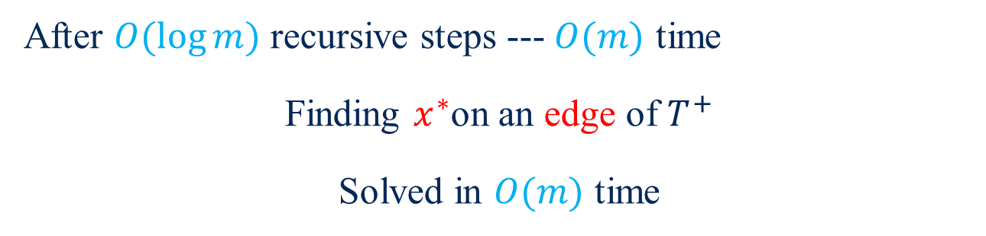



Finding $x^{∗}$of $O(1)$ uncertain points on $T^{+}$
$$x^{∗}$$
Centroid
$$T^{+}$$
After $O(\log{m})$ recursive steps --- $O(m)$ time
Finding $x^{∗}$on an edge of $T^{+}$
Solved in $O(m)$ time

Slide 36
Thanks!

