Slide 1
Shortest Paths Among Obstacles in the Plane Revisited
Haitao Wang
Utah State University
SODA 2021

Slide 2
Problem definition
P: a set of disjoint polygonal obstacles in the plane
n: the total number of all vertices
Free space: the space outside all obstacles
s, t: two points
Goal: find a Euclidean shortest s-t path in the free space
Single-source-shortest-paths:
s is given as a source point
t is a query point
build a data structure to answer shortest path queries
shortest path map SPM(s): O(n) space
O(log n) query time
t
s

Slide 3
Previous work and our result
Lower bound: Ω(n log n) time
Two methods:
Visibility graphs
compute the visibility graph G
find a shortest s-t path in G
Ω(n²) time as G has Ω(n²) edges
Continuous Dijkstra
O(n^{3/2+ε}) time, Mitchell, ’96
O(n log n) time, Hershberger and Suri, ’99
O(n log n) space
O(n) space, our result
for single shortest path only
builds SPM(s)
t
s

Slide 4
Main idea
Two parts of the HS algorithm (Hershberger and Suri) need O(n log n) space
Use persistent binary trees (with path-copying) to represent wavefronts
O(n) bisector events, each costing O(log n) extra space
Our solution:
Divide the algorithm into O(log n) phases, each involving O(n / log n) bisector events
Total extra space for each phase is O(n)
Reset the space at the end of each phase:
store a “snapshot” of the algorithm such that
it contains sufficient information for the algorithm to proceed as usual
its space is only O(n)
Build SPM(s) after the wavefront expansion algorithm, using the following information computed during the algorithm
wavefronts of the edges of a conforming subdivision of the free space
O(n) marked generators (each generator is an obstacle vertex)
Our solution: mark additional O(n) generators such that all generators maintain sufficient information to restore all wavefronts that are needed to construct SPM(s)

Slide 5
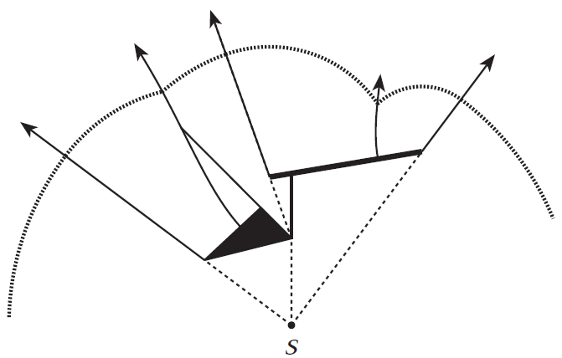
Review of the HS algorithm
The difficulty of continuous Dijkstra: how to maintain the wavefront (consisting of all points with the same geodesic distance from s)
a sequence of wavelets, each centered at an obstacle vertex, called a generator (shortest path from s to every point of the wavelet through its generator)
a wavefront is represented by a list of generators
need a geometric structure to
guide the wavefront expansion
from HS

Slide 6
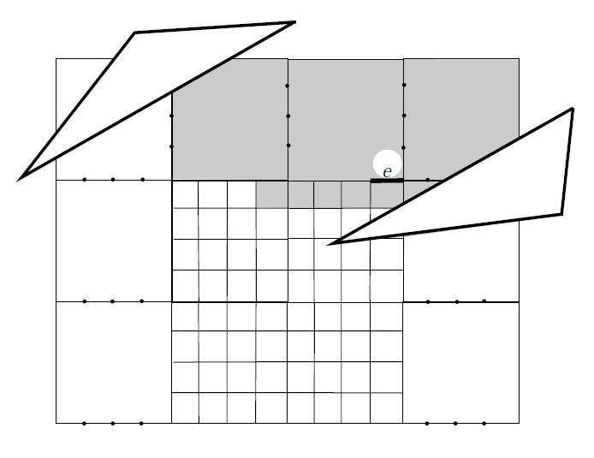
A conforming subdivision S
O(n) cells of O(1) edges each
Transparent edges (axis-parallel)
Obstacle/opaque edges
Each (transparent) edge e has a well-covering region U(e)
union of O(1) cells
e is inside U(e)
well-covering property: for each edge f on ∂U(e), d(e,f) ≥ 2|e| and d(e,f) ≥ 2|f|
S can be constructed in O(n log n) time and O(n) space
opaque
f
transparent
from HS

Slide 7
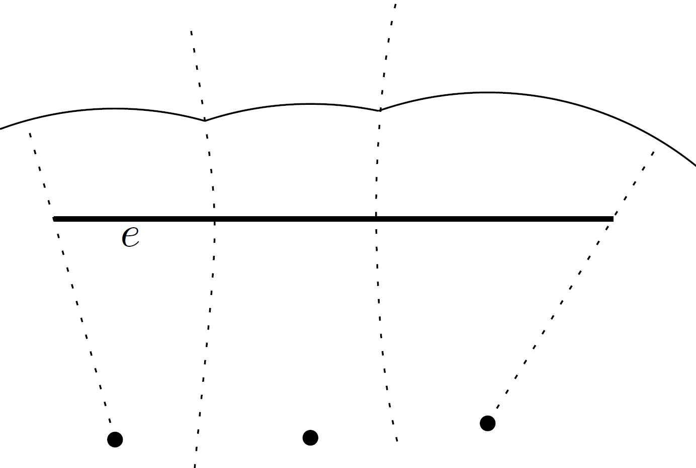
Using S to guide the wavefront expansion
Difficult to maintain a true wavefront
Maintain two one-sided wavefronts W(e) for each edge e of S
each representing the wavefront coming from one side of e
input(e): the set of edges f on the boundary of U(e)
W(e) is constructed from W(f) for edges f of input(e)
output(e) = { f | e ϵ input(f)} U input(e)
|input(e)| = O(1)
|output(e)| = O(1)
f
All edges of input(e) and
output(e) are within
O(1) cells from e
e
U(e)

Slide 8
Two major procedures of the wavefront expansion algorithm
Wavefront propagation procedure:
Propagating W(e) to all edges g ϵ output(e) , i.e., computing W(e, g), the portion of W(e) that arrives at g
Wavefront merging procedure:
Merging W(f, e) for edges f ϵ input(e) to construct W(e)
g
e
f
e
U(e)

Slide 9
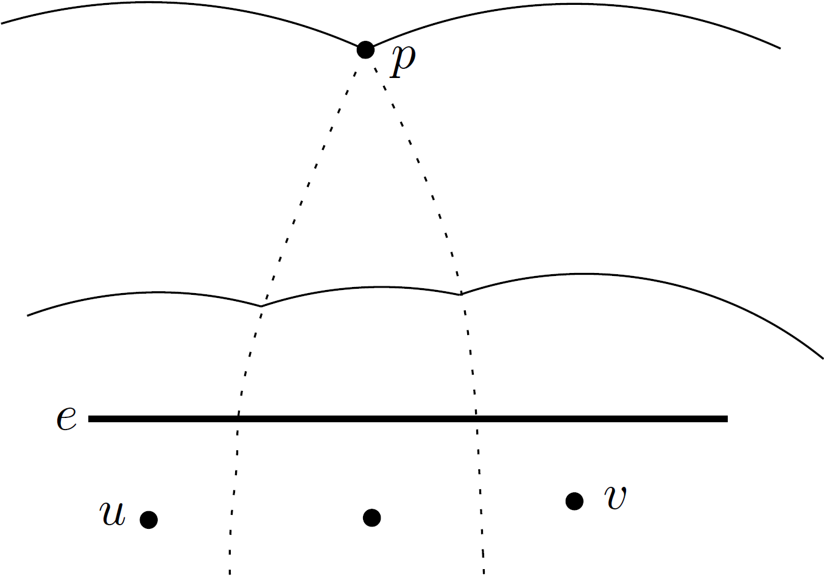
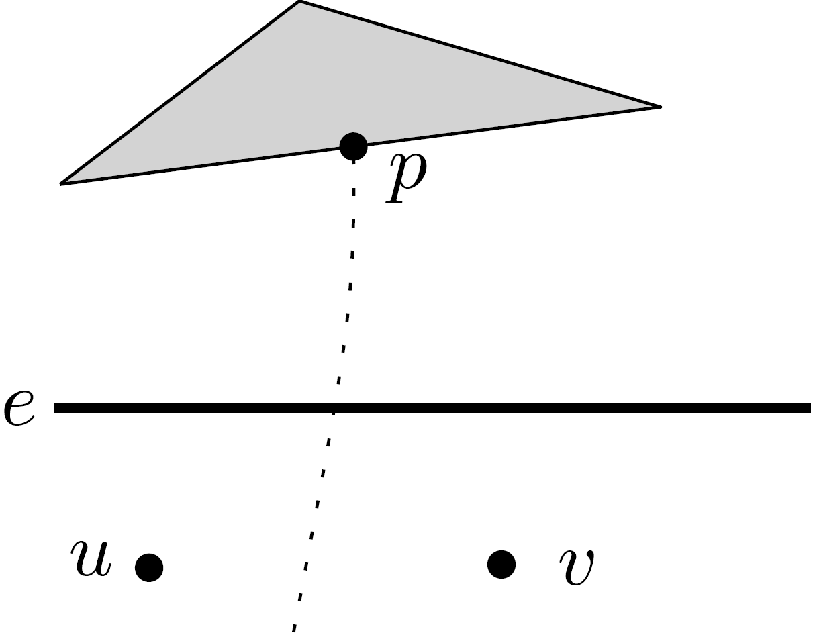
Bisector events
Type 1: two bisectors intersect
Type 2: a bisector intersects an obstacle

Slide 10
The wavefront expansion algorithm
s
Process the edges e of S in a rough time/distance order
Construct W(e) at time covertime(e) = d’(s,e) + |e|
d’(s,e): minimum distance from s to the two endpoints of e
a conservative time when all points of e are covered by the true wavefront
Pseudocode:
While there are unprocessed edges of S
find an unprocessed edge e with minimum covertime(e);
call wavefront merging procedure on e;
//construct W(e) from W(f, e) for f ϵ input(e)
call wavefront propagation procedure on e;
//compute W(e,g) for all g ϵ output(e) and update covertime(g)
Time and space:
O(n) bisector events in total
Each W(e) is represented by a persistent binary tree (with path-copying)
O(log n) time and extra space for each bisector event
O(n log n) time and space
e

Slide 11
Why need persistent trees?
Wavefront propagation procedure:
Computing W(e,g) for all edges g ϵ output(e)
After W(e,g₁) is computed for some g₁ ϵ output(e), W(e) needs to be kept for computing W(e,g) for other g ϵ output(e)
Constructing SPM(s)
W(e) needs to be kept also for constructing SPM(S), which is done after the wavefront expansion algorithm
Wavefront merging procedure:
Merging W(f,e) for edges f ϵ input(e) to construct W(e)
Persistent trees are NOT needed because after W(e) is constructed, W(f,e) is not useful anymore
g₂
g₁
f₂
f₁
W(e)
W(f₁,e)
W(f₂,e)
e
e

Slide 12
Our contribution: reducing the space to O(n)
Still use persistent trees
Divide the wavefront propagation procedure of the entire algorithm into O(log n) phases, each involving O(n / log n) bisector events
The extra space introduced by the persistent trees in each phase O(n)
Reset the space at the end of each phase:
maintain a “snapshot” of the algorithm such that
it contains sufficient information for the algorithm to proceed as usual
its space is only O(n)
disregard all other space
intuitively, the snapshot is the “forefront” of the true wavefront
Total space: O(n)
Time: O(n log n)

Slide 13
Details
Maintain a counter in the wavefront propagation procedure to record the number of bisector events that have been processed since the last space-reset
If counter < n / log n, proceed as usual
Otherwise, reset the space and store the following information (the snapshot):
(g: the edge of output(e) whose W(e, g) is currently being computed)
Store the tree that is currently being used to compute W(e, g)
For each g’ ϵ output(e) \ {g} whose W(e, g’) has been computed, store W(e, g’)
Store W(e)
For each edge e’ of S \ {e}, if e’ has been processed (i.e., W(e’) already propagated to output(e’)) and there is an edge g’ ϵ output(e’) whose W(g’) has not been constructed yet, store W(e’, g’)
The snapshot has sufficient information
The total space of the snapshot is O(n)
g’
g’
g
W(e’)
W(e)
e’
e

Slide 14
Constructing SPM(s)
The HS algorithm relies on W(e) for all edges e of S, maintained by persistent trees
With all W(e) as well as O(n) generators marked in the wavefront expansion algorithm, SPM(s) can be constructed in O(n log n) time and O(n) space
Due to the space reset in our new algorithm, W(e) is not available anymore
Need to restore W(e) for those edges e that are needed to construct SPM(s)
Observation: Mark additional O(n) generators during the wavefront
For each originally marked generator, mark its two neighbors as well
These marked generators suffice to restore W(e) for those edges e that are needed to construct SPM(s)
Summary:
O(n log n) time and O(n) space to construct SPM(s)

Slide 15
Thank you for your attention

