Slide 1
Dispersing Points on Intervals
Shimin Li and Haitao Wang
Utah State University

Slide 2
Problem Definition
Given $n$ non-overlapping intervals on a line $ℓ$.
Find a point on each interval.
Objective: Maximize the minimum distance of any pairwise points
$$ℓ$$
$$I_{1}$$
$$I_{2}$$
$$I_{3}$$
$$I_{4}$$
$$p_{1}$$
$$p_{2}$$
$$p_{3}$$
$$p_{4}$$

Slide 3
The Cycle Version
$$I_{1}$$
$$I_{2}$$
$$p_{2}$$
In a cycle version, the intervals are arcs on a cycle $C$.
$$p_{1}$$
$$I_{3}$$
$$p_{3}$$
$$p_{4}$$
$$I_{4}$$

Slide 4
Previous Work and Our Results
Previous Work:
Two or high-dimensional space
Many problem variations, NP-hard in general
1D
No previous work particularly on 1D
Our Result (for 1D):
An $O(n)$ time greedy algorithm

Slide 5
An Example
$$ℓ$$
$$I_{1}$$
$$I_{2}$$
$$I_{3}$$
$$I_{4}$$
$$p_{1}$$
$$p_{2}$$
$$p_{3}$$
$$p_{4}$$
$$|p_{1}p_{2}|$$
$$|p_{2}p_{3}|$$
The minimum distance is $\left|p_{1}p_{2}\right|=|p_{2}p_{3}|$

Slide 6
Notation
$$ℓ$$
$$I_{i}$$
$$I_{j}$$
$$l_{i}$$
$$p_{i}$$
$$r_{i}$$
$$l_{j}$$
$$p_{j}$$
$$r_{j}$$
$I_{i}$: The $i$-th interval
$l_{i}$: The left endpoint of $I_{i}$
$r_{i}$: The right endpoint of $I_{i}$
$p_{i}$: The point on $I_{i}$

Slide 7

An Observation
Spacing points evenly can maximize the minimum distance
$$ℓ$$
$$I_{i}$$
$$I_{j}$$
$$p_{i}$$
$$p_{k}$$
$$p_{j}$$
$$d_{opt}≤\frac{r_{j}−l_{i}}{j−i}$$

Slide 8
An Observation(Cont.)
$$d_{opt}=\min_{1≤i<j≤n}{\frac{r_{j}−l_{i}}{j−i}}$$
An O(n²) time algorithm:
Compute each value of $d_{ij}=\frac{r_{j}−l_{i}}{j−i}$, for $1≤i<j≤n$.
Improve to $O(n)$ time.

Slide 9
A Greedy Algorithm
Place points on intervals from left to right.
Place the first point on the left endpoint of $I_{1}$.
$$ℓ$$
$$I_{1}$$
$$p_{1}$$
$$d_{min}=+∞$$
$d_{min}$: The current minimum distance

Slide 10
A Greedy Algorithm (Cont.)
Try to maximize the minimum distance.
$$ℓ$$
$$I_{1}$$
$$I_{2}$$
$$p_{1}$$
$$p_{2}$$
Its position may be changed later
$$d_{min}=|l_{1}r_{2}|$$

Slide 11
A Greedy Algorithm (Cont.)
Try to decrease the minimum distance as small as possible.
Their positions may be changed later
Pending Points
$$ℓ$$
$$I_{1}$$
$$I_{2}$$
$$I_{3}$$
$$p_{1}$$
$$p_{2}$$
$$p_{3}$$
$$d_{min}=\frac{|l_{1}r_{3}|}{3−1}$$
$$d_{min}=|l_{1}r_{2}|$$

Slide 12
An Example(Case I)
$$ℓ$$
$$I_{1}$$
$$I_{2}$$
$$I_{3}$$
$$p_{1}$$
$$p_{2}$$
$$p_{3}$$
$$d_{min}=|l_{1}r_{2}|$$
$$p_{2}+d_{min}≤l_{3}$$
$$d_{min}=|p_{1}p_{2}|$$

Slide 13
An Example(Case II)
$$ℓ$$
$$I_{1}$$
$$I_{2}$$
$$I_{3}$$
$$p_{1}$$
$$p_{2}$$
$$p_{3}$$
$$d_{min}=|l_{1}r_{2}|$$
$$l_{3}<p_{2}+d_{min}≤r_{3}$$
$$d_{min}=\left|p_{1}p_{2}\right|=\left|p_{2}p_{3}\right|$$

Slide 14
An Example(Case III)
$$ℓ$$
$$I_{1}$$
$$I_{2}$$
$$I_{3}$$
$$p_{1}$$
$$p_{2}$$
$$p_{3}$$
$$d_{min}=\frac{|p_{1}p_{3}| }{2}$$
$$d_{min}=|p_{1}p_{2}|$$
$$r_{3}<p_{2}+d_{min}$$
$$ℓ$$
$$I_{1}$$
$$I_{2}$$
$$I_{3}$$
$$p_{1}$$
$$p_{2}$$
$$p_{3}$$
$$d_{min}=|p_{1}p_{2}|$$
$$d_{min}=\frac{|p_{2}p_{3}| }{2}$$
$$r_{3}<p_{2}+d_{min}$$

Slide 15
Case III in General
$$ℓ$$
$$I_{i}$$
$$I_{i+1}$$
$$I_{i+2}$$
$$I_{i+3}$$
$$I_{i+4}$$
$$p_{i}$$
$$p_{i+1}$$
$$p_{i+2}$$
$$p_{i+3}$$
$$p_{i+4}$$
Checking every interval takes $O(n)$ time in total, resulting an overall $O(n^{2})$ time
An $O(n)$ time algorithm:
The key idea: Maintain a critical list of intervals. We only need to check the intervals in the list from left to right. Once an interval is checked, we can remove it from the list.
Overall time: $O(n)$

Slide 16
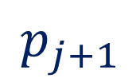
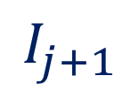
Another Observation
$I_{k}$ could be removed from the critical list.
$$ℓ$$
$$I_{i}$$
$$I_{k}$$
$$I_{h}$$
$$p_{i}$$
$$p_{k}$$
$$p_{h}$$
$$ℓ$$
$$I_{i}$$
$$I_{k}$$
$$I_{h}$$
$$I_{j}$$
$$I_{j+1}$$
$$p_{i}$$
$$p_{k}$$
$$p_{h}$$
$$p_{j}$$
$$p_{j+1}$$

Slide 17
Another Observation (Cont.)
$I_{k}$ should be checked earlier than following intervals in the critical list.
$$ℓ$$
$$I_{i}$$
$$I_{k}$$
$$I_{h}$$
$$p_{i}$$
$$p_{k}$$
$$p_{h}$$
$$ℓ$$
$$I_{i}$$
$$I_{k}$$
$$I_{h}$$
$$I_{j}$$
$$I_{j+1}$$
$$p_{i}$$
$$p_{k}$$
$$p_{h}$$
$$p_{j}$$
$$p_{j+1}$$

Slide 18
An Example
$$ℓ$$
$$I_{6}$$
$$I_{8}$$
$$I_{16}$$
$$I_{19}$$
$$p_{6}$$
$$p_{8}$$
$$p_{16}$$
$$p_{19}$$
$$\frac{l_{8}−l_{6}}{8−6}>\frac{l_{16}−l_{6}}{16−6}$$
$$\frac{l_{16}−l_{8}}{16−8}>\frac{l_{19}−l_{8}}{19−8}$$

Slide 19
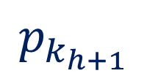
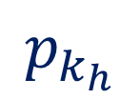
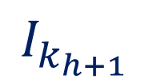
A Critical List of Intervals
$$I_{i}$$
$$I_{k_{h}}$$
$$I_{k_{h+1}}$$
$$I_{j}$$
$$p_{i}$$
$$p_{k_{h}}$$
$$p_{k_{h+1}}$$
$$p_{j}$$
$$(i=k_{1})$$
$$\frac{l_{k_{h+1}}−l_{k_{h}}}{k_{h+1}−k_{h}}>\frac{l_{j}−l_{k_{h}}}{j−k_{h}}(i≤k_{h}<k_{h+1}≤j)$$

Slide 20
A Summary
Maintain a critical list of intervals
Update the list in $O(1)$ amortized time for processing each interval
Total time: $O(n)$

Slide 21
The Cycle Version
$$I_{1}$$
$$I_{2}$$
$$p_{2}$$
In a cycle version, the intervals are arcs on a cycle $C$.
$$p_{1}$$
$$I_{3}$$
$$p_{3}$$
$$p_{4}$$
$$I_{4}$$

Slide 22
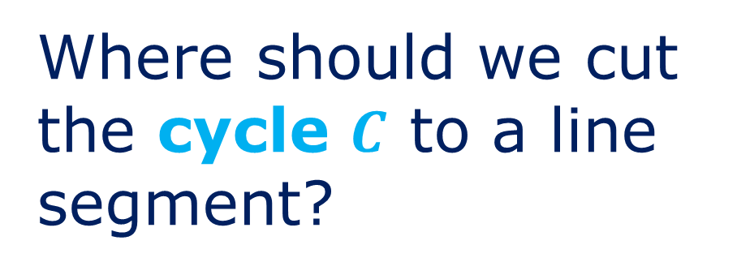
Convert it to a Line Version
$$I_{1}$$
$$I_{2}$$
$$p_{1}$$
Where should we cut the cycle $C$ to a line segment?
$$I_{4}$$
$$p_{1}$$
$$p_{2}$$
$$p_{4}$$
$$p_{2}$$
$$p_{4}$$
$$p_{3}$$
$$I_{3}$$
$$p_{3}$$
$$I_{1}$$
$$I_{2}$$
$$I_{3}$$
$$I_{4}$$
$$ℓ$$
$$p_{1}$$
$$p_{2}$$
$$p_{3}$$
$$p_{4}$$

Slide 23
Duplicate the Line Segment
$$I_{1}$$
$$I_{2}$$
$${p′}_{1}$$
$$I_{1}$$
$$I_{2}$$
$$I_{3}$$
$$I_{4}$$
$$I_{4}$$
$$ℓ$$
$${p′}_{2}$$
$$p_{4}$$
Let $d_{min}=\frac{|C|}{n}$, initially.
$${p′}_{3}$$
$$I_{3}$$
$$I_{1}$$
$$I_{2}$$
$$I_{3}$$
$$I_{4}$$
$${I′}_{1}$$
$${I′}_{2}$$
$${I′}_{3}$$
$${I′}_{4}$$
$$p_{1}$$
$$p_{2}$$
$$p_{3}$$
$$p_{4}$$
$${p′}_{1}$$
$${p′}_{2}$$
$${p′}_{3}$$
$${p′}_{4}$$

Slide 24
Thanks!

