Slide 1


Your Programmable NIC Should Be a Programmable Switch
HotNets 2018
Brent Stephens
Aditya Akella, Mike Swift

Slide 2
Programmable (“Smart”) NICs
It is hard for CPUs to keep up with increasing line-rates (5-120ns per packet @100Gbps)
Offloading to programmable NICs can help drive increasing line-rates (100Gbps+)
P₁
CPU
NIC
App
…
P_{N}
P₁
Programmable NIC
Offload
CPU
App
…
P_{N}

Slide 3









Use Cases:
Programmable NICs can accelerate a wide range of cloud applications and services
Applications
Infrastructure

Slide 4
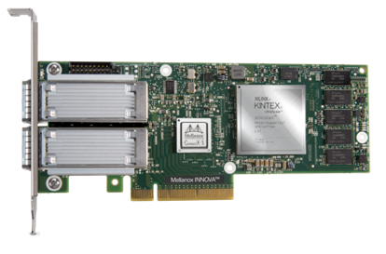
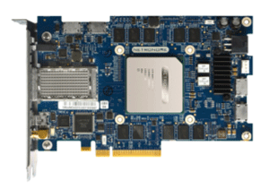
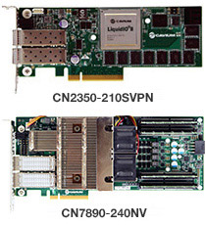
Problem:
Although there are many programmable NICs,
no programmable NIC is good at running multiple offloads
Mellanox Innova-2 Flex
Netronome Agilio LX
NetFPGA Sume
Cavium
Liquid IO II
Azure SmartNIC

Slide 5

NIC Requirements:
Chaining:
It should be possible to send packets through offloads in any order
Generality:
The NIC should not restrict the types of offloads (e.g., FPGAs, ASICs, and CPUs)
High Performance:
The NIC should forward at line-rate without increasing latency
Isolation:
Competing offloads should fairly share resources

Slide 6

Goal
Build a NIC that meets our requirements (and can support a wide-range of diverse offloads)
Solution
PANIC, a programmable NIC that is a programmable switch
Insight: Not every packet uses every offload

Slide 7



Outline
Limitations of Existing NIC Designs
PANIC Overview
Motivation

Slide 8




NIC Design Overview
Pipelined NICs
Tiled NICs
RMT NICs
 | Pipelined NICs | Tiled NICs | RMT NICs | PANIC
Chaining
Generality
Performance
Isolation
x
x
x
x
x

Slide 9
Pipelined NICs
Example: Mellanox Innova-2 Smart NIC
NIC
Benefits:
Problems:
x
Chaining
Generality
Isolation
General: Offload 1 may be an FPGA while Offload N may be an ASIC
Chaining: Static Chaining
Isolation: Head-of-Line Blocking
x

Slide 10


Tiled NICs
Example: Cavium Liquid IO II
NIC
Chaining
Generality
Performance
x
Performance:
High latency
Low per-flow tput
Generality:
Requires CPUs
Chaining:
On-chip network makes chaining easy
Problems:
Benefits:
x

Slide 11
RMT NICs
Example: FlexNIC
NIC
P₁
Match + Action 1
M + A N
to CPU
…
…
P_{N}
Benefits:
Problem:
x
Predictable performance
Protocol Independence
Generality
Performance
Not all offloads can be supported
(e.g., crypto, compression, and RDMA)

Slide 12
PANIC Overview
PANIC Components:
Heavyweight RMT Engines: Parse packets and determine offload chain
High-throughput on-chip network: Forwards packets between engines
Independent Engines
  Distributed Scheduling: Local priority queues
P1
RMT 1
FPGA
1
Core
2
DMA
1
To CPU
P2
RMT 2
Core
1
Crypto/Zip
RDMA/TCP
P3
RMT 3
FPGA
2
Core
3
DMA
2
To CPU

Slide 13
PANIC Satisfies Our Requirements
Chaining: RMT engines compute source routes
Generality: Independent engines may be arbitrary
High Performance: RMT engines and the on-chip network provide high performance
Isolation: Packets are scheduled at every engine
P1
RMT 1
FPGA
1
Core
2
DMA
1
To CPU
P2
RMT 2
Core
1
Crypto/Zip
RDMA/TCP
P3
RMT 3
FPGA
2
Core
3
DMA
2
To CPU

Slide 14



Life of a Packet in PANIC
Pkt Hdrs (L2/L3/L4)
Packets: Search with HW-accel for machine learning
Engines: FPGA 1 -> DMA 1
P1
RMT 1
FPGA
1
Core
2
DMA
1
To CPU
Pkt Hdrs (L2/L3/L4)
Packets: VSwitch offload for container to container networking
Engines: DMA 2 -> RMT 2 -> DMA 1
P2
RMT 2
Core
1
Crypto/Zip
RDMA/TCP
P3
RMT 3
FPGA
2
Core
3
DMA
2
Pkt Hdrs (L2/L3/L4)
To CPU
Packets: Encrypted One-sided RDMA
Engines: Crypto -> RMT 3 -> RDMA -> RMT 3 -> P3

Slide 15
Life of a Packet in PANIC
Pkt Hdrs (L2/L3/L4)
Packets: Search with HW-accel for machine learning
Engines: FPGA 1 -> DMA 1
P1
RMT 1
FPGA
1
Core
2
DMA
1
To CPU
Pkt Hdrs (L2/L3/L4)
Packets: VSwitch offload for container to container networking
Engines: DMA 2 -> RMT 2 -> DMA 1
P2
RMT 2
Core
1
Crypto/Zip
RDMA/TCP
P3
RMT 3
FPGA
2
Core
3
DMA
2
Pkt Hdrs (L2/L3/L4)
To CPU
Packets: Encrypted One-sided RDMA
Engines: Crypto -> RMT 3 -> RDMA -> RMT 3 -> P3

Slide 16

PANIC Feasibility:
PANIC needs sufficient throughput from both:
RMT Pipeline
On-Chip Network
Reasonable RMT pipelines and on-chip networks provide high throughput and long chains!

Slide 17





Future PANIC
Implementation
and
simulation
Build new offloads and languages
Topology Design and Engine Placement

Slide 18

Conclusions
Supporting a wide-range of diverse offloads is difficult on current NICs
PANIC overcomes the limitations of existing designs with an on-NIC switch

