Slide 1
cs5460/6460: Operating Systems
Lecture: System Init
(Kernel Memory Allocator and Page Table)
Anton Burtsev
March, 2023

Slide 2
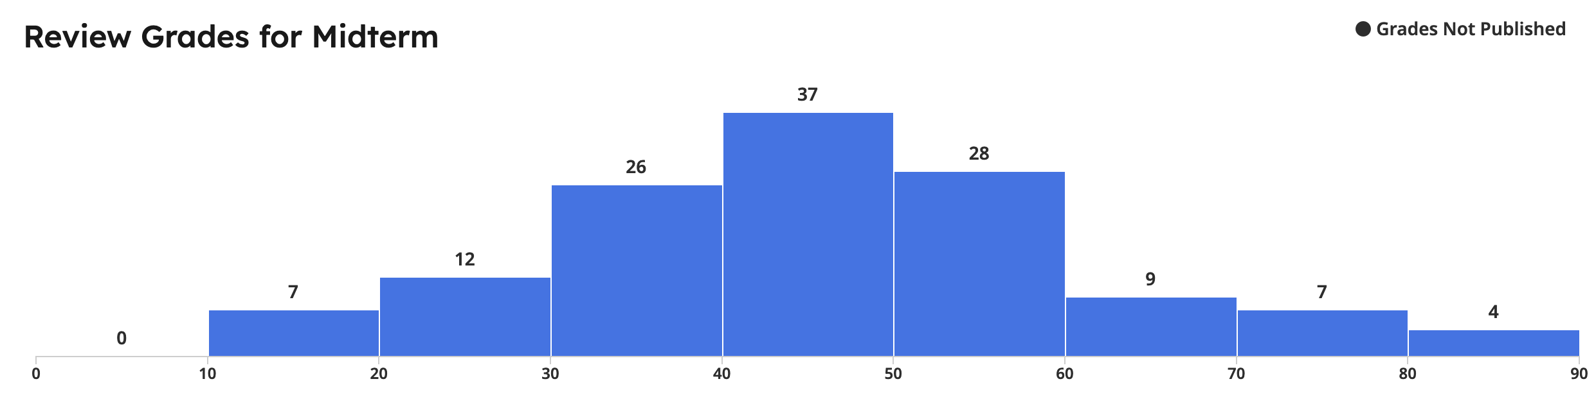

Slide 3
Recap of the boot sequence
Setup segments (data and code)
Switched to protected mode
  Loaded GDT (segmentation is on)
Setup stack (to call C functions)
Loaded kernel from disk
Setup first page table
    2 entries [ 0 : 4MB ] and [ 2GB : (2GB + 4MB) ]
Setup high-address stack
Jumped to main()

Slide 4
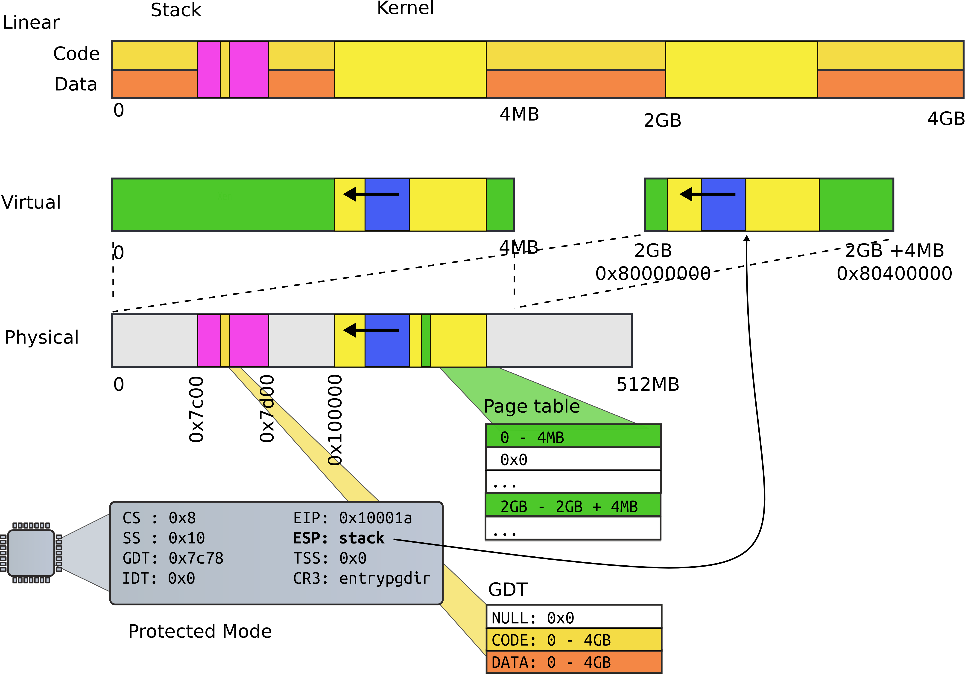
State of the system after boot

Slide 5
Running in main()
1313 // Bootstrap processor starts running C code here.
1314 // Allocate a real stack and switch to it, first
1315 // doing some setup required for memory allocator to work.
1316 int
1317 main(void)
1318 {
1319 kinit1(end, P2V(4*1024*1024)); // phys page allocator
1320 kvmalloc(); // kernel page table
1321 mpinit(); // detect other processors
1322 lapicinit(); // interrupt controller
1323 seginit(); // segment descriptors
1324 cprintf("\ncpu%d: starting xv6\n\n", cpunum());
...
1340 }

Slide 6
Poll: PollEv.com/aburtsev

Slide 7
What's next?

Slide 8
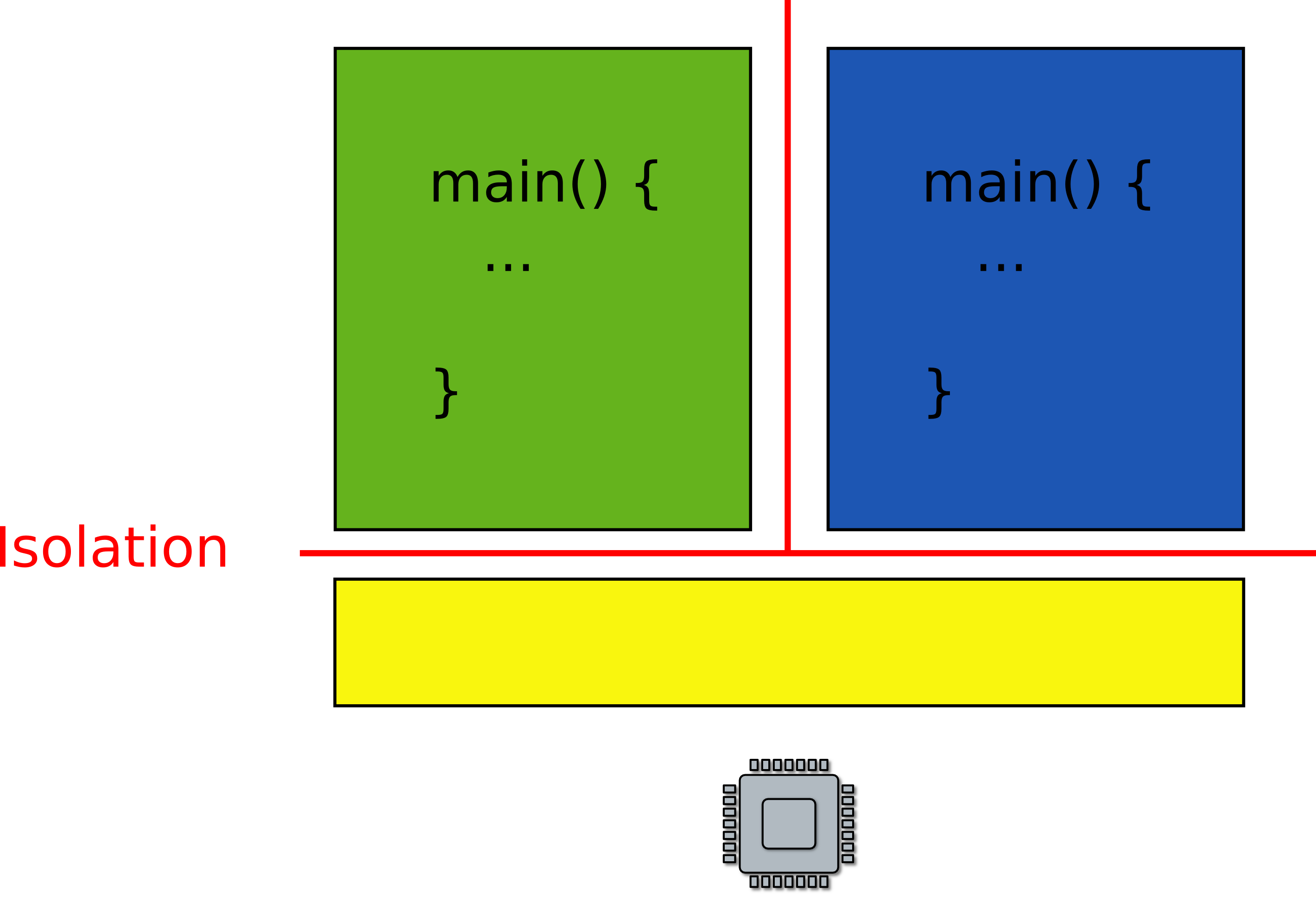
We want to run multiple programs (processes)

Slide 9
But what is a process?

Slide 10
A couple of requirements
Each process is a collection of resources
  Memory
      E.g., text, stack, heap
  In-kernel state
      E.g., open file descriptors, network sockets (connections)

Slide 11
A couple of requirements
Each process is a collection of resources
  Memory
      E.g., text, stack, heap
  In-kernel state
      E.g., open file descriptors, network sockets (connections)
Processes are isolated from each other
  Processes don't trust each other
      Individual users, some privileged
  Can't interfere with other processes
  Can't change kernel (to affect other processes)

Slide 12
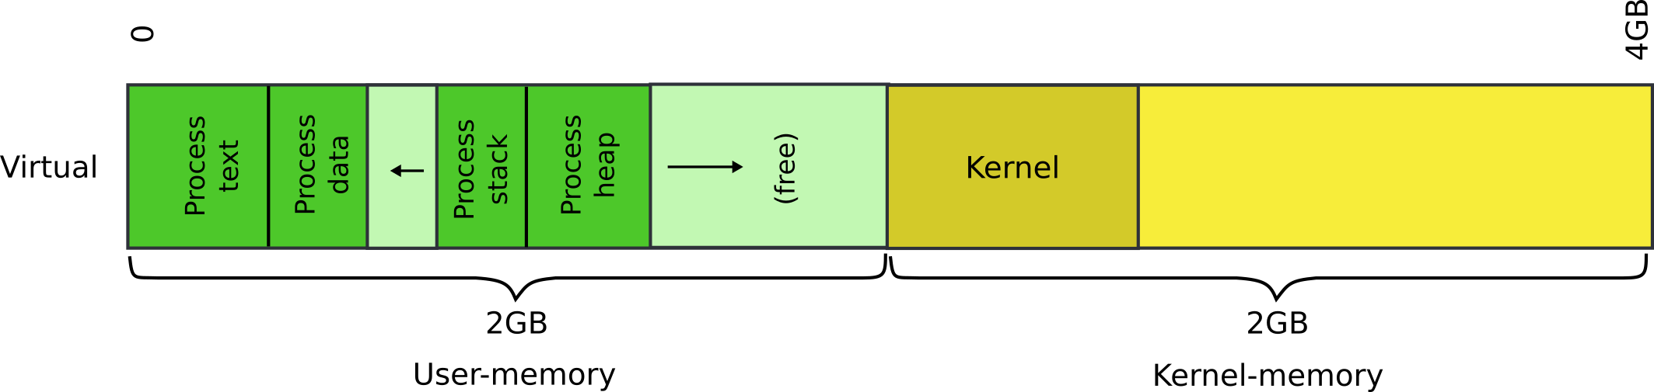
Each process will have a 2GB/2GB private address space

Slide 13
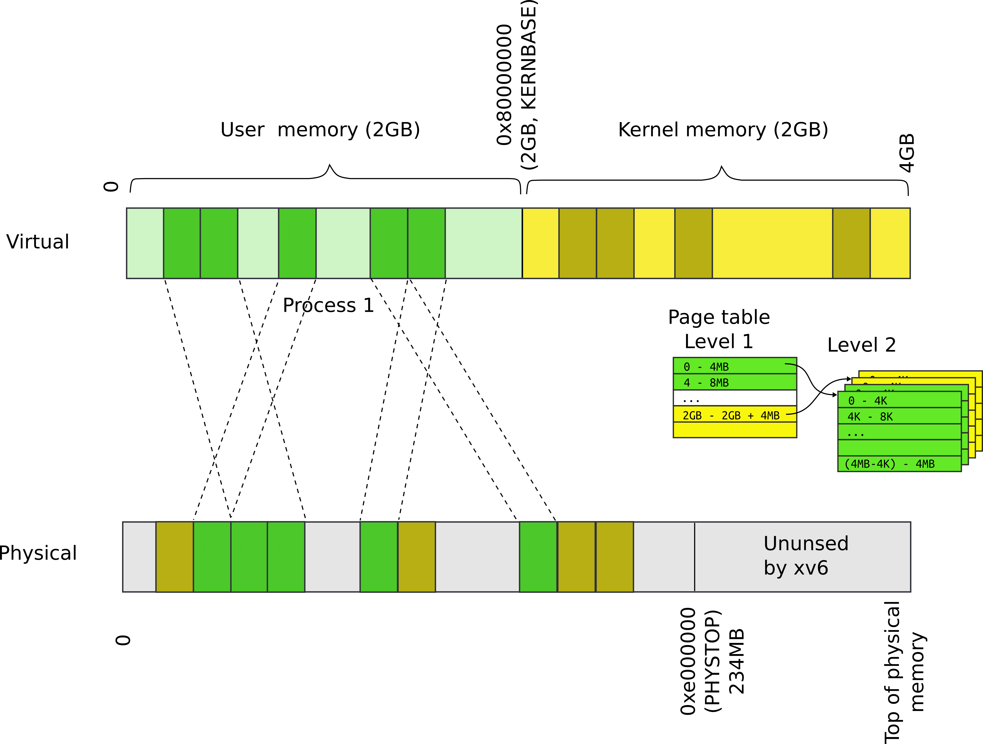
Each process has a private address space

Slide 14
Each process maps the kernel
It's not strictly required
  But convenient for system calls
  No need to change the page table when process enters the kernel with a system call
  Things are much faster!

Slide 15
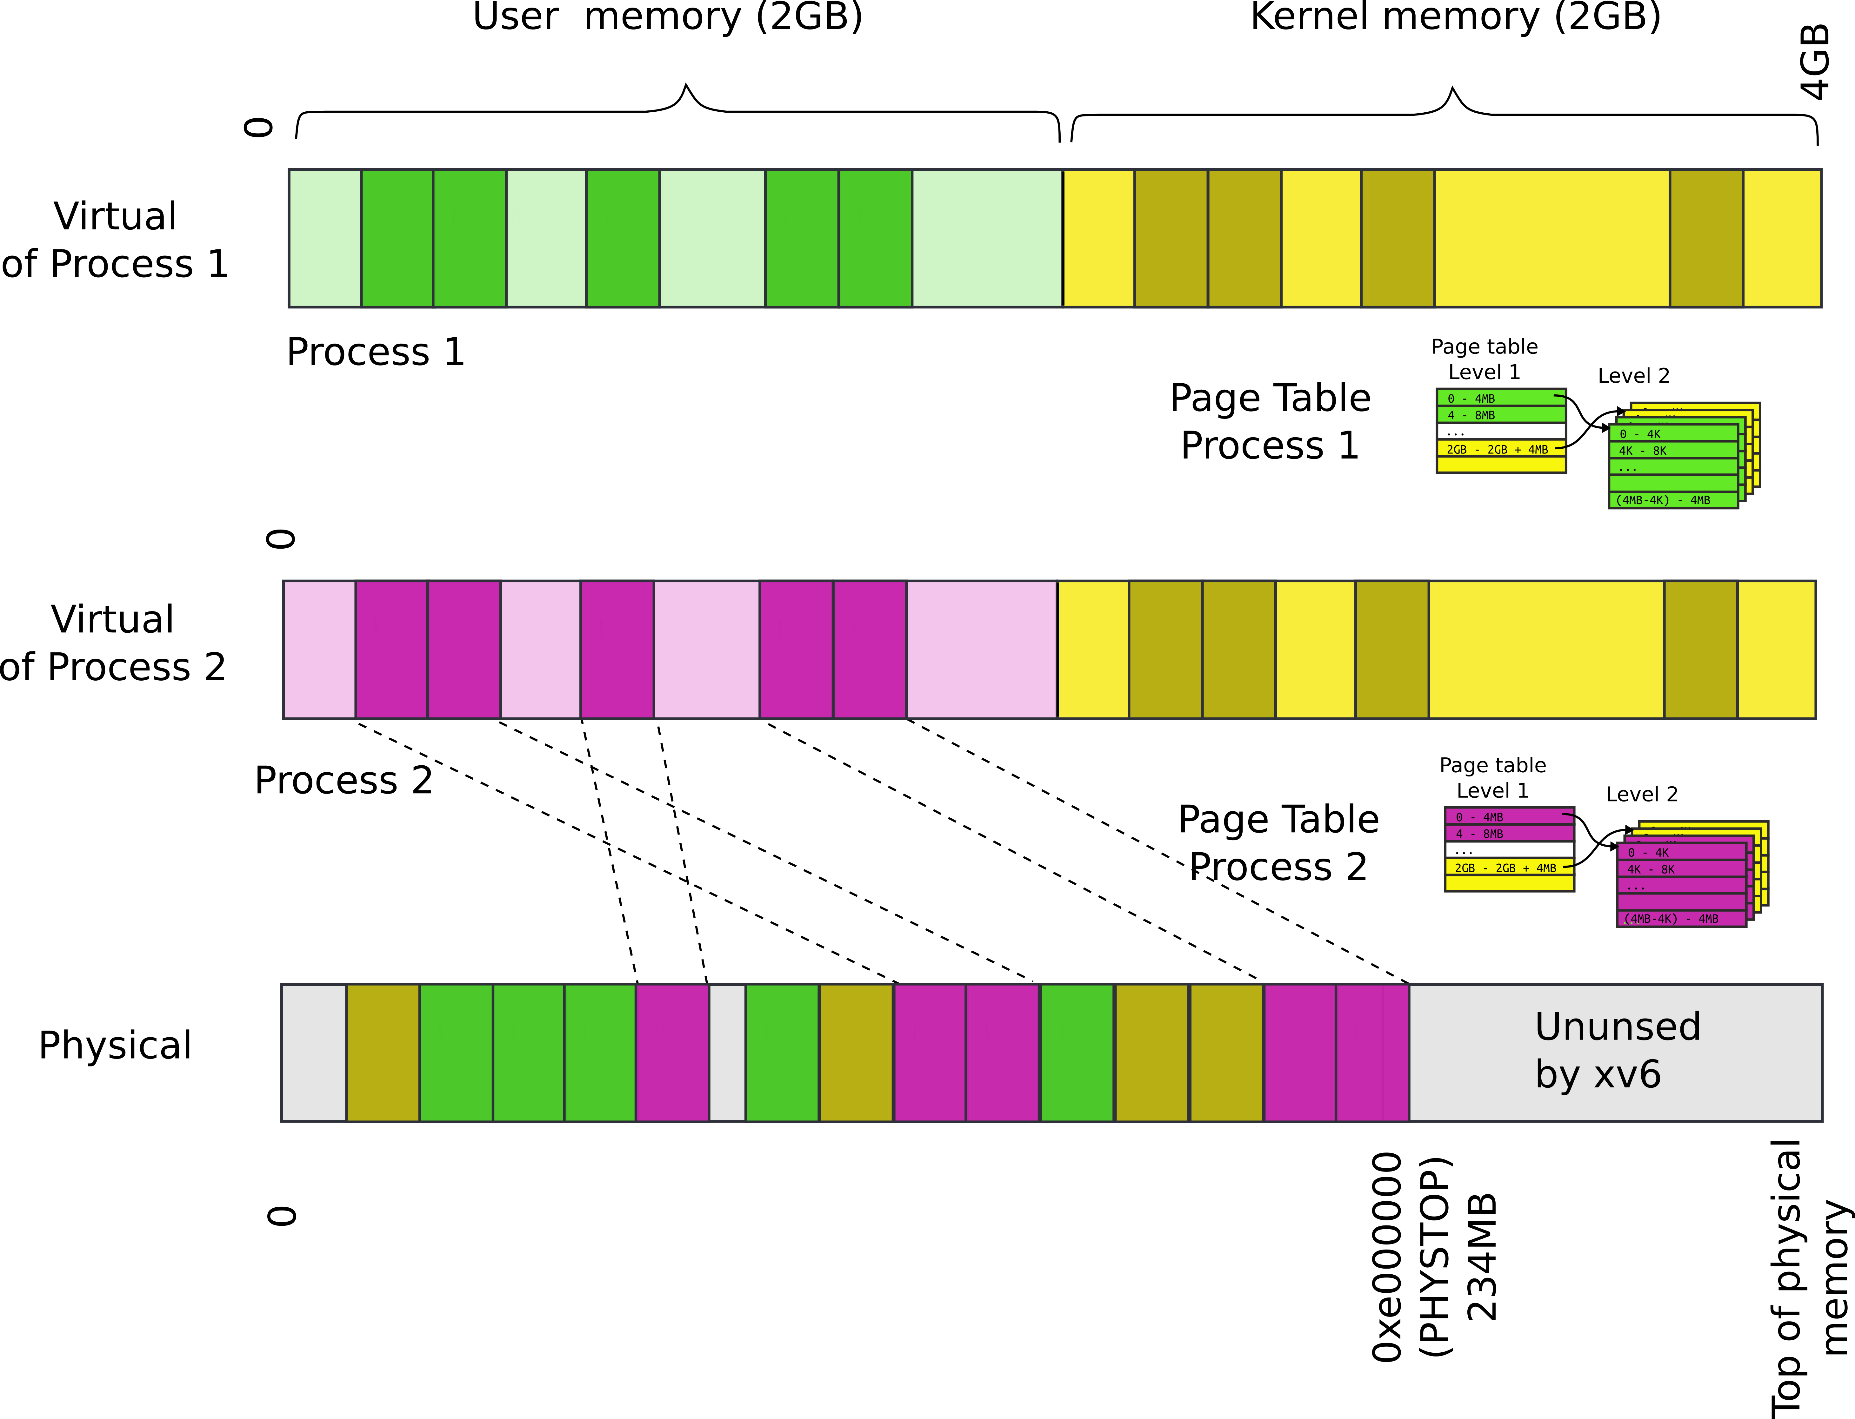
P1 and P2 can't access each other memory

Slide 16
Our goal: 2GB/2GB address space

Slide 17
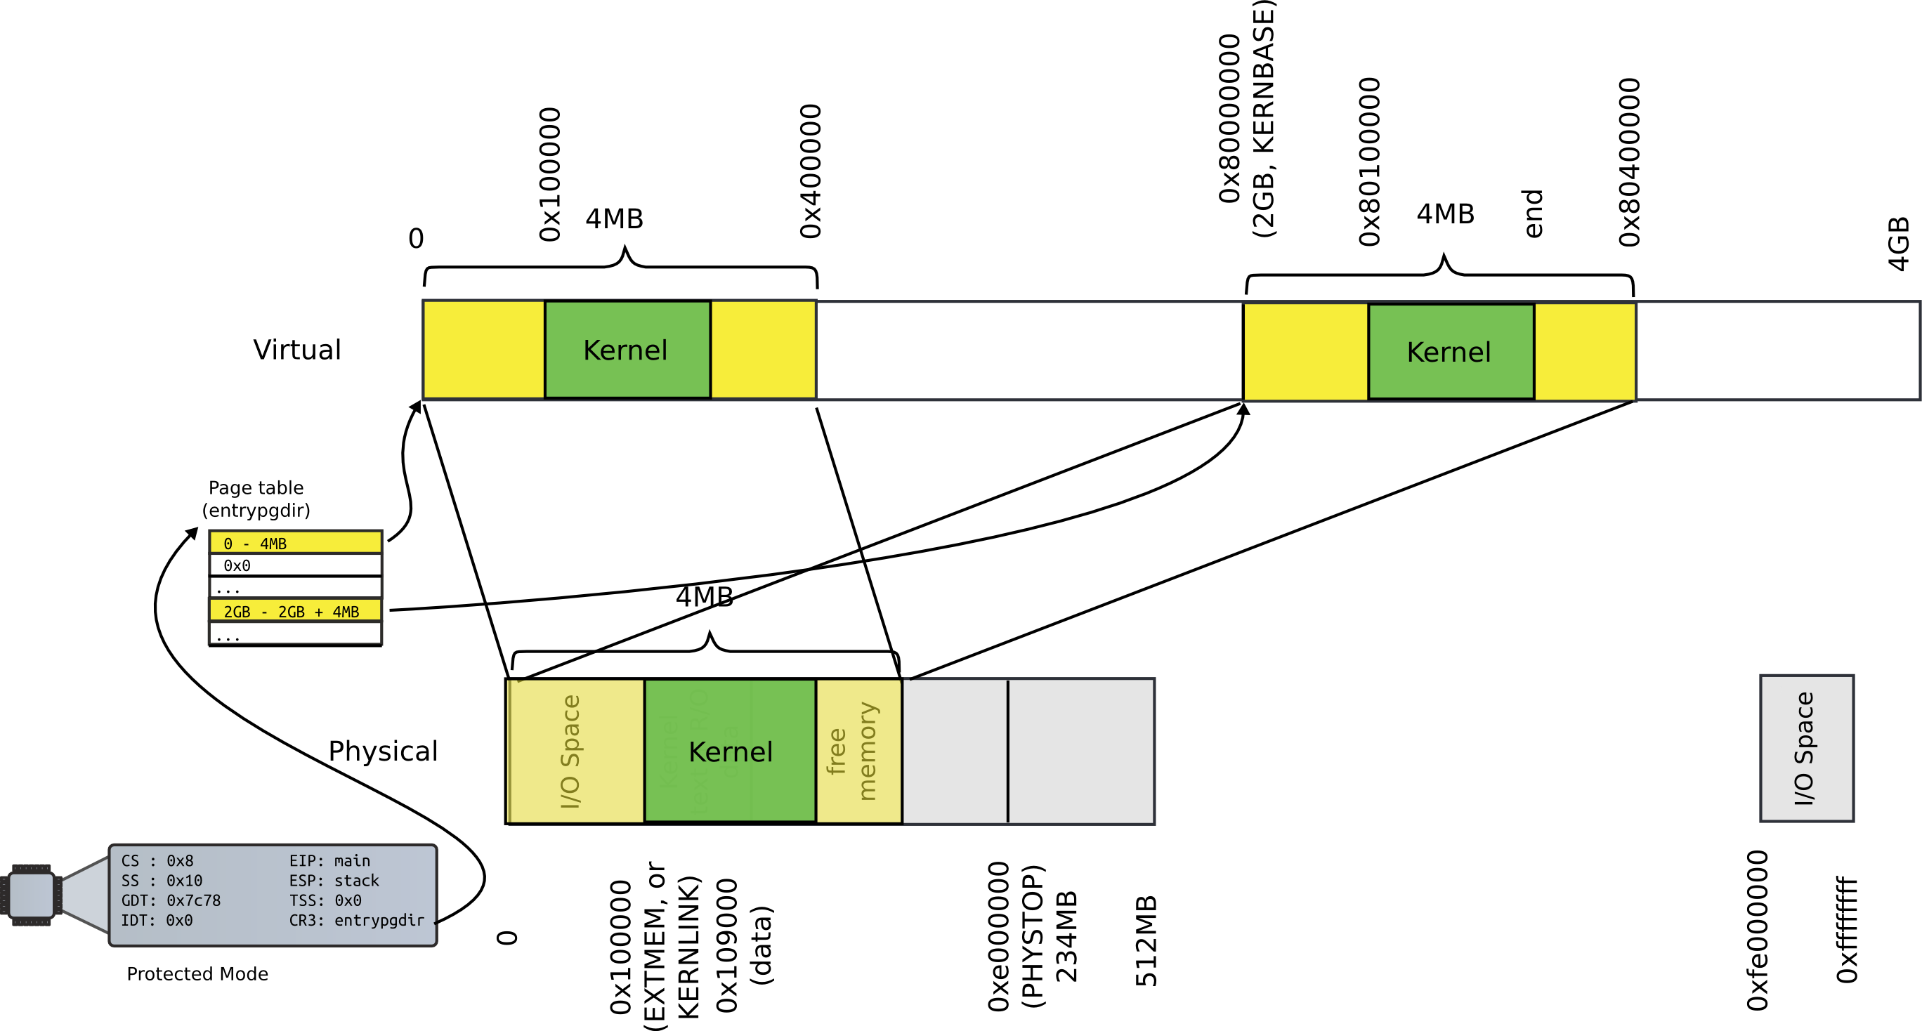
Memory after boot

Slide 18
Outline
Create the kernel address space
  Create kernel memory allocator
  Allocate memory for page tables
      Page table directory and page table

Slide 19
Kernel memory allocator

Slide 20
Kernel needs normal 2 level, 4KB page table
  Right now we have
      One (statically allocated) page table
      That has only two entries
  And it is a page table for 4MB pages
4KB page table is a better choice
  Xv6 processes are small
  Wasting 4MB on a program that fits into 1KB is absurd
But to create page tables we need memory
  Where can it come from?

Slide 21
Simple memory allocator
Goal:
    alloc() and free()
    To allocate page tables, stacks, data structures, etc.

Slide 22
What can it look like?

Slide 23
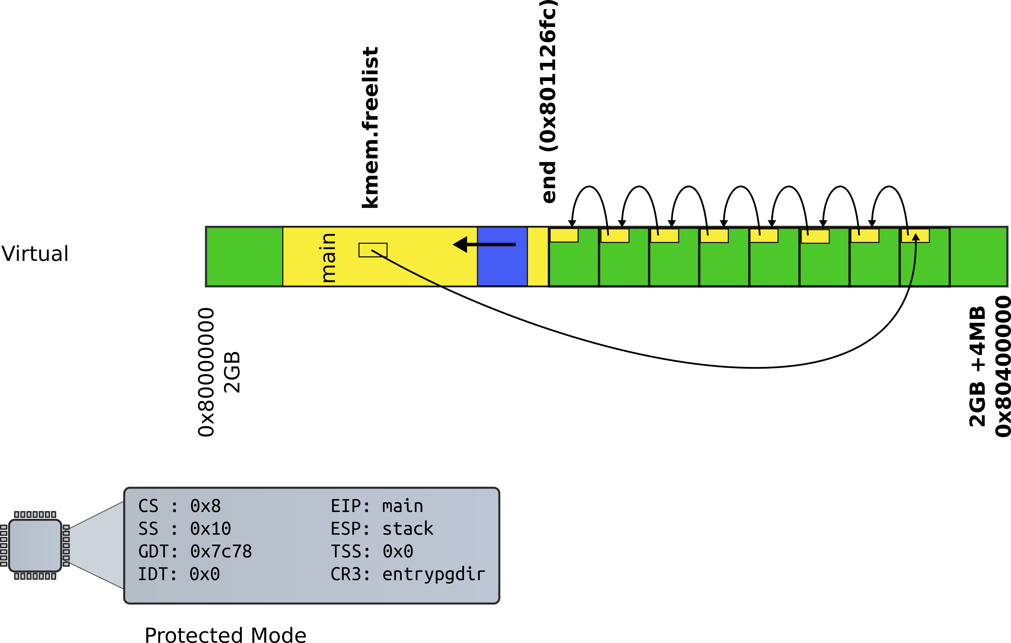
Page allocator

Slide 24
Page allocator
3014 struct run {
3015 struct run *next;
3016 };

Slide 25
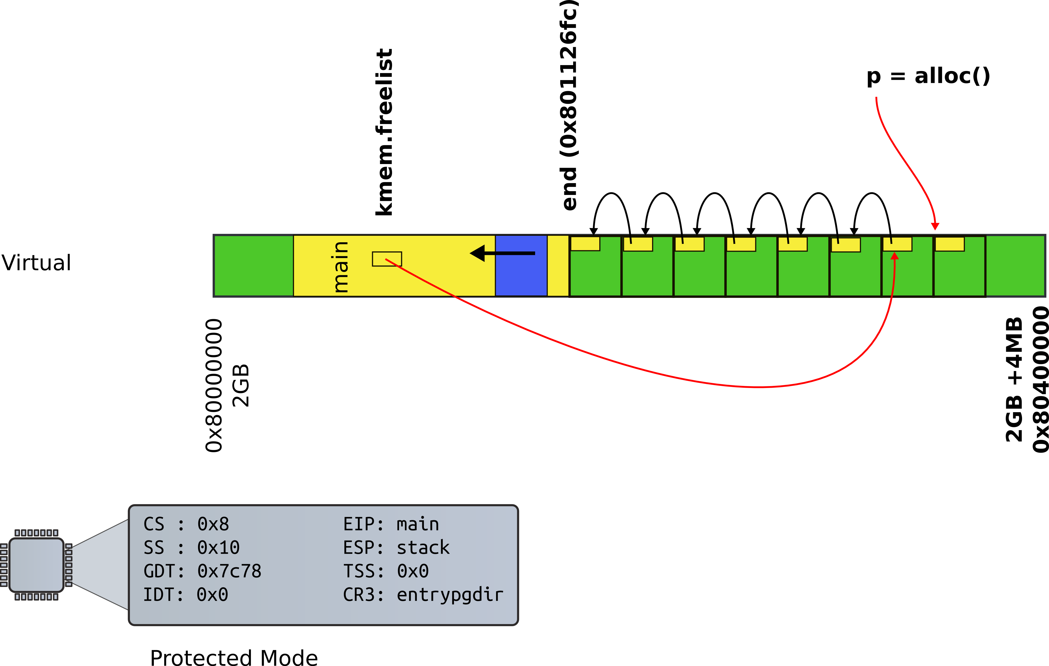
Page allocator
3014 struct run {
3015 struct run *next;
3016 };

Slide 26
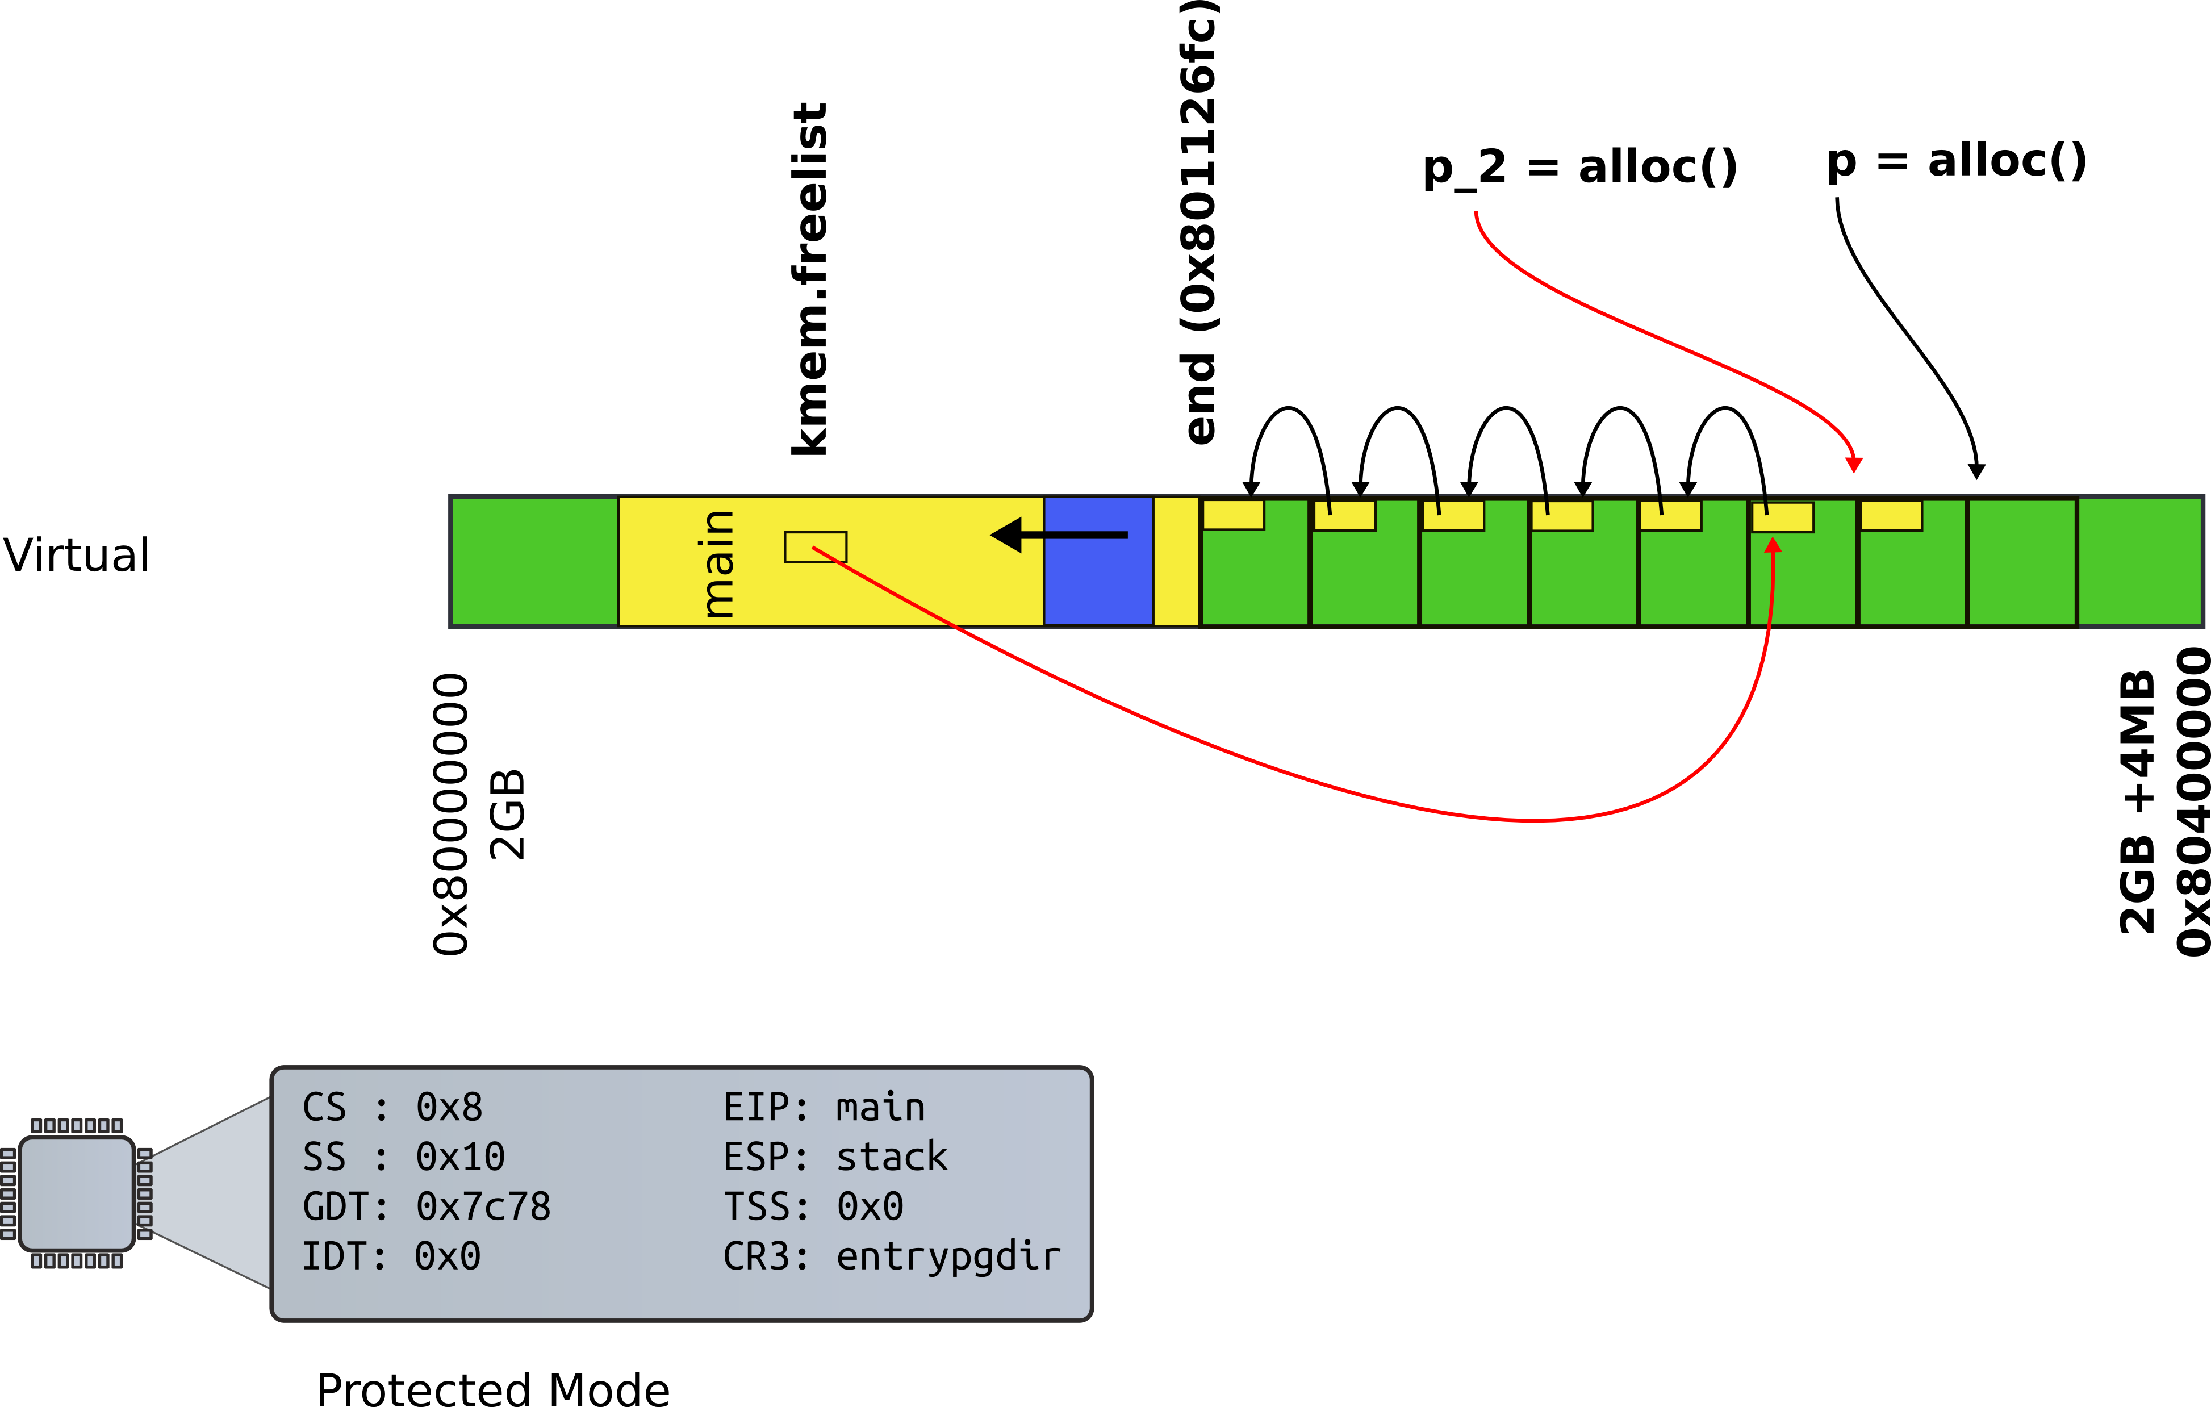
Page allocator
3014 struct run {
3015 struct run *next;
3016 };

Slide 27
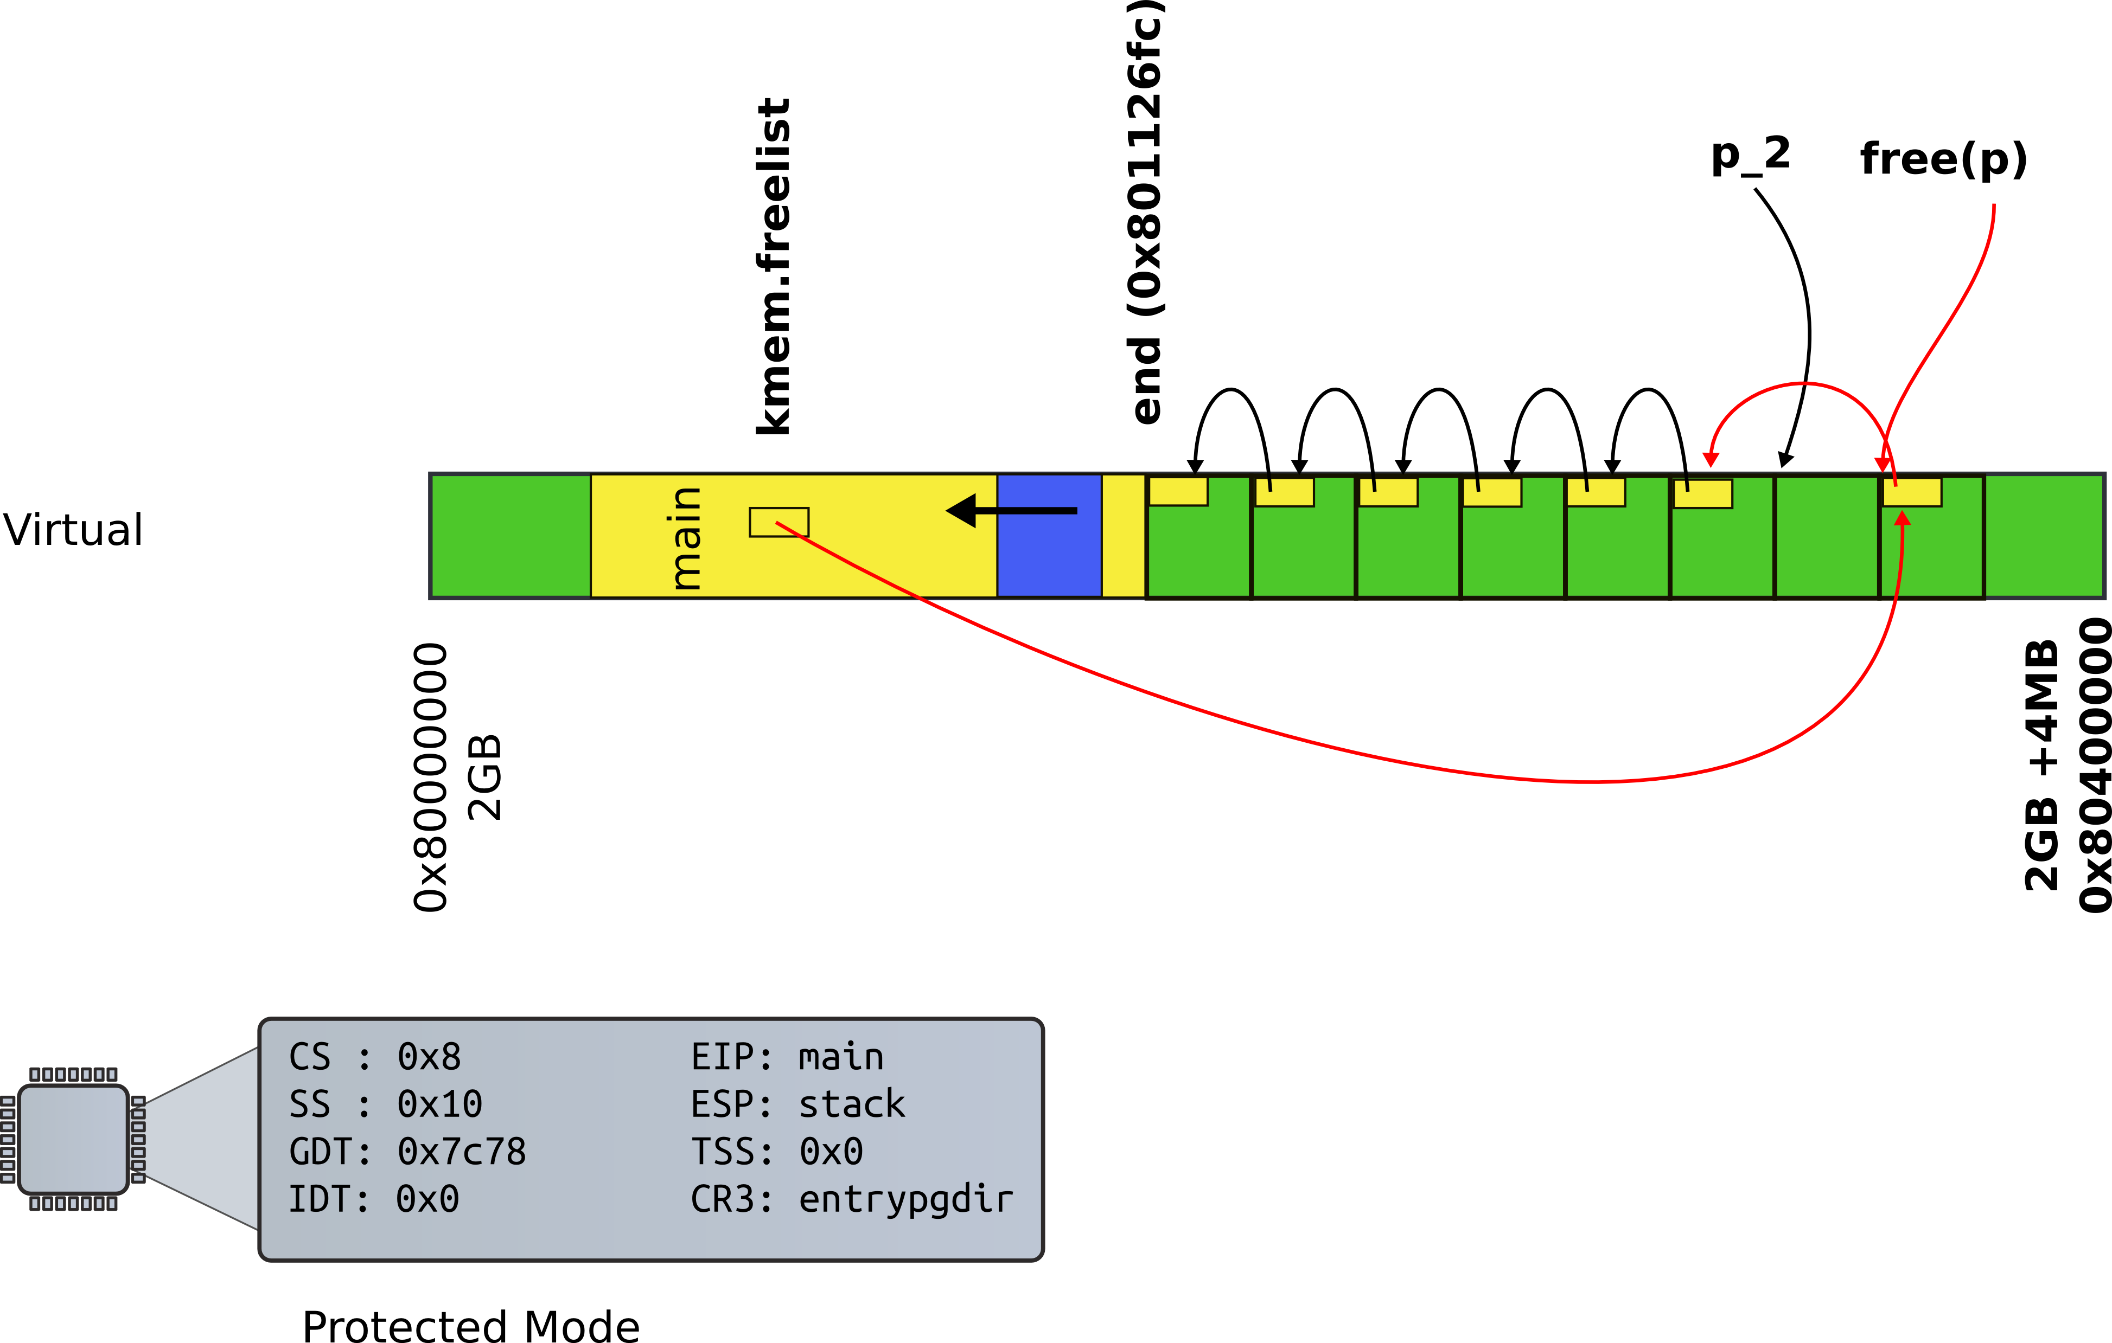
Page allocator
3014 struct run {
3015 struct run *next;
3016 };

Slide 28
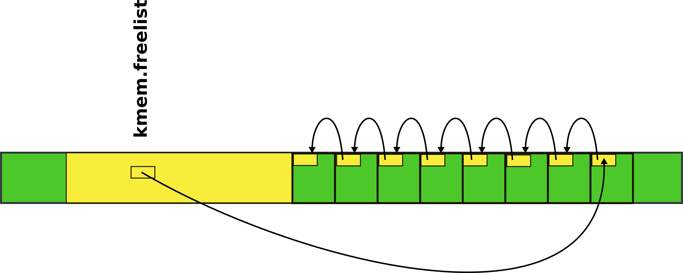
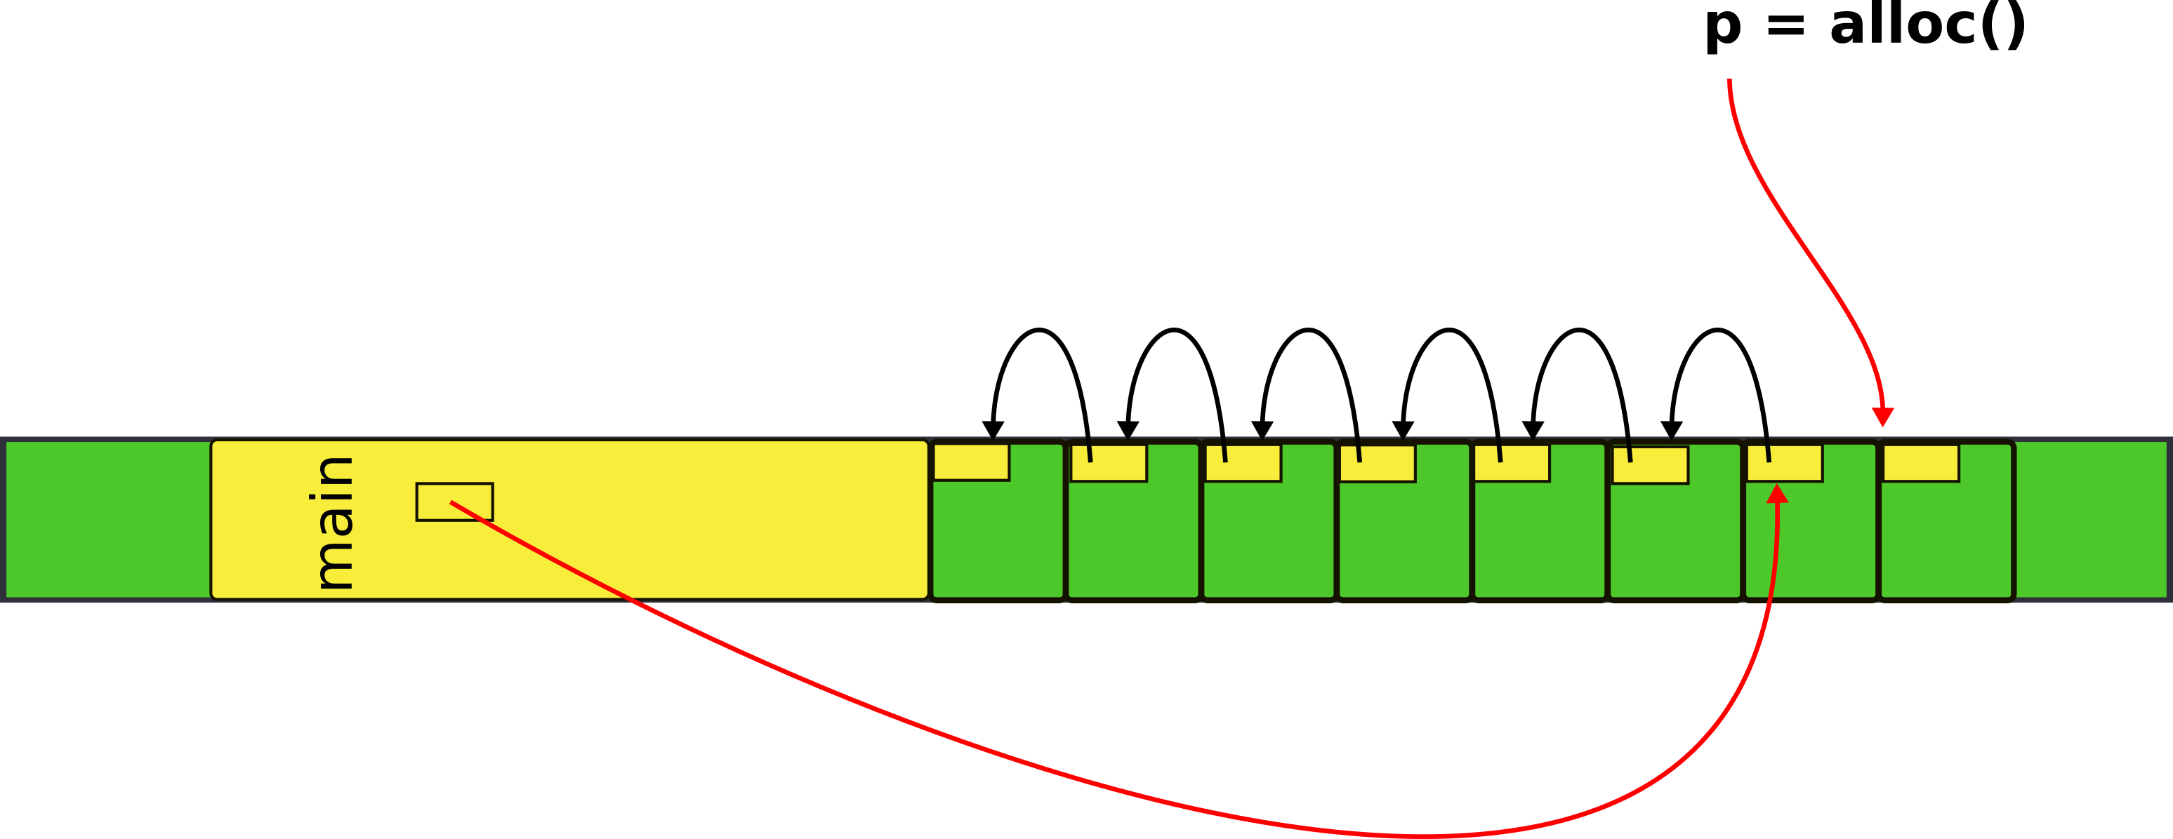
kalloc() - kernel allocator
3087 char*
3088 kalloc(void)
3089 {
3080 struct run *r;
...
3094 r = kmem.freelist;
3095 if(r)
3096 kmem.freelist = r−>next;
…
3099 return (char*)r;
3099 }

Slide 29
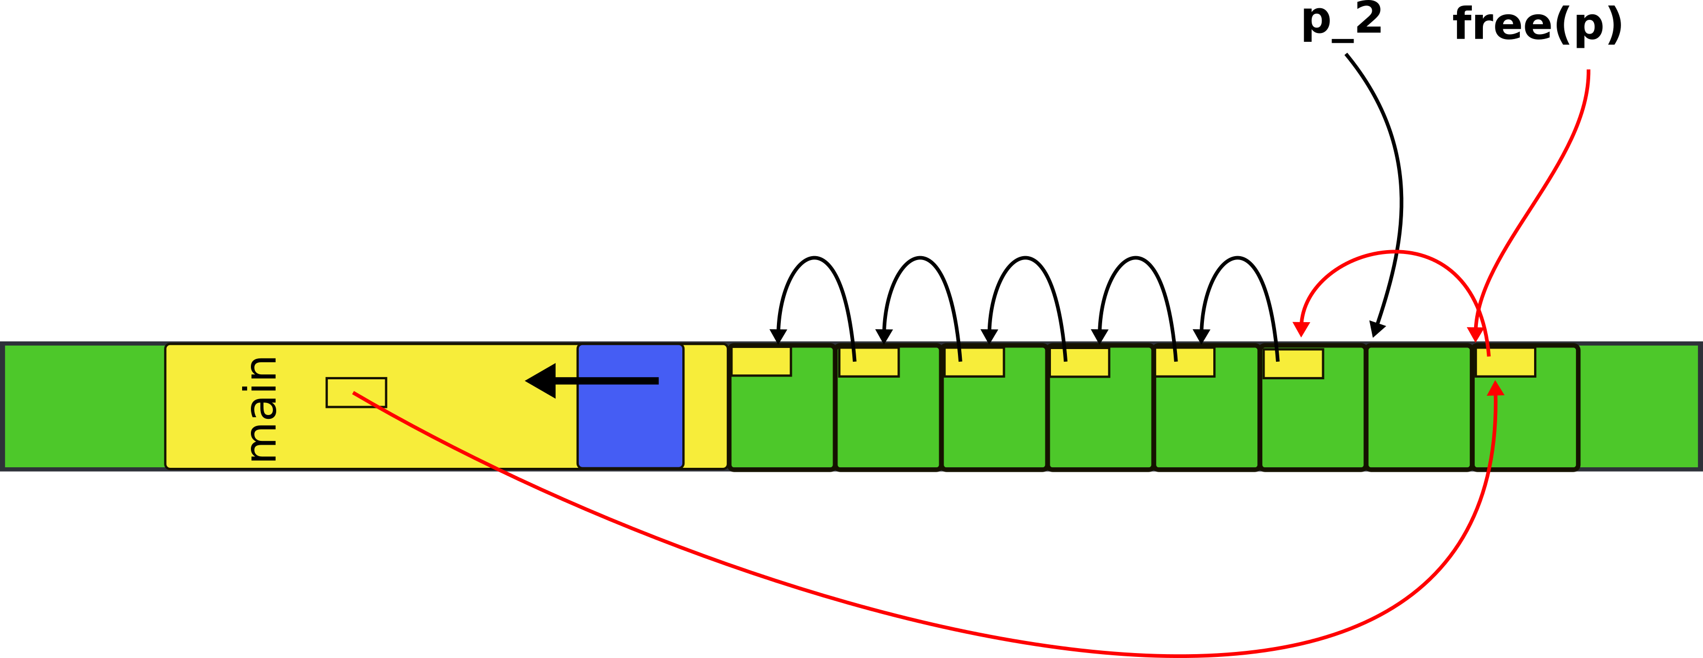
3065 kfree(char *v)
3066 {
3067 struct run *r;
...
3077 r = (struct run*)v;
3078 r−>next = kmem.freelist;
3079 kmem.freelist = r;
...
2832 }

Slide 30
Where can we get memory to keep the list itself?
  Notice, the list is allocated within the pages
  It has to write each page though to update the “next” pointer

Slide 31
There is a bit of free memory in the 4MB page we've mapped

Slide 32
Donate this free memory to the allocator
Take memory from the end of the kernel binary
To the end of the 4MB page

Slide 33
kinit1(): donate free memory
1316 int
1317 main(void)
1318 {
1319 kinit1(end, P2V(4*1024*1024)); // phys page allocator
1320 kvmalloc(); // kernel page table
1321 mpinit(); // detect other processors
1322 lapicinit(); // interrupt controller
1323 seginit(); // segment descriptors
1324 cprintf("\ncpu%d: starting xv6\n\n", cpunum());
1325 picinit(); // another interrupt controller
1326 ioapicinit(); // another interrupt controller
1327 consoleinit(); // console hardware
1328 uartinit(); // serial port
...
1340 }

Slide 34
Freerange()
3030 kinit1(void *vstart, void *vend)
3031 {
...
3034 freerange(vstart, vend);
3035 }
Free range of memory from vstart to vend giving it to the allocator
i.e., adding pages to the list

Slide 35
freerange()
3051 freerange(void *vstart, void *vend)
3052 {
3053 char *p;
3054 p = (char*)PGROUNDUP((uint)vstart);
3055 for(; p + PGSIZE <= (char*)vend; p += PGSIZE)
3056 kfree(p);
3057 }
freerange() internally simply frees the pages from vstart to vend
kfree() adds them to the allocator list

Slide 36
Where do we start?
1316 int
1317 main(void)
1318 {
1319 kinit1(end, P2V(4*1024*1024)); // phys page allocator
1320 kvmalloc(); // kernel page table
1321 mpinit(); // detect other processors
What is this end?
1311 extern char end[];

Slide 37
Where do we start?
1316 int
1317 main(void)
1318 {
1319 kinit1(end, P2V(4*1024*1024)); // phys page allocator
1320 kvmalloc(); // kernel page table
1321 mpinit(); // detect other processors
What is this end?
1311 extern char end[]; // first address after
kernel loaded from ELF file

Slide 38
Donate this free memory to the allocator

Slide 39
Recap
Kernel has a memory allocator
  It allocates memory in chunks of 4KB
  Good enough to maintain kernel data structures

Slide 40
Kernel page table
(4KB page tables)

Slide 41
Back to main(): Kernel address space
1316 int
1317 main(void)
1318 {
1319 kinit1(end, P2V(4*1024*1024)); // phys page allocator
1320 kvmalloc(); // kernel page table
1321 mpinit(); // detect other processors
1322 lapicinit(); // interrupt controller
1323 seginit(); // segment descriptors
1324 cprintf("\ncpu%d: starting xv6\n\n", cpunum());
1325 picinit(); // another interrupt controller
1326 ioapicinit(); // another interrupt controller
1327 consoleinit(); // console hardware
1328 uartinit(); // serial port
...
1340 }

Slide 42
What do you think has to happen?
    i.e., how to construct a kernel address space?

Slide 43
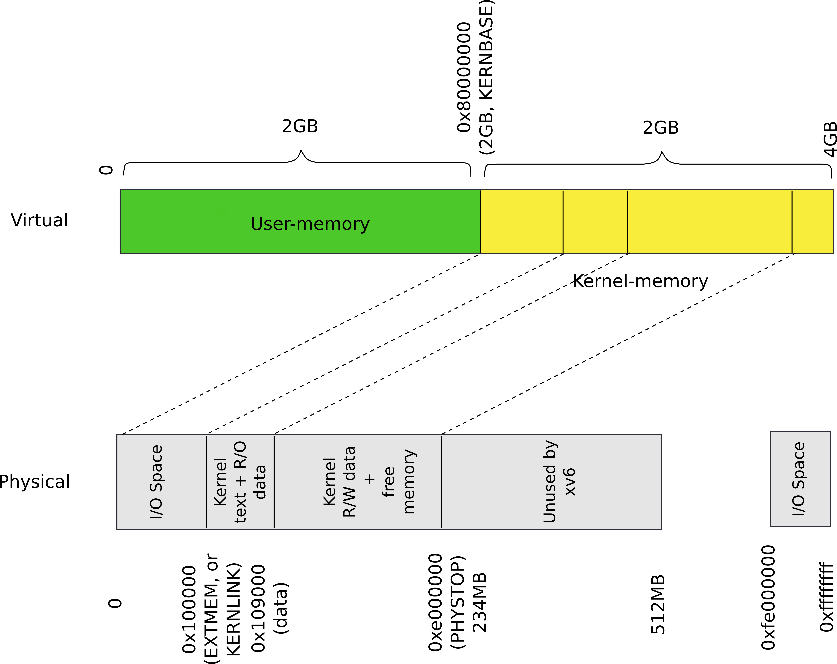
Recap: our goal

Slide 44
Outline
Map a region of virtual memory into page tables
  Start from 2GBs
  Iterate memory page by page
  Allocate page table directory and page tables as we go
  Fill in page table entries with proper physical addresses

Slide 45
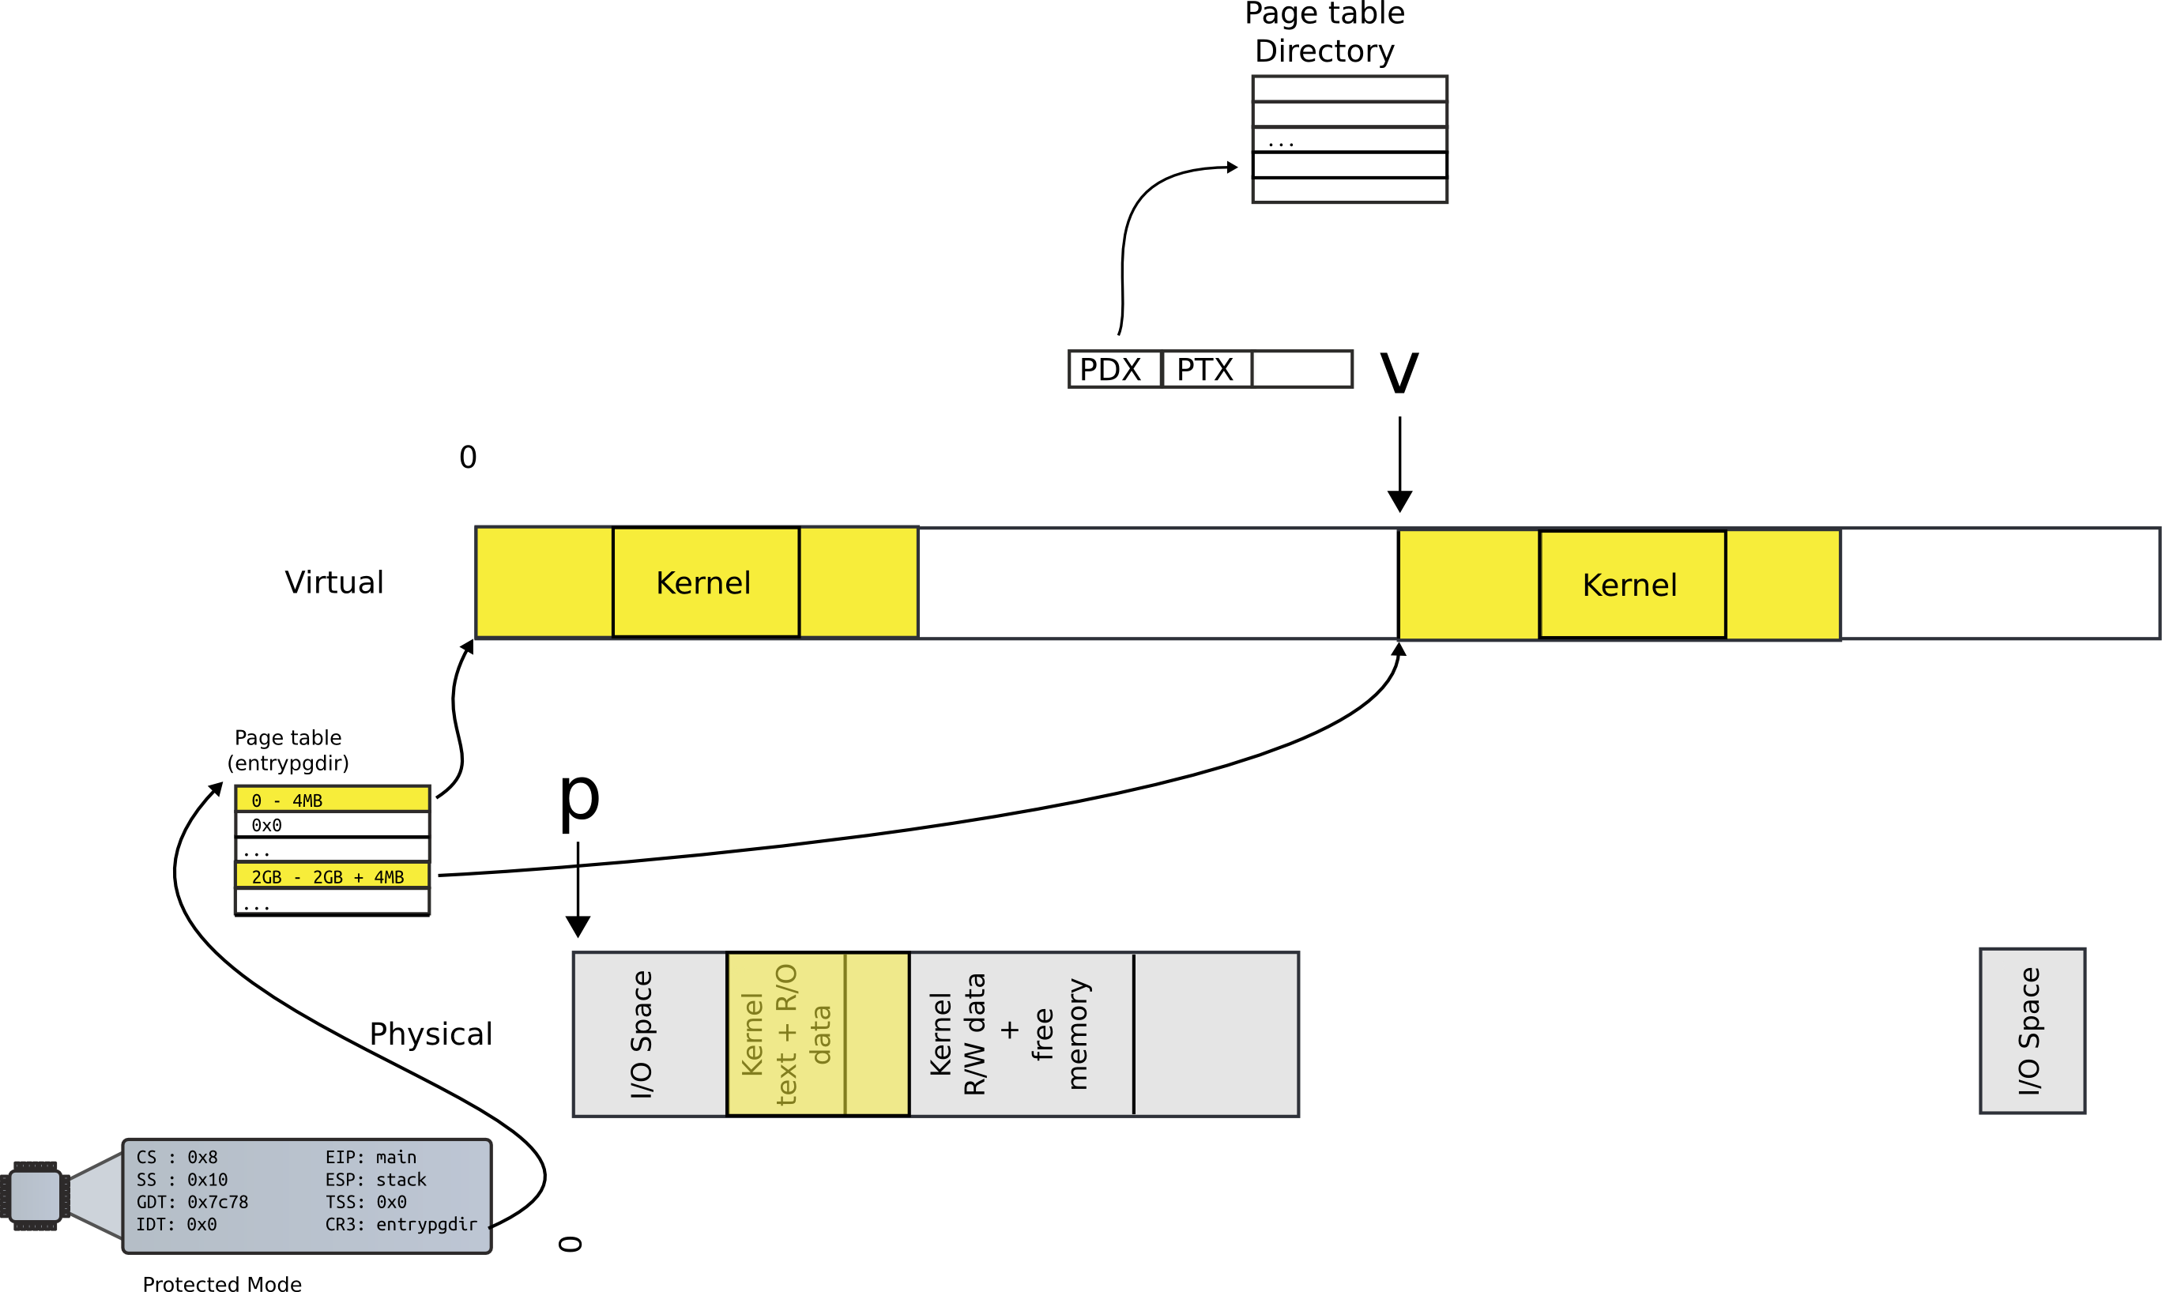
Allocate page table directory entry

Slide 46
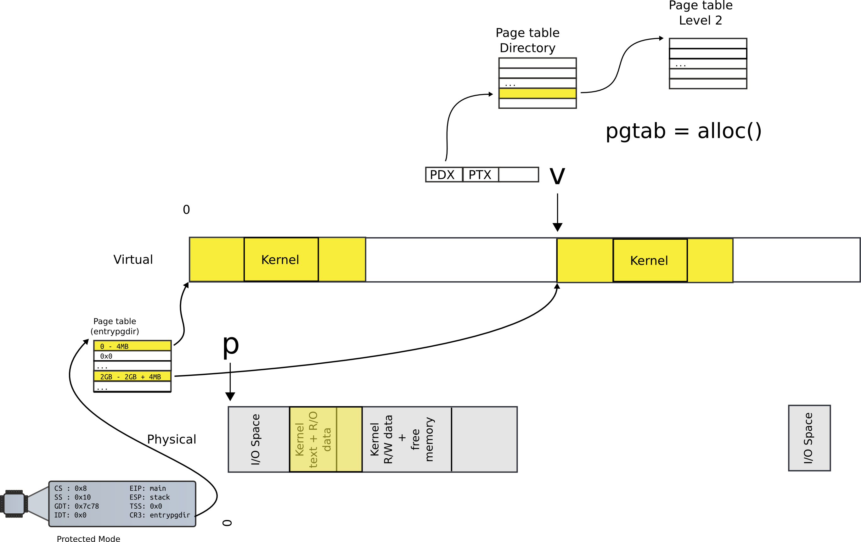
Allocate next level page table

Slide 47
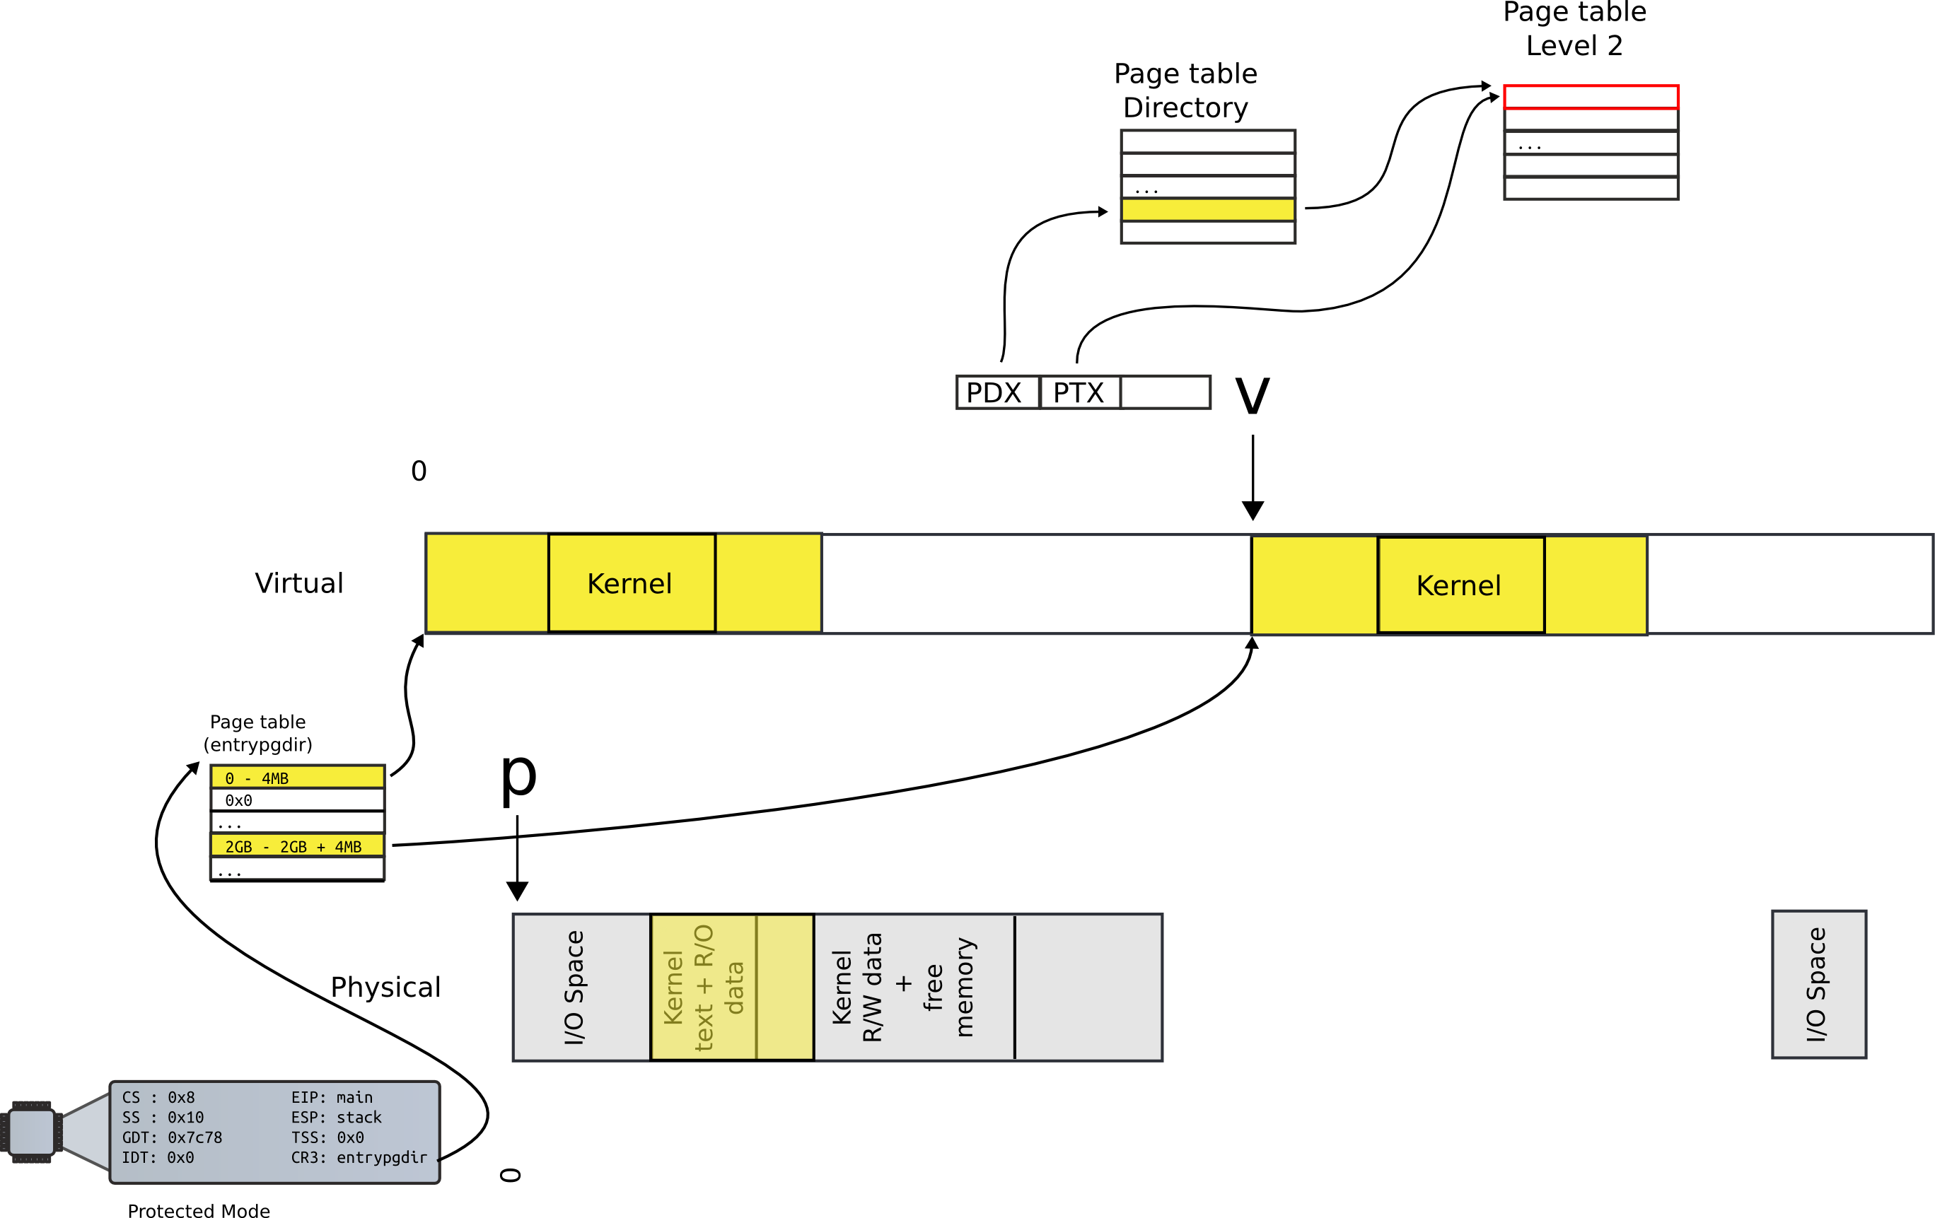
Locate PTE entry

Slide 48
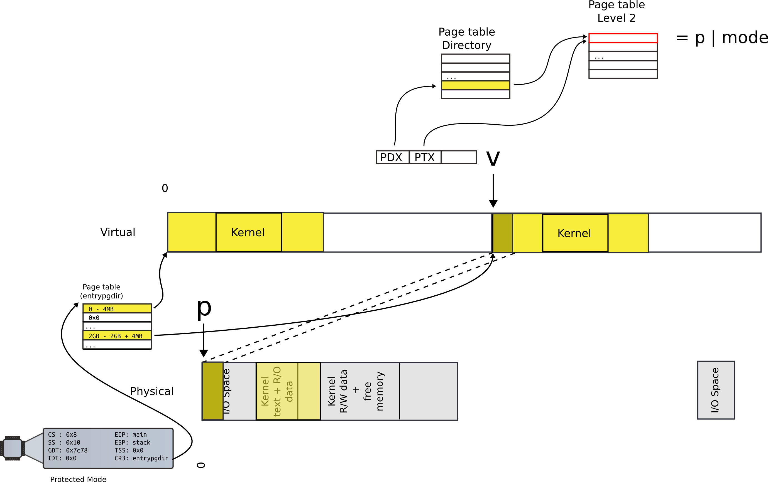
Update mapping with physical addr

Slide 49
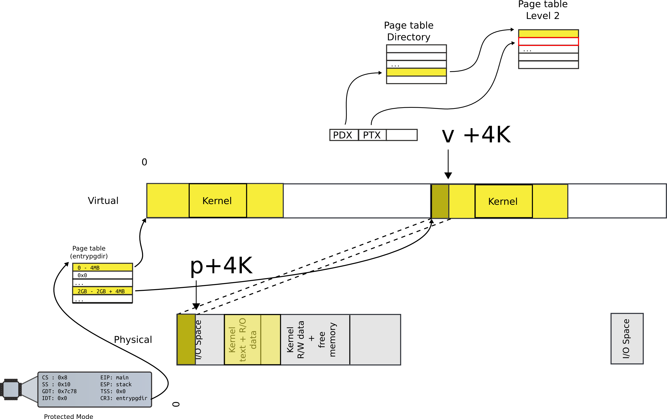
Move to next page

Slide 50
This is exactly what kernel is doing

Slide 51
Allocate page tables
1316 int
1317 main(void)
1318 {
1319 kinit1(end, P2V(4*1024*1024)); // phys page allocator
1320 kvmalloc(); // kernel page table
1321 mpinit(); // detect other processors
1322 lapicinit(); // interrupt controller
1323 seginit(); // segment descriptors
1324 cprintf("\ncpu%d: starting xv6\n\n", cpunum());
1325 picinit(); // another interrupt controller
1326 ioapicinit(); // another interrupt controller
1327 consoleinit(); // console hardware
1328 uartinit(); // serial port
...
1340 }

Slide 52
kvmalloc()
main()
1857 kvmalloc(void)
1858 {
1859 kpgdir = setupkvm();
1860 switchkvm();
1861 }
kvmalloc()

Slide 53
Allocate page table directory
1836 pde_t*
1837 setupkvm(void)
1838 {
1839 pde_t *pgdir;
1840 struct kmap *k;
1841
1842 if((pgdir = (pde_t*)kalloc()) == 0)
1843 return 0;
1844 memset(pgdir, 0, PGSIZE);
...
1847 for(k = kmap; k < &kmap[NELEM(kmap)]; k++)
1848 if(mappages(pgdir, k−>virt, k−>phys_end − k−>phys_start,
1849 (uint)k−>phys_start, k−>perm) < 0)
1850 return 0;
1851 return pgdir;
1852 }
main()
kvmalloc()
setupkvm()

Slide 54
Allocate page table directory

Slide 55
Iterate in a loop: map physical pages
1836 pde_t*
1887 setupkvm(void)
1838 {
1839 pde_t *pgdir;
1840 struct kmap *k;
1841
1842 if((pgdir = (pde_t*)kalloc()) == 0)
1843 return 0;
1844 memset(pgdir, 0, PGSIZE);
...
1847 for(k = kmap; k < &kmap[NELEM(kmap)]; k++)
1848 if(mappages(pgdir, k−>virt, k−>phys_end − k−>phys_start,
1849 (uint)k−>phys_start, k−>perm) < 0)
1850 return 0;
1851 return pgdir;
1852 }
main()
kvmalloc()
setupkvm()

Slide 56
Iterate in a loop: map physical pages
1836 pde_t*
1887 setupkvm(void)
1838 {
1839 pde_t *pgdir;
1840 struct kmap *k;
1841
1842 if((pgdir = (pde_t*)kalloc()) == 0)
1843 return 0;
1844 memset(pgdir, 0, PGSIZE);
...
1847 for(k = kmap; k < &kmap[NELEM(kmap)]; k++)
1848 if(mappages(pgdir, k−>virt, k−>phys_end − k−>phys_start,
1849 (uint)k−>phys_start, k−>perm) < 0)
1850 return 0;
1851 return pgdir;
1852 }
main()
kvmalloc()
setupkvm()

Slide 57
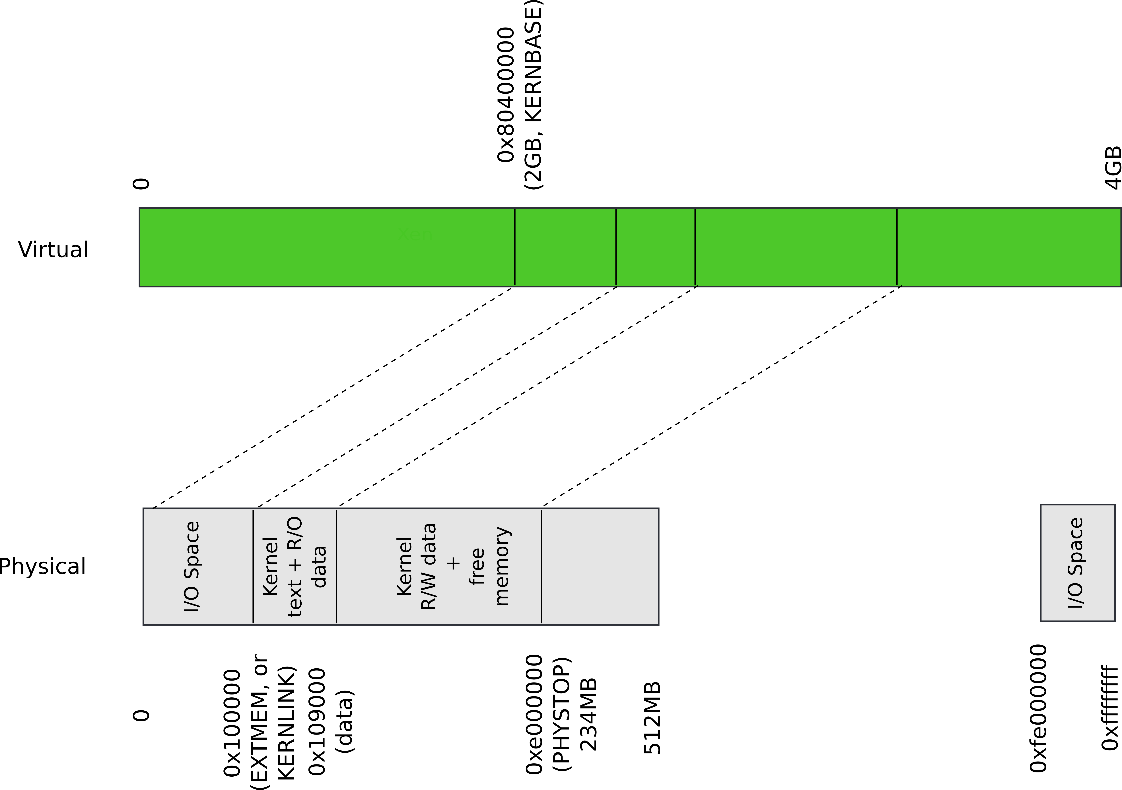
Kernel map

Slide 58
Kernel map
PollEv.com/aburtsev

Slide 59
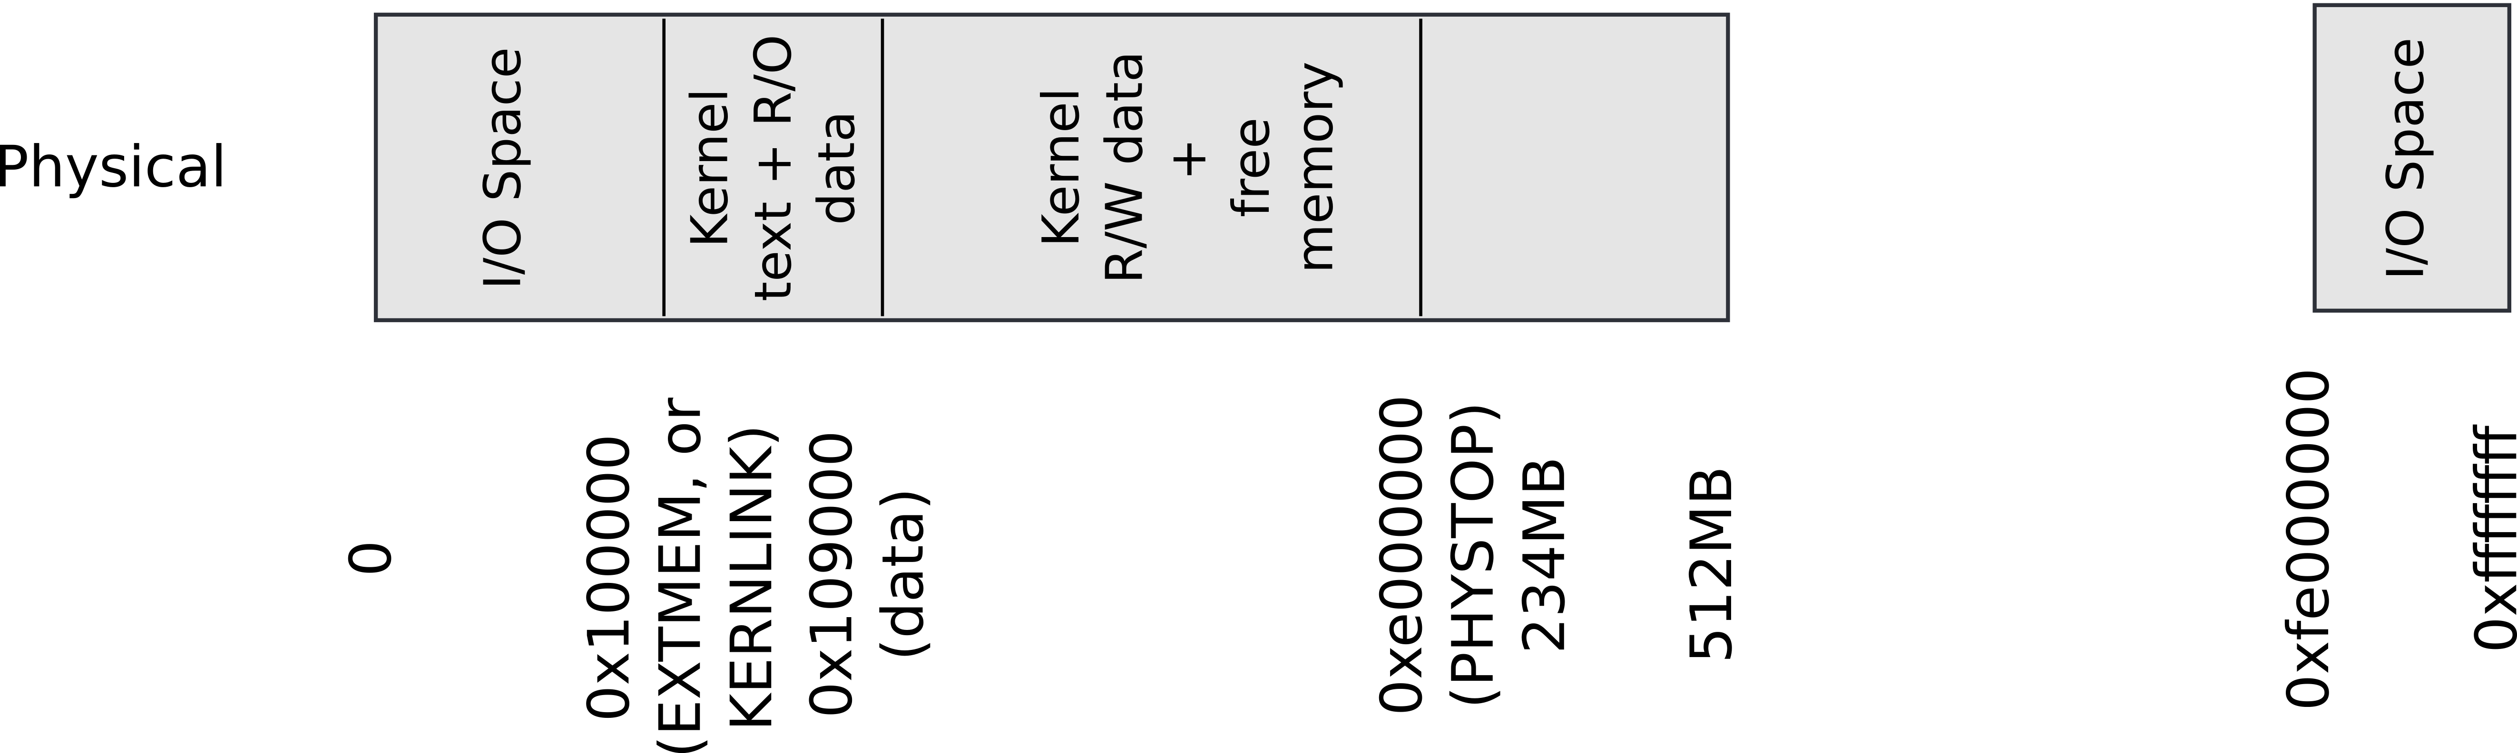
Kmap – kernel map
1823 static struct kmap {
1824 void *virt;
1825 uint phys_start;
1826 uint phys_end;
1827 int perm;
1828 } kmap[] = {
1829 { (void*)KERNBASE, 0, EXTMEM, PTE_W}, // I/O space
1830 { (void*)KERNLINK, V2P(KERNLINK), V2P(data), 0},//text+rodata
1831 { (void*)data, V2P(data), PHYSTOP, PTE_W}, // kern data+memory
1832 { (void*)DEVSPACE, DEVSPACE, 0, PTE_W}, // more devices
1833 };

Slide 60
Start virtual address
1836 pde_t*
1887 setupkvm(void)
1838 {
1839 pde_t *pgdir;
1840 struct kmap *k;
1841
1842 if((pgdir = (pde_t*)kalloc()) == 0)
1843 return 0;
1844 memset(pgdir, 0, PGSIZE);
...
1847 for(k = kmap; k < &kmap[NELEM(kmap)]; k++)
1848 if(mappages(pgdir, k−>virt, k−>phys_end − k−>phys_start,
1849 (uint)k−>phys_start, k−>perm) < 0)
1850 return 0;
1851 return pgdir;
1852 }
main()
kvmalloc()
setupkvm()

Slide 61
Size
1836 pde_t*
1887 setupkvm(void)
1838 {
1839 pde_t *pgdir;
1840 struct kmap *k;
1841
1842 if((pgdir = (pde_t*)kalloc()) == 0)
1843 return 0;
1844 memset(pgdir, 0, PGSIZE);
...
1847 for(k = kmap; k < &kmap[NELEM(kmap)]; k++)
1848 if(mappages(pgdir, k−>virt, k−>phys_end − k−>phys_start,
1849 (uint)k−>phys_start, k−>perm) < 0)
1850 return 0;
1851 return pgdir;
1852 }
main()
kvmalloc()
setupkvm()

Slide 62
Start physical address
1836 pde_t*
1887 setupkvm(void)
1838 {
1839 pde_t *pgdir;
1840 struct kmap *k;
1841
1842 if((pgdir = (pde_t*)kalloc()) == 0)
1843 return 0;
1844 memset(pgdir, 0, PGSIZE);
...
1847 for(k = kmap; k < &kmap[NELEM(kmap)]; k++)
1848 if(mappages(pgdir, k−>virt, k−>phys_end − k−>phys_start,
1849 (uint)k−>phys_start, k−>perm) < 0)
1850 return 0;
1851 return pgdir;
1852 }
main()
kvmalloc()
setupkvm()

Slide 63
Inside mappages()
1779 mappages(pde_t *pgdir, void *va, uint size, uint pa, int perm)
1780 {
1781 char *a, *last;
1782 pte_t *pte;
1783
1784 a = (char*)PGROUNDDOWN((uint)va);
1785 last = (char*)PGROUNDDOWN(((uint)va) + size − 1);
1786 for(;;){
1787 if((pte = walkpgdir(pgdir, a, 1)) == 0)
1788 return −1;
1789 if(*pte & PTE_P)
1790 panic("remap");
1791 *pte = pa | perm | PTE_P;
1792 if(a == last)
1793 break;
1794 a += PGSIZE;
1795 pa += PGSIZE;
1796 }
1797 return 0;
1798 }
main()
kvmalloc()
setupkvm()
mappages()
Get the start (a) and end (last) pages fo the virtual address range we are mapping
Then work in a loop mapping every page one by one

Slide 64
1779 mappages(pde_t *pgdir, void *va, uint size, uint pa, int perm)
1780 {
1781 char *a, *last;
1782 pte_t *pte;
1783
1784 a = (char*)PGROUNDDOWN((uint)va);
1785 last = (char*)PGROUNDDOWN(((uint)va) + size − 1);
1786 for(;;){
1787 if((pte = walkpgdir(pgdir, a, 1)) == 0)
1788 return −1;
1789 if(*pte & PTE_P)
1790 panic("remap");
1791 *pte = pa | perm | PTE_P;
1792 if(a == last)
1793 break;
1794 a += PGSIZE;
1795 pa += PGSIZE;
1796 }
1797 return 0;
1798 }
main()
kvmalloc()
setupkvm()
mappages()
First lookup the page table entry (pte) corresponding to the virtual address (a) we’re mapping

Slide 65
Locate the page table entry

Slide 66
1779 mappages(pde_t *pgdir, void *va, uint size, uint pa, int perm)
1780 {
1781 char *a, *last;
1782 pte_t *pte;
1783
1784 a = (char*)PGROUNDDOWN((uint)va);
1785 last = (char*)PGROUNDDOWN(((uint)va) + size − 1);
1786 for(;;){
1787 if((pte = walkpgdir(pgdir, a, 1)) == 0)
1788 return −1;
1789 if(*pte & PTE_P)
1790 panic("remap");
1791 *pte = pa | perm | PTE_P;
1792 if(a == last)
1793 break;
1794 a += PGSIZE;
1795 pa += PGSIZE;
1796 }
1797 return 0;
1798 }
main()
kvmalloc()
setupkvm()
mappages()
Update the page directory entry (*pte) with the physical address (pa)

Slide 67
Update mapping with physical addr

Slide 68
1779 mappages(pde_t *pgdir, void *va, uint size, uint pa, int perm)
1780 {
1781 char *a, *last;
1782 pte_t *pte;
1783
1784 a = (char*)PGROUNDDOWN((uint)va);
1785 last = (char*)PGROUNDDOWN(((uint)va) + size − 1);
1786 for(;;){
1787 if((pte = walkpgdir(pgdir, a, 1)) == 0)
1788 return −1;
1789 if(*pte & PTE_P)
1790 panic("remap");
1791 *pte = pa | perm | PTE_P;
1792 if(a == last)
1793 break;
1794 a += PGSIZE;
1795 pa += PGSIZE;
1796 }
1797 return 0;
1798 }
main()
kvmalloc()
setupkvm()
mappages()
But we need a function that locates the pte for us...

Slide 69
What should it look like?
A function takes a virtual address
Returns a page table directory entry that maps it

Slide 70
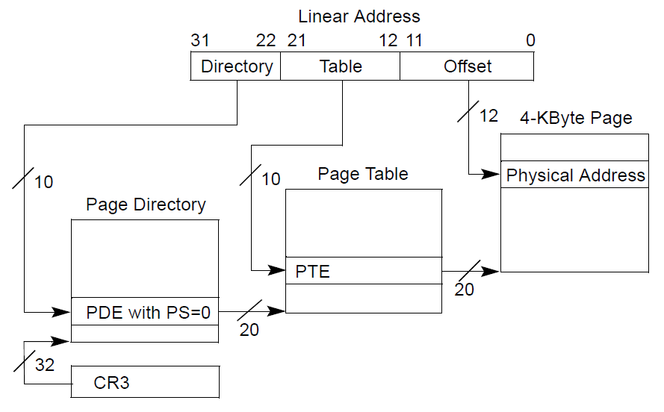
Recap of the page table

Slide 71
Locate the PDE frist

Slide 72
walkpgdir(): walk page table
1754 walkpgdir(pde_t *pgdir, const void *va, int alloc)
1755 {
1756 pde_t *pde;
1757 pte_t *pgtab;
1758
1759 pde = &pgdir[PDX(va)];
1760 if(*pde & PTE_P){
1761 pgtab = (pte_t*)P2V(PTE_ADDR(*pde));
1762 } else {
1763 if(!alloc || (pgtab = (pte_t*)kalloc()) == 0)
1764 return 0;
1765 // Make sure all those PTE_P bits are zero.
1766 memset(pgtab, 0, PGSIZE);
...
1770 *pde = V2P(pgtab) | PTE_P | PTE_W | PTE_U;
1771 }
1772 return &pgtab[PTX(va)];
1773 }
Locate the page directory entry (*pde)

Slide 73
PDX()
0855 // +−−−−−−−−10−−−−−−+−−−−−−−10−−−−−−−+−−−−−−−−−12−−−−−−−−−−+
0856 // | Page Directory | Page Table | Offset within Page |
0857 // | Index | Index | |
0858 // +−−−−−−−−−−−−−−−−+−−−−−−−−−−−−−−−−+−−−−−−−−−−−−−−−−−−−−−+
0859 // \−−− PDX(va) −−/ \−−− PTX(va) −−/
0860
0861 // page directory index
0862 #define PDX(va) (((uint)(va) >> PDXSHIFT) & 0x3FF)
0863
0864 // page table index
0865 #define PTX(va) (((uint)(va) >> PTXSHIFT) & 0x3FF)
…
0876 #define PTXSHIFT 12 // offset of PTX in a linear address
0877 #define PDXSHIFT 22 // offset of PDX in a linear address

Slide 74
PDX()
0855 // +−−−−−−−−10−−−−−−+−−−−−−−10−−−−−−−+−−−−−−−−−12−−−−−−−−−−+
0856 // | Page Directory | Page Table | Offset within Page |
0857 // | Index | Index | |
0858 // +−−−−−−−−−−−−−−−−+−−−−−−−−−−−−−−−−+−−−−−−−−−−−−−−−−−−−−−+
0859 // \−−− PDX(va) −−/ \−−− PTX(va) −−/
0860
0861 // page directory index
0862 #define PDX(va) (((uint)(va) >> PDXSHIFT) & 0x3FF)
0863
0864 // page table index
0865 #define PTX(va) (((uint)(va) >> PTXSHIFT) & 0x3FF)
…
0876 #define PTXSHIFT 12 // offset of PTX in a linear address
0877 #define PDXSHIFT 22 // offset of PDX in a linear address

Slide 75
walkpgdir(): walk page table
1754 walkpgdir(pde_t *pgdir, const void *va, int alloc)
1755 {
1756 pde_t *pde;
1757 pte_t *pgtab;
1758
1759 pde = &pgdir[PDX(va)];
1760 if(*pde & PTE_P){
1761 pgtab = (pte_t*)P2V(PTE_ADDR(*pde));
1762 } else {
1763 if(!alloc || (pgtab = (pte_t*)kalloc()) == 0)
1764 return 0;
1765 // Make sure all those PTE_P bits are zero.
1766 memset(pgtab, 0, PGSIZE);
...
1770 *pde = V2P(pgtab) | PTE_P | PTE_W | PTE_U;
1771 }
1772 return &pgtab[PTX(va)];
1773 }
Check if page table is allocated (present)

Slide 76
Check if level 2 page table is allocated

Slide 77
walkpgdir(): walk page table
1754 walkpgdir(pde_t *pgdir, const void *va, int alloc)
1755 {
1756 pde_t *pde;
1757 pte_t *pgtab;
1758
1759 pde = &pgdir[PDX(va)];
1760 if(*pde & PTE_P){
1761 pgtab = (pte_t*)P2V(PTE_ADDR(*pde));
1762 } else {
1763 if(!alloc || (pgtab = (pte_t*)kalloc()) == 0)
1764 return 0;
1765 // Make sure all those PTE_P bits are zero.
1766 memset(pgtab, 0, PGSIZE);
...
1770 *pde = V2P(pgtab) | PTE_P | PTE_W | PTE_U;
1771 }
1772 return &pgtab[PTX(va)];
1773 }
Allocate if needed

Slide 78
See if the next page table level exists (PTE_P is set)

Slide 79
walkpgdir(): walk page table
1754 walkpgdir(pde_t *pgdir, const void *va, int alloc)
1755 {
1756 pde_t *pde;
1757 pte_t *pgtab;
1758
1759 pde = &pgdir[PDX(va)];
1760 if(*pde & PTE_P){
1761 pgtab = (pte_t*)P2V(PTE_ADDR(*pde));
1762 } else {
1763 if(!alloc || (pgtab = (pte_t*)kalloc()) == 0)
1764 return 0;
1765 // Make sure all those PTE_P bits are zero.
1766 memset(pgtab, 0, PGSIZE);
...
1770 *pde = V2P(pgtab) | PTE_P | PTE_W | PTE_U;
1771 }
1772 return &pgtab[PTX(va)];
1773 }
If exists, get the address of the next level

Slide 80
PDE contains 20 bits which represent physical page number

Slide 81
Getting level 2 page
1761 pgtab = (pte_t*)P2V(PTE_ADDR(*pde));
We need two things
  Convert from 20 bits of physical page number to physical address of the page
  PTE_ADDR(*pde)
  Convert from physical address of that page to virtual address
  P2V(...)
      We can’t access physical addresses directly
      We can only access virtual addresses
        Registers, mov instructions, etc. contain virtual addresses
        Physical address have to be mapped by the current page table

Slide 82
Step 1
Convert from 20 bits of physical page number to physical address of the page
  PTE_ADDR(*pde)
  This is trivial

Slide 83
Step 2
Convert from physical address of that page to virtual address
  P2V(...)
  This seems a bit tricky

Slide 84
Remember how we mapped the kernel?

Slide 85
0207 #define KERNBASE 0x80000000 // First kernel virtual address
0210 #define V2P(a) (((uint) (a)) − KERNBASE)
0211 #define P2V(a) (((void *) (a)) + KERNBASE)

Slide 86
walkpgdir(): walk page table
1754 walkpgdir(pde_t *pgdir, const void *va, int alloc)
1755 {
1756 pde_t *pde;
1757 pte_t *pgtab;
1758
1759 pde = &pgdir[PDX(va)];
1760 if(*pde & PTE_P){
1761 pgtab = (pte_t*)P2V(PTE_ADDR(*pde));
1762 } else {
1763 if(!alloc || (pgtab = (pte_t*)kalloc()) == 0)
1764 return 0;
1765 // Make sure all those PTE_P bits are zero.
1766 memset(pgtab, 0, PGSIZE);
...
1770 *pde = V2P(pgtab) | PTE_P | PTE_W | PTE_U;
1771 }
1772 return &pgtab[PTX(va)];
1773 }
Return pointer to the PTE

Slide 87
Poll: what are we returning?
4
3
1
2
PollEv.com/aburtsev

Slide 88
Return a pointer to PTE

Slide 89
Back to mappages() function that maps a region of virtual memory into continuous region of physical memory

Slide 90
Remember we just discussed walkpgdir()
1779 mappages(pde_t *pgdir, void *va, uint size, uint pa, int perm)
1780 {
1781 char *a, *last;
1782 pte_t *pte;
1783
1784 a = (char*)PGROUNDDOWN((uint)va);
1785 last = (char*)PGROUNDDOWN(((uint)va) + size − 1);
1786 for(;;){
1787 if((pte = walkpgdir(pgdir, a, 1)) == 0)
1788 return −1;
1789 if(*pte & PTE_P)
1790 panic("remap");
1791 *pte = pa | perm | PTE_P;
1792 if(a == last)
1793 break;
1794 a += PGSIZE;
1795 pa += PGSIZE;
1796 }
1797 return 0;
1798 }
main()
kvmalloc()
setupkvm()
mappages()

Slide 91
1779 mappages(pde_t *pgdir, void *va, uint size, uint pa, int perm)
1780 {
1781 char *a, *last;
1782 pte_t *pte;
1783
1784 a = (char*)PGROUNDDOWN((uint)va);
1785 last = (char*)PGROUNDDOWN(((uint)va) + size − 1);
1786 for(;;){
1787 if((pte = walkpgdir(pgdir, a, 1)) == 0)
1788 return −1;
1789 if(*pte & PTE_P)
1790 panic("remap");
1791 *pte = pa | perm | PTE_P;
1792 if(a == last)
1793 break;
1794 a += PGSIZE;
1795 pa += PGSIZE;
1796 }
1797 return 0;
1798 }
main()
kvmalloc()
setupkvm()
mappages()
Page present (PTE_P) – panic

Slide 92
1779 mappages(pde_t *pgdir, void *va, uint size, uint pa, int perm)
1780 {
1781 char *a, *last;
1782 pte_t *pte;
1783
1784 a = (char*)PGROUNDDOWN((uint)va);
1785 last = (char*)PGROUNDDOWN(((uint)va) + size − 1);
1786 for(;;){
1787 if((pte = walkpgdir(pgdir, a, 1)) == 0)
1788 return −1;
1789 if(*pte & PTE_P)
1790 panic("remap");
1791 *pte = pa | perm | PTE_P;
1792 if(a == last)
1793 break;
1794 a += PGSIZE;
1795 pa += PGSIZE;
1796 }
1797 return 0;
1798 }
main()
kvmalloc()
setupkvm()
mappages()
Update page table entry
  Where does *pte point?
    pa – physical address of the page

Slide 93
1779 mappages(pde_t *pgdir, void *va, uint size, uint pa, int perm)
1780 {
1781 char *a, *last;
1782 pte_t *pte;
1783
1784 a = (char*)PGROUNDDOWN((uint)va);
1785 last = (char*)PGROUNDDOWN(((uint)va) + size − 1);
1786 for(;;){
1787 if((pte = walkpgdir(pgdir, a, 1)) == 0)
1788 return −1;
1789 if(*pte & PTE_P)
1790 panic("remap");
1791 *pte = pa | perm | PTE_P;
1792 if(a == last)
1793 break;
1794 a += PGSIZE;
1795 pa += PGSIZE;
1796 }
1797 return 0;
1798 }
main()
kvmalloc()
setupkvm()
mappages()
Move to the next page

Slide 94
kvmalloc()
1757 kvmalloc(void)
1758 {
1759 kpgdir = setupkvm();
1760 switchkvm();
1761 }
main()
kvmalloc()

Slide 95
Switch to the new page table
1765 void
1766 switchkvm(void)
1767 {
1768 lcr3(v2p(kpgdir));
1769 }
main()
kvmalloc()
setupkvm()
switchkvm()

Slide 96
Recap
Kernel has a memory allocator
Kernel has a its own address space
  It uses 4KB page tables
It is ready to create processes

Slide 97
1317 main(void)
1318 {
1319 kinit1(end, P2V(4*1024*1024)); // phys page allocator
1320 kvmalloc(); // kernel page table
1321 mpinit(); // detect other processors
1322 lapicinit(); // interrupt controller
1323 seginit(); // segment descriptors
1324 cprintf("\ncpu%d: starting xv6\n\n", cpunum());
1325 picinit(); // another interrupt controller
1326 ioapicinit(); // another interrupt controller
1327 consoleinit(); // console hardware
1328 uartinit(); // serial port
1329 pinit(); // process table
1330 tvinit(); // trap vectors
1331 binit(); // buffer cache
1332 fileinit(); // file table
1333 ideinit(); // disk
1334 if(!ismp)
1335 timerinit(); // uniprocessor timer
1336 startothers(); // start other processors
1337 kinit2(P2V(4*1024*1024), P2V(PHYSTOP)); // must come after startothers()
1338 userinit(); // first user process
1339 mpmain(); // finish this processor’s setup
1340 }
main()

Slide 98
1317 main(void)
1318 {
1319 kinit1(end, P2V(4*1024*1024)); // phys page allocator
1320 kvmalloc(); // kernel page table
1321 mpinit(); // detect other processors
1322 lapicinit(); // interrupt controller
1323 seginit(); // segment descriptors
1324 cprintf("\ncpu%d: starting xv6\n\n", cpunum());
1325 picinit(); // another interrupt controller
1326 ioapicinit(); // another interrupt controller
1327 consoleinit(); // console hardware
1328 uartinit(); // serial port
1329 pinit(); // process table
1330 tvinit(); // trap vectors
1331 binit(); // buffer cache
1332 fileinit(); // file table
1333 ideinit(); // disk
1334 if(!ismp)
1335 timerinit(); // uniprocessor timer
1336 startothers(); // start other processors
1337 kinit2(P2V(4*1024*1024), P2V(PHYSTOP)); // must come after startothers()
1338 userinit(); // first user process
1339 mpmain(); // finish this processor’s setup
1340 }
main()

Slide 99
Initialize GDT
1712 // Set up CPU’s kernel segment descriptors.
1713 // Run once on entry on each CPU.
1714 void
1715 seginit(void)
1716 {
1717 struct cpu *c;
1718
1719 // Map "logical" addresses to virtual addresses using identity map.
1720 // Cannot share a CODE descriptor for both kernel and user
1721 // because it would have to have DPL_USR, but the CPU forbids
1722 // an interrupt from CPL=0 to DPL=3.
1723 c = &cpus[cpuid()];
1724 c−>gdt[SEG_KCODE] = SEG(STA_X|STA_R, 0, 0xffffffff, 0);
1725 c−>gdt[SEG_KDATA] = SEG(STA_W, 0, 0xffffffff, 0);
1726 c−>gdt[SEG_UCODE] = SEG(STA_X|STA_R, 0, 0xffffffff, DPL_USER);
1727 c−>gdt[SEG_UDATA] = SEG(STA_W, 0, 0xffffffff, DPL_USER);
1728 lgdt(c−>gdt, sizeof(c−>gdt));
1729 }
main()
seginit()

Slide 100
Struct CPU
2300 // Per−CPU state
2301 struct cpu {
2302 uchar apicid; // Local APIC ID
2303 struct context *scheduler; // swtch() here to enter scheduler
2304 struct taskstate ts; // Used by x86 to find stack for interrupt
2305 struct segdesc gdt[NSEGS]; // x86 global descriptor table
2306 volatile uint started; // Has the CPU started?
2307 int ncli; // Depth of pushcli nesting.
2308 int intena; // Were interrupts enabled before pushcli?
2309 struct proc *proc; // The process running on this cpu or null
2310 };
2311
2312 extern struct cpu cpus[NCPU];

Slide 101
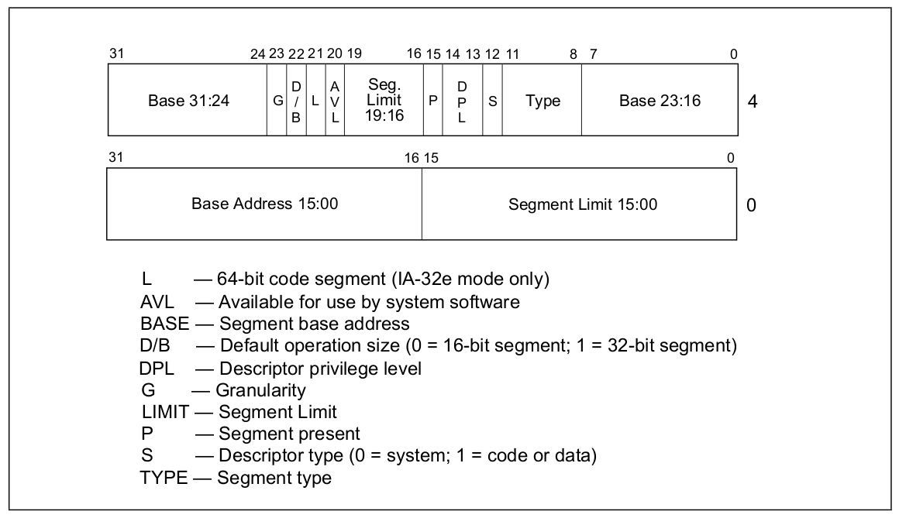
Segment descriptor

Slide 102
Segment Descriptor
0724 // Segment Descriptor
0725 struct segdesc {
0726 uint lim_15_0 : 16; // Low bits of segment limit
0727 uint base_15_0 : 16; // Low bits of segment base address
0728 uint base_23_16 : 8; // Middle bits of segment base address
0729 uint type : 4; // Segment type (see STS_ constants)
0730 uint s : 1; // 0 = system, 1 = application
0731 uint dpl : 2; // Descriptor Privilege Level
0732 uint p : 1; // Present
0733 uint lim_19_16 : 4; // High bits of segment limit
0734 uint avl : 1; // Unused (available for software use)
0735 uint rsv1 : 1; // Reserved
0736 uint db : 1; // 0 = 16−bit segment, 1 = 32−bit segment
0737 uint g : 1; // Granularity: limit scaled by 4K when set
0738 uint base_31_24 : 8; // High bits of segment base address
0739 };

Slide 103
Thank you!
(Next time: interrupts!)

