Slide 1
Lecture 2: OS Interfaces cs5460/6460 Operating Systems
Anton Burtsev
January, 2023

Slide 2
Recap: role of the operating system
Share hardware across multiple processes
Illusion of private CPU, private memory
Abstract hardware
Hide details of specific hardware devices
Provide services
Serve as a library for applications
Security
Isolation of processes
Controlled ways to communicate (in a secure manner)

Slide 3
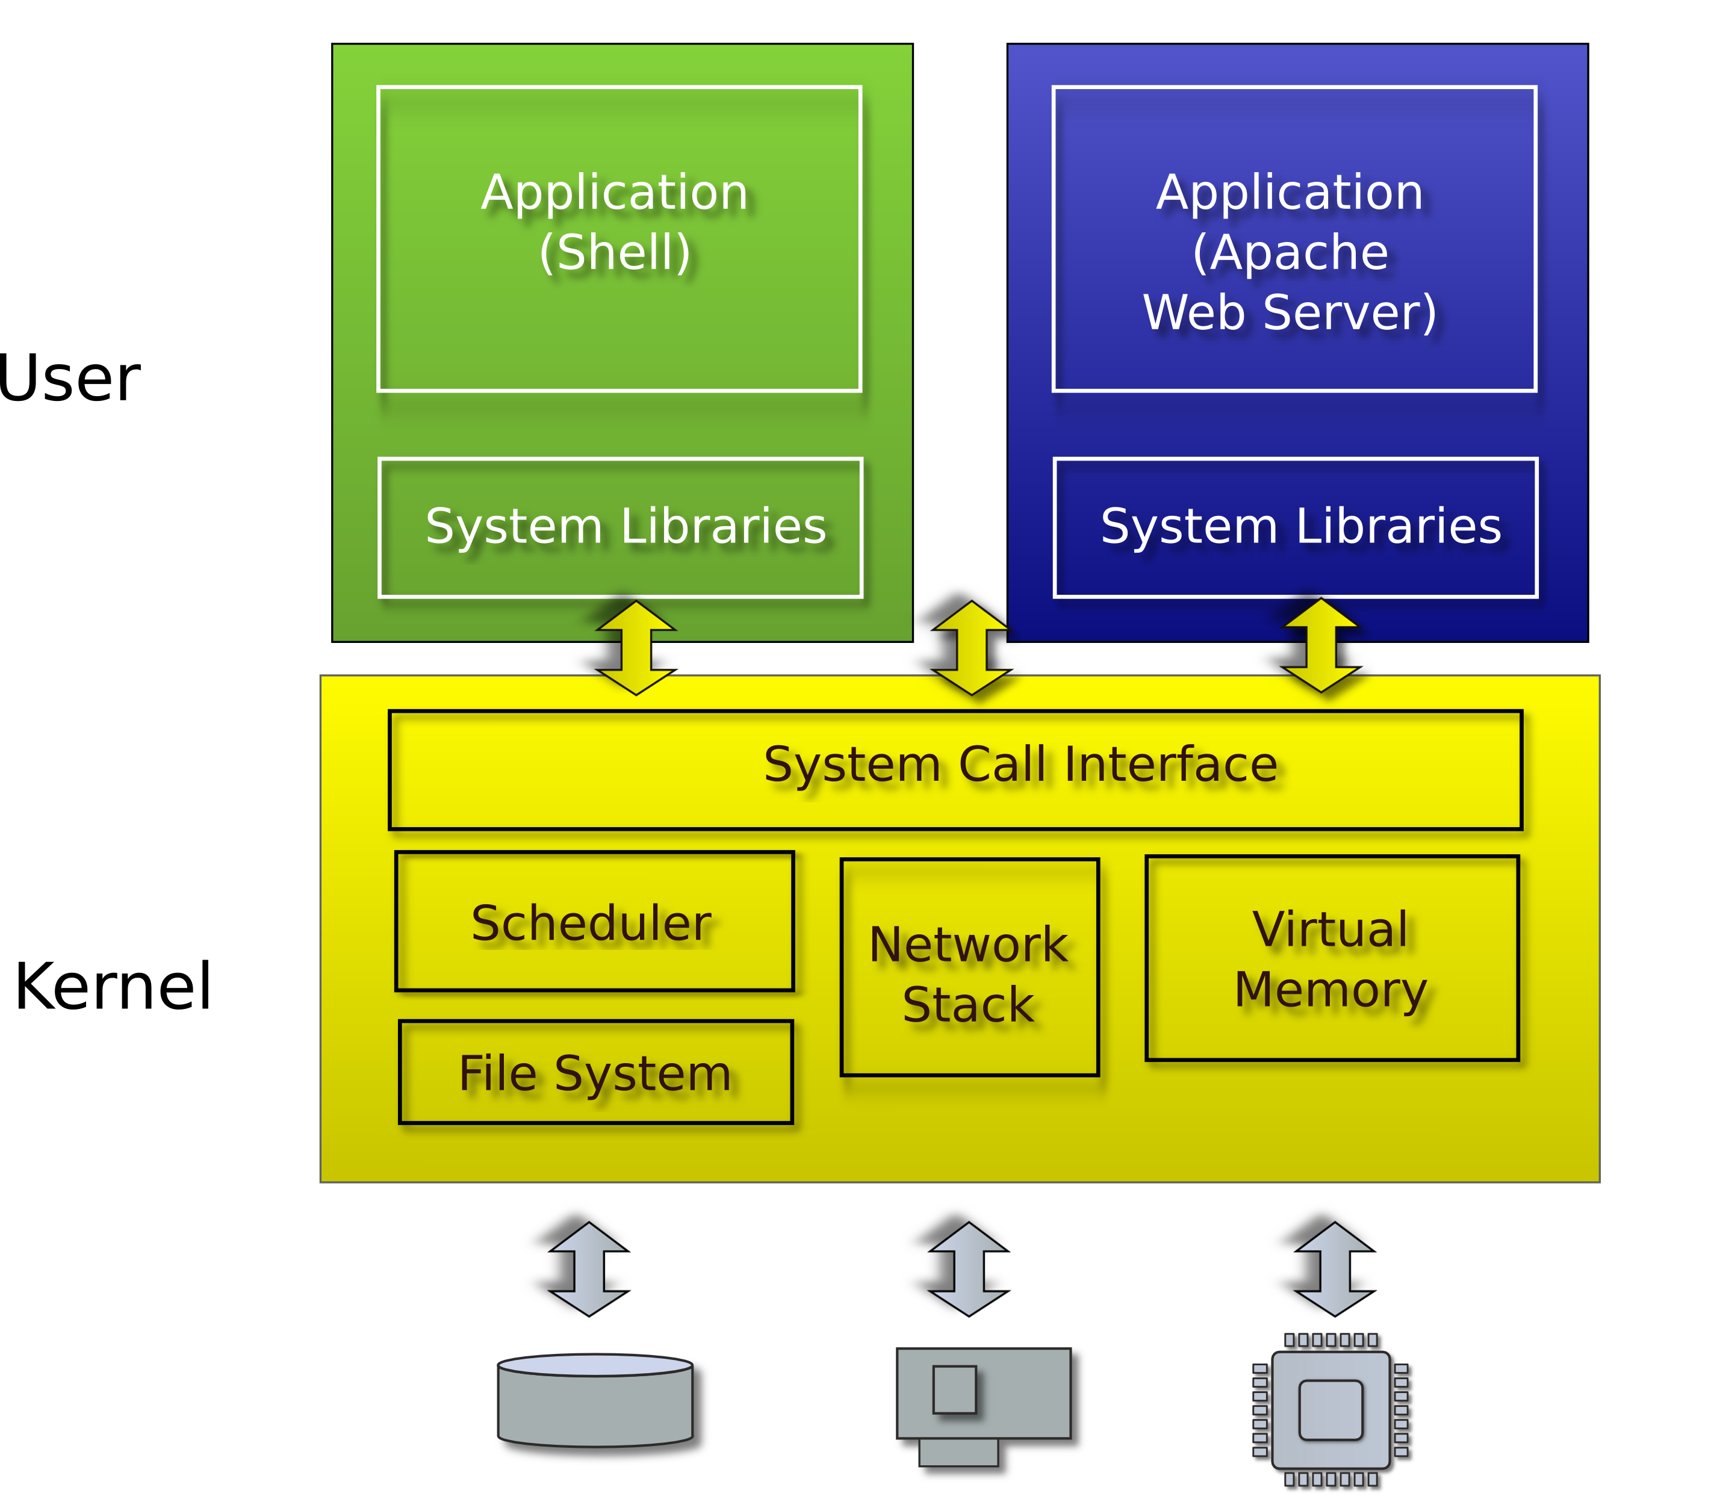
Typical UNIX OS

Slide 4
System calls
Provide user to kernel communication
Effectively an invocation of a kernel function
System calls implement the interface of the OS

Slide 5
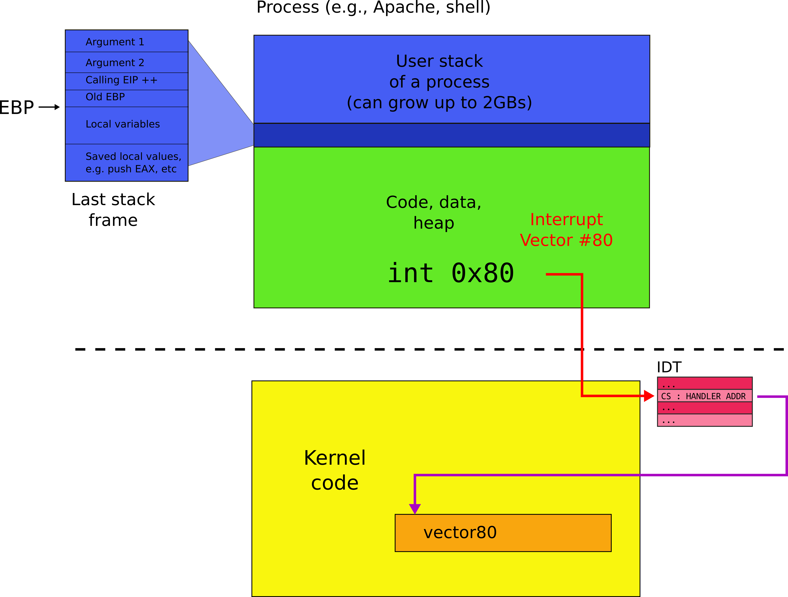
System call

Slide 6
What system calls do we need?

Slide 7
System calls, interface for...
Processes
Creating, exiting, waiting, terminating
Memory
Allocation, deallocation
Files and folders
Opening, reading, writing, closing
Inter-process communication
Pipes

Slide 8
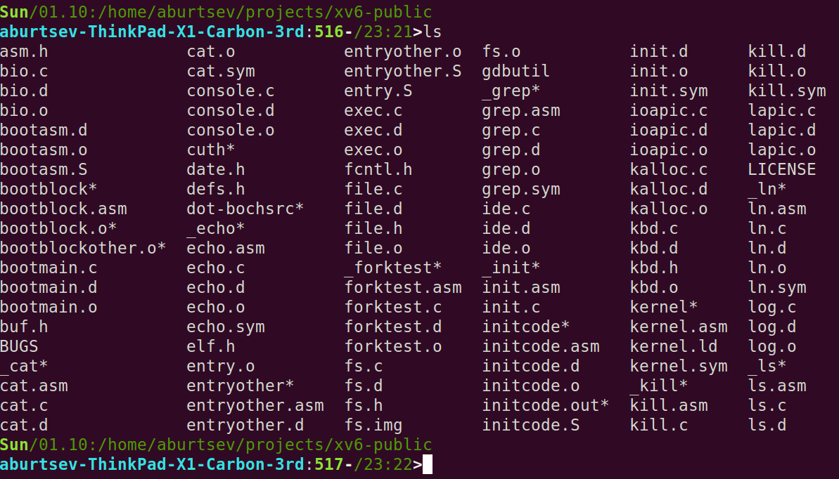
UNIX (xv6) system calls are designed around the shell

Slide 9
Why shell?

Slide 10
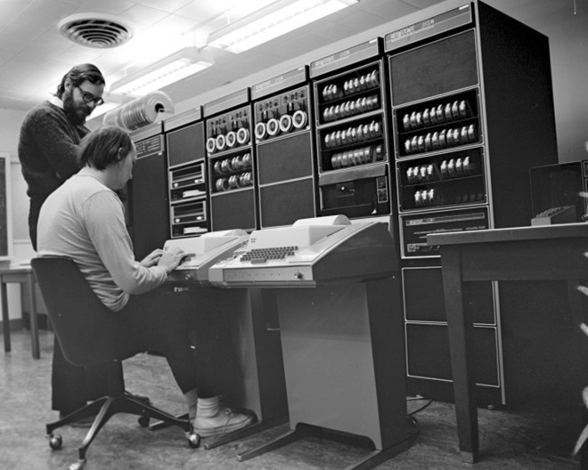
Ken Thompson (sitting) and Dennis Ritchie (standing) are working together on a PDP-11 (around 1970). They are using Teletype Model 33 terminals.

Slide 11
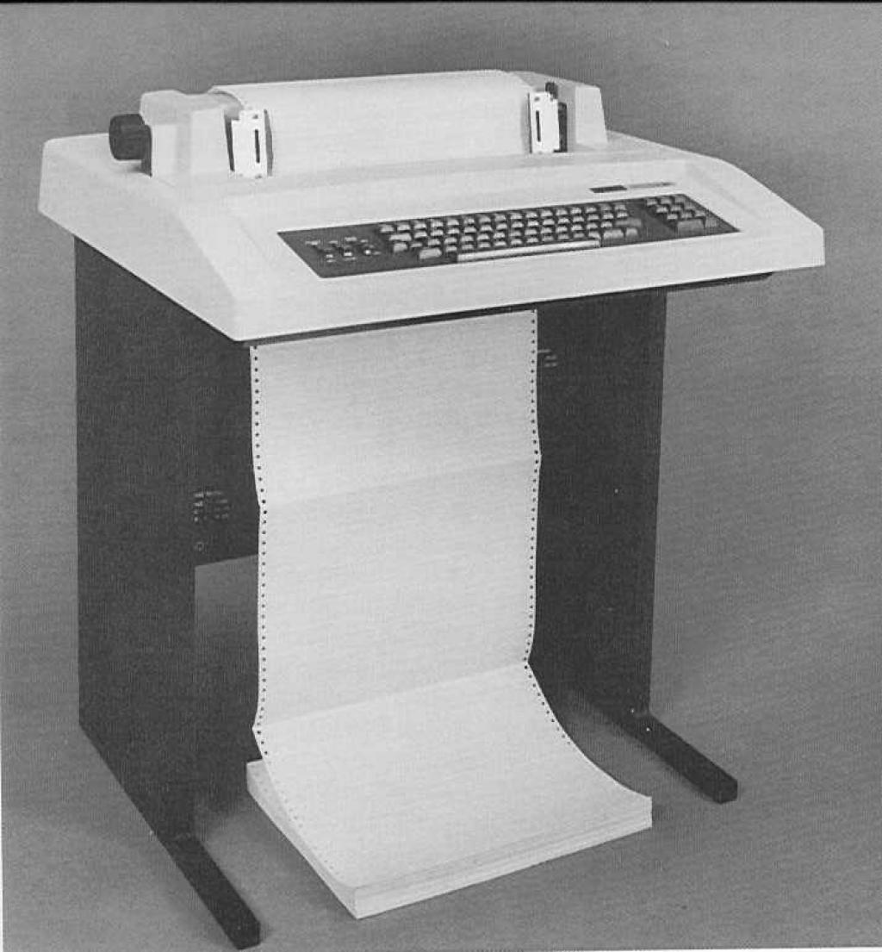
DEC LA36 DECwriter II Terminal

Slide 12
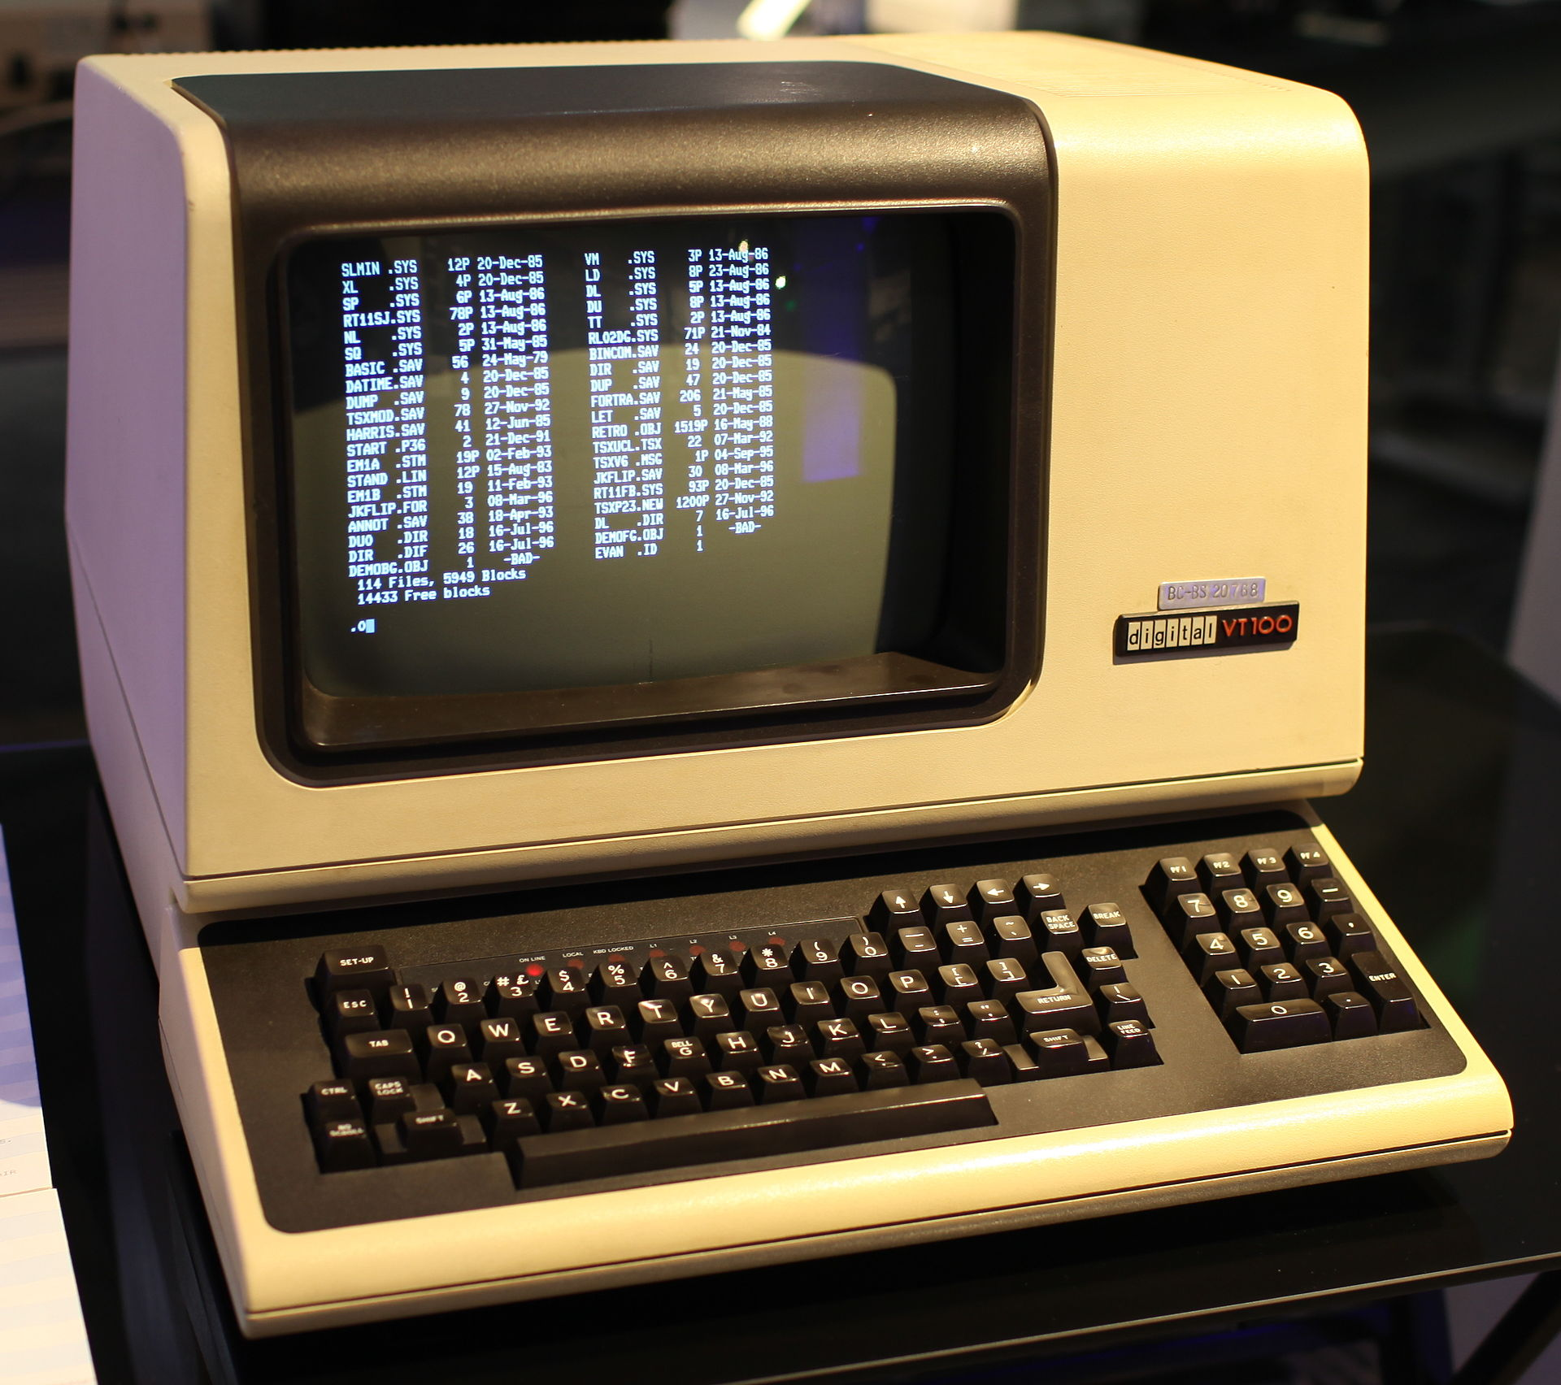
DEC VT100 terminal, 1980

Slide 13
Suddenly this makes sense
List all files
\> ls
total 9212
drwxrwxr-x 3 aburtsev aburtsev 12288 Oct 1 08:27 ./
drwxrwxr-x 43 aburtsev aburtsev 4096 Oct 1 08:25 ../
-rw-rw-r-- 1 aburtsev aburtsev 936 Oct 1 08:26 asm.h
-rw-rw-r-- 1 aburtsev aburtsev 3397 Oct 1 08:26 bio.c
-rw-rw-r-- 1 aburtsev aburtsev 100 Oct 1 08:26 bio.d
-rw-rw-r-- 1 aburtsev aburtsev 6416 Oct 1 08:26 bio.o
…
Count number of lines in a file (ls.c imlements ls)
\> wc -l ls.c
85 ls.c

Slide 14
But what is shell?

Slide 15
But what is shell?
Normal process
Kernel starts it for each user that logs into the system
In xv6 shell is created after the kernel boots
Shell interacts with the kernel through system calls
E.g., starts other processes

Slide 16
What happens underneath?
\> wc -l ls.c
85 ls.c
\>
Shell starts wc
Creates a new process to run wc
Passes the arguments (-l and ls.c)
wc sends its output to the terminal (console)
Exits when done with exit()
Shell detects that wc is done (wait())
Prints (to the same terminal) its command prompt
Ready to execute the next command

Slide 17
Console and file I/O

Slide 18
File open
fd = open(“ls.c”, O_READONLY) – open a file
Operating system returns a file descriptor

Slide 19
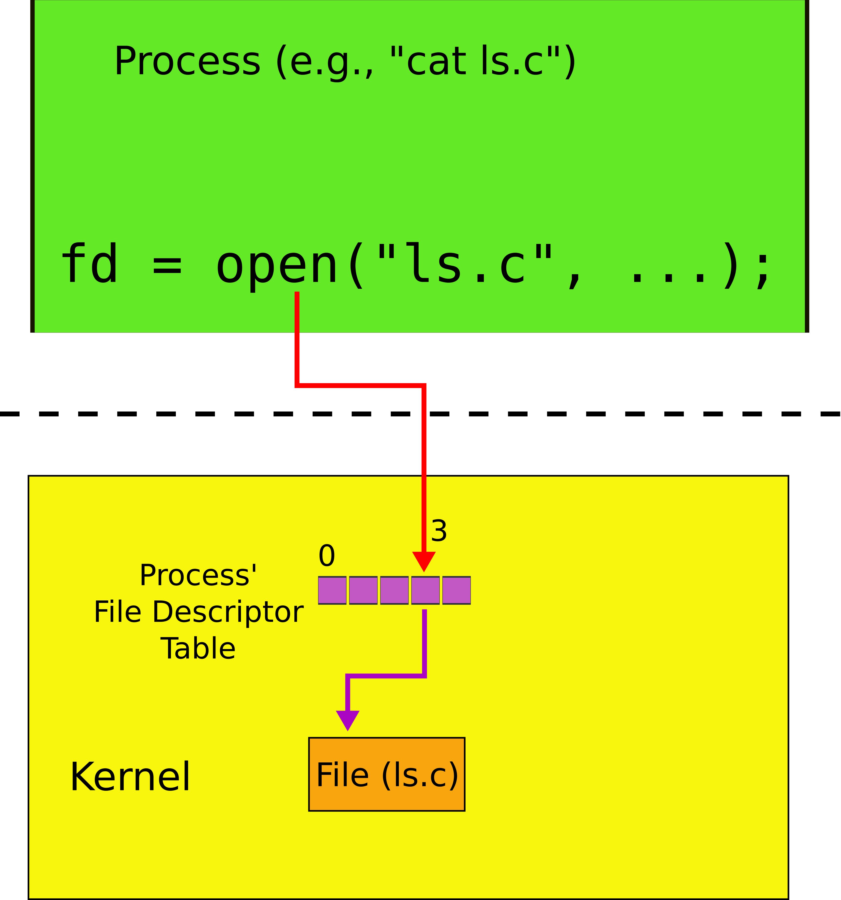
File descriptors

Slide 20
File descriptors
An index into a table, i.e., just an integer
The table maintains pointers to “file” objects
Abstracts files, devices, pipes
In UNIX everything is a file – all objects provide file interface
Process may obtain file descriptors through
Opening a file, directory, device
By creating a pipe
Duplicating an existing descriptor

Slide 21
File I/O
fd = open(“foobar.txt”, O_READONLY) – open a file
Operating system returns a file desciptor
read(fd, buf, n) – read n bytes from fd into buf
write(fd, buf, n) – write n bytes from buf into fd

Slide 22
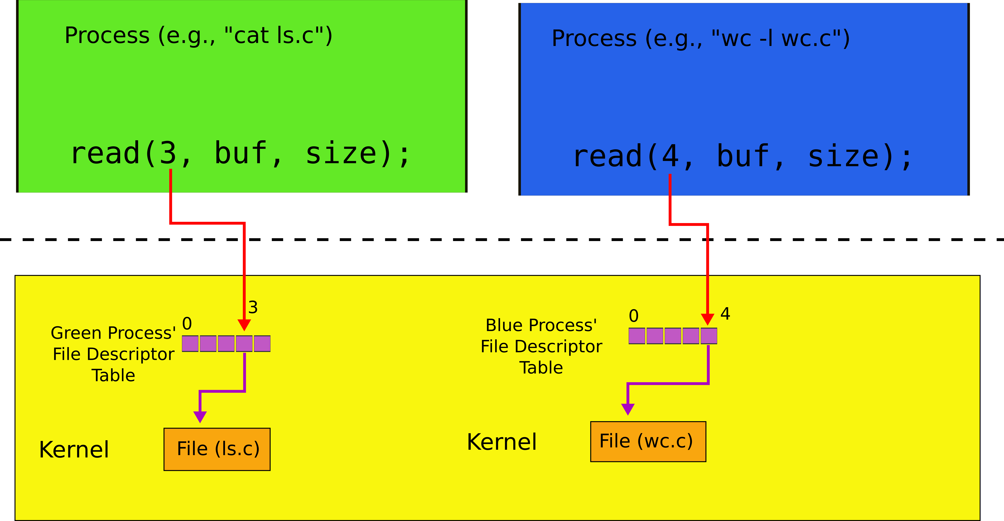
File descriptors: two processes

Slide 23
Console I/O

Slide 24
Each process has standard file descriptors
Numbers are just a convention
0 – standard input
1 – standard output
2 – standard error
This convention is used by the shell to implement I/O redirection and pipes

Slide 25
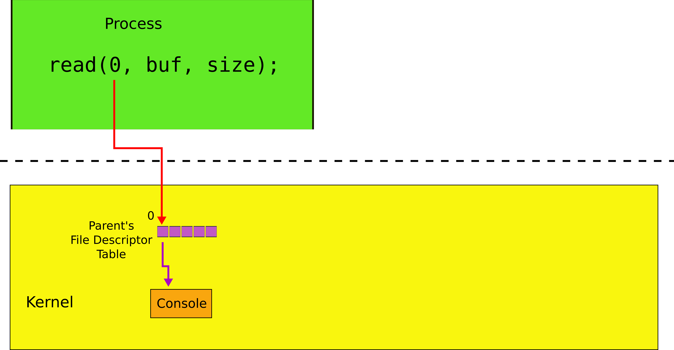
Console read (read of standard intput)

Slide 26
Console write (write of standard output)

Slide 27
Example: cat
char buf[512];
int n;
for(;;) {
n = read(0, buf, sizeof buf);
if(n == 0)
break;
if(n < 0) {
fprintf(2, "read error\n");
exit(); }
if(write(1, buf, n) != n) {
fprintf(2, "write error\n");
exit();
}
}

Slide 28
Creating processes

Slide 29
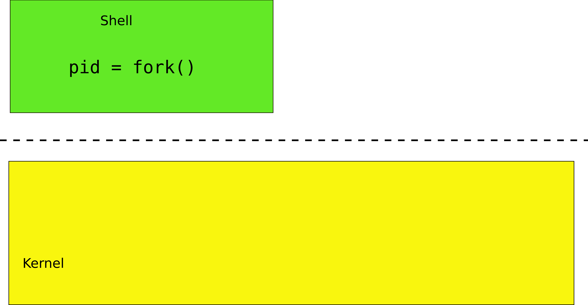
fork()

Slide 30
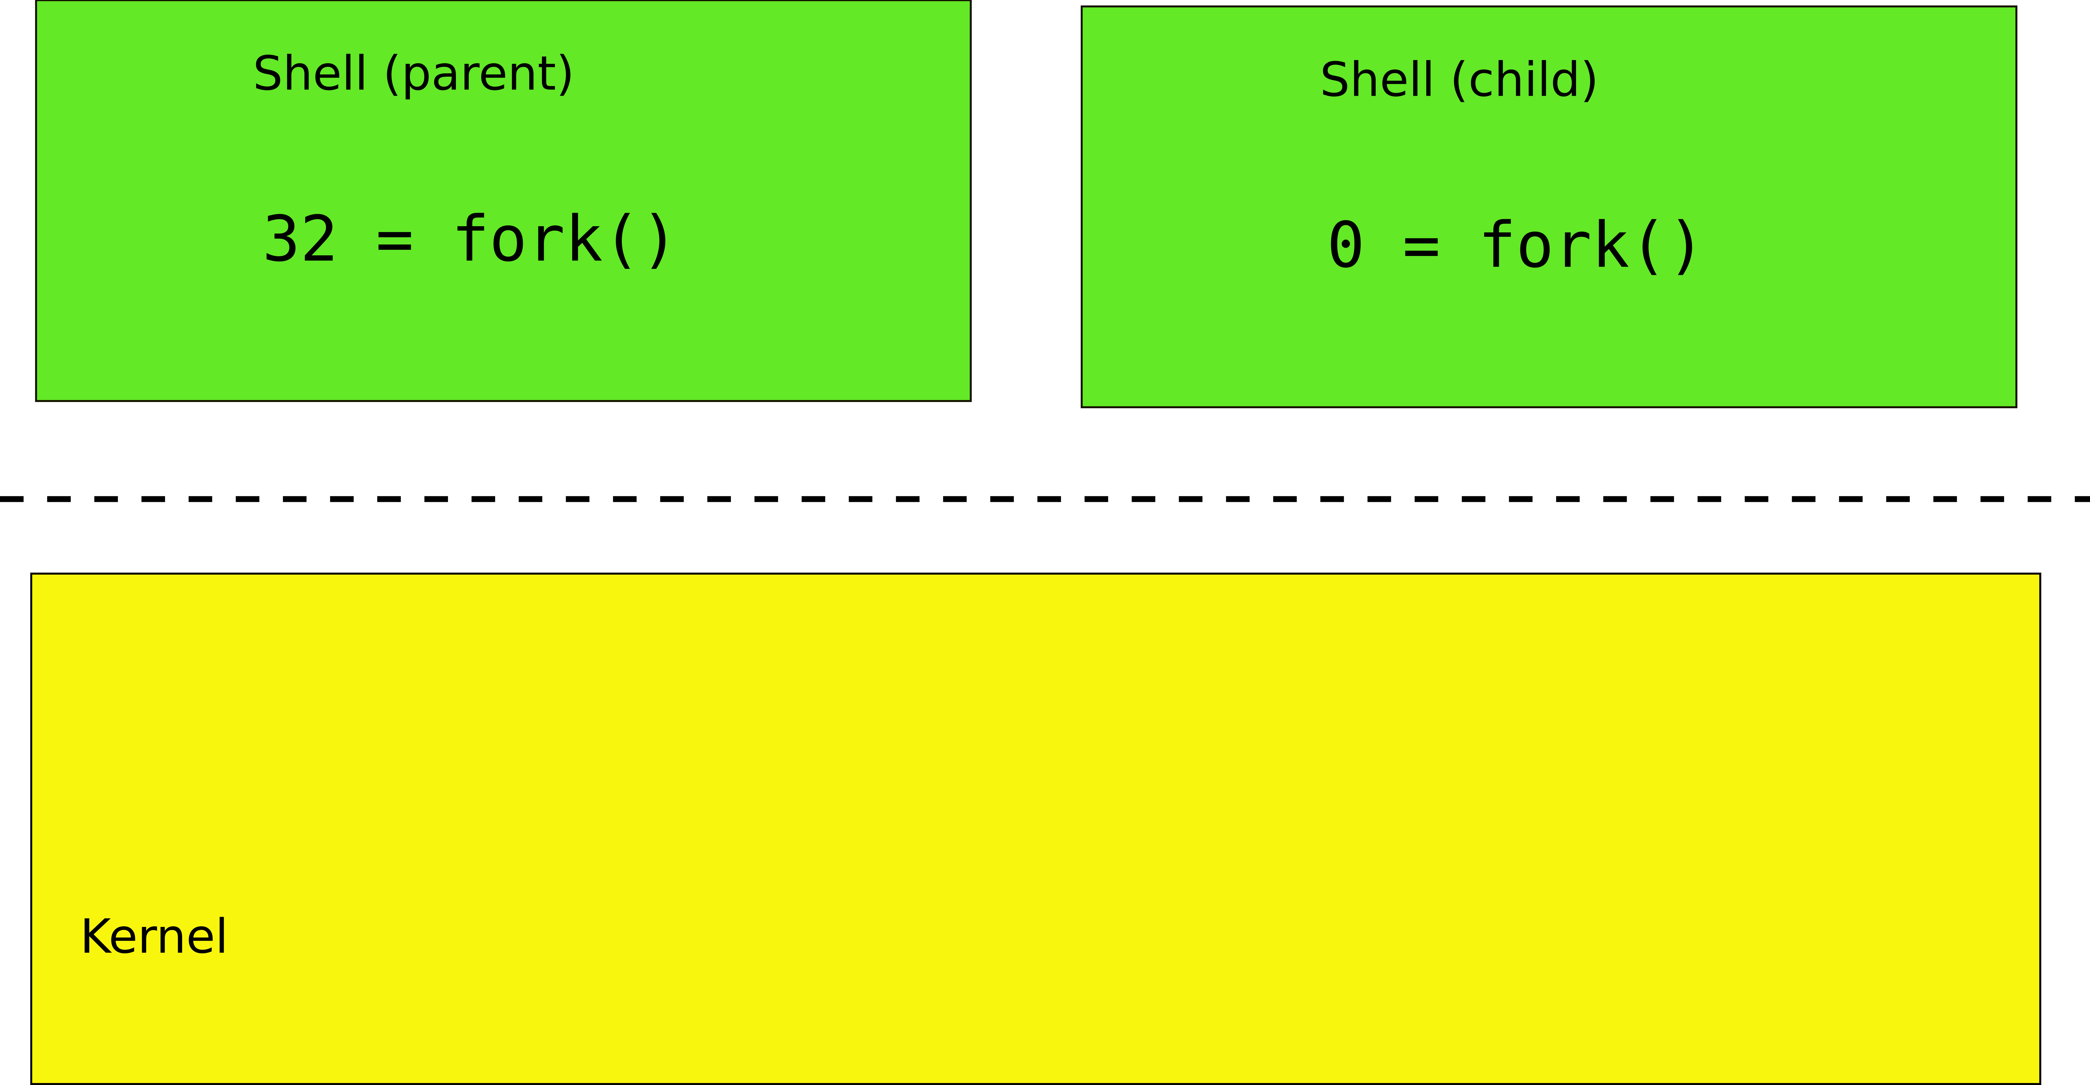
fork()

Slide 31
fork() -- creates a new process
int pid;
pid = fork();
if(pid > 0){
printf("parent: child=%d\n", pid);
pid = wait();
printf("child %d is done\n", pid);
} else if(pid == 0){
printf("child: exiting\n");
exit();
} else {
printf("fork error\n");
}

Slide 32
This is weird... fork() creates copies of the same process, why?

Slide 33
fork() is used together with exec()
exec() -- replaces memory of a current process with a memory image (of a program) loaded from a file
char *argv[3];
argv[0] = "echo";
argv[1] = "hello";
argv[2] = 0;
exec("/bin/echo", argv);
printf("exec error\n");

Slide 34
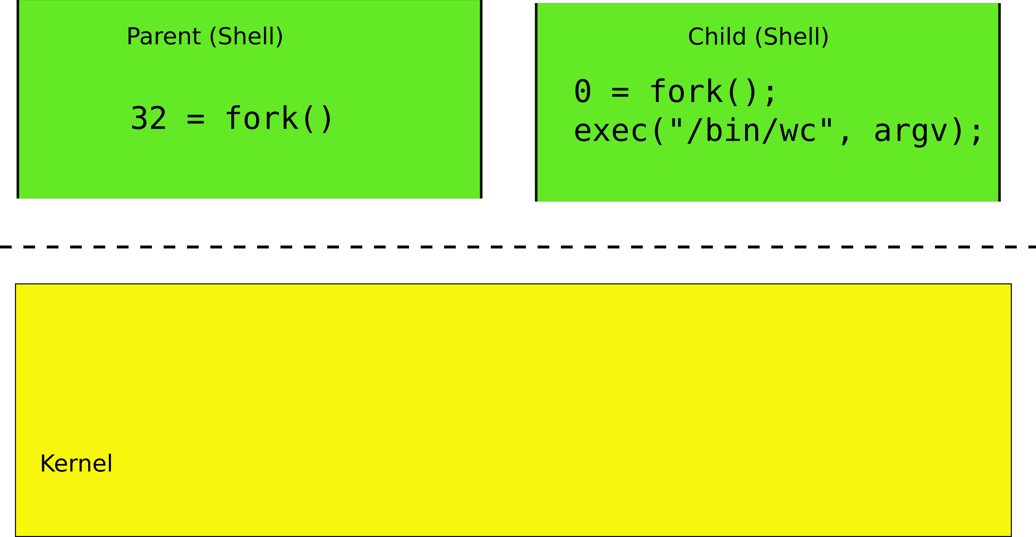
fork() and exec()

Slide 35
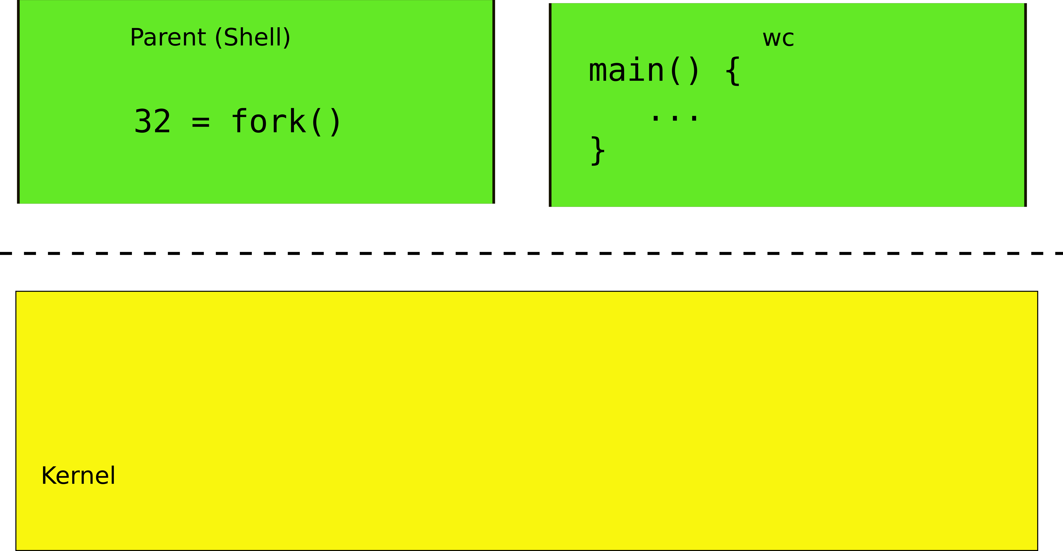
fork() and exec()

Slide 36
Still weird... why first fork() and then exec()?
Why not exec() directly?

Slide 37
I/O Redirection

Slide 38
Motivating example #1
Normally wc sends its output to the console (screen)
Count the number of lines in ls.c
\> wc -l ls.c
85 ls.c
What if we want to save the number of lines into a file?

Slide 39
Motivating example #1
Normally wc sends its output to the console (screen)
Count the number of lines in ls.c
\> wc -l ls.c
85 ls.c
What if we want to save the number of lines into a file?
We can add an argument
\> wc -l ls.c -o foobar.txt

Slide 40
Motivating example #1
\> wc -l ls.c -o foobar.txt
But there is a better way
\> wc -l ls.c > foobar.txt

Slide 41
I/O redirection
> redirect output
Redirect output of a command into a file
\> wc -l ls.c > foobar.txt
\> cat ls.c > ls-new.c
< redirect input
Redirect input to read from a file
\> wc -l < ls.c
\> cat < ls.c
You can redirect both
\> wc -l < ls.c > foobar.txt

Slide 42
Standard output is now a file

Slide 43
Powerful design choice
File descriptors don't have to point to files only
Any object with the same read/write interface is ok
Files
Devices
Console
Pipes

Slide 44
Example: cat
char buf[512]; int n;
for(;;) {
n = read(0, buf, sizeof buf);
if(n == 0)
break;
if(n < 0) {
fprintf(2, "read error\n");
exit(); }
if(write(1, buf, n) != n) {
fprintf(2, "write error\n");
exit();
}
}

Slide 45
Why do we need I/O redirection?

Slide 46
Motivating example #2
We want to see how many strings in ls.c contain “main”

Slide 47
Motivating example #2
We want to see how many strings in ls.c contain “main”
Imagine we have grep
grep filters strings matching a pattern
\>grep "main" ls.c
main(int argc, char *argv[])
Or the same written differently
\>grep "main" < ls.c
main(int argc, char *argv[])

Slide 48
Motivating example #2
Now we have
grep
Filters strings matching a pattern
wc -l
Counts lines
Can we combine them?

Slide 49
Pipes
Imagine we have a way to redirect output of one process into input of another
\> cat ls.c | grep main
|(a “pipe”) does redirection

Slide 50
Pipes
In our example:
\> cat ls.c | grep main
cat outputs ls.c to its output
cat's output is connected to grep's input with the pipe
grep filters lines that match a specific criteria, i.e., once that have “main”

Slide 51
pipe - inter-process communication
Pipe is a kernel buffer exposed as a pair of file descriptors
One for reading, one for writing
Pipes allow processes to communicate
Send messages to each other

Slide 52
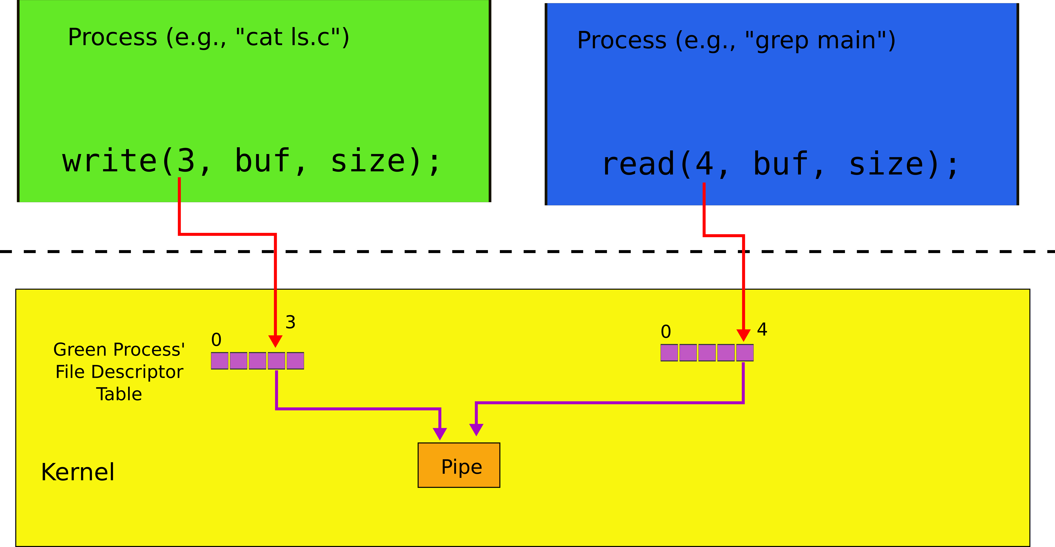
Two file descriptors pointing to a pipe

Slide 53
Pipes allow us to connect programs,
i.e., the output of one program to the input of another

Slide 54
Composability
Now if we want to see how many strings in ls.c contain “main” we do:
\> cat ls.c | grep main | wc -l
1
.. but if we want to count the once that contain “a”:
cat ls.c | grep a | wc -l
33
We change only input to grep!
Small set of tools (ls, grep, wc) compose into complex workflows

Slide 55
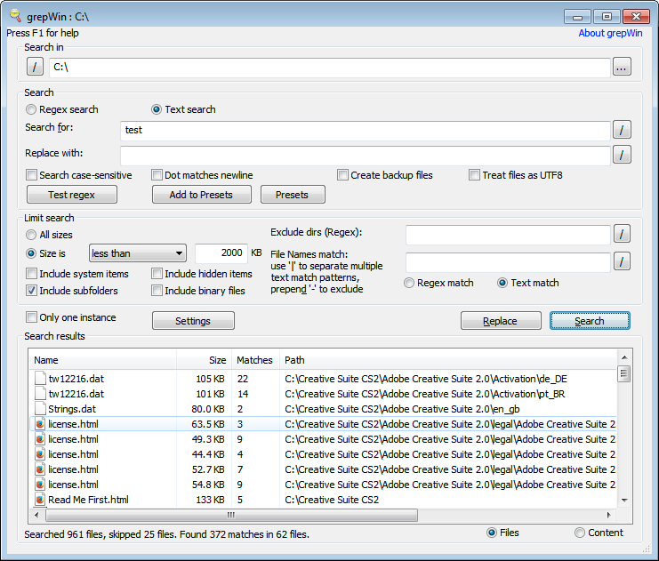
Better than this...

Slide 56
Building I/O redirection

Slide 57
How can we build this?
\> cat ls.c | grep main | wc -l
wc has to operate on the output of grep
grep operates on the output of cat

Slide 58
Back to fork()

Slide 59
fork()

Slide 60
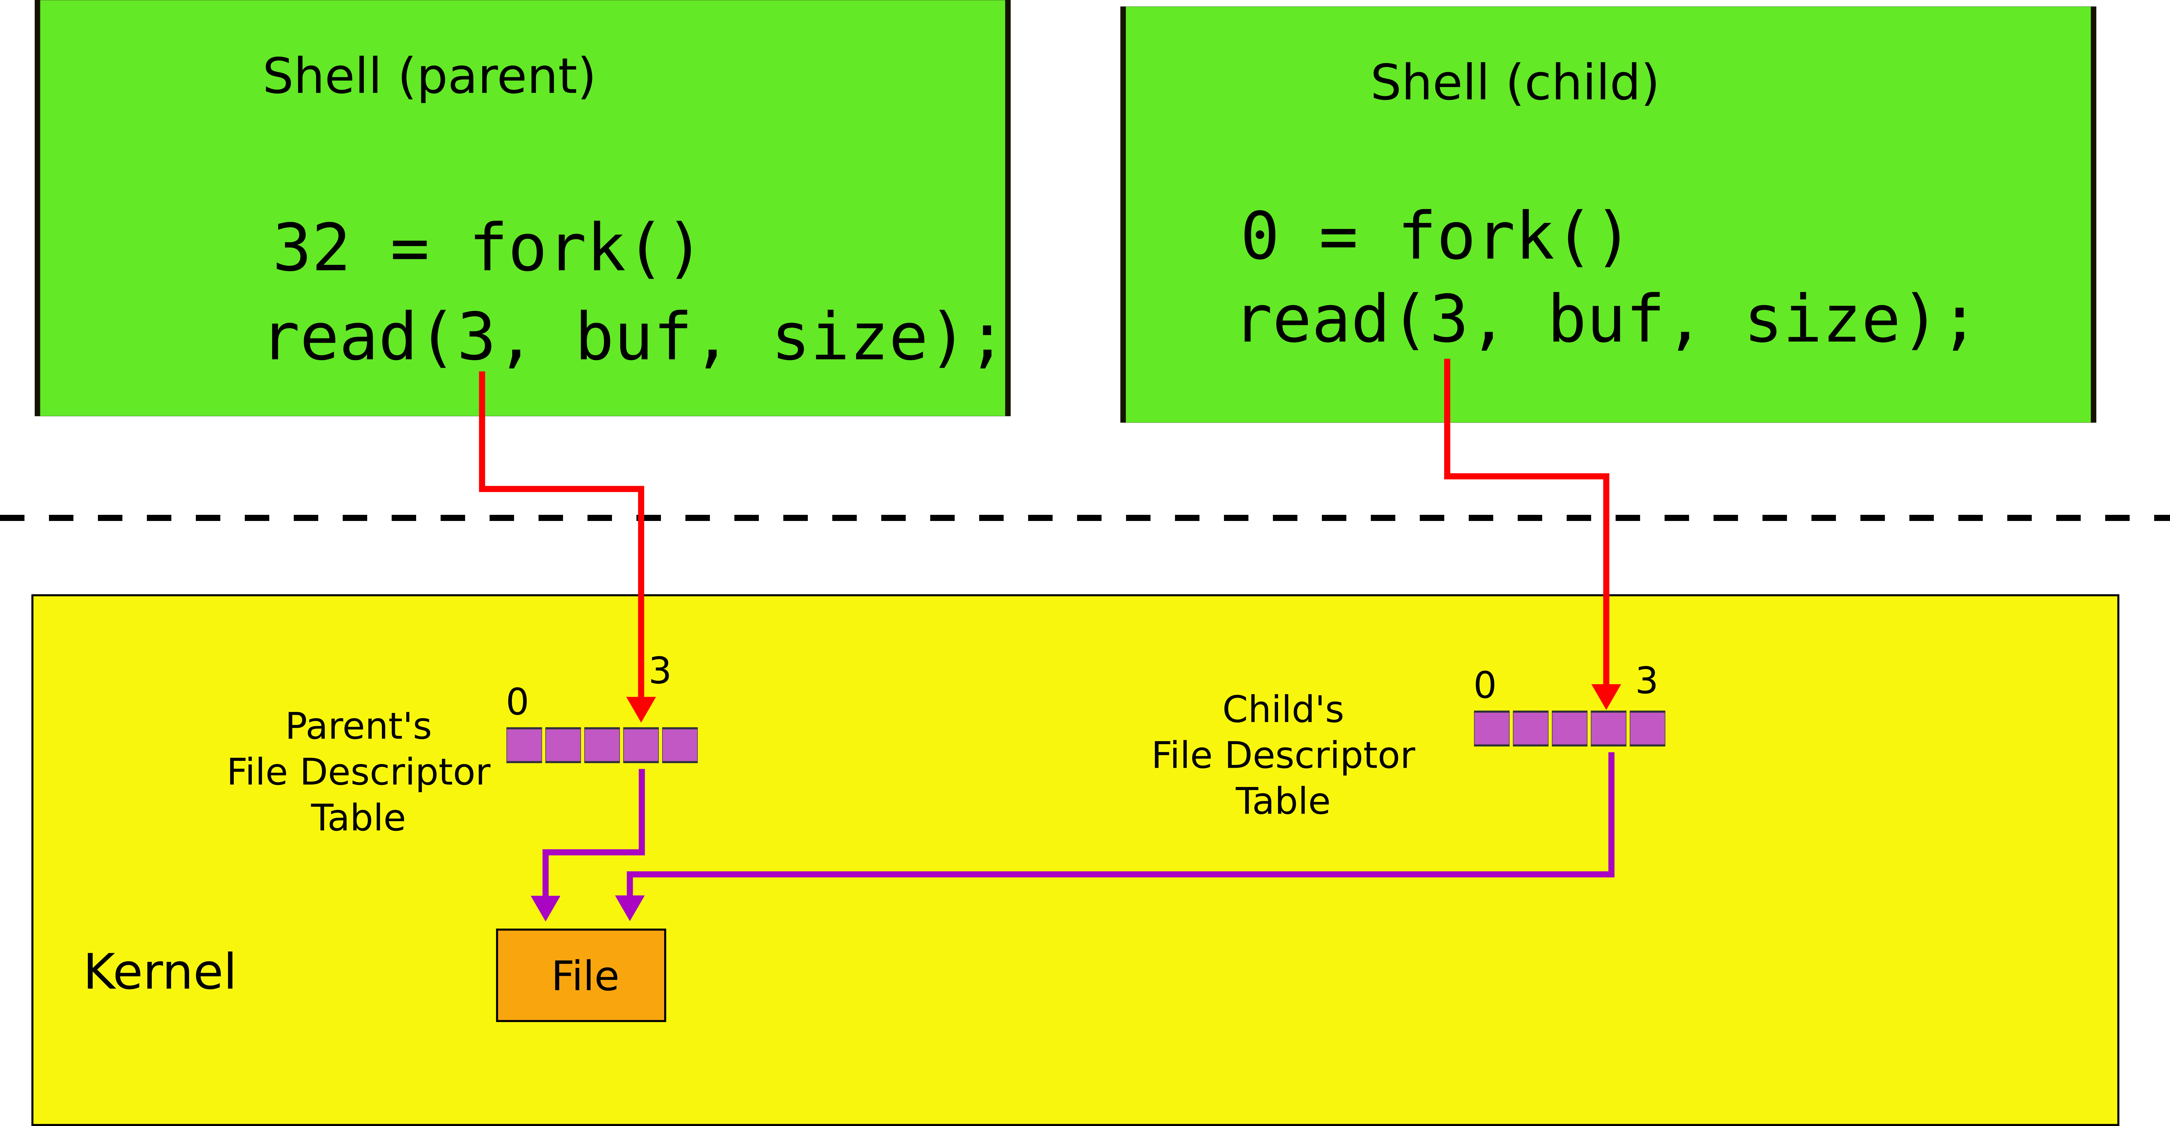
File descriptors after fork()

Slide 61
Two system calls for I/O redirection
close(fd) – closes file descriptor
The next opened file descriptor will have the lowest number

Slide 62
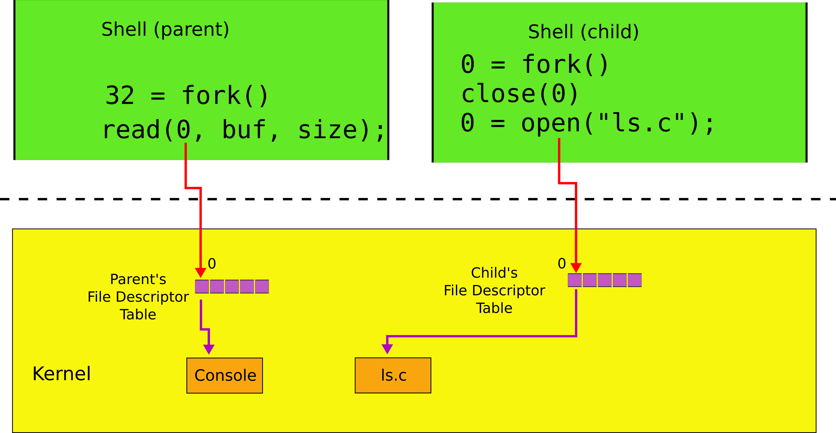
File descriptors after close()/open()
Example: \> cat < ls.c

Slide 63
Two system calls for I/O redirection
close(fd) – closes file descriptor
The next opened file descriptor will have the lowest number
exec() replaces process memory, but
leaves its file descriptor table intact
A process can create a copy of itself with fork()
Change the file descriptors for the next program it is about to run
And then execute the program with exec()

Slide 64
File descriptors after exec()
Example: \> cat < ls.c

Slide 65
Example: \> cat < ls.c
char *argv[2];
argv[0] = "cat";
argv[1] = 0;
if(fork() == 0) {
close(0);
open("ls.c", O_RDONLY);
exec("cat", argv);
}
…
Poll time
Inside the cat process which file file descriptor 0 points to?
Do we reach line 9?

Slide 66
Why fork() not just exec()
The reason for the pair of fork()/exec()
Shell can manipulate the new process (the copy created by fork())
Before running it with exec()

Slide 67
Back to Motivating example #2
(\> cat ls.c | grep main | wc -l)

Slide 68
Pipes
We now understand how to use a pipe to connect two programs
Create a pipe
Fork
Attach one end to standard output
of the left side of “|”
Another to the standard input
of the right side of “|”

Slide 69
wc on the read end of the pipe
int p[2];
char *argv[2]; argv[0] = "wc"; argv[1] = 0;
pipe(p);
if(fork() == 0) {
close(0);
dup(p[0]);
close(p[0]);
close(p[1]);
exec("/bin/wc", argv);
} else {
write(p[1], "hello world\n", 12);
close(p[0]);
close(p[1]);
}

Slide 70
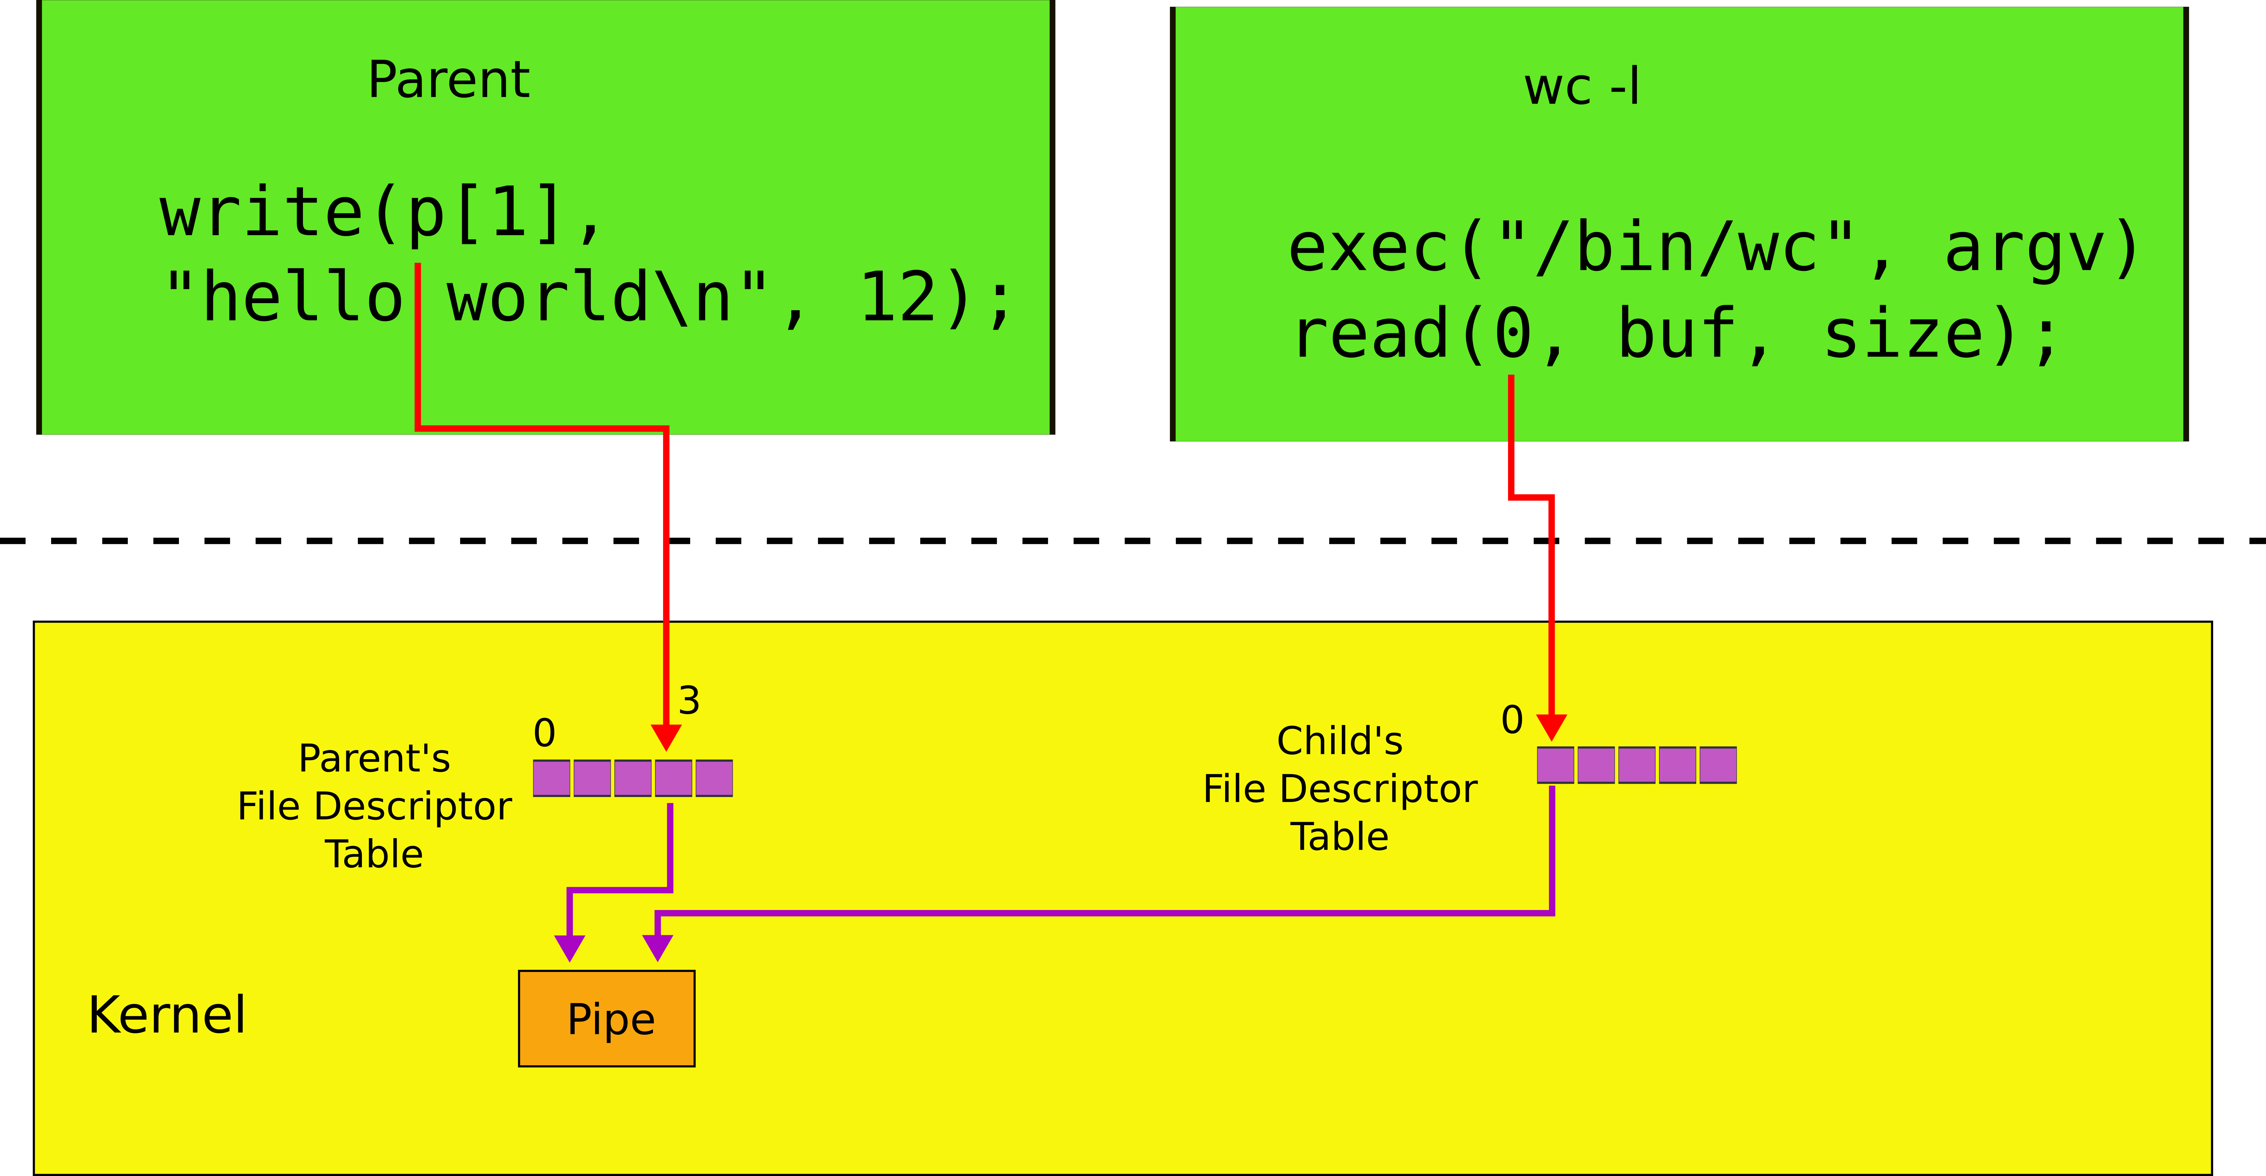

Slide 71
Powerful conclusion
fork(), standard file descriptors, pipes and exec() allow complex programs out of simple tools
They form the core of the UNIX interface

Slide 72
More system calls

Slide 73
Process management
exit() -- terminate current process
wait() -- wait for the child to exit
Any child (can be multiple)
Return it’s process id (pid)

Slide 74
Creating files
mkdir() – creates a directory
open(…, O_CREATE) – creates a file
mknod() – creates an empty file marked as device
Major and minor numbers uniquely identify the device in the kernel
fstat() – retrieve information about a file

Slide 75
Links, inodes
Same file can have multiple names – links
But unique inode number
link() – create a link
unlink() – delete file
Example, create a temporary file
fd = open("/tmp/xyz", O_CREATE|O_RDWR);
unlink("/tmp/xyz");

Slide 76
Xv6 system calls
fork() Create a process
exit() Terminate the current process
wait() Wait for a child process to exit
kill(pid) Terminate process pid
getpid() Return the current process’s pid
sleep(n) Sleep for n clock ticks
exec(filename, *argv) Load a file and execute it
sbrk(n) Grow process’s memory by n bytes
open(filename, flags) Open a file; the flags indicate read/write
read(fd, buf, n) Read n bytes from an open file into buf
write(fd, buf, n) Write n bytes to an open file
close(fd) Release open file fd
dup(fd) Duplicate fd
pipe(p) Create a pipe and return fd’s in p
chdir(dirname) Change the current directory
mkdir(dirname) Create a new directory
mknod(name, major, minor) Create a device file
fstat(fd) Return info about an open file
link(f1, f2) Create another name (f2) for the file f1
unlink(filename) Remove a file

Slide 77
In many ways xv6 is very similar to the operating systems we run today

Slide 78
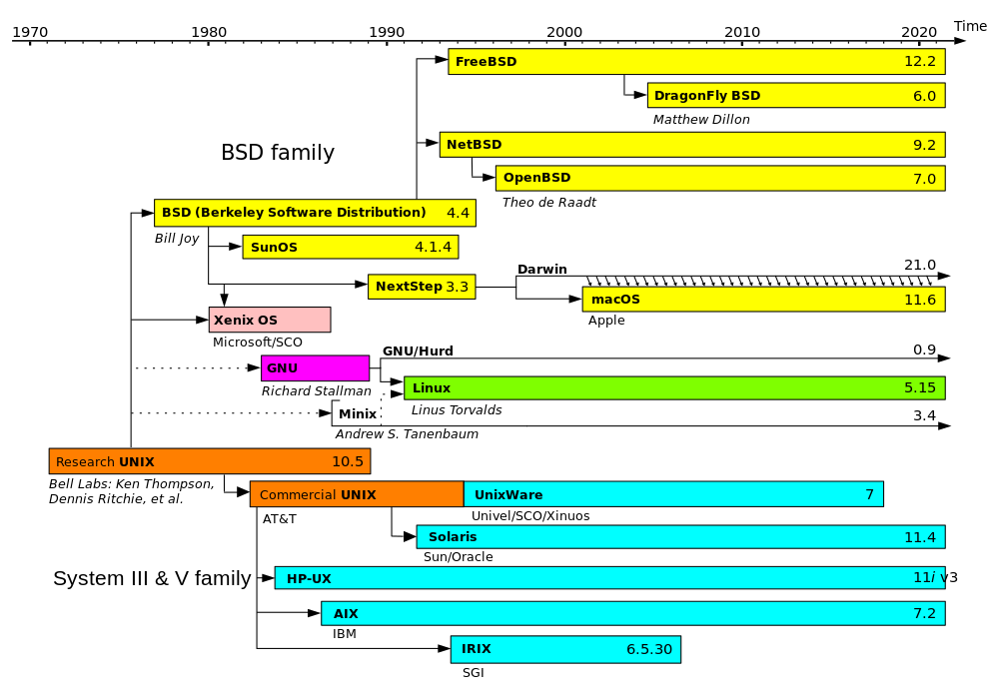
Evolution of Unix and Unix-like systems

Slide 79
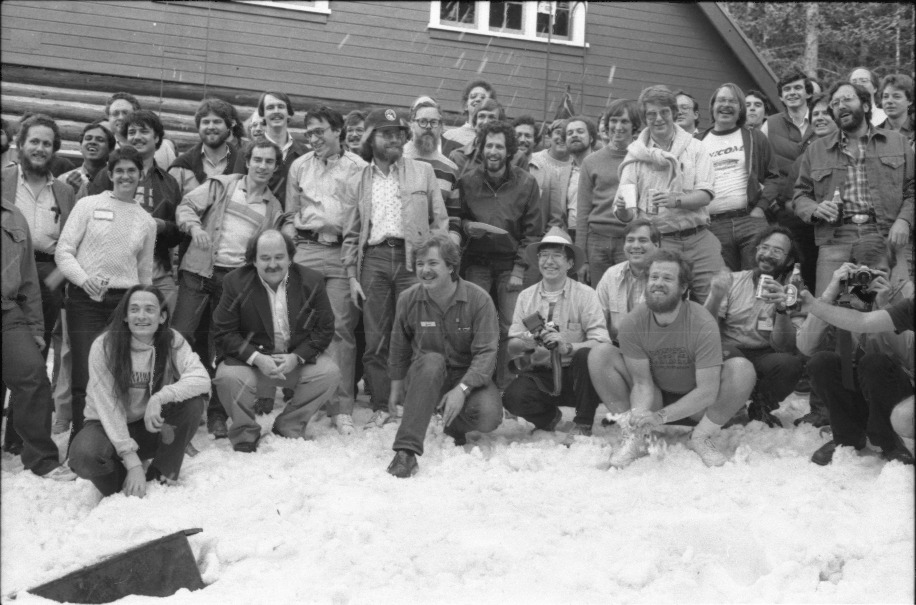
Speakers from the 1984 Summer USENIX Conference (Salt Lake City, UT)

Slide 80
Backup slides

Slide 81
Pipes
Shell composes simple utilities into more complex actions with pipes, e.g.
grep FORK sh.c | wc -l
Create a pipe and connect ends

Slide 82
System call

Slide 83
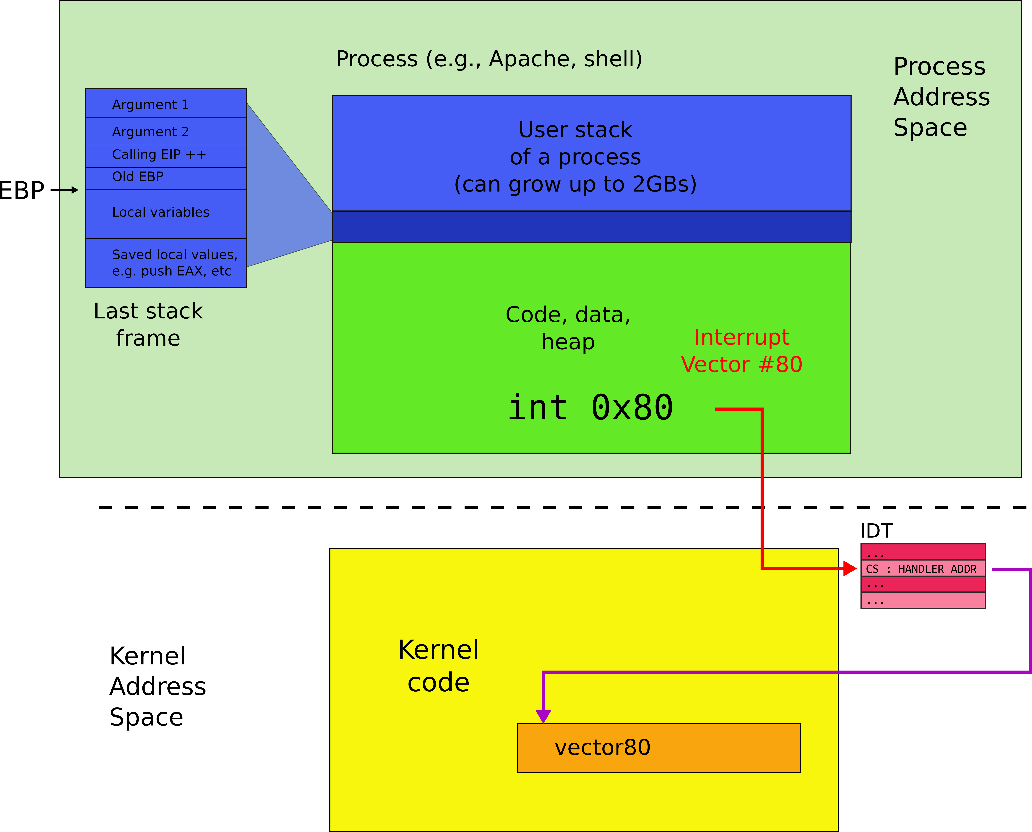
User address space

Slide 84
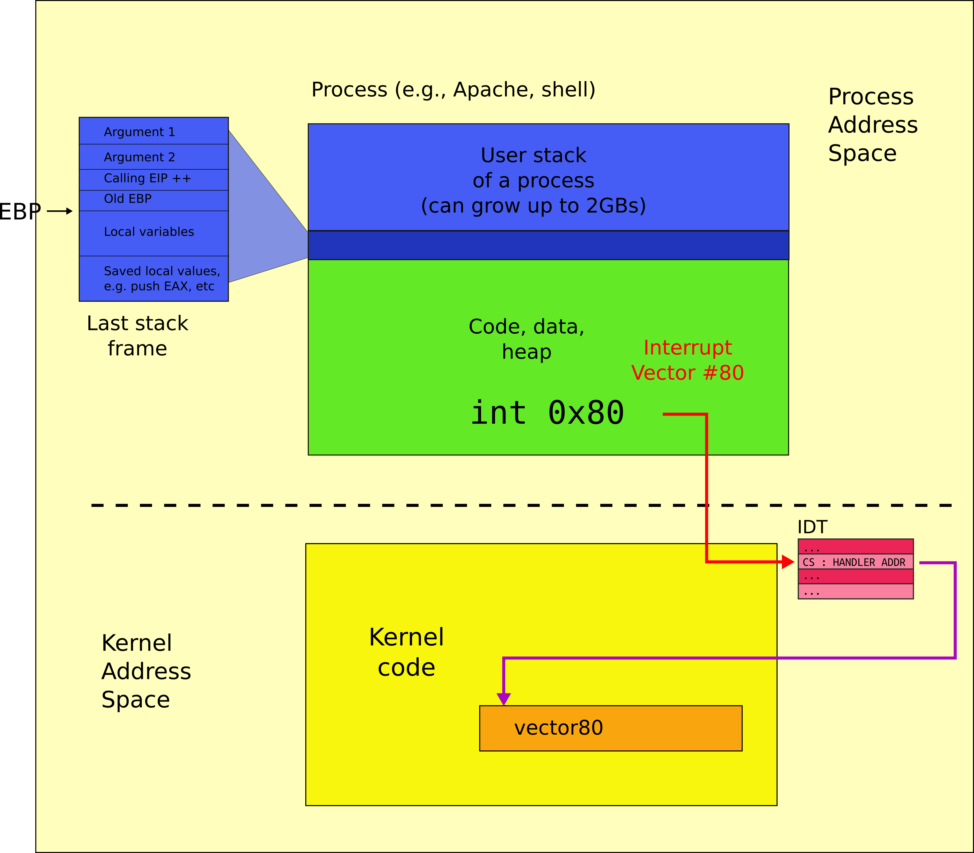
Kernel address space

Slide 85
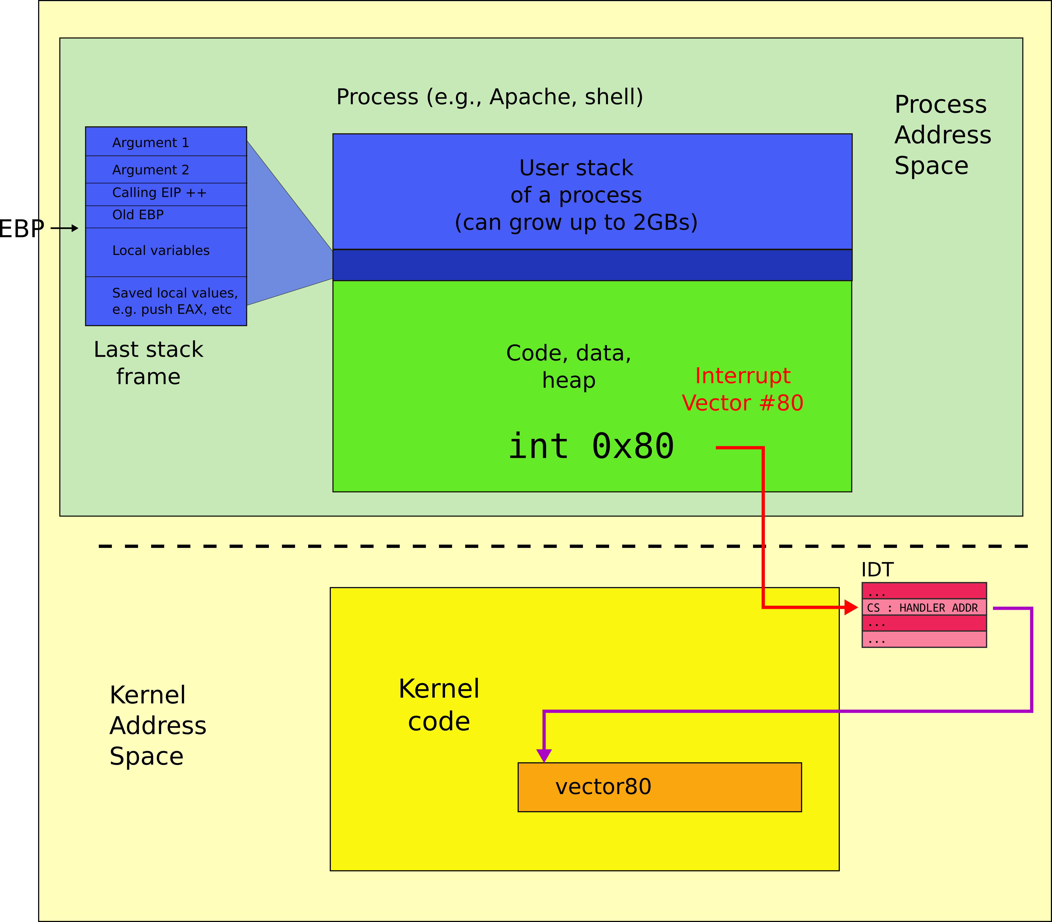
Kernel and user address spaces

