Slide 1
Why should you do an OS class?
In the age of data centers, heterogeneous hardware and targeted Security attacks
Anton Burtsev
www.cs.utah.edu/~aburtsev
anton.burtsev@utah.edu
Notes:
Today I’ll talk about my work on designing and building a safer, more secure operating system kernel.

Slide 2
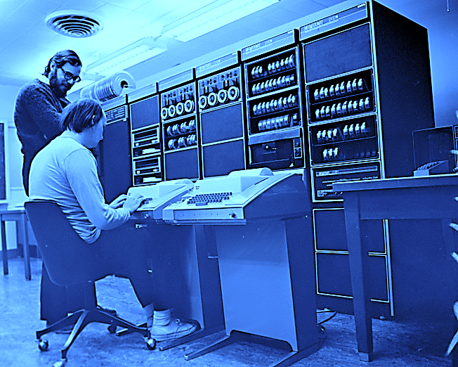
Operating systems haven’t changed for decades
40 years old
Time-sharing
Expensive hardware
Overly general
Ken Thompson (sitting) and Dennis Ritchie working together at a PDP-11 (1972)
Notes:
Despite numerous ways in how the use of computer systems has evolved over the last four decades, modern OS kernels rely on the software
development technology that has not changed since early computer systems.
Modern kernels are still developed with a legacy software engineering techniques - a combination of an unsafe programming
Language, and virtually no testing or verification tools.

Slide 3
cs5460/6460 teaches this system
Xv6 is an x86 implementation of UNIX 6th edition
All lectures are recorded
You’re welcome to take a look
Notes:
Despite numerous ways in how the use of computer systems has evolved over the last four decades, modern OS kernels rely on the software
development technology that has not changed since early computer systems.
Modern kernels are still developed with a legacy software engineering techniques - a combination of an unsafe programming
Language, and virtually no testing or verification tools.

Slide 4
Notes:
Modern kernels are designed to time-share scarce hardware resources of a single server, but today, thousands of machines are dedicated to a single task.

Slide 5
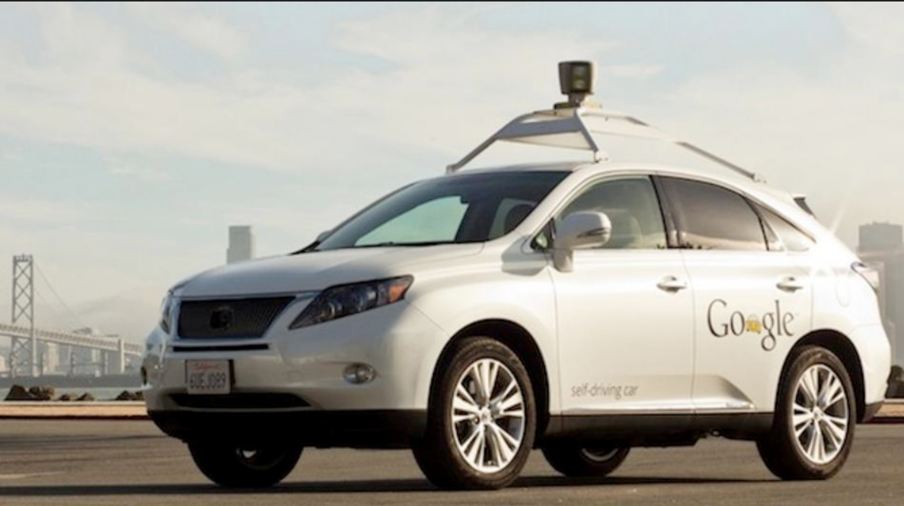
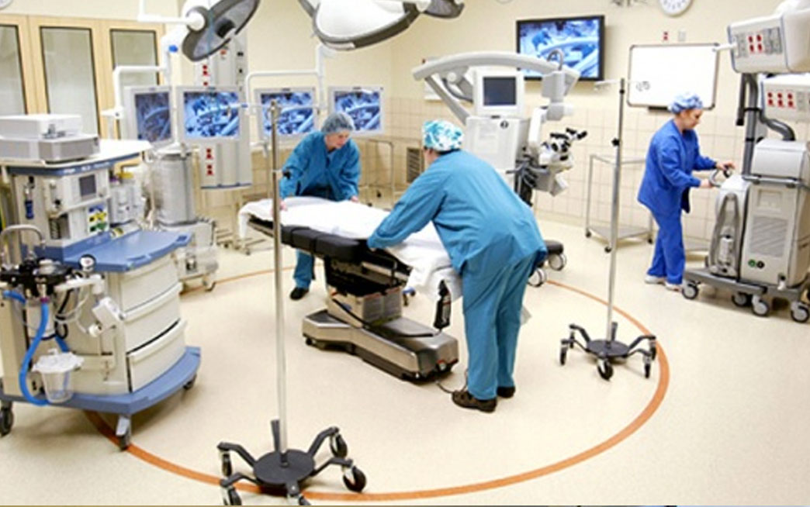
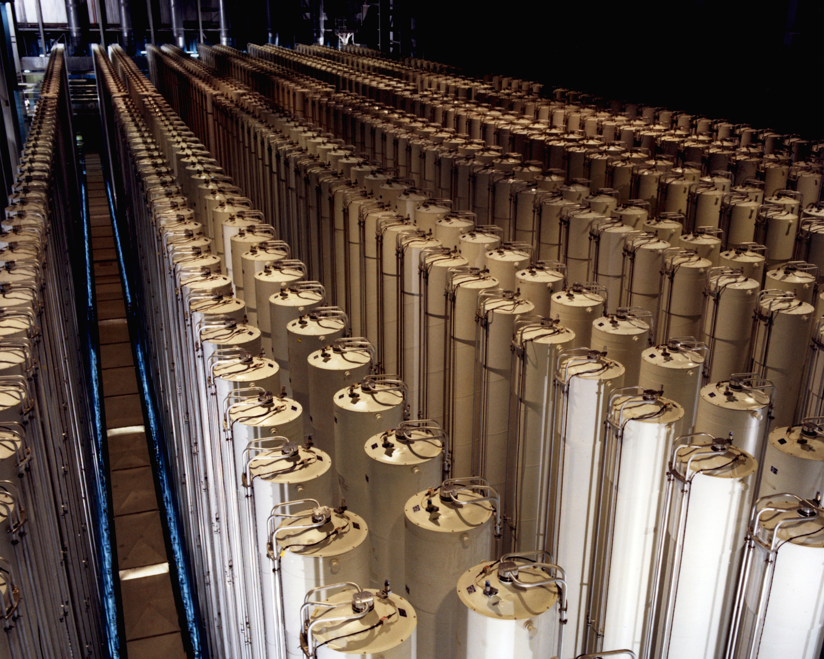
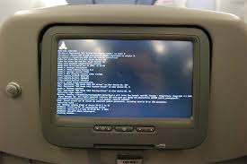
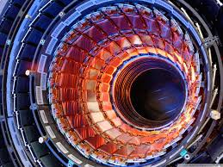
OS kernels are ubiquitous
Notes:
OS kernels provide an industry standard execution environment for nearly every consumer and enterprise device ranging from mobile phones to data centers.
Today, conventional OS kernels are a de-facto part of many mission critical systems
Autonomous cars,
Embedded medical devices
Industrial control systems like uranium centrifuges
Flight control and in-flight entertainment systems,
And even scientific tools like large hordon collider

Slide 6
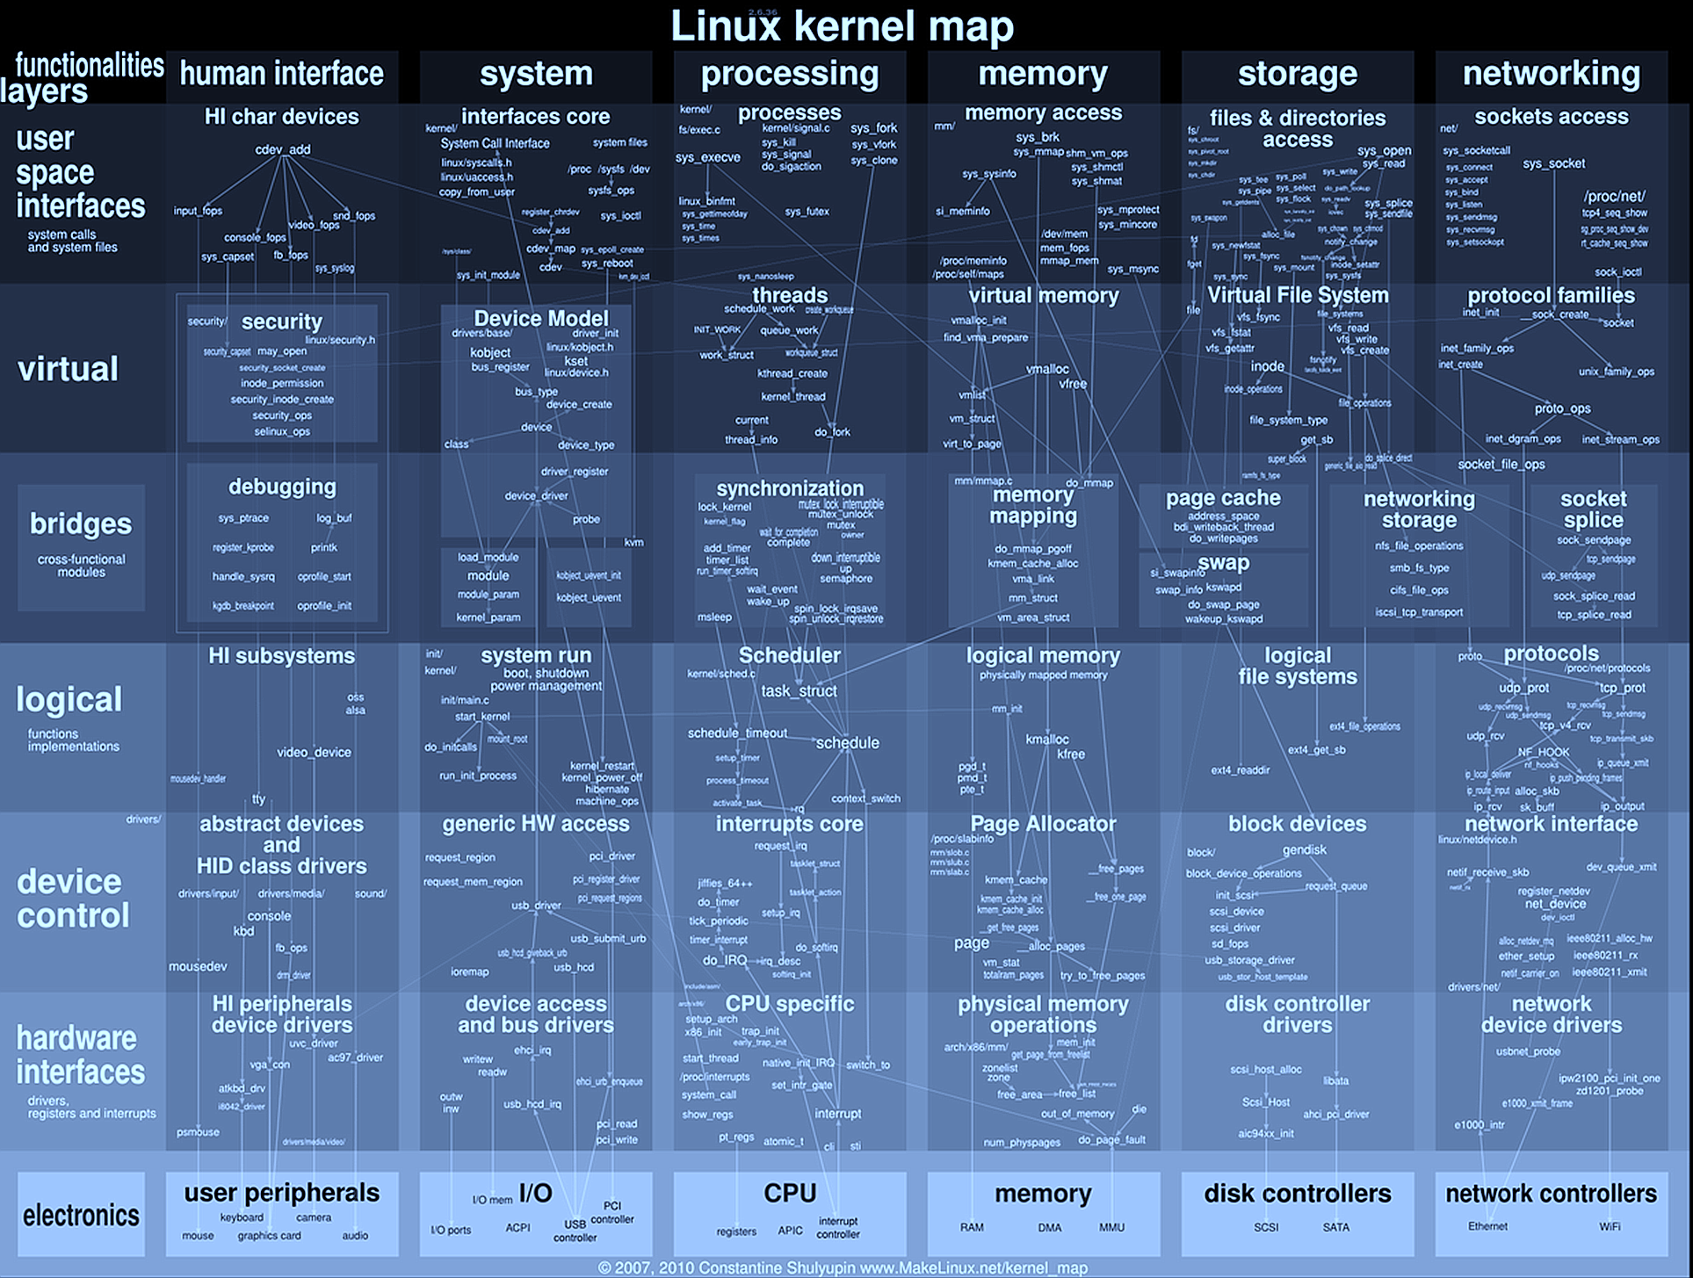
27,000,000 LoC
40 subsystems
8,900 device drivers
Notes:
Modern kernels are notoriously complex. A typical kernel like Linux consists of 12,000,000 lines of code, 40 major subsystems, and over 3,000 device drivers.
Kernel code routinely employs
-- manual management of low-level concurrency primitives,
-- handles millions of object allocations and deallocations per second,
-- implements numerous security and access control checks,
-- and adheres to multiple conventions that describe allocation, locking, and synchronization of kernel data structures in nearly every kernel function.

Slide 7
Problem #1: Security

Slide 8
Notes:
In 2014, the Common Vulnerabilities and Exposures database lists 133 Linux kernel vulnerabilities that allow for privilege escalation,
denial-of-service, and other exploits. This number is consistent across several years.

Slide 9
Example
static bool dccp_new (...) {
struct dccp_header _dh, *dh;
- skb_header_pointer(skb, dataoff, sizeof(_dh), &dh);
+ skb_header_pointer(skb, dataoff, sizeof(_dh), &_dh);
};
Stack smash
Correct
Remote exploit in Linux network firewall
Arbitrary code execution
Linux Kernel v 3.0 (June, 2011) – 3.13.6 (March, 2014)
CVE-2014-2523
Notes:
Kernel bugs can be simple. This is an example of an error that allows execution of an arbitrary code, and thus privilege escalation. This exploit was present in the Linux kernel for nearly three years. Moreover this code is part of the Linux network firewall, or in other words part of the system that is responsible for controlling network traffic to the system. This exploit was enabling exploitation of the system over the network by simply sending a well-designed network packet.

Slide 10
In a modern system, an attacker is one kernel vulnerability away from gaining complete control of the entire machine
Not going to change
Notes:
In a modern system, an attacker is one kernel vulnerability away from taking control over the entire machine.
Despite the fact that a number of dynamic mechanisms have been invented to protect execution of the operating system kernel (like
-- stack guards [32],
-- address space randomization [60],
-- executable space protection [110],
-- control flow integrity [1, 40],
Attackers come up with new ways to bypass these protection techniques
At the same time, monolithic kernels are still beyond the reach of verification and static analysis tools due to their complexity in terms of size, number of components, complex interfaces, and complex interactions.

Slide 11
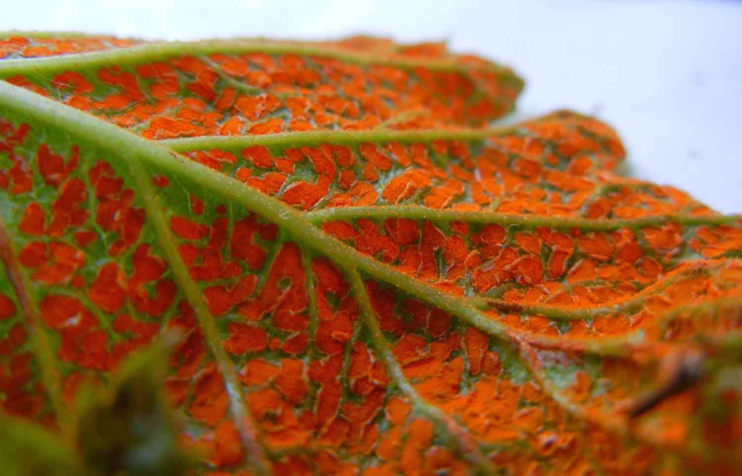
Can we make these systems secure? RedLeaf Operating System Rust + Dafny-style verification
Notes:
At the moment we work on RedLeaf, a new operating system aimed at leveraging a safe, linear-typed
programming language, Rust, for developing secure and reliable systems. 3 RedLeaf builds on two premises: (1) lin-
ear types enable practical language safety even for systems with tightest performance and resource bud-
gets, (2) a combination of SMT-based reasoning and pointer discipline enforced by Rust’s linear type system
provides a way to automate and simplify verification effort and scale it to the size of an operating system
kernel. RedLeaf provides a Dafny-style [24] automated verification for low-level systems that are designed
to be fast. RedLeaf develops a new verification toolchain built on the SMACK verifier, Boogie intermedi-
ate verification language, and the Z3 SMT solver. We argue that RedLeaf is a good fit for implementing
functionality of typical firmware subsystems that provide strong security through safety and verification.

Slide 12
Rust
A
B
Safe language build around idea of linear types
Normally, safety requires a garbage collector
Multiple pointers can point into an object
Even if one pointer is deallocated we don’t know if there are other aliases
In Rust there are no aliases!
No need to walk the heap
Java, C#
?
Garbage
Collector
vec
A
B
Rust
vec

Slide 13
Rust is the first safe alternative to C for low-level systems code
Safe code remains fast
No garbage collection
Lightweight fine-grained software isolation
Zero-copy communication across isolated subsystems

Slide 14
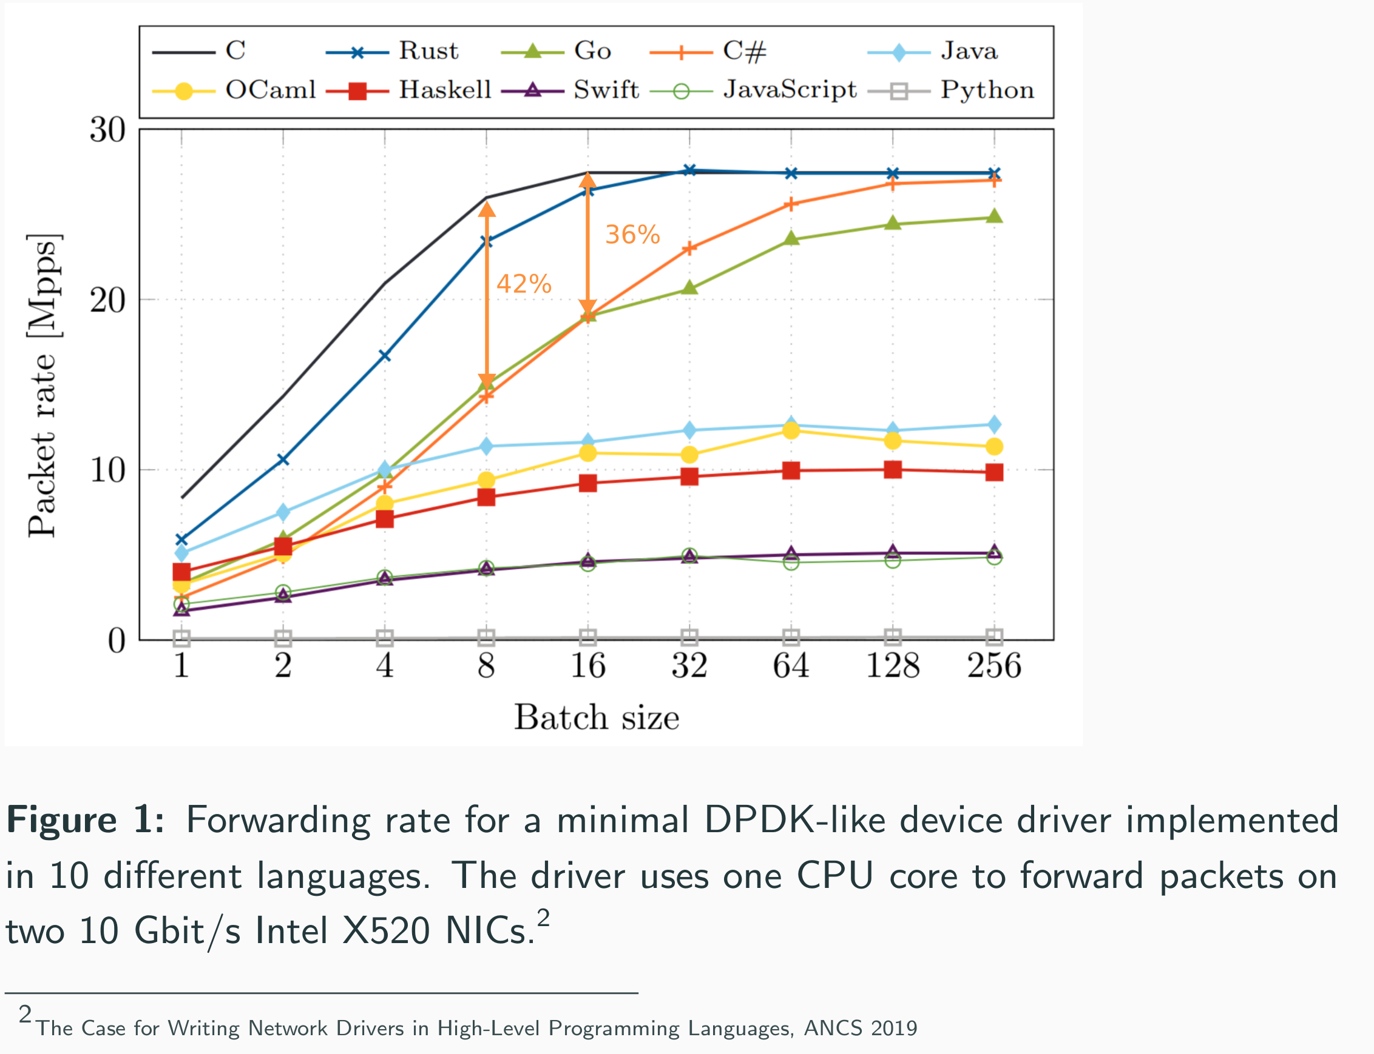

Slide 15
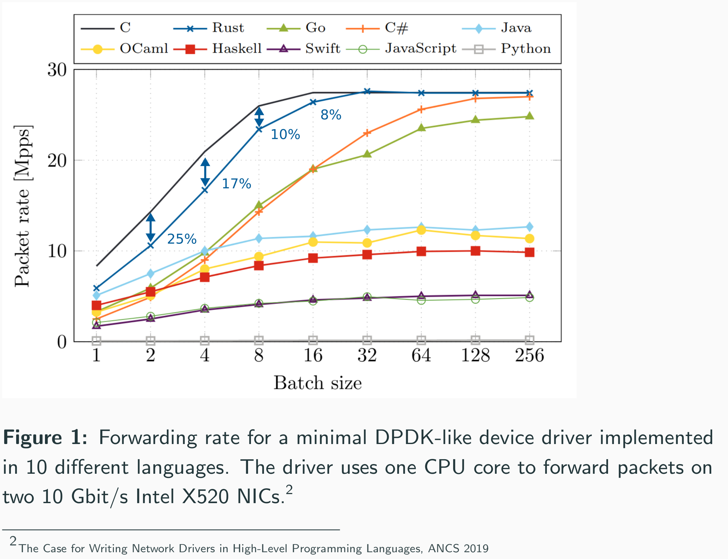

Slide 17
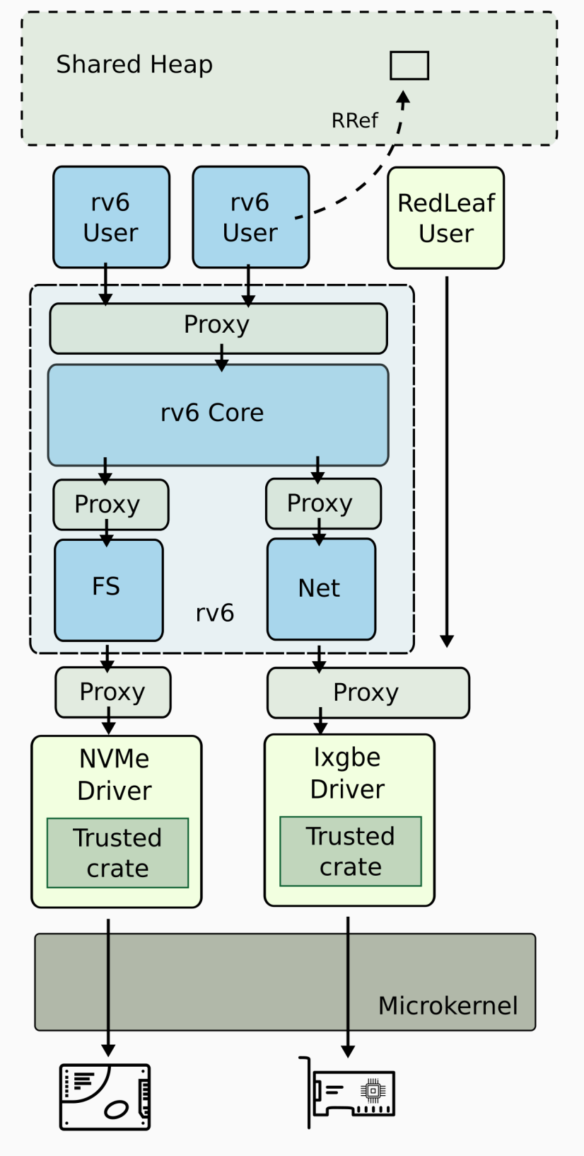
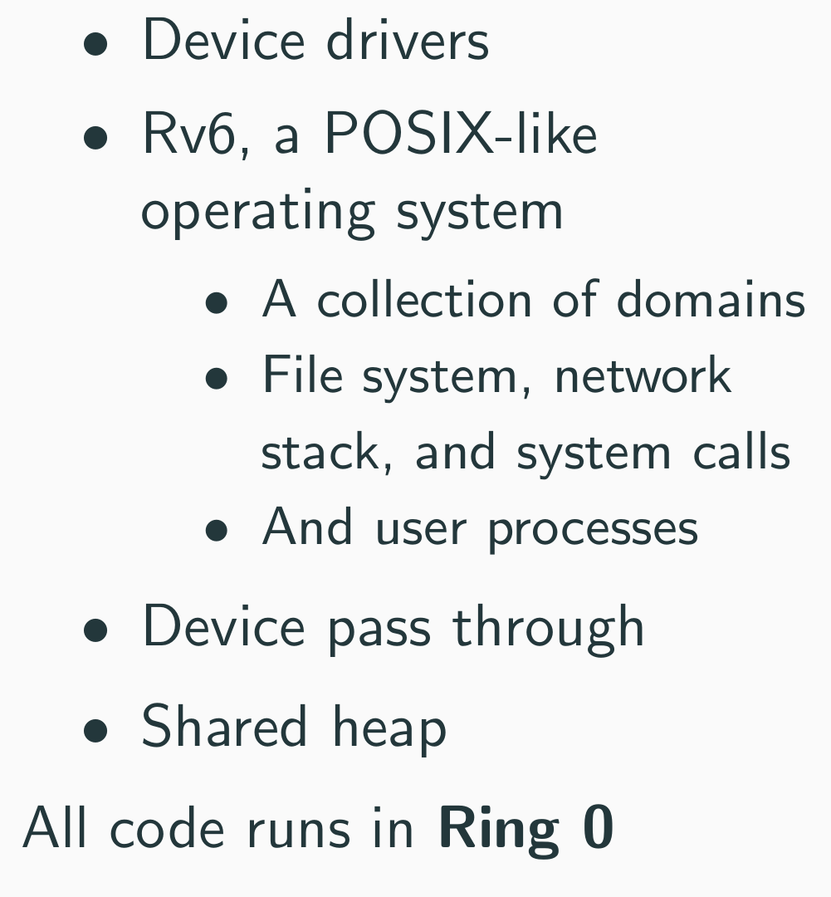
RedLeaf
Notes:
At the moment we work on RedLeaf, a new operating system aimed at leveraging a safe, linear-typed
programming language, Rust, for developing secure and reliable systems. 3 RedLeaf builds on two premises: (1) lin-
ear types enable practical language safety even for systems with tightest performance and resource bud-
gets, (2) a combination of SMT-based reasoning and pointer discipline enforced by Rust’s linear type system
provides a way to automate and simplify verification effort and scale it to the size of an operating system
kernel. RedLeaf provides a Dafny-style [24] automated verification for low-level systems that are designed
to be fast. RedLeaf develops a new verification toolchain built on the SMACK verifier, Boogie intermedi-
ate verification language, and the Z3 SMT solver. We argue that RedLeaf is a good fit for implementing
functionality of typical firmware subsystems that provide strong security through safety and verification.

Slide 18
Problem #2: Performance What does the new hardware look like?

Slide 19
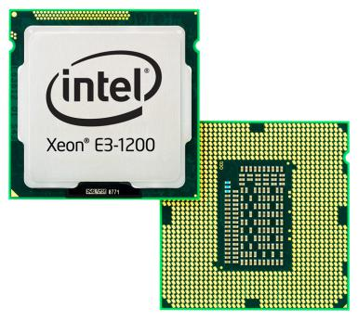
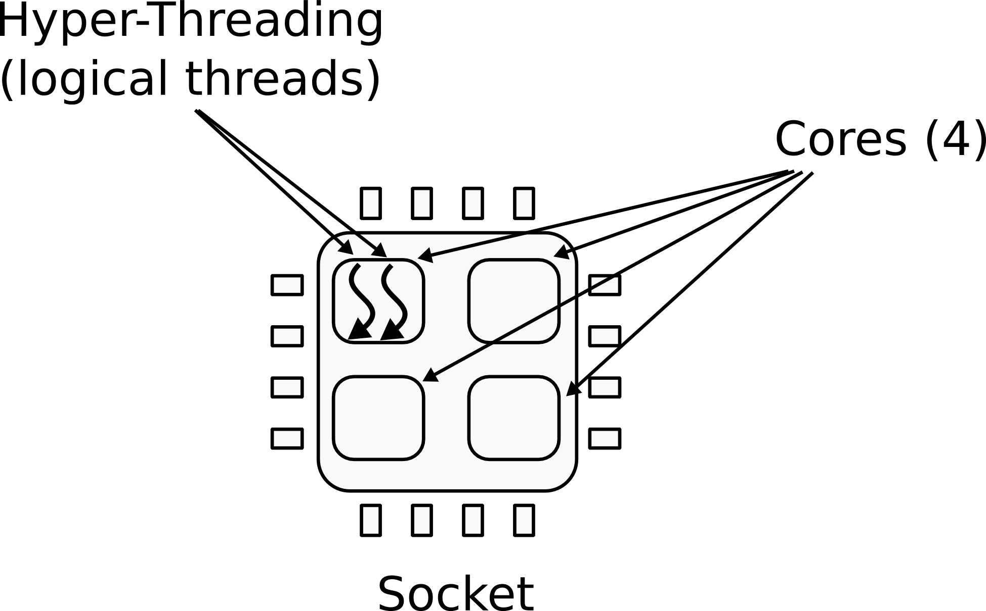
CPU
1 CPU socket
4 cores
2 logical (HT) threads each

Slide 20
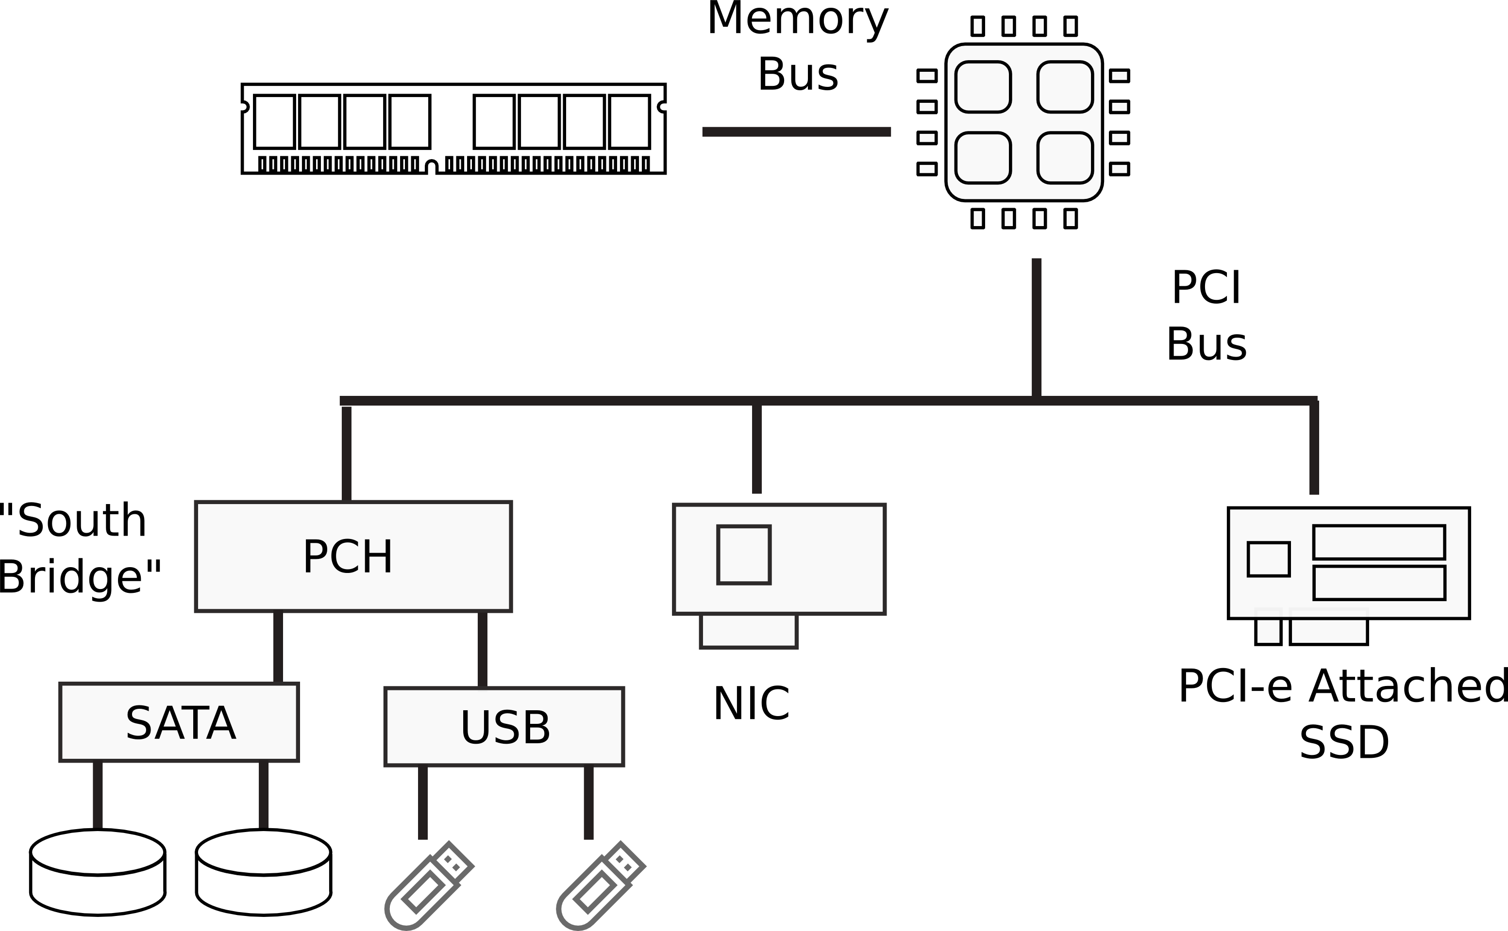
I/O Devices

Slide 21
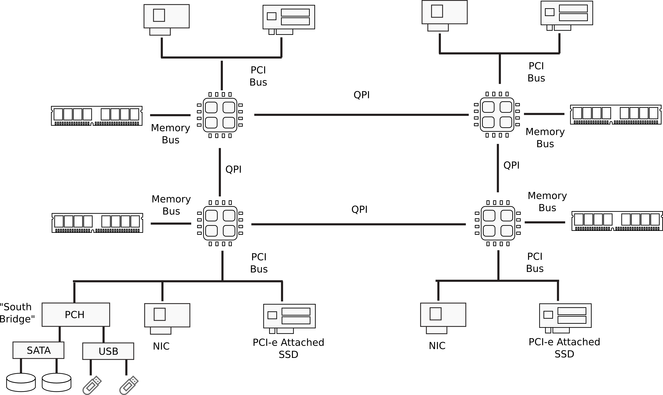
Multi-socket machines

Slide 22
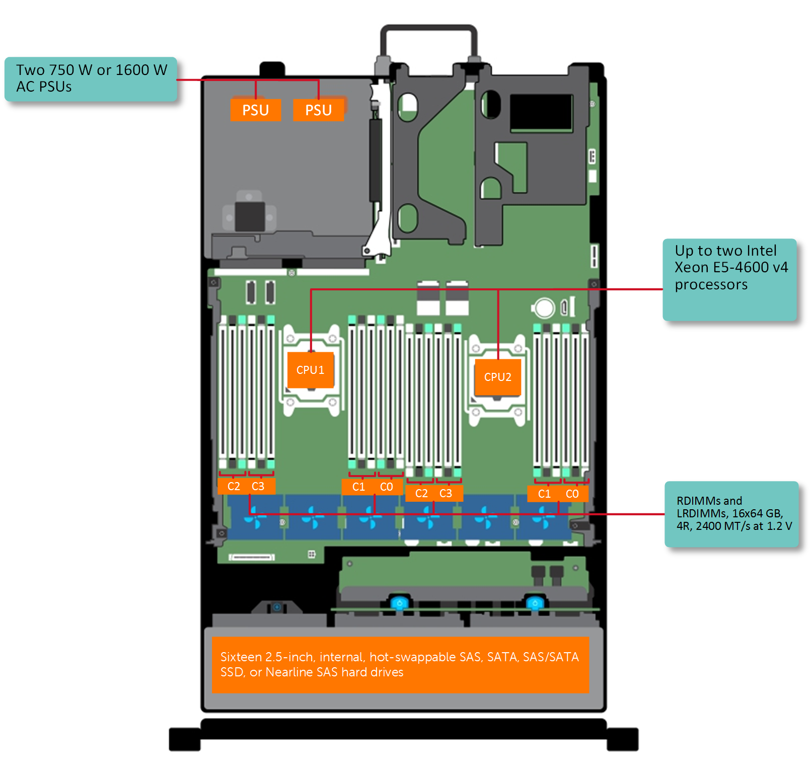
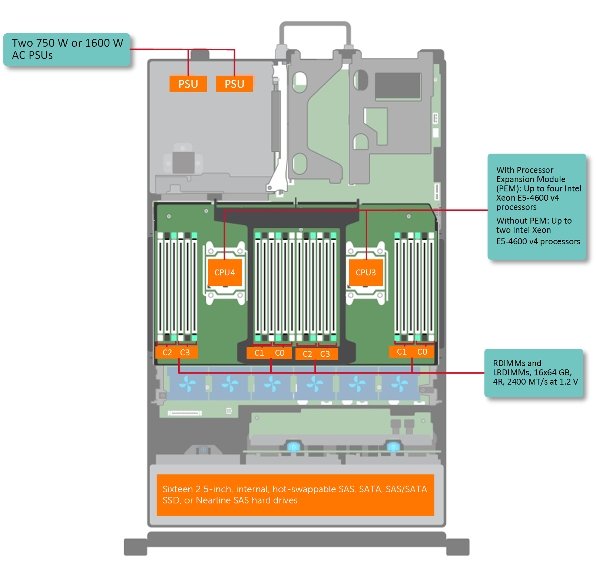
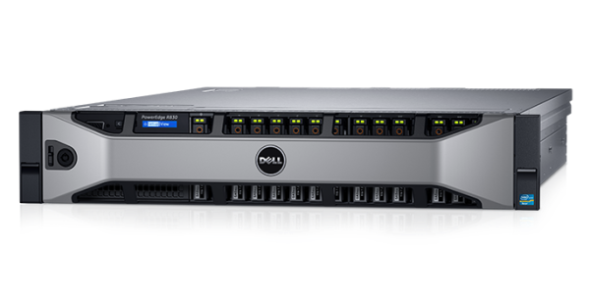
Dell R830 4-socket server
Dell Poweredge R830 System Server with 2 sockets on the main floor and 2 sockets on the expansion
http://www.dell.com/support/manuals/us/en/19/poweredge-r830/r830_om/supported-configurations-for-the-poweredge-r830-system?guid=guid-01303b2b-f884-4435-b4e2-57bec2ce225a&lang=en-us

Slide 23
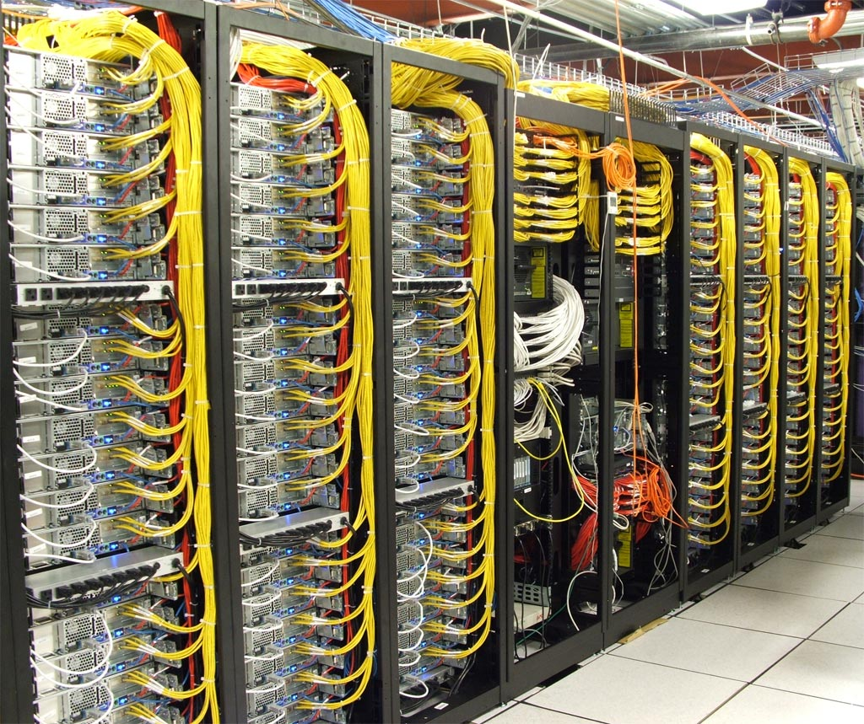

Slide 24
But what will it look like in 5-10 years?

Slide 25
Massively heterogeneous
Not just many-cores
GPUs, AI accelerators, near-storage and near-network cores
But also
Fine-grained hardware ASICs accelerators
Programmable hardware (FPGA)

Slide 26
Redshift: Operating system for heterogeneous hardware
Execution will no longer stay on the CPU

Slide 27
Problem #3: Can we own our data in the cloud?

Slide 28
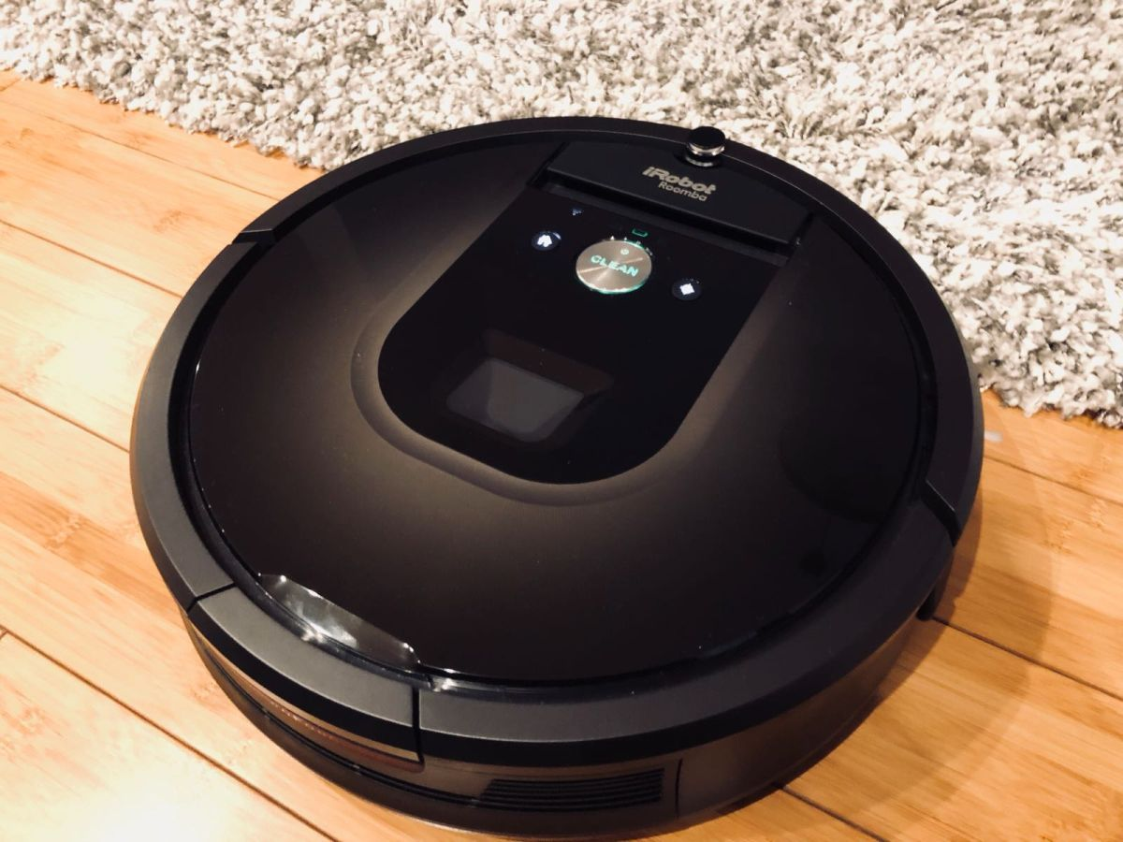
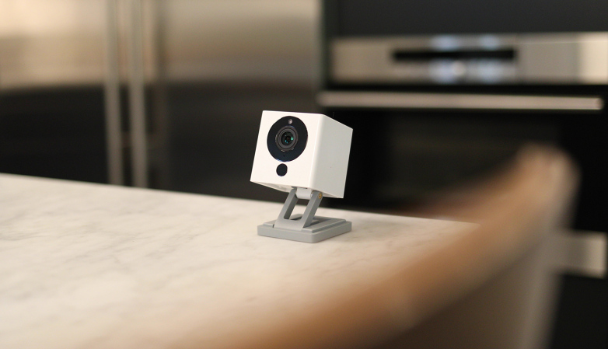

Slide 29
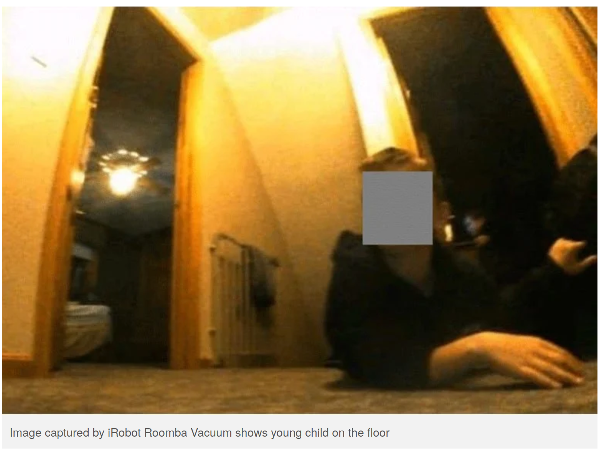

Slide 30
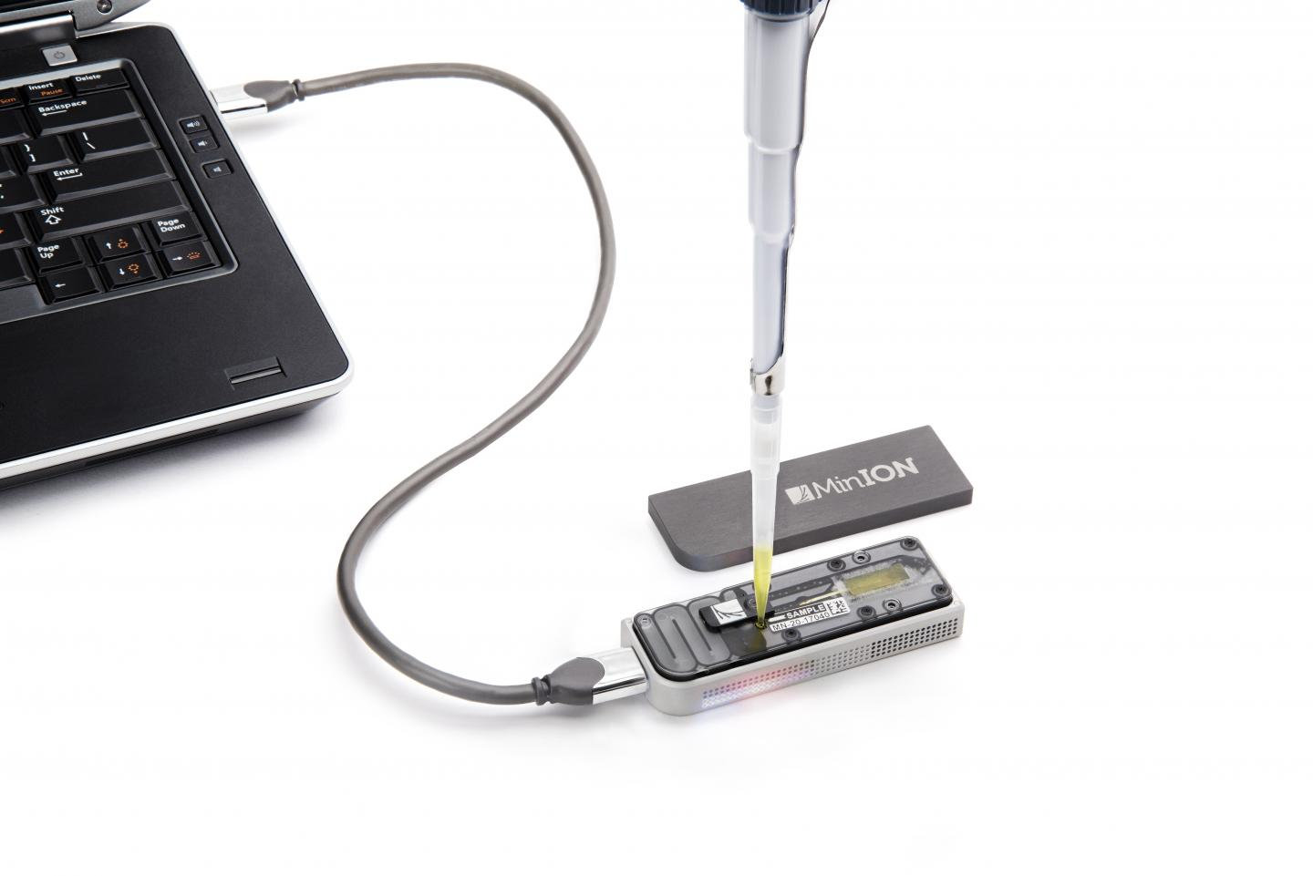
MinION Nanopore DNA Sequencing

Slide 31
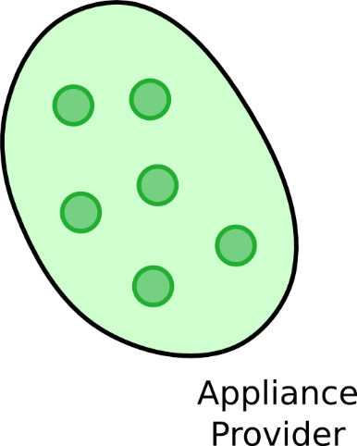
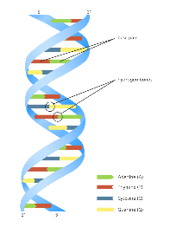
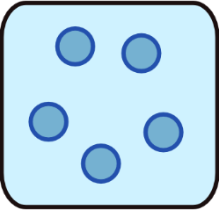
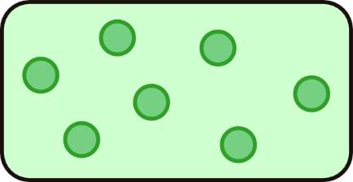
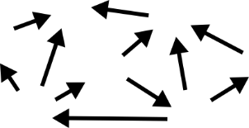
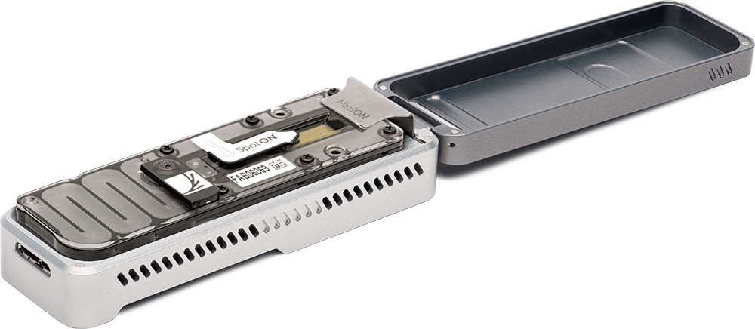
Deeper problem: cloud is inherently collaborative
Data is processed by third parties

Slide 32
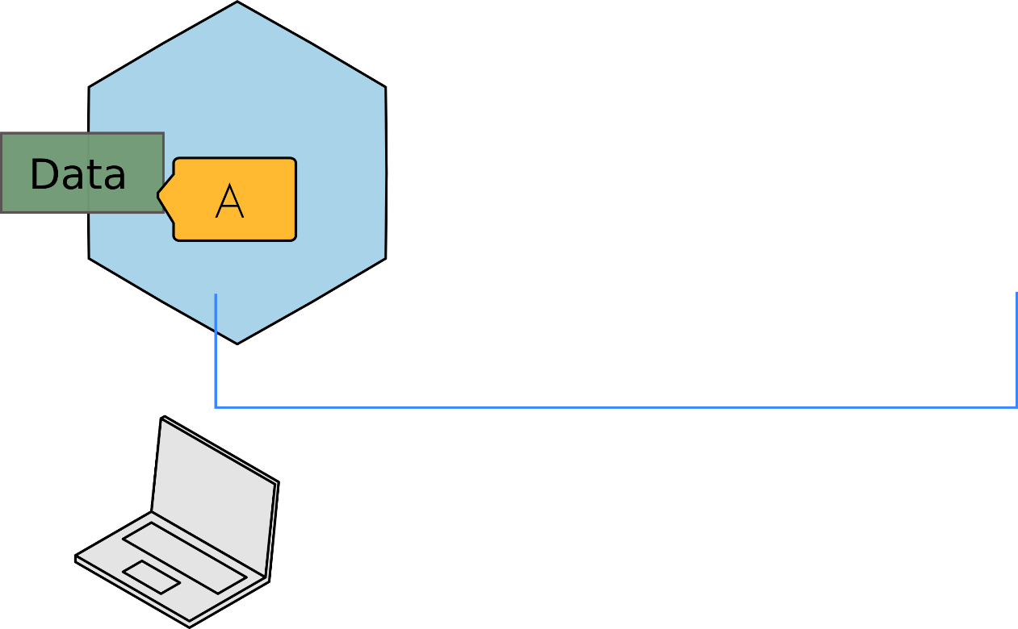
What needs to be done?
Goal #1: Secure execution environment

Slide 33
It’s impossible to secure legacy OS stack
27,000,000 LoC
40 subsystems
8,900 device drivers

Slide 34
Thank you!
Anton Burtsev
http://www.cs.utah.edu/~aburtsev
anton.burtsev@utah.edu

