Slide 1
cs5460/6460: Operating Systems Midterm recap, sample questions
Anton Burtsev
February, 2024

Slide 2
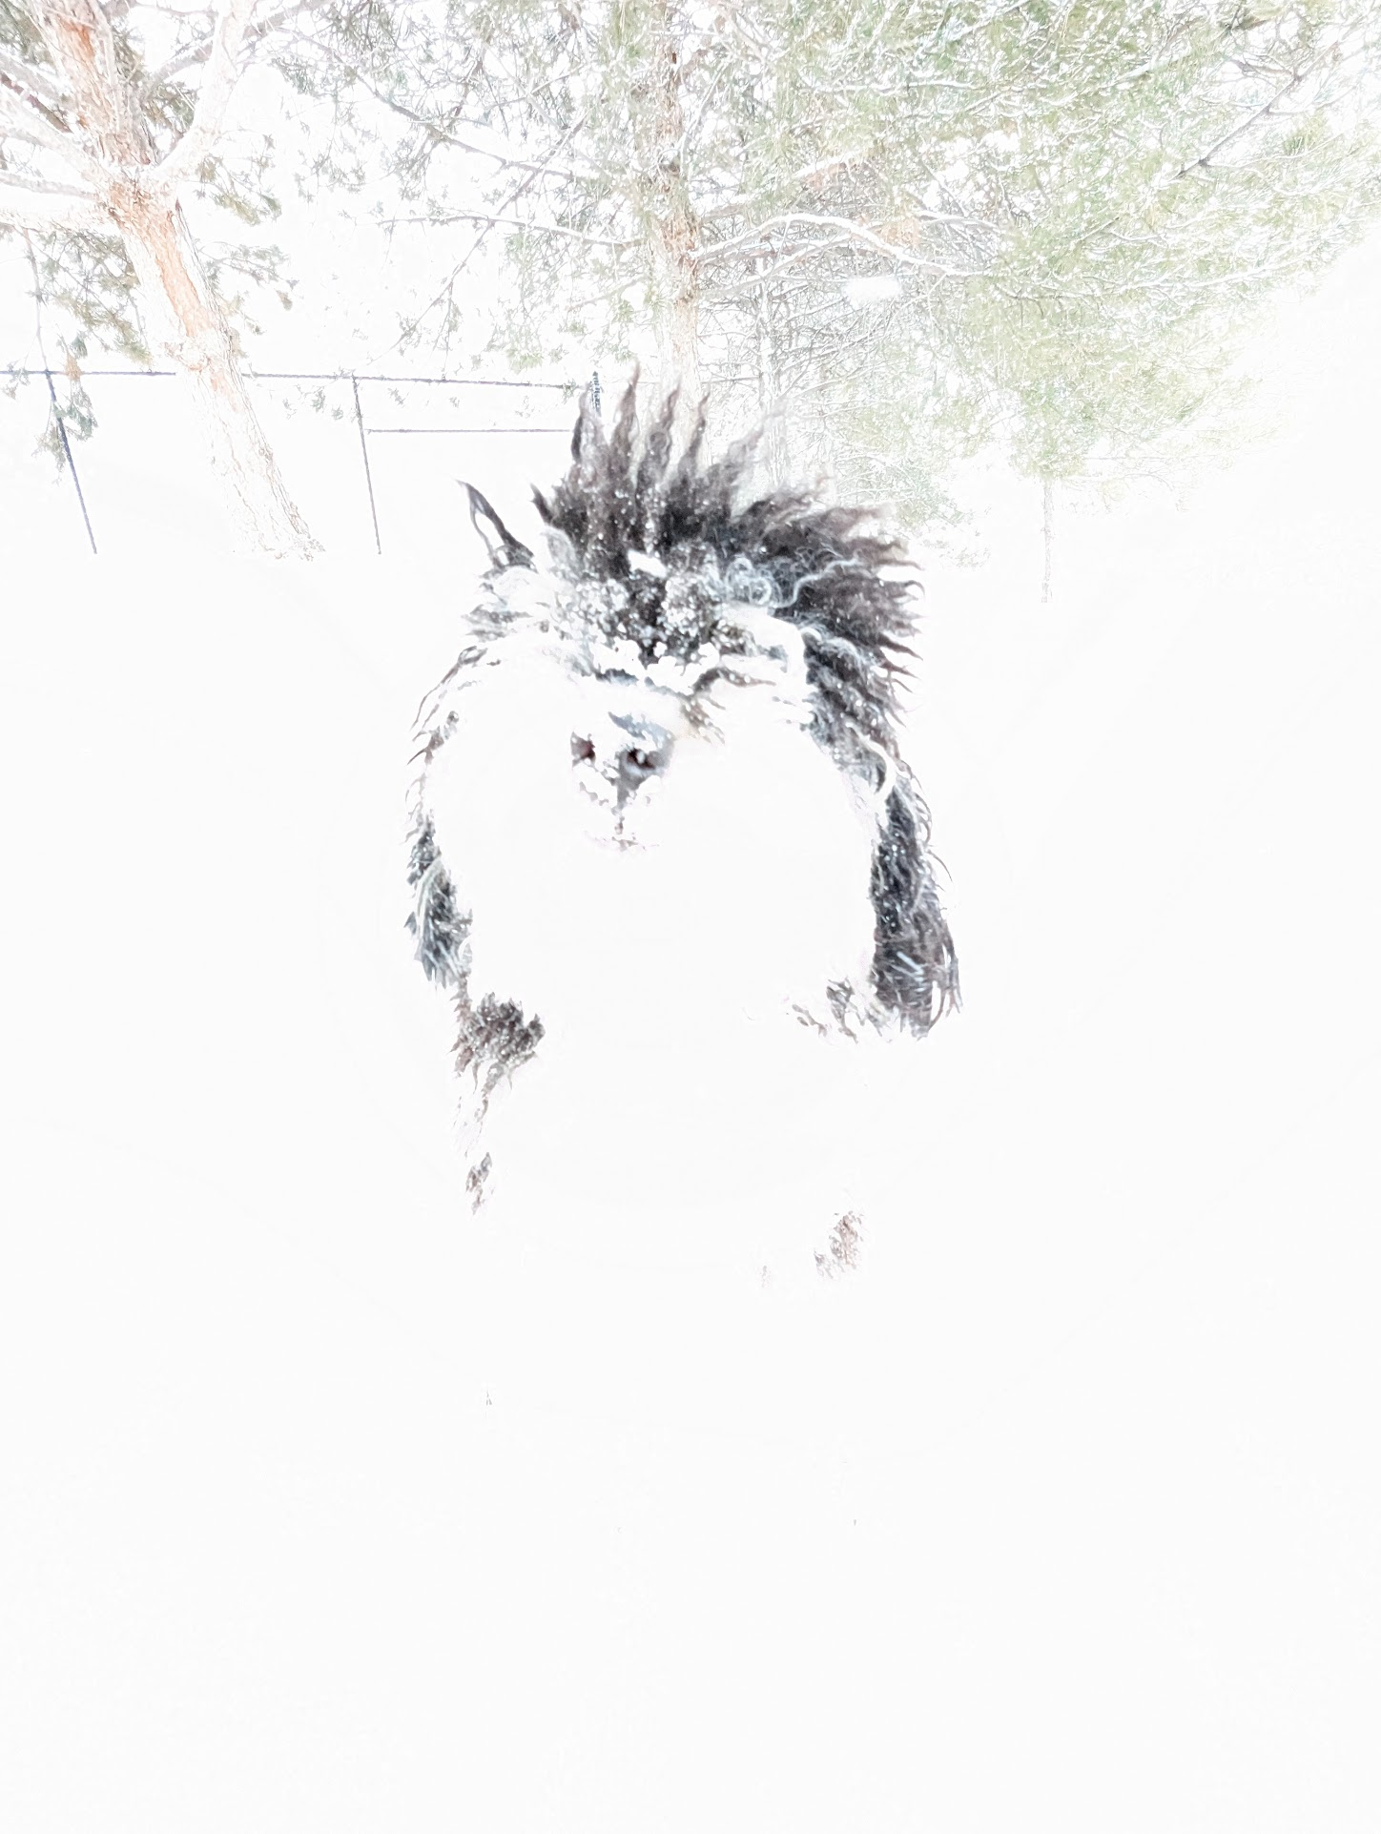
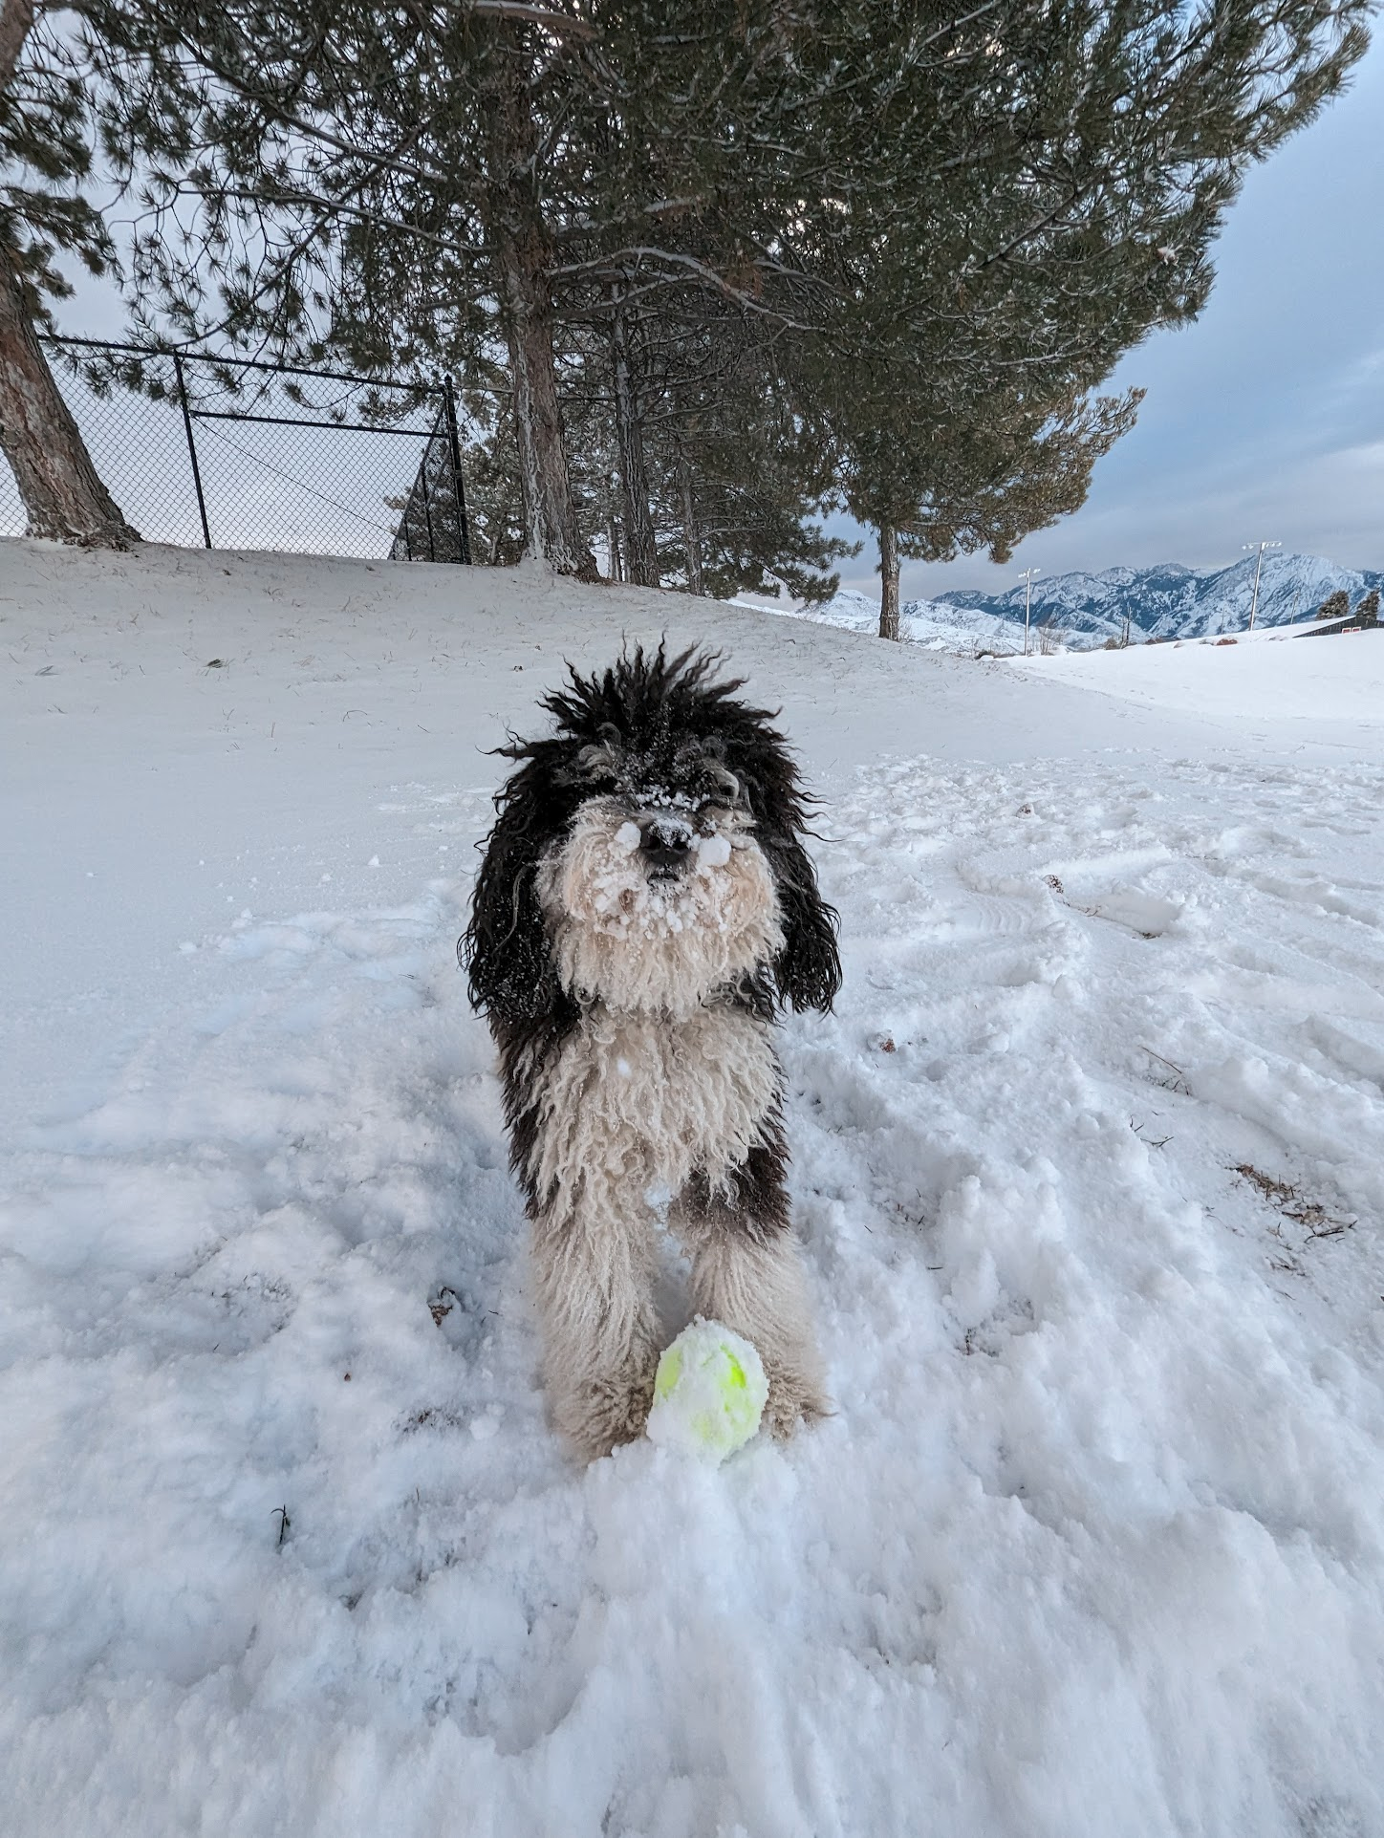

Slide 4
Thank you!

