Slide 1
Trusted Disk Loading in the
Emulab Network Testbed
Cody Cutler, Mike Hibler, Eric Eide, Rob Ricci

Slide 2
Emulab
Public network testbed
Create complex experiments quickly
500+ nodes at Utah Emulab
Notes:
Emulab lets researchers …

Slide 3
Emulab Nodes
Physical nodes
Users have root
Space/time shared
Artifacts from previous experiment may persist on node
Notes:
Why physical nodes?

Slide 4
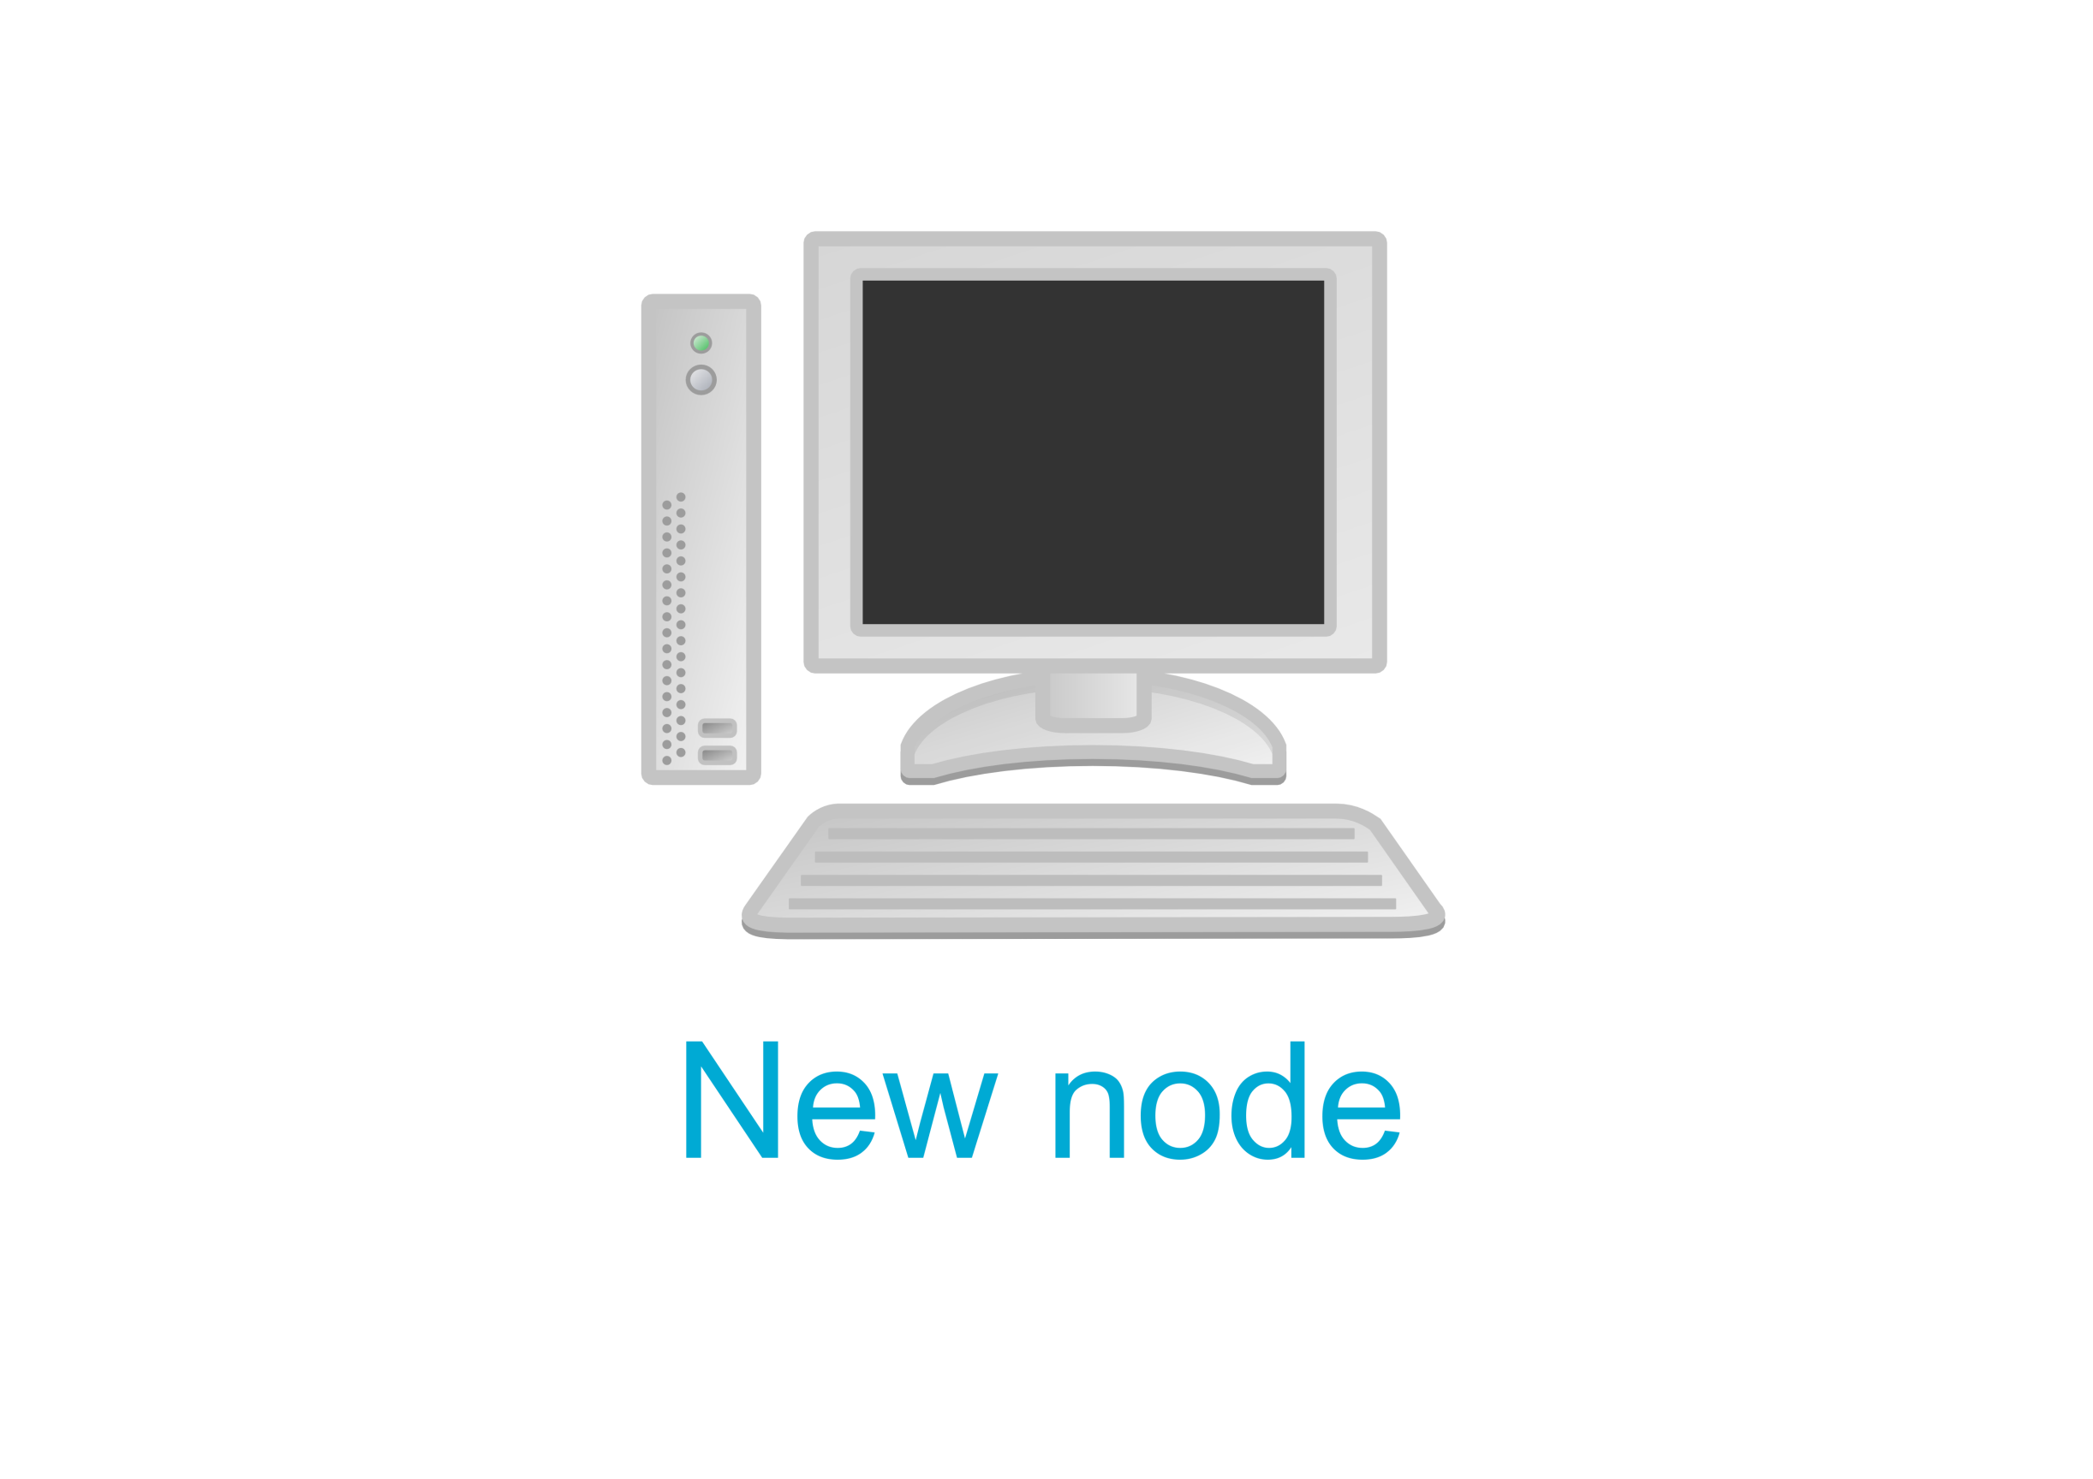
Node Corruption
Notes:
Emulab will re-image but malware persists in BIOS…

Slide 5
Why Reset State?
Experiment fidelity depends on a fresh start
“Contaminated start” is unacceptable for security sensitive experiments

Slide 6
Disk Reloading
Control server forces reboot and directs node re-imaging over network
Disk reloading network is shared with other nodes
In current system state reset is not guaranteed and is not tamper-proof

Slide 7
Goals
Disk reloading must be reliable
Must be flexible for many boot paths
Must scale to size of testbed

Slide 8
Solution: Trusted Disk Loading System (TDLS)
If the experiment is created successfully, node state is reset

Slide 9
Contributions
Design and implementation of secure disk loading protocol
Flexible and secure reloading software scalable to size of testbed

Slide 10
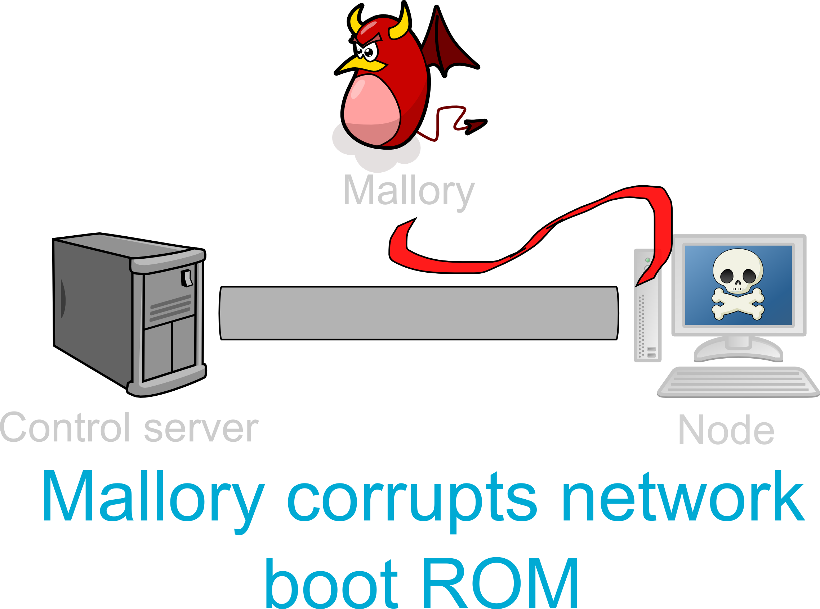
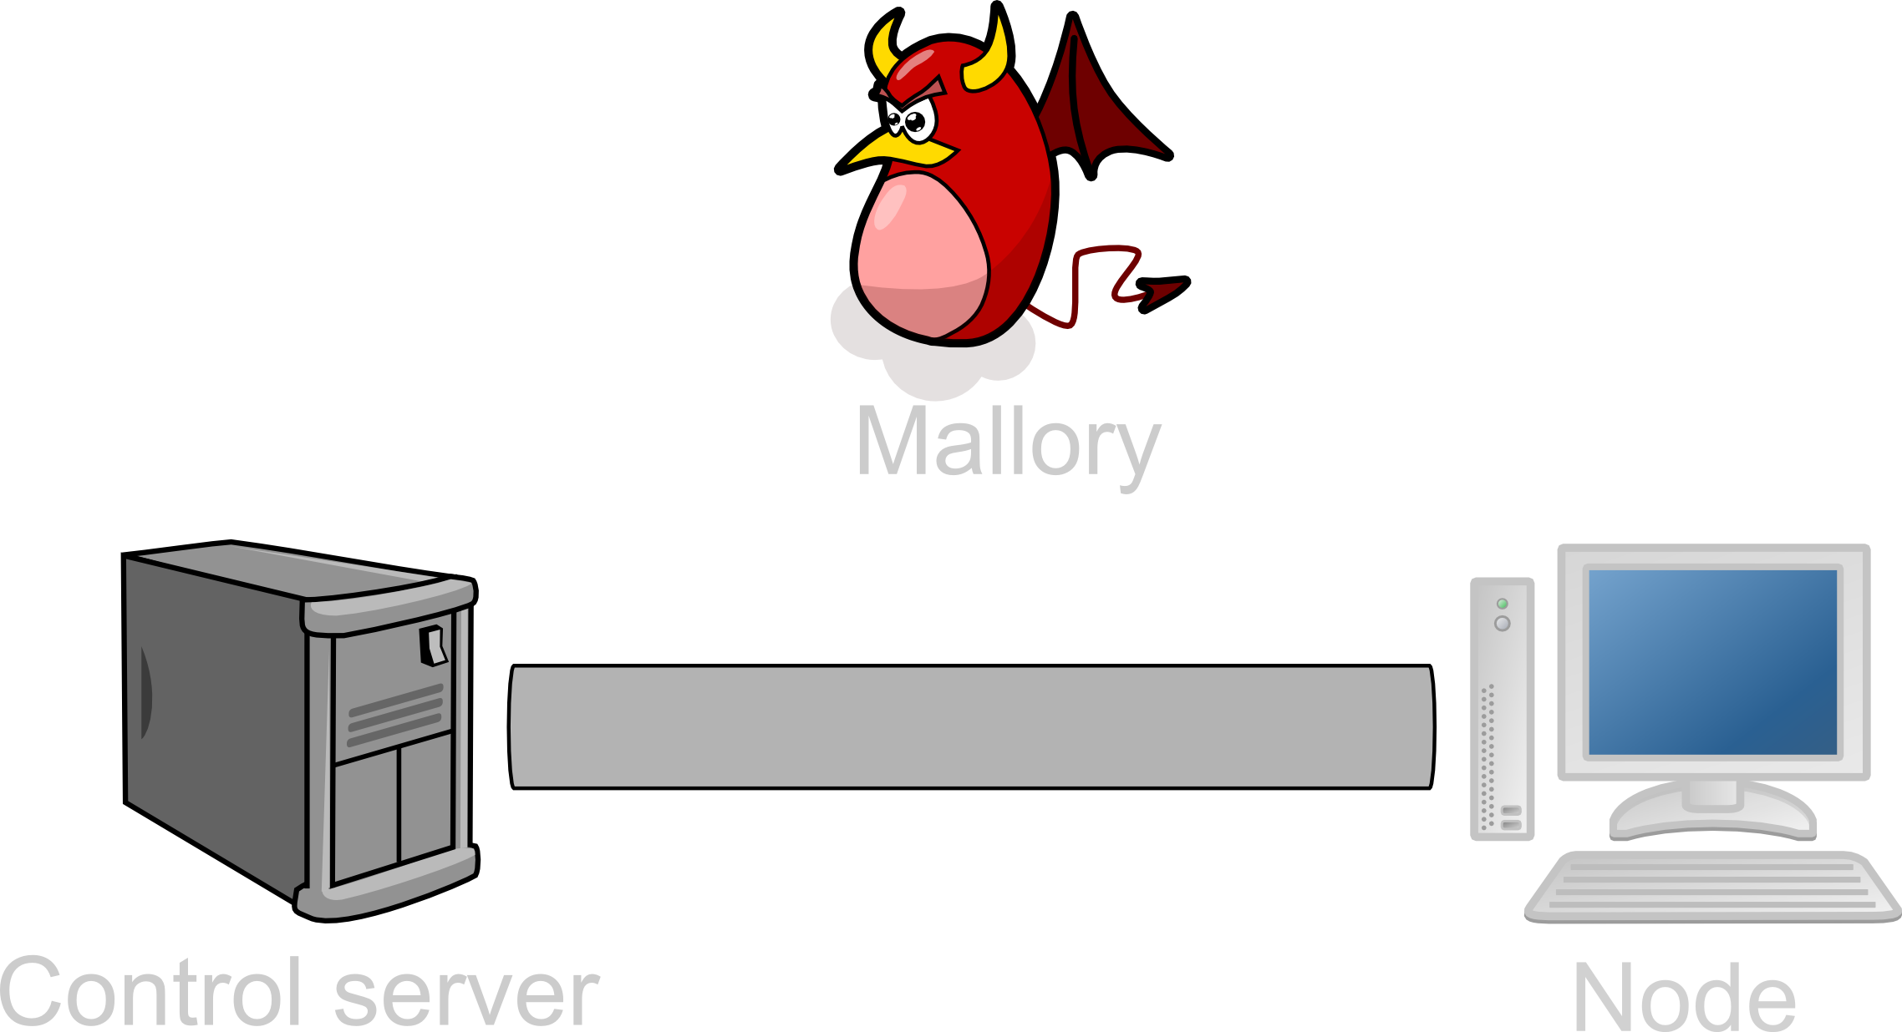
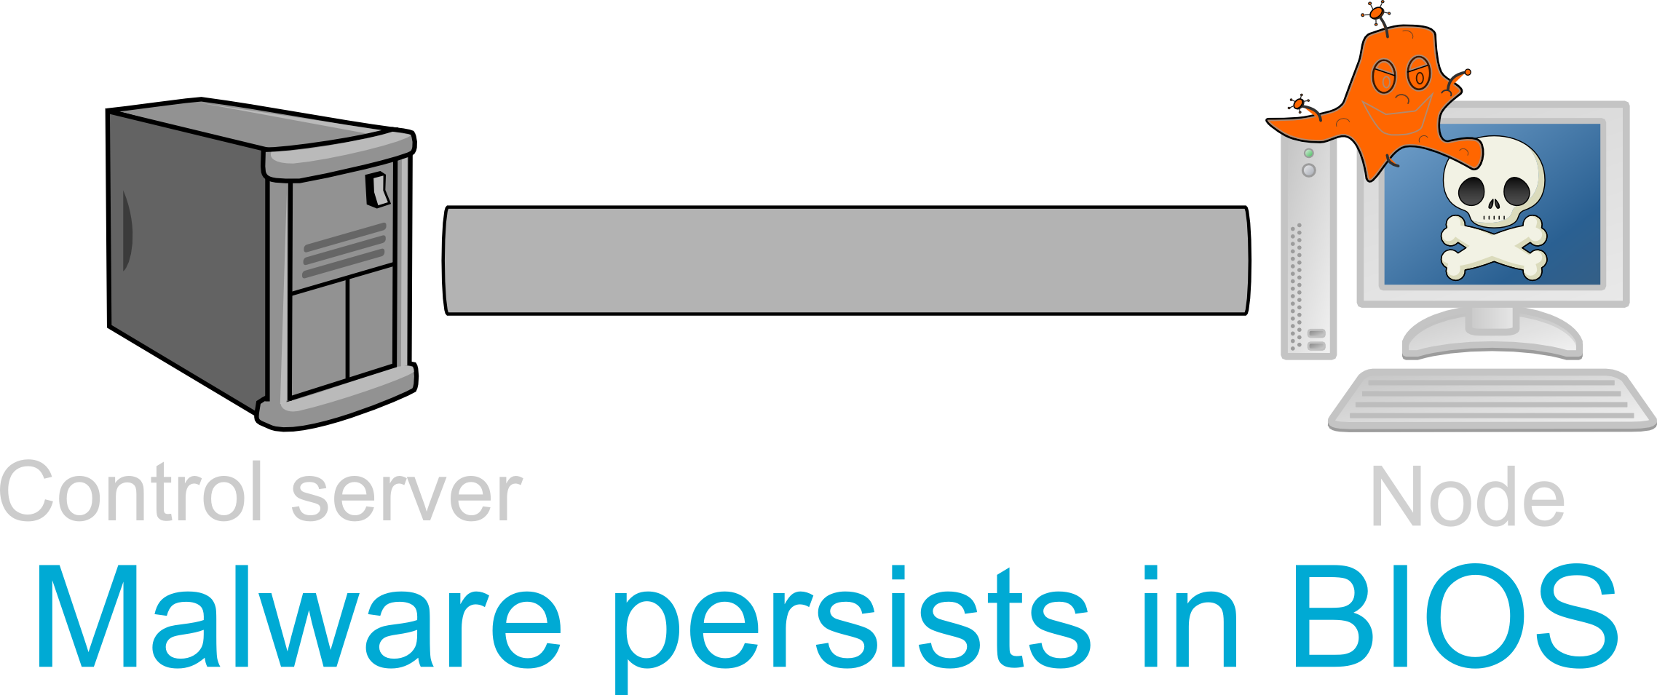
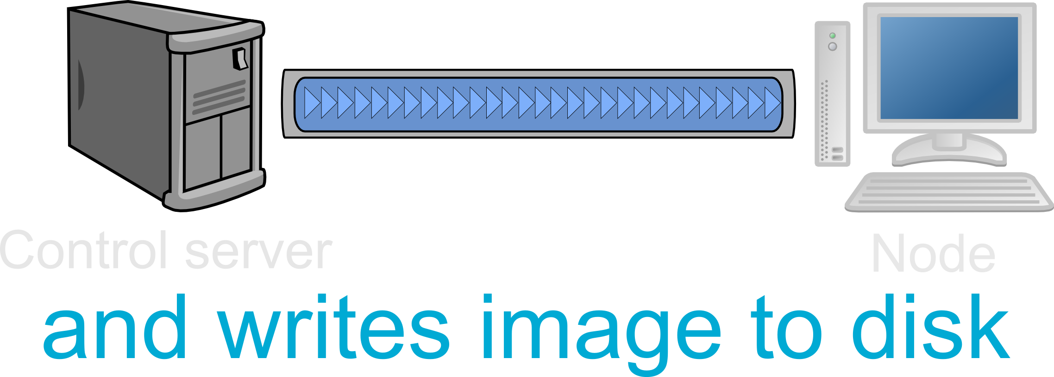
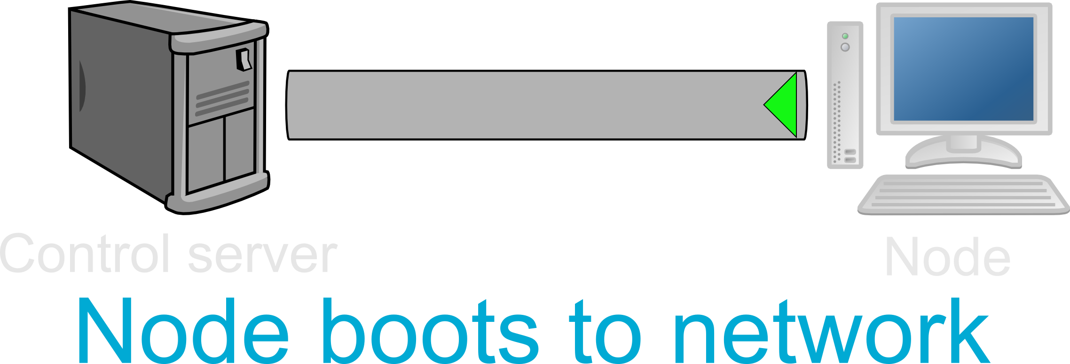
Node Reloading

Slide 11
TDLS Fundamentals
Establish trust
Verify every stage of node reloading with control server
Approach: use the Trusted
Platform Module

Slide 12
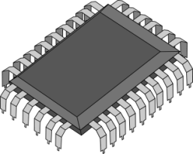
Trusted Platform Module (TPM)
Secure key storage
Measurement
Remote attestation (quotes)

Slide 13
Secure Key Storage
Keys are always encrypted before they leave the TPM
Keys are only usable on the same TPM where they were created
Control server can identify nodes by the public portion of these keys

Slide 14
TDLS Fundamentals
Establish trust
Verify every stage of node reloading with control server

Slide 15
Trusted Platform Module (TPM)
Secure key storage
Measurement
Remote attestation (quotes)

Slide 16
Measurement
Measuring is when we hash a region of memory and extend a certain PCR with the resulting hash
Platform Configuration Registers (PCR)
TPMs generally have 24 PCRs
Holds a hash
PCRs can only be modified through extension
Extending:
PCR = hash(previous value of PCR + a new hash)

Slide 17
Secure Boot Chain with TPM
Immutable part of BIOS measures the rest of BIOS
BIOS measures boot device
Boot device then measures whatever it loads
etc.

Slide 18
Remote Attestation
TPM packages up the desired PCRs and signs them
This is called a quote
Tamper-proof as it is signed by the TPM
Very easy to differentiate between a genuine quote and arbitrary data signed by TPM

Slide 19
TDLS Fundamentals
Establish trust
Verify every stage of node reloading with control server

Slide 20
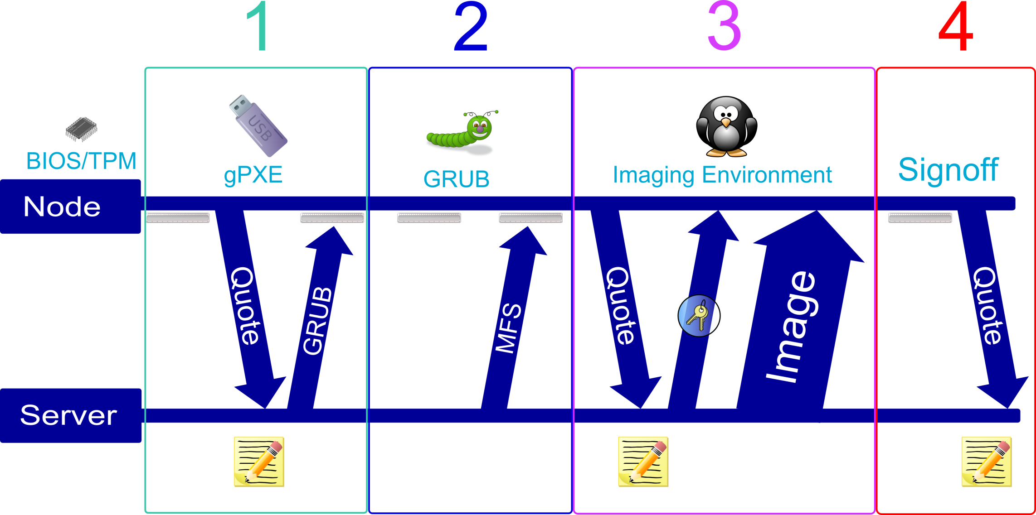
TDLS Reloading

Slide 21
Stage 1: PXE Boot
PXE is a network boot protocol
PXE ROMs aren’t TPM aware
PXE ROMs won't check-in with the control server
Boot to USB dongle with gPXE

Slide 22
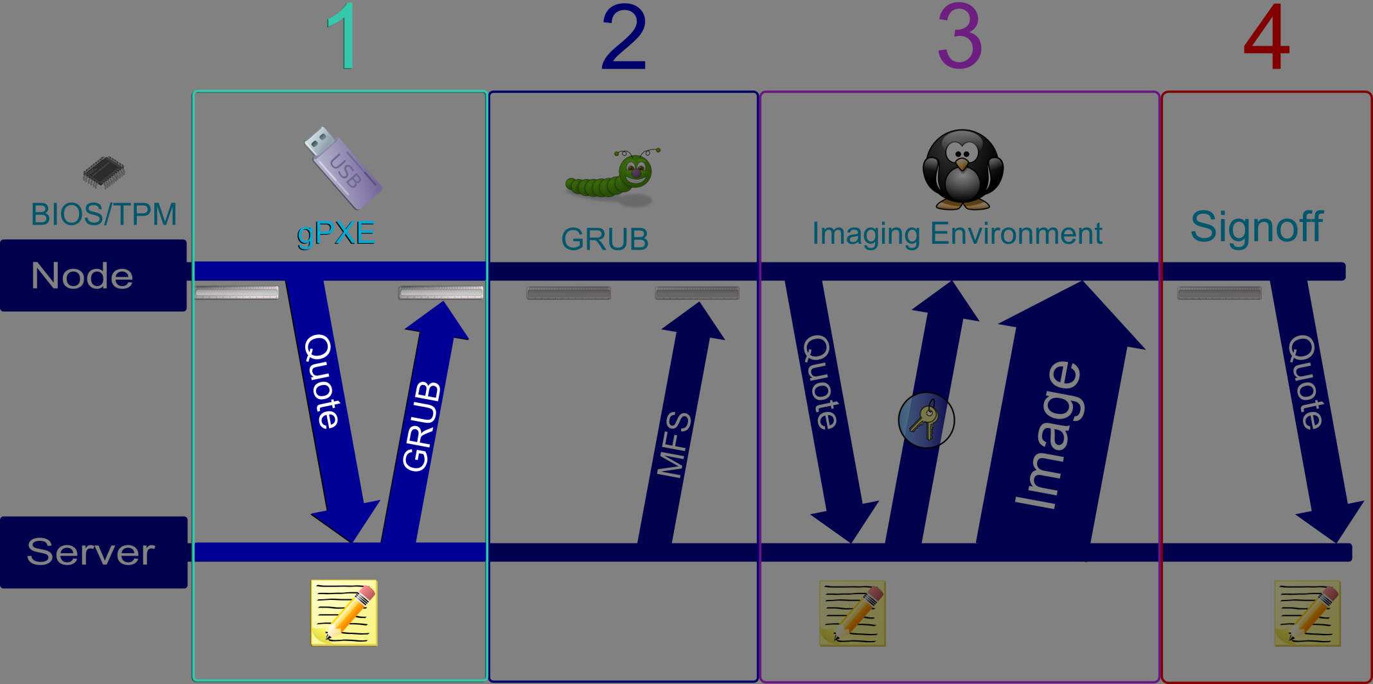
Stage 1: gPXE
Measured by BIOS
Embedded certificate for server authentication
Sends a quote to control server
Notes:
An important note is that a certificate is embedded in the gPXE dongle…

Slide 23
Checking Quotes
Server compares every PCR in the quote with known good values in the database
The TPM signature over the quotes is verified
Quotes contain a nonce from the server to guarantee freshness
Different stages are measured into different PCRs

Slide 24
Incorrect Quotes
An incorrect PCR means something was modified
Failure to send a quote before a timeout is treated as a verification failure
Control server cuts power to the node and quarantines it
Notes:
WHY we want to boot to PXE
but the problems are...

Slide 25
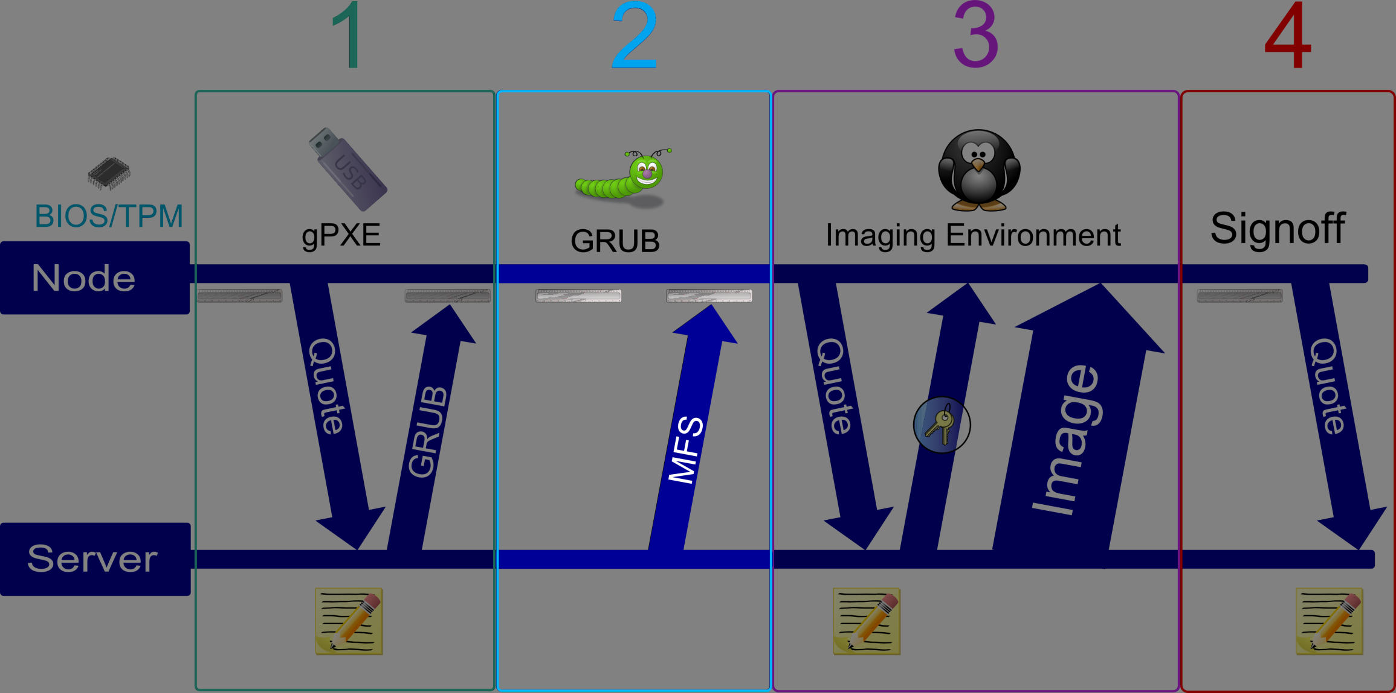
Stage 2: GRUB
Retrieves, measures, and boots the imaging MFS
Will boot to disk when necessary

Slide 26
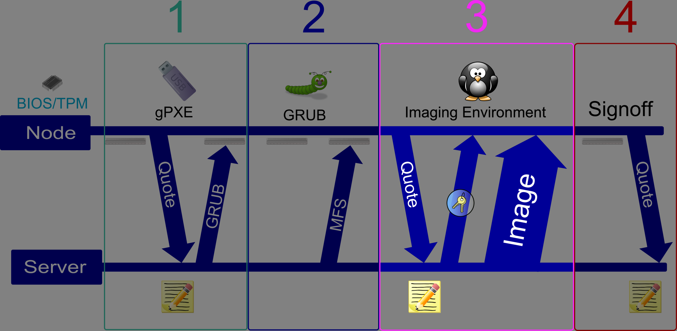
Stage 3: Imaging MFS
Sends quote covering everything
Writes the encrypted image to disk

Slide 27
Sensitive Resources
Control server closely monitors a node’s progress via quotes
A node can only receive sensitive resources (decryption keys) in a particular state

Slide 28
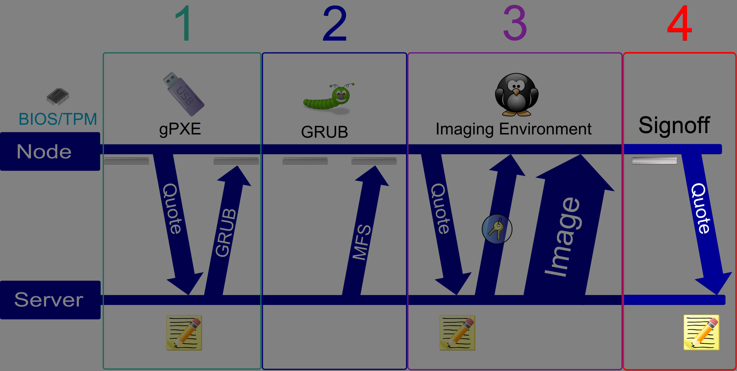
Stage 4: Signoff
Disk is imaged
Extends known value into designated reboot PCR
Marks the end of the trusted chain

Slide 29
Image Security
The TDLS writes the user-chosen disk image on a node
Security researchers want to use both secure and insecure images
By design, the TDLS does not check the user-chosen image

Slide 30
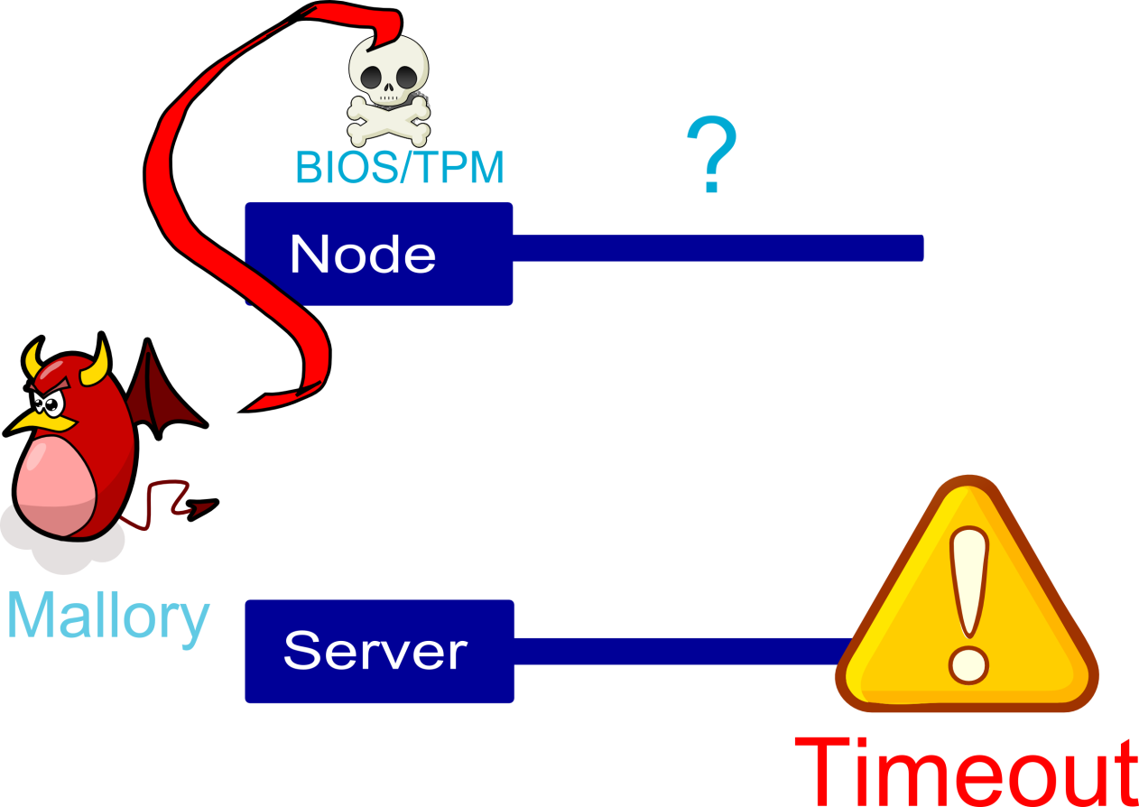
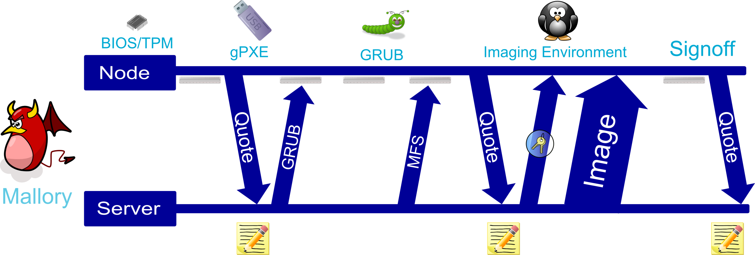
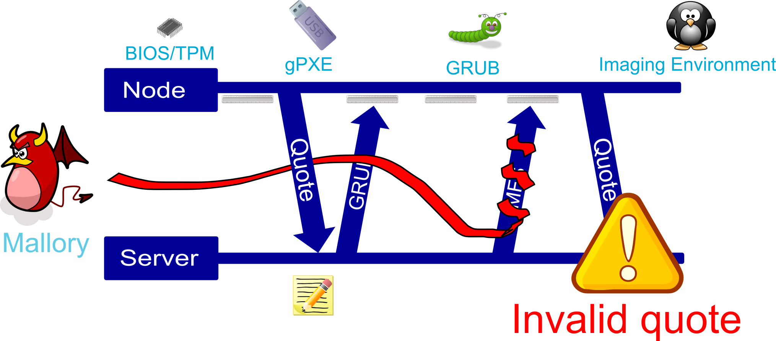
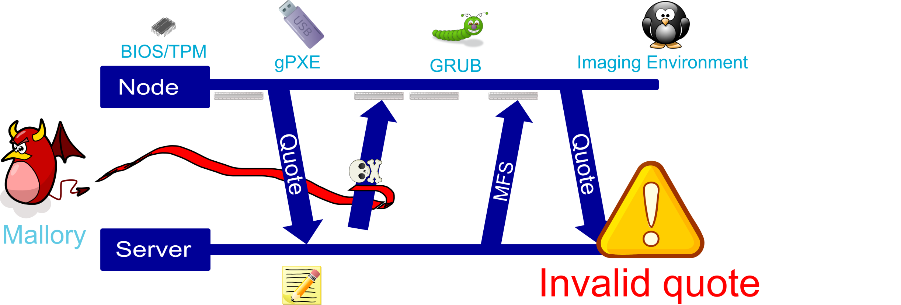
Attacks That Will Fail
Any boot stage corruption
BIOS code or configuration modifications
Injecting new stages
Notes:
Explain in detail

Slide 31
What this means
We win

Slide 32
Summary
Node state must be fully reset in a secure way
Some testbed properties make this very difficult
Trusted Disk Loading System
Tracks node progress with quotes
Guarantees node state is reset
Leveraging the Trusted Platform Module
Establish trust between the node and server
Verify every stage of boot chain
If experiment creation succeeds the disk has been securely reloaded

Slide 33
Future Work
Refine the violation model
Integrate with Emulab UI
Deploy on 160 TPM-enabled nodes at Utah
Enable experimenters to verify node state

Slide 34
Questions?
ccutler@cs.utah.edu
http://www.emulab.net

